Slide 1
Git & GitHub
How to get started with GIT and work with GIT Remote Repo
( https://www3.ntu.edu.sg/home/ehchua/programming/howto/Git_HowTo.html )

Slide 2
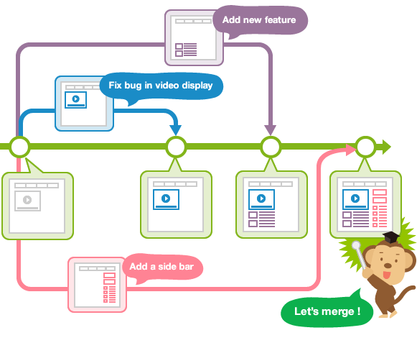
5. Branching/Merging
Branch allows each developer to branch out from the original code base and isolate their work from others.
Different branches can be merged into any one branch
Branching/Merging is the most important feature in a concurrent version control system.

Slide 3
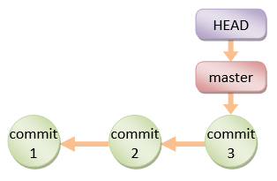
5.1 Overview
For the initial commit, git assigns the default branch name called master and sets the master branch pointer at the initial commit.
As you make further commits on the master branch, the master branch pointer move forward accordingly.

Slide 4
Overview
Git also uses a special pointer called HEAD to keep track of the branch that you are currently working on.
The HEAD always refers to the latest commit on the current branch.
Whenever you switch branch, the HEAD also switches to the latest commit on the branch switched.

Slide 5
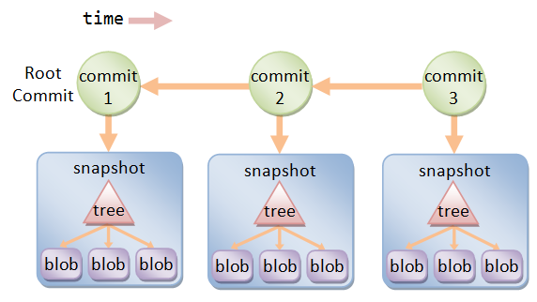
Overview
Git Objects
Each version of a file is represented by a blob (binary large object)
A snapshot of the working tree is represented by a tree object,
A commit object points to a tree object
It holds metadata such as timestamp, log message, author's and committer's username and email
It also references its parent commit(s)
Each object is by a SHA-1 hash value(40 hex-digit) of its contents

Slide 6
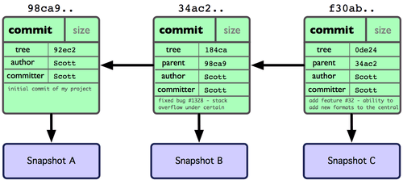
Overview
Git Objects Relations(Example)

Slide 7
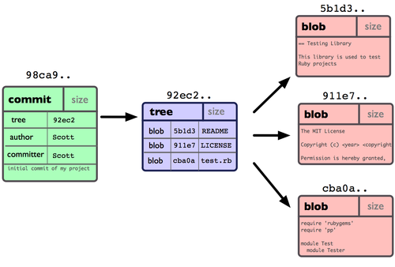
Overview
Git Objects Relations(Example)

Slide 8
Overview
$ git init
$ git add README.md
$ git commit -m "Commit 1"
// Append a line in README.md: This line is added after Commit 1
$ git status
$ git add README.md
$ git commit -m "Commit 2"
// Append a line in README.md: This line is added after Commit 2
$ git status
$ git add README.md
$ git commit -m "Commit 3"
// Show all the commits (oneline each)
$ git log --oneline
44fdf4c Commit 3
51f6827 Commit 2
fbed70e Commit 1

Slide 9

5.1 Branching
Master Branch
Upon making the first commit in a repository, Git will automatically create a master branch by default.

Slide 10
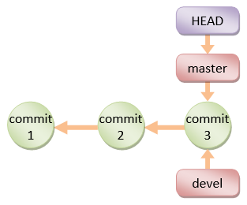
1) Creating a new Branch (git branch <branch-name>)
$ git branch devel
Take note that when you create a new branch,
the HEAD pointer is still pointing at the current branch.

Slide 11
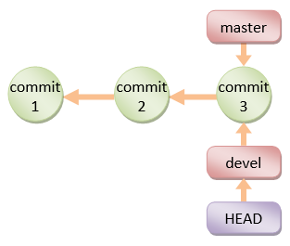
2) Switching to a Branch (git checkout <branch-name>)
// The HEAD pointer will be
// pointing at devel branch
$ git checkout devel
Alternatively, you can use "git checkout -b <branch-name>"
to create a new branch and switch into the new branch.

Slide 12
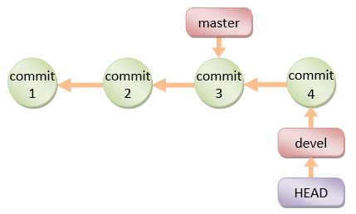
3) Make Changes and commit
// Append a line in README.md:
// This line is added on devel branch after Commit 3
$ git status // NOTE "On branch devel"
$ git add README.md
$ git commit -m "Commit 4"
[devel c9b88d9] Commit 4

Slide 13
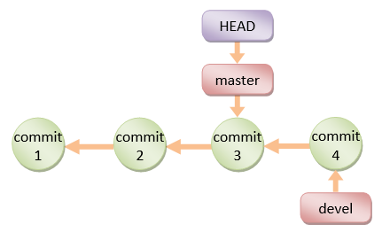
4) Switching back to the master branch
$ git checkout master
Switched to branch 'master'
// Check the content of the README.md,
// which is reminded back to Commit 3

Slide 14
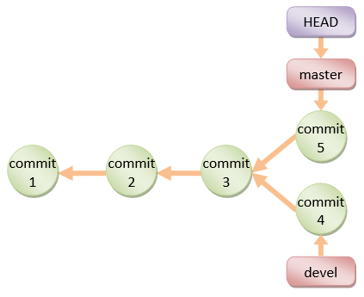
5) Work on the master branch and commit
// Append a line in README.md:
// This line is added on master branch after Commit 4
$ git status // NOTE "On branch master"
$ git add README.md
$ git commit -m "Commit 5"
[master 6464eb8] Commit 5
$ git checkout devel
// the file contents will be rewinded back to Commit-4.

Slide 15
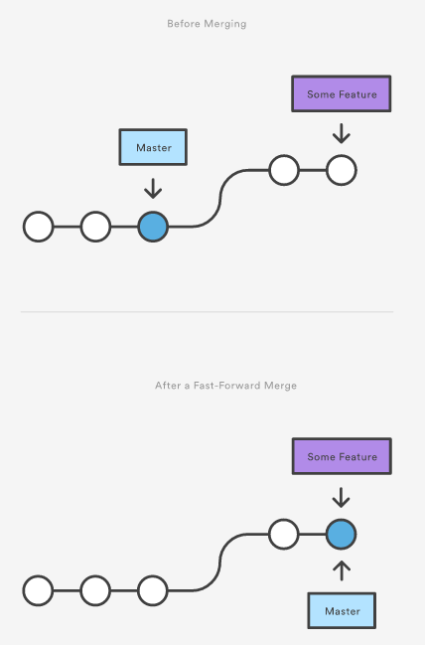
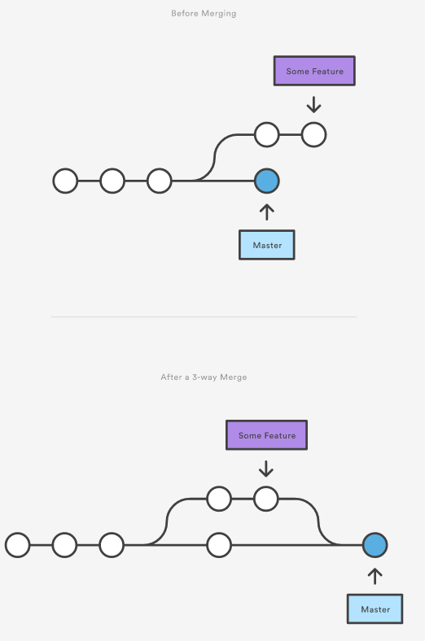
5.2 Merging Two Branches (git merge <branch-name>)
Merge Types
Before
Before
After
After
1) Fast-Forward Merge
2) 3-Way Merge

Slide 16
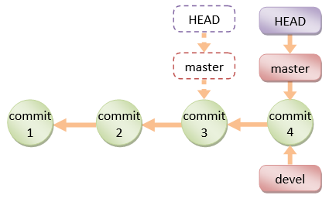
Merging Two Branches (fast-forward merge)
If the branch to be merged is a direct descendant (when there is a linear path), Git performs fast forward by moving the HEAD pointer forward.
Note that no new commit is created.

Slide 17
Merging Two Branches (fast-forward merge)
$ git checkout master
// Let discard the Commit-5 totally and rewind to commit-3 on master branch
// This is solely for illustration!!! Do this with great care!!!
$ git reset --hard HEAD~1
HEAD is now at 7e7cb40 Commit 3
// HEAD~1 moves the HEAD pointer back by one commit (-1)
// --hard also resets the working tree
$ git merge devel

Slide 18
Merging Two Branches (3-way merge)
If the two branches are diverged, git automatically searches for the common ancestor commit and performs a 3-way merge.
If there is no conflict, a new commit will be created.

Slide 19
Merging Two Branches (3-way merge)
If git detects a conflict, it will pause the merge and issue a merge conflict and ask you to resolve the conflict manually.
The file is marked as unmerged.
You can issue "git status" to check the unmerged files, study the details of the conflict, and decide which way to resolve the conflict.
Once the conflict is resolve, stage the file (via "git add <file>"). Finally, run a "git commit" to finalize the 3-way merge.

Slide 20
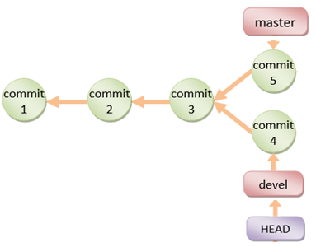
Merging Two Branches (3-way merge)
Example
// Master Branch
$ git checkout master
$ git reset --hard HEAD~1
// Change the email to abc@abc.com
$ git add README.md
$ git commit -m "Commit 5"
// Devel Branch
$ git checkout devel
$ git reset --hard HEAD~1
// Change the email to xyz@xyz.com
// to trigger conflict
$ git add README.md
$ git commit -m "Commit 4"

Slide 21
Merging Two Branches (3-way merge)
// Let's do a 3-way merge with conflict
$ git checkout master
$ git merge devel
Auto-merging README.md
CONFLICT (content): Merge conflict in README.md
Automatic merge failed; fix conflicts and then commit the result.
$ git status
# On branch master
# You have unmerged paths.
# (fix conflicts and run "git commit")
#
# Unmerged paths:
# (use "git add <file>..." to mark resolution)
# both modified: README.md
no changes added to commit (use "git add" and/or "git commit -a")

Slide 22

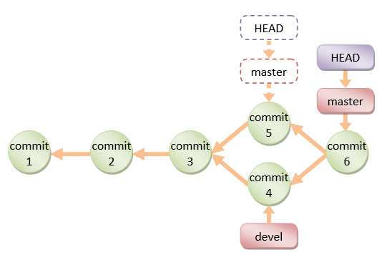
Merging Two Branches (3-way merge)
// (in "git status"):
<<<<<<< HEAD
This is the README. My email is abc@abc.com
=======
This is the README. My email is xyz@xyz.com
>>>>>>> devel
This line is added after Commit 1
This line is added after Commit 2
// Modify README
// commit
$ git add README.md
$ git commit -m "Commit 6"
a new commit will be created in the process
(unlike fast-forward merge).

Slide 23
5.3 Deleting a Merged Branch (git branch -d <branch-name>)
The merged branch (e.g., devel) is no longer needed.
$ git branch -d devel
Deleted branch devel (was a20f002).
// Create the development branch again at the latest commit
$ git branch devel

Slide 24
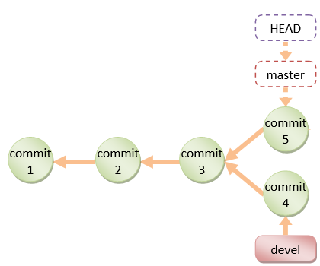
Lab 3
Branching/Merging
branching: master, devel Branch
Merging after the conflict is resolve
Viewing the commit graph(git-gui)
1) branch
2) merge

Slide 25
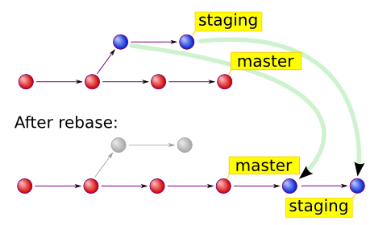
5.4 Rebasing Branch (git rebase)
The primary purpose for rebasing is to maintain a linear project history.
devel
devel

Slide 26
Rebasing Branch
SYNTAX
$ git rebase <base-name>
<base-name> could be any kind of commit reference (such as an commit-name, a branch name, a tag, or a relative reference to HEAD)

Slide 27
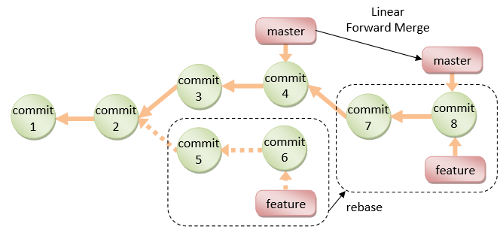
Rebasing Branch (Example)
if you checkout a feature branch and work on commit-5 and commit-6, (instead of doing a 3-way merge into the master branch and subsequently remove the feature branch)
you can rebase the commit-5 and commit-6, on commit-4, and perform a linear forward merge to maintain all the project history.
New commits (7 and 8) will be created for the rebased commit (5 and 6).

Slide 28
Rebasing Branch (Example)
// Start a new feature branch from the current master
$ git checkout -b feature master
// Edit/Stage/Commit changes to feature branch
// Need to work on a fix on the master
$ git checkout -b hotfix master
// Edit/Stage/Commit changes to hotfix branch
// Merge hotfix into master
$ git checkout master
$ git merge hotfix
// Delete hotfix branch
$ git branch -d hotfix
// Rebase feature branch on master branch to maintain a linear history
$ git checkout feature
$ git rebase master
// Now, linear merge
$ git checkout master
$ git merge feature

Slide 29
5.5 Amend the Last Commit (git commit --amend)
If you make a commit but want to change the commit message or adding more changes,
you may amend the recent commit (instead of creating new commit)
$ git commit --amend –m “message”

Slide 30
Amend the Last Commit
// Do a commit
$ git commit -m "added login menu"
// Realize that you have not staged some files.
// Amend the commit
$ git add morefile
$ git commit –amend –m “after amend”

Slide 31
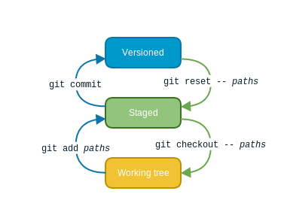
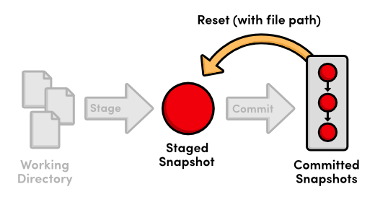
5.6 Undoing Git Changes (git reset <file>)
Unstage the changes of <file> from staging area, not affecting the working tree.
$ git reset <file>

Slide 32
Undoing Git Changes (git reset --hard)
Reset the staging area and working tree to match the recent commit (i.e., discard all changes since the last commit)
$ git reset --hard

Slide 33
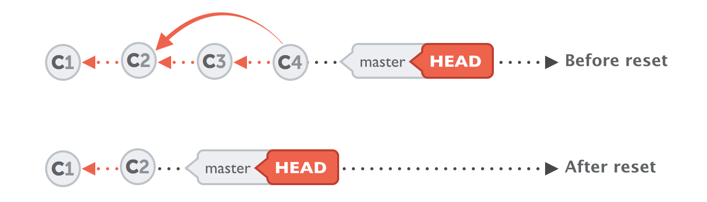
Undoing Git Changes (git reset --hard <commit>)
Reset both staging area and working tree to the given commit, i.e., discard all changes after that commit.
It works by resetting your current HEAD branch to an older revision (also called "rolling back" to that older revision)
$ git reset --hard <commit-name>
stored for at least 30 days.

Slide 34
Undoing Git Changes (git revert <commit>)
This command doesn't delete any commits. Instead, it reverts the effects of a certain commit, effectively undoing it.
Generate a new commit that undoes all of the changes introduced in <commit>, then apply it to the current branch
$ git revert <commit-name>

Slide 35
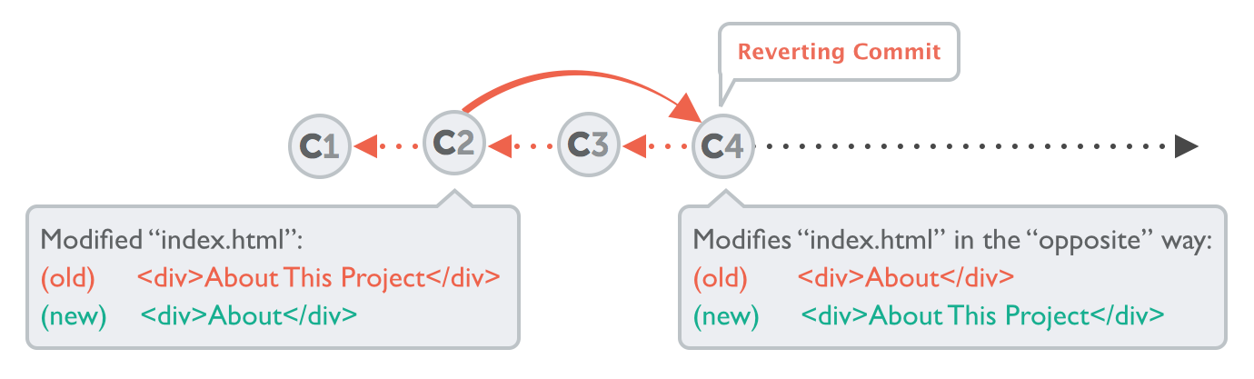
Undoing Git Changes (git revert <commit>)
This prevents Git from losing history. "git revert" is a safer way comparing with "git reset".
$ git revert c2

Slide 36
Summary: Branch and Merge
// Create a branch called "devel" and checkout.
// The "devel" is initially synchronized with the "master" branch.
$ git checkout -b devel
// same as:
// $ git branch devel $ git checkout
// Edit/Stage/Commit
$ git add <file>
$ git commit -m "commit-message"
// To merge the "devel" into the production "master" branch
$ git checkout master
$ git merge devel
// Push master branch to remote repo
$ git push origin master
// To remove the devel branch
$ git branch –d devel

