Slide 1
Git & GitHub
How to get started with GIT and work with GIT Remote Repo
( https://www3.ntu.edu.sg/home/ehchua/programming/howto/Git_HowTo.html )

Slide 2
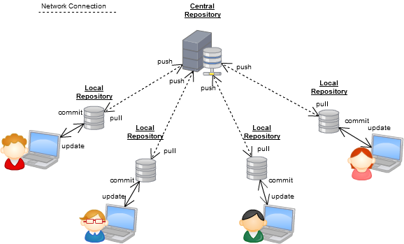
6. Collaboration

Slide 3
Collaboration
The git remote command lets you create, view, and delete connections to other repositories.
$ git remote add <name> <url>
Create a new connection to a remote repository. After adding a remote, you’ll be able to use <name> as a convenient shortcut for<url> in other Git commands.
$ git remote rm <name>
Remove the connection to the remote repository called <name>.

Slide 4
Collaboration
$ git remote add origin https://hostname/username/project-name.git
// List all the remote names
$ git remote -v
// Delete a remote name
$ git remote rm <remote-name>
// Rename a remote name
$ git remote rename <old-remote-name> <new-remote-name>
// Cloning a repo
$ git clone <remote-url>
// Init a GIT local repo and copy all objects from the remote repo
// a remote name called "origin" is automatically added

Slide 5
6.1 Synchronizing Remote and Local (Fetch/Merge, Pull and Push)
To pull down a project from the remote repo:
$ git clone <repo_url>
Then update with:
$ git pull
$ git fetch/merge
Remote Repository
git pull
git fetch
git merge
Working
Directory
Local
Repository

Slide 6
1) git fetch
The git fetch command imports commits from a remote repository into your local repo.
The resulting commits are stored as remote branches instead of the normal local branches that we’ve been working with.
This gives you a chance to review changes before integrating them into your copy of the project.
// Fetch ALL branches from the remote repo to your local repo
$ git fetch <remote-name>
// Fetch the specific branch from the remote repo to your local repo
$ git fetch <remote-name> <branch-name>

Slide 7
git fetch
$ git fetch origin
// List the remote branches
$ git branch –r
origin/master
origin/devel
// To see what commits have been added to the remote master
$ git log –p master..origin/master
//To see which commits are on your master
// which you haven't yet pushed, use
// $ git log origin/master..master
$ git checkout master
$ git merge origin/master

Slide 8
2) git pull
Merging upstream changes into your local repository is a common task in Git-based collaboration workflows.
git pull = git fetch + git merge
$ git pull <remote-repo-name>
Fetch the specified remote’s copy of the current branch and immediately merge it into the local copy

Slide 9
3) git push
This is the counterpart of "git fetch", which exports commits from local repo to remote repo.
$ git push <remote-repo-name> <local-branch-name>

Slide 10
git push
$ git push <remote-name> <branch-name>
// Push the specific branch of the local repo
$ git push <remote-name> --all
// Push all branches of the local repo
$ git push <remote-name> --tag
// Push all tags
// "git push" does not push tags
$ git push -u <remote-name> <branch-name>
// Save the remote-name and branch-name as the
// reference (or current) remote-name and branch-name.
// Subsequent "git push" without argument will use these references.

Slide 11
4) Fork and Pull Request
"Fork" and "Pull Request" are features provided by GIT hosts (such as GitHub and BitBucket)
Pushing "Fork" button to copy a project from an account (e.g., project maintainer) to your own personal account.
Pushing "Pull Request" button to notify other developers (e.g., project maintainer or the entire project team) to review your changes

Slide 12
6.2 Git Workflows
Now that you have the basics of branching and merging down, what can or should you do with them?
We’ll cover some common
Feature Branch Workflow
Forking Workflow
Gitflow Workflow

Slide 13
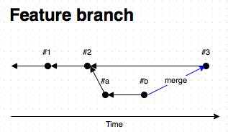
1) Feature-Branch Workflow
The core idea is that all feature development should take place in a dedicated branch instead of the master branch.
This encapsulation makes it easy for multiple developers to work on a particular feature without disturbing the main codebase.
It also means the master branch will never contain broken code
master
feature

Slide 14
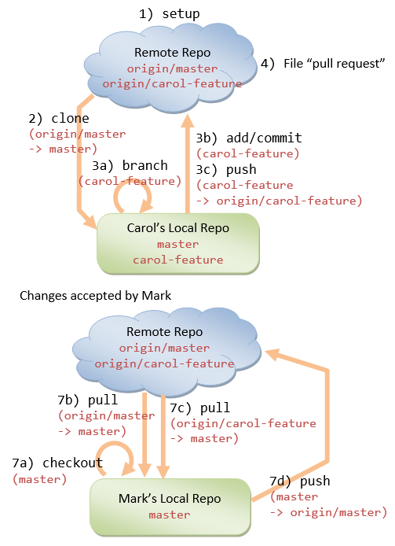
WorkFlow
Scenario

Slide 15
Feature-Branch Workflow
Mark, the project maintainer, starts the project
by pushing to the shared remote repo's "master“ branch.
Carol, a contributor, clones the project into her local repo, via:
// Carol:
$ cd parent-directory-of-the-working-directory
$ git clone https://hostname/path-to/project-name.git
// Create a remote-name "origin" (default), branch "master"
// on her local repo

Slide 16
Feature-Branch Workflow
3. Carol starts a feature branch (says "carol-feature")
under the "master" branch to work on a new feature, via:
// Carol:
$ git checkout -b carol-feature master
// Create a new branch "carol-feature" under "master" branch
// and switch to the new branch
// Edit/Stage/Commit/Push cycles on carol-feature branch
$ git status
$ git add <file>
$ git commit -m <message>
$ git push origin carol-feature
// Repeat until done

Slide 17
Feature-Branch Workflow
4. Carol completes the new feature.
She files a "pull request" to notify the rest of the team
members (by pushing the "pull request" button on the
Git host)
5. Mark, the project maintainer, or anyone in the team,
can comment on Carol's feature.
Carol can re-work on the feature, if necessary, and
pushes all subsequent commits under her feature branch.

Slide 18
Feature-Branch Workflow
6. Once the feature is accepted, Mark, or anyone in the team
(including Carol), performs a merge
to apply the feature branch into the "master" branch:
// Mark, or Anyone:
$ git checkout master
// Fetch and merge the latest changes on local's "master" branch
$ git pull origin master
// Fetch and merge carol-feature branch on local's "master" branch
$ git pull origin carol-feature
// Update the shared remote repo
$ git push origin master

Slide 19
Feature-Branch Workflow
7. Everyone can update their local repo, via:
// Everyone: Switch to the "master" branch of the local repo
$ git checkout master
// Fetch and merge the latest changes on local "master" branch
$ git pull origin master

Slide 20
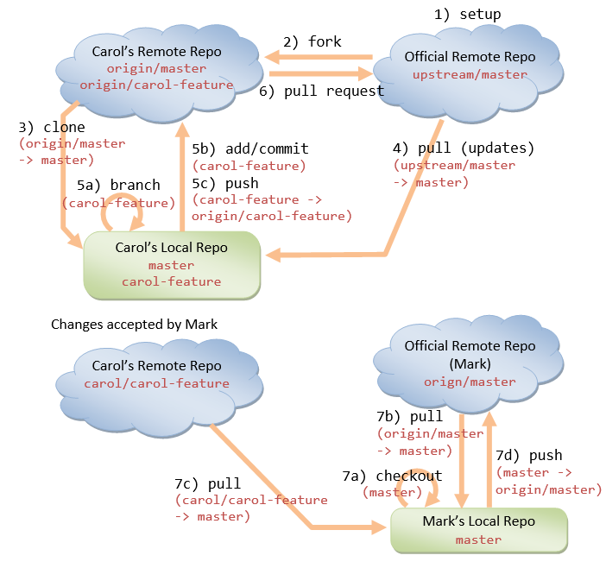
2) Forking Workflow

Slide 21
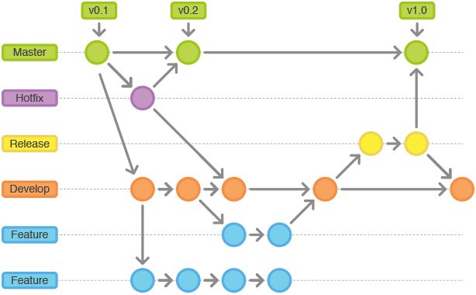
3) GitFlow
GitFlow

Slide 22
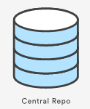


Lab 4: Feature-Branch Workflow
Collaboration between Alice and Bob
Prevalent with small teams on private projects.
GitHub
Bob
Alice

