Slide 1
Golden Time

Slide 2
CONTENTS
01 02 03 04 05
Problem
Solution
Detail
Complement
& Effect
Q & A

Slide 3
Problem 1
Problem 2

Slide 4

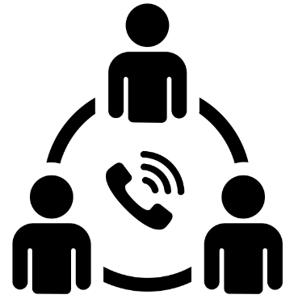

“ ”
Why is Golden Time

Slide 5
Complement & Effect

Slide 6
Solution

Slide 7
Q&A

Slide 8
감사합니다
출처 : 도로교통공단, 연합뉴스, 질병관리본부,

