Slide 1




Team 1
Bastien Baret
Lou Kramer
Cristoffer Sarevall
Jennifer Tipecska

Slide 2
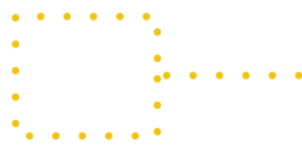
ShaderManager
Extract the shader part out of the drawable objects
-> separation between geometry&transformations and rendering
-> handy for swapping shaders at run time
every object stores a variable of public enum Shader {
TOON, PHONG, DIFFUSE
}

Slide 3
Material
stores material specific variables
color/ texture
diffuse component
specular component
shininess
enables the creation of predefined materials, like ‘ghost material’

Slide 4
Next steps
Enhancing the shader manager to support multi pass
create different shaders for bonus/ malus effects

Slide 5
Creating Basic Models
Model creation through Maya
Use of Basic shapes and tools provided through the software
Hardened Edges on the Mesh's Surface
Triangulation of the Mesh is necessary
Exported as OBJ file and imported through Parser

Slide 6
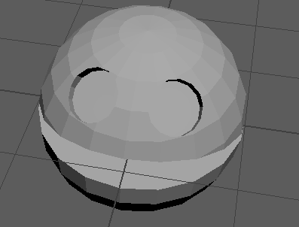
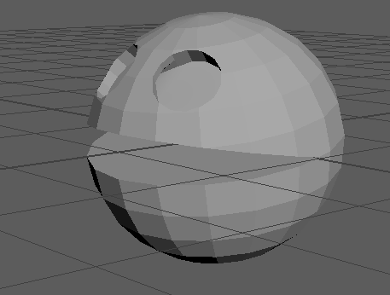
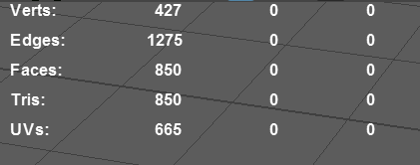
Pacman

Slide 7
Future models and changes
Model creation through Maya
Use of Basic shapes and tools provided through the software
Hardened Edges on the Mesh's Surface
Triangulation of the Mesh is necessary
Exported as OBJ file and imported through Parser

Slide 8
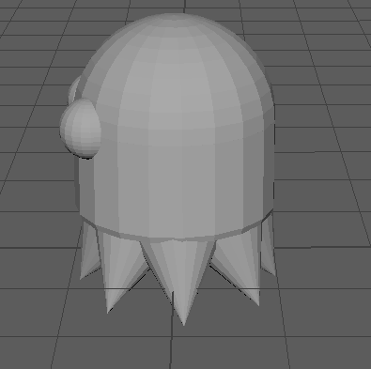
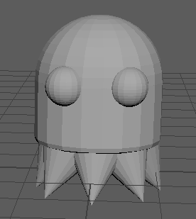
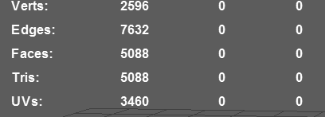
Ghost

Slide 9
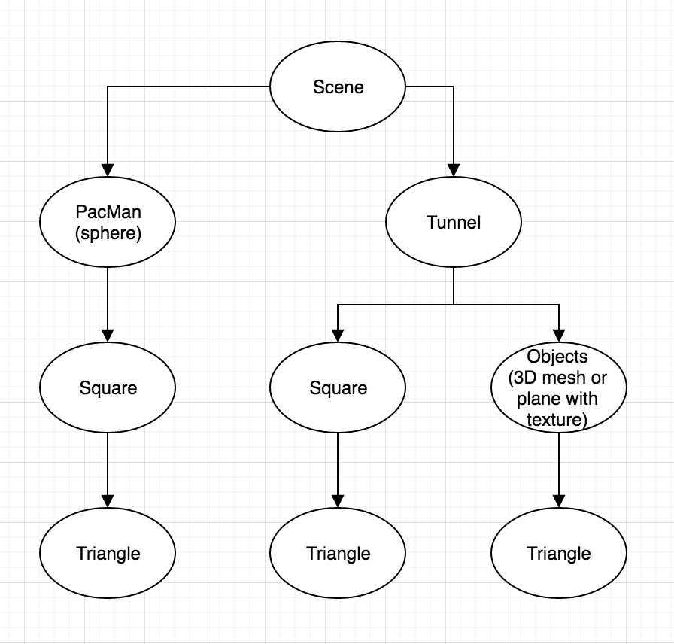
Scenegraph
First implementation
Simple but working scenegraph
Populations position is set on
creation. Movement of e.g
ghosts is based solely on
parent node.

Slide 10
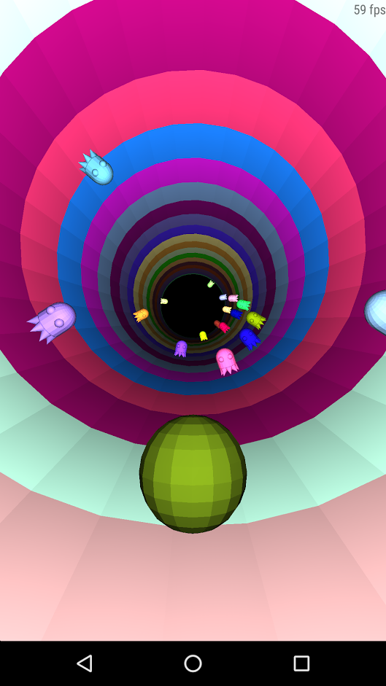
Scenegraph
Pacman is static
Tunnel divided into small
pre-loaded sections.
Each section is a parent to ghosts.

Slide 11
Scenegraph
Pacman still static
“node” rotates based on input
Population is Ghosts, power-ups,
coins etc.
Better control over where objects
spawn.

Slide 12
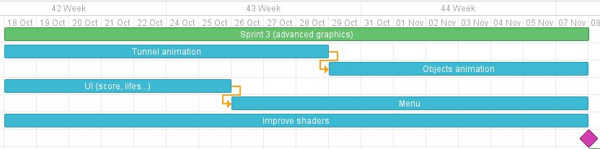
Next sprint

Slide 13
Next sprint
Add a point system (coin collection based) and UI
Animation on models and textures, modeling of bonus and malus objects
Scenegraph improvements
Shader improvements
Code and Performance optimizations

