Slide 1
Introduction
Team 1:
Jennifer Tipecska: The Pacman Game
Lou Kramer: Figure Skater
Cristoffer Sarevall: Cyclops shooting game
Bastien Baret: Roll for your life
Notes:
3d interaction simple game
simple graphics with the option of enhancing the layout
opengl
possibility of leaderboard if there is time left

Slide 2

The Pacman Game

Slide 3
Story
Pacman needs to move forward until he can see the light at the end of the tunnel
Collecting Items grant him special powers that make it more easy to evade the ghosts which lure inside the tunnel
The Ghosts want to catch pacmac to hinder him from getting out of the tunel

Slide 4
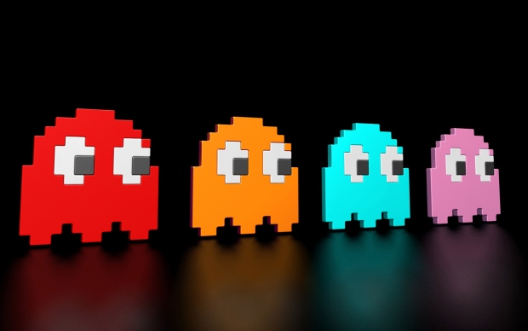
Pacman need to evade the ghosts, or else he will die
By collecting the items the player can earn extra points and special properties, like shields, etc

Slide 5
Pacman moves continuously forward
By swiping to the right/ left, Pacman is able to move onto another part of the infinite tunnel.
The items and enemies spawn randomly in their number and position

Slide 6
By swiping down at the top, the menu can be displayed
On the left side are the options for increasing/decreasing the difficulty level
On the right side are the options for increasing/ decreasing the movement speed of Pacman

Slide 7
Conceptual Model
Simple geometric models: Pacman, Monsters, Items
Use of Randomizer
Use of Touchscreen interaction
Use of Shaders
Use of Lighting
Use of Texture

Slide 8
Conceptual Model

Slide 9
System architecture
Single Player
APK on device installation
Possible Leaderboard Extension

Slide 10
Figure Skater - Story
Want to become a successful figure skater
Need to practice
Practicing by collecting the items -> could stand for choreos etc. :)

Slide 11
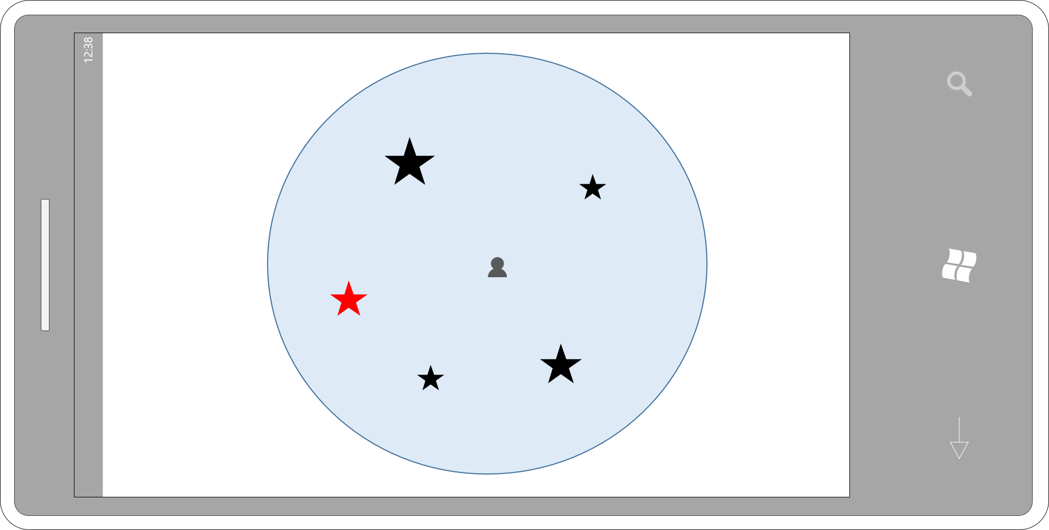
Figure Skater
Figure skater on the ice
Needs to catch items
Player movement done by tilting the device

Slide 12
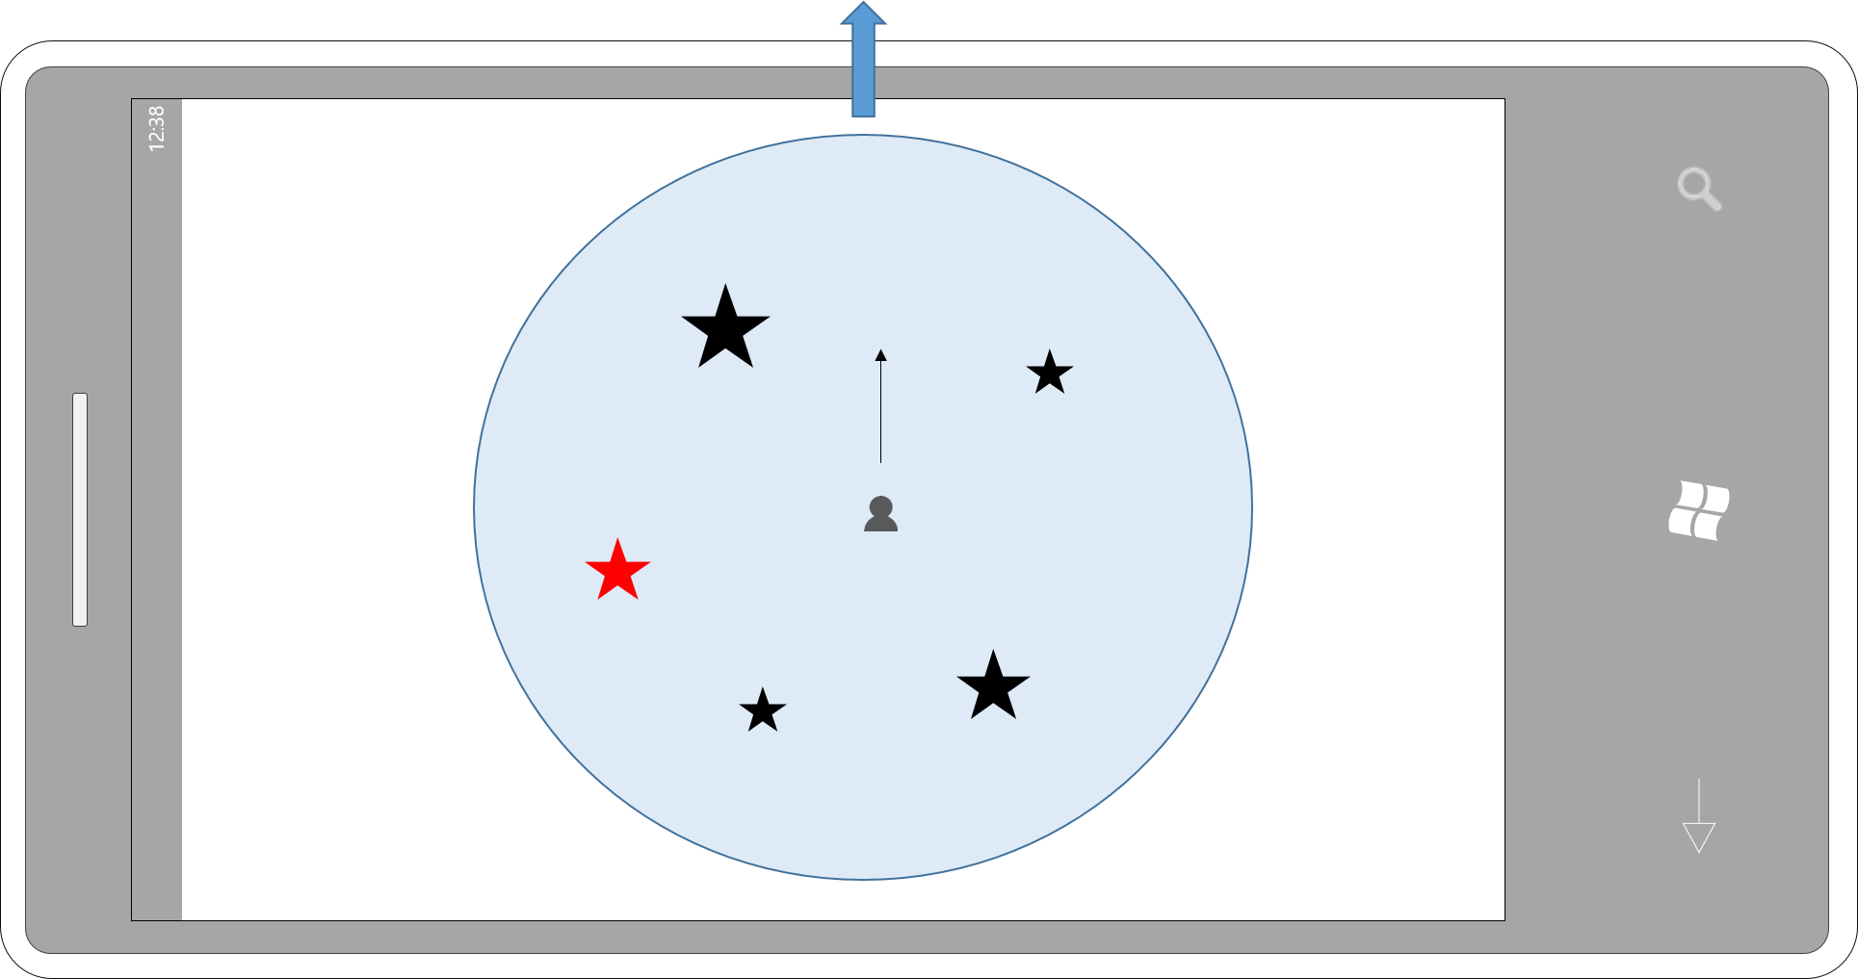
Figure Skater
Figure skater on the ice
Needs to catch items
Player movement done by tilting the device

Slide 13
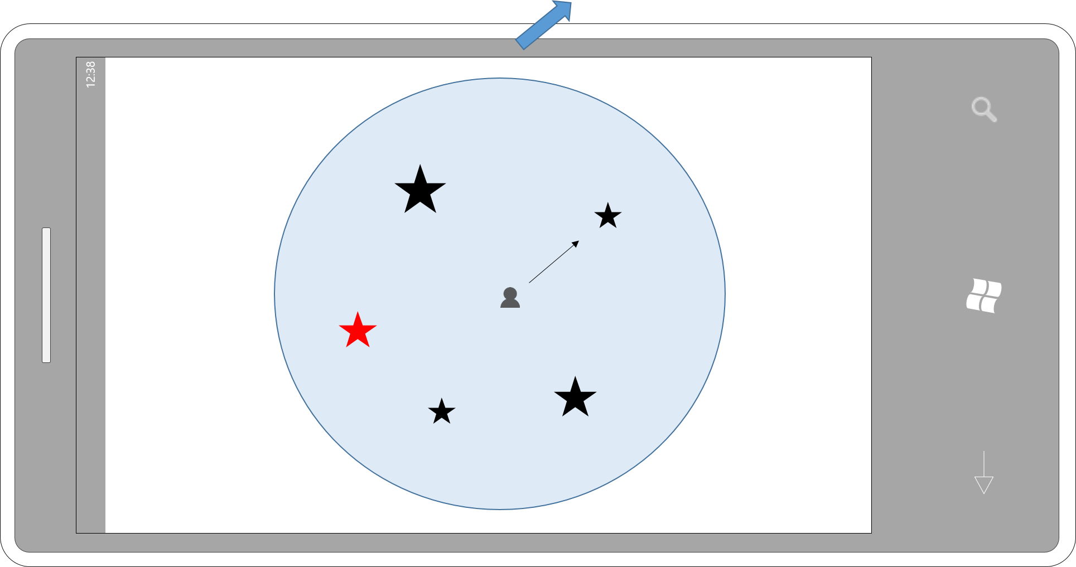
Figure Skater
Figure skater on the ice
Needs to catch items
Player movement done by tilting the device

Slide 14
Figure Skater - Gameplay elements
Randomized placement of the items on the ice
Security border
“Bad” items, which should not be collected
Moving items
Water holes
Jump by tapping on the screen
...

Slide 15
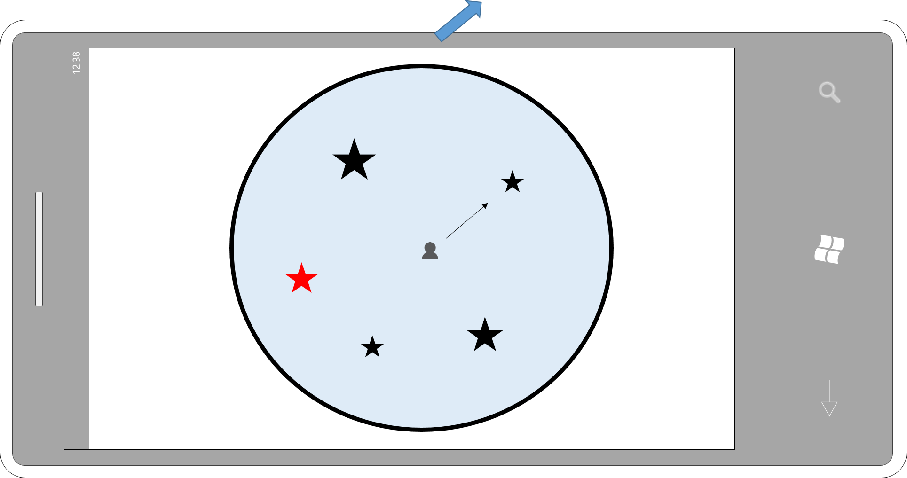
Figure Skater - Gameplay elements

Slide 16
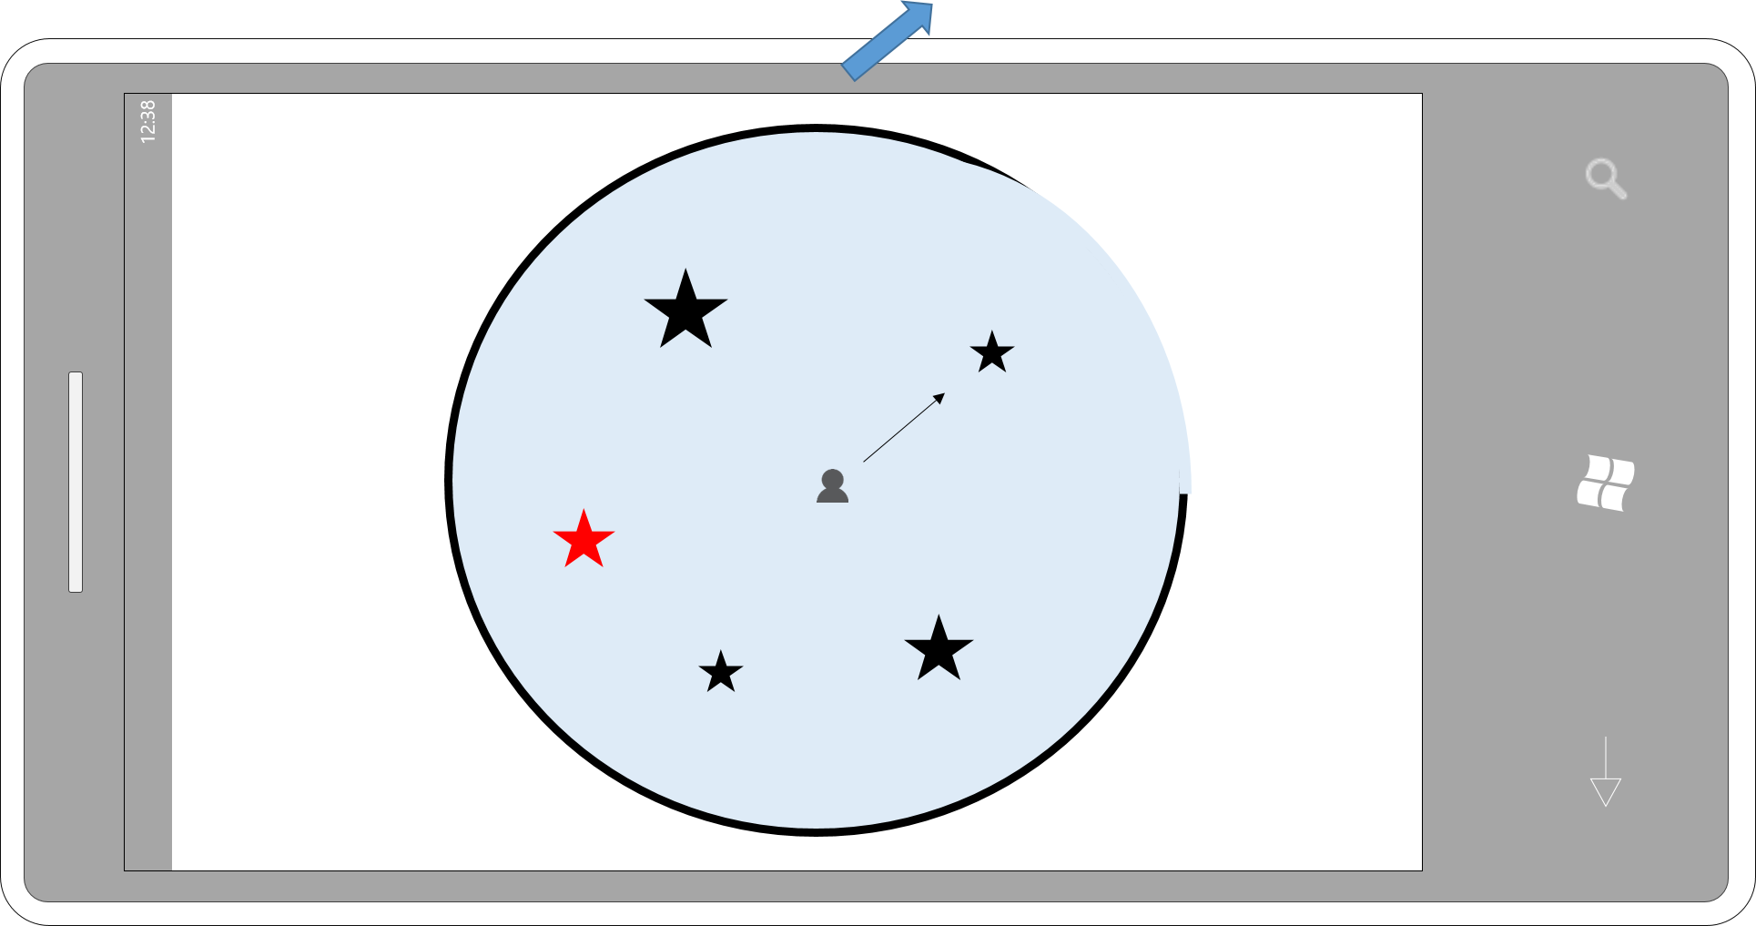
Figure Skater - Gameplay elements

Slide 17
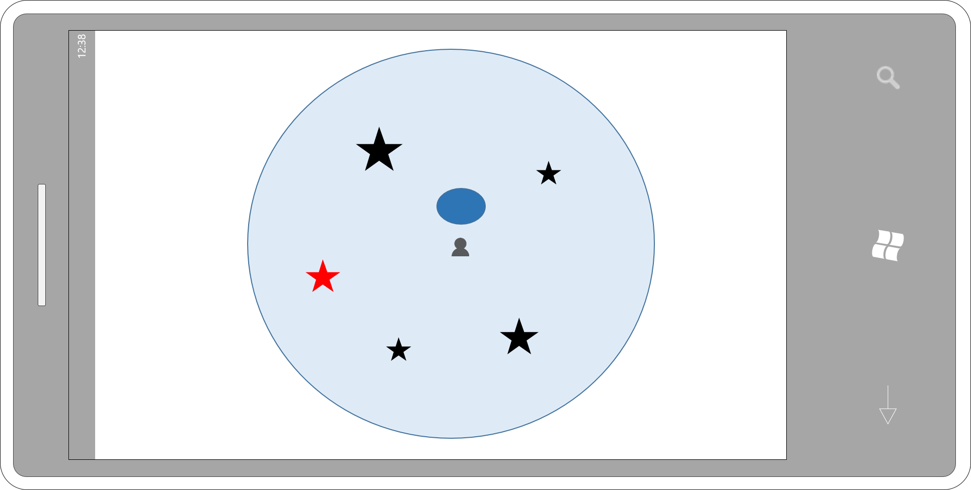
Figure Skater - Gameplay elements

Slide 18
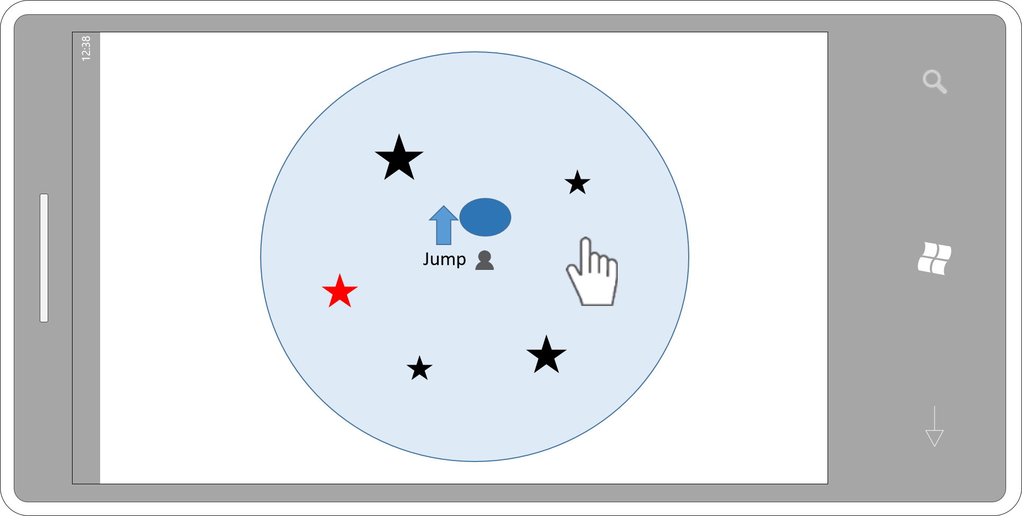
Figure Skater - Gameplay elements

Slide 19
Figure Skater - Conceptual Model
Use of Gyroscope
Basic physics
Random generator
Visual effects possible
Shaders
Simple geometrical models (e.g. figure skater is a snowman)
...

Slide 20
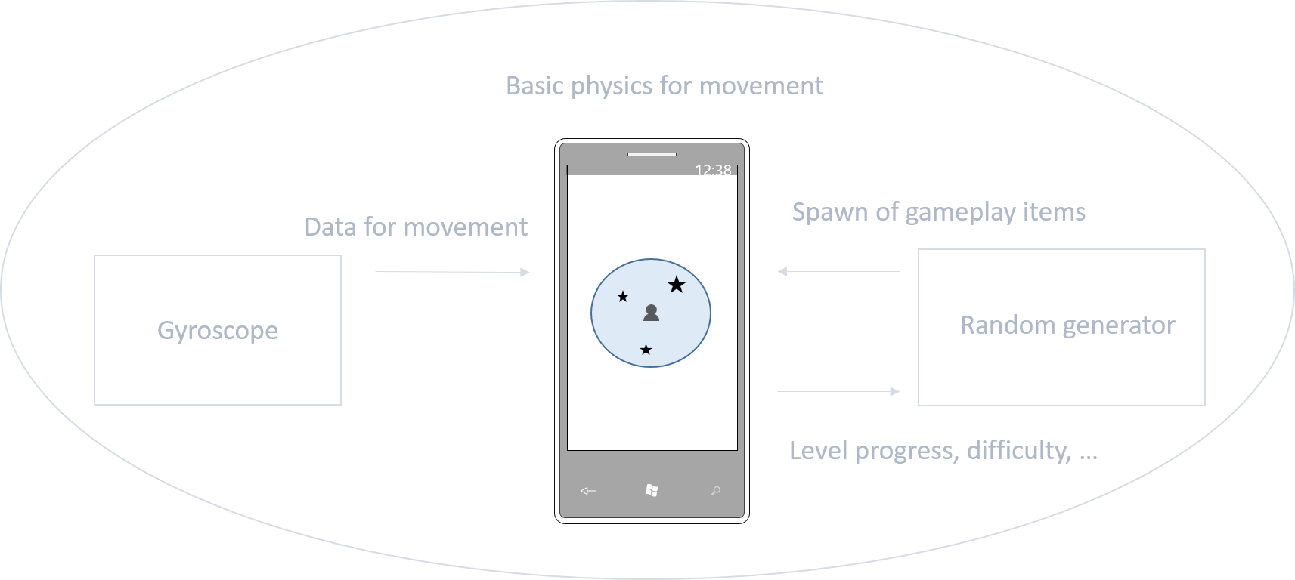
Figure Skater - Conceptual Model

Slide 21
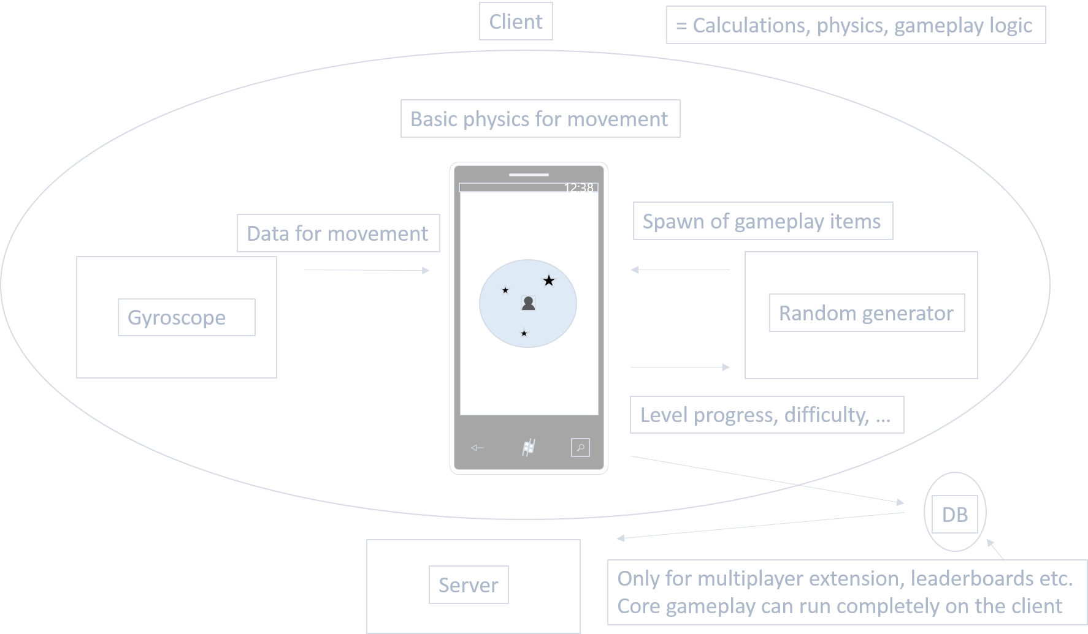
Figure Skater - System architecture

Slide 22
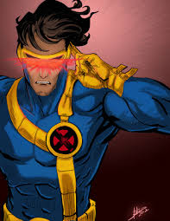
Cyclops shooting game - concept
Based on the fictional character Cyclops.
Virtual Reality using Google Cardboard.
Shooting things coming towards you.

Slide 23
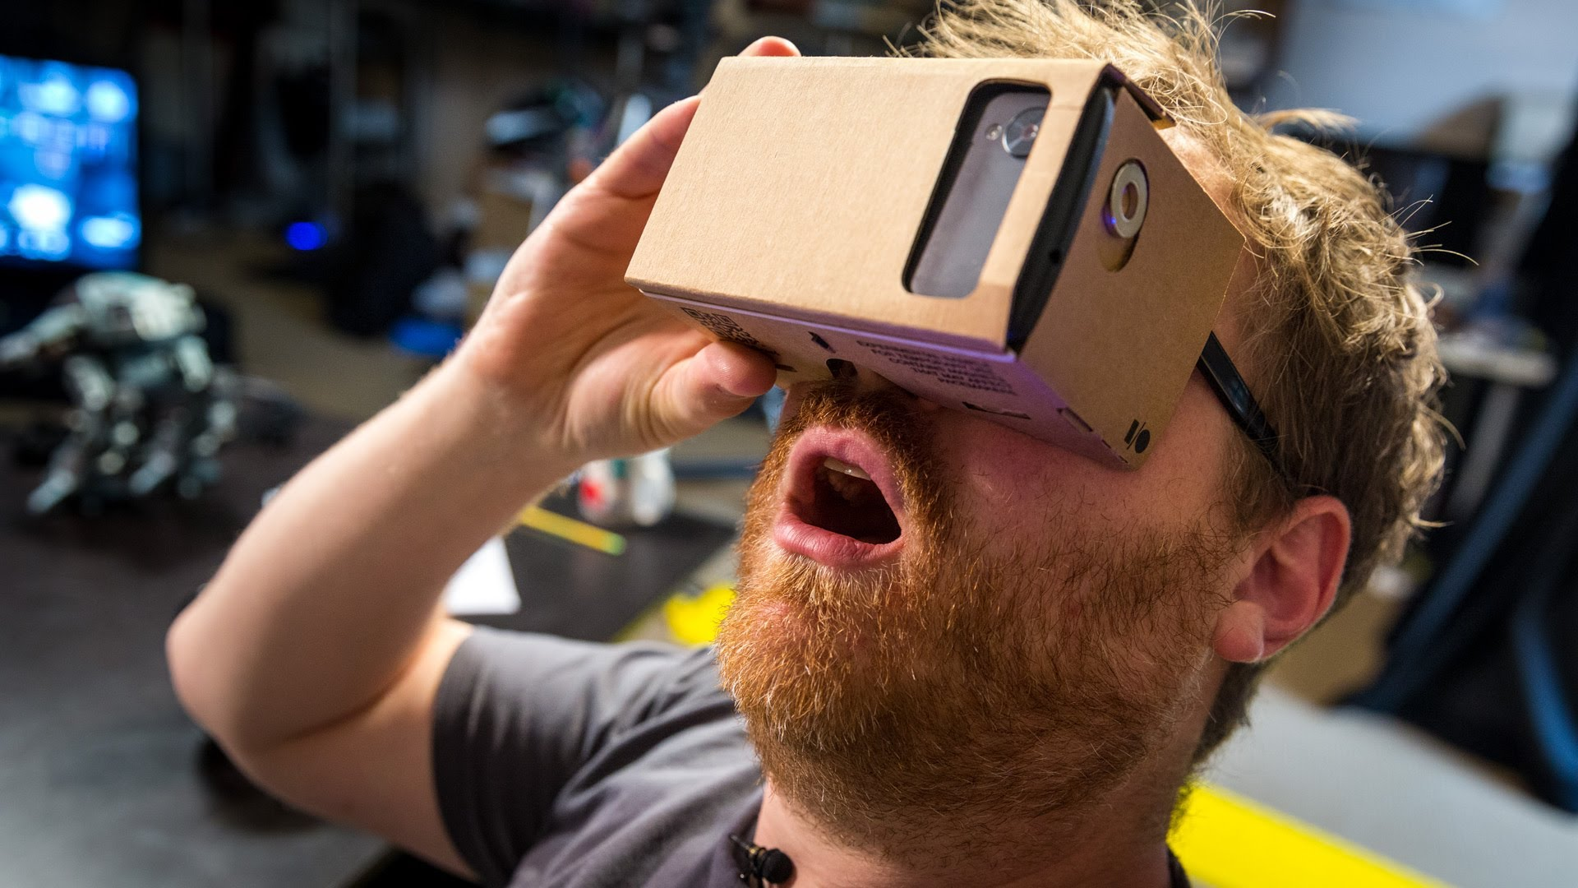
Cyclops shooting game - Story
Blow up things coming towards you.
Minimalistic design.
Game is lost when you miss a certain amount of objects.
“Virtual training session”

Slide 24
Cyclops shooting game

Slide 25
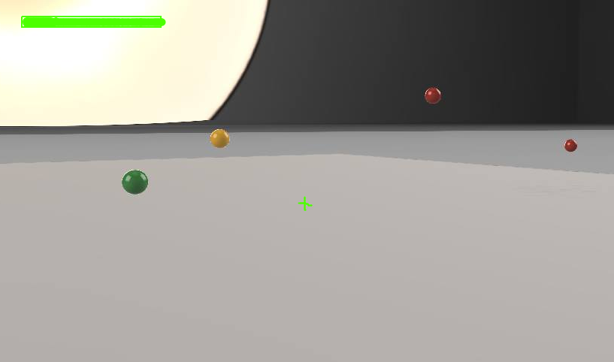
Cyclops shooting game - graphics

Slide 26
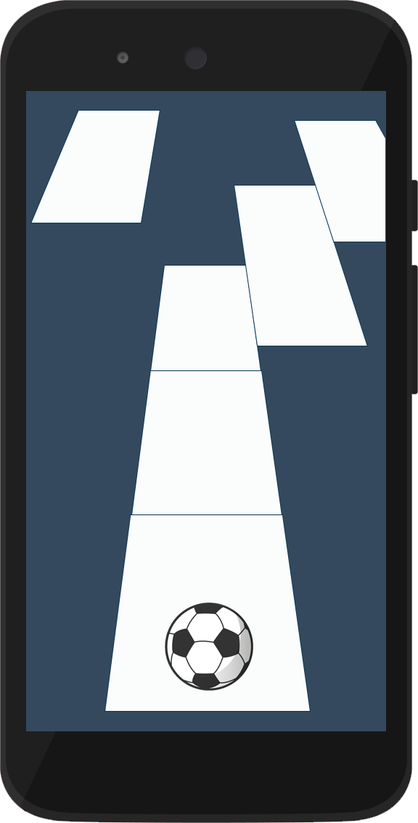
Roll for your life
Ball roll straight forward
Player needs to avoid holes in the ground
The ball can move to the right/left by tilting the device
Tap to jump
Challenge your reflex and your anticipation

Slide 27
Roll for your life
Ground generated randomly
Mode levels: more and more difficult
Bonus/malus
Mode « free »: less ground and the ball goes faster over the time

Slide 28
Roll for your life: conceptual model
Simple graphics
Ball physics
Gyroscope
Random generator (level design)

Slide 29
Roll for your life: conceptual model
Level difficulty, time elapsed
Touchscreen
Random generator
Jump
Spawn ground and bonus/malus
Gyroscope
Move the ball laterally

