Slide 1




Team 1
Bastien Baret
Lou Kramer
Cristoffer Sarevall
Jennifer Tipecska

Slide 2






Progress presentation 3
Sprint 1
Sprint 2
Sprint 3
Sprint 4
Sprint 5
Setup
Graphics
Advanced graphics
Gameplay
Validation
Progress
presentation 1
Progress
presentation 2
Progress
presentation 3
Progress
presentation 1
Final presentation

Slide 3

Object 3D factory
Avoid parsing the same .OBJ file multiple times
Significantly improve loading time by cloning existing object
Save memory
Dynamically instantiate the right sub-class of Object3D
Easy to use:

Slide 4

Texturing
Object3D class can now handle textured OBJ file using UV mapping
UV mapping is defined in Blender/Maya
Set the texture file in the code directly:

Slide 5
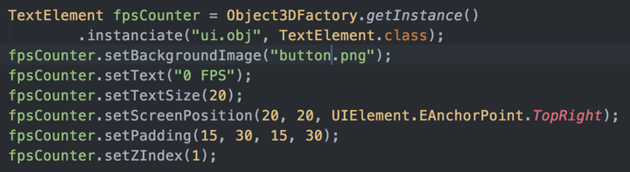
UI
Use a simple plan with texture at the nearest plan of the frustum from the camera
Generate text texture at runtime using Android’s Canvas
Compute OpenGL coordinate from screen coordinate
Compute scaling to fit text/image size (avoid stretched texture)

Slide 6
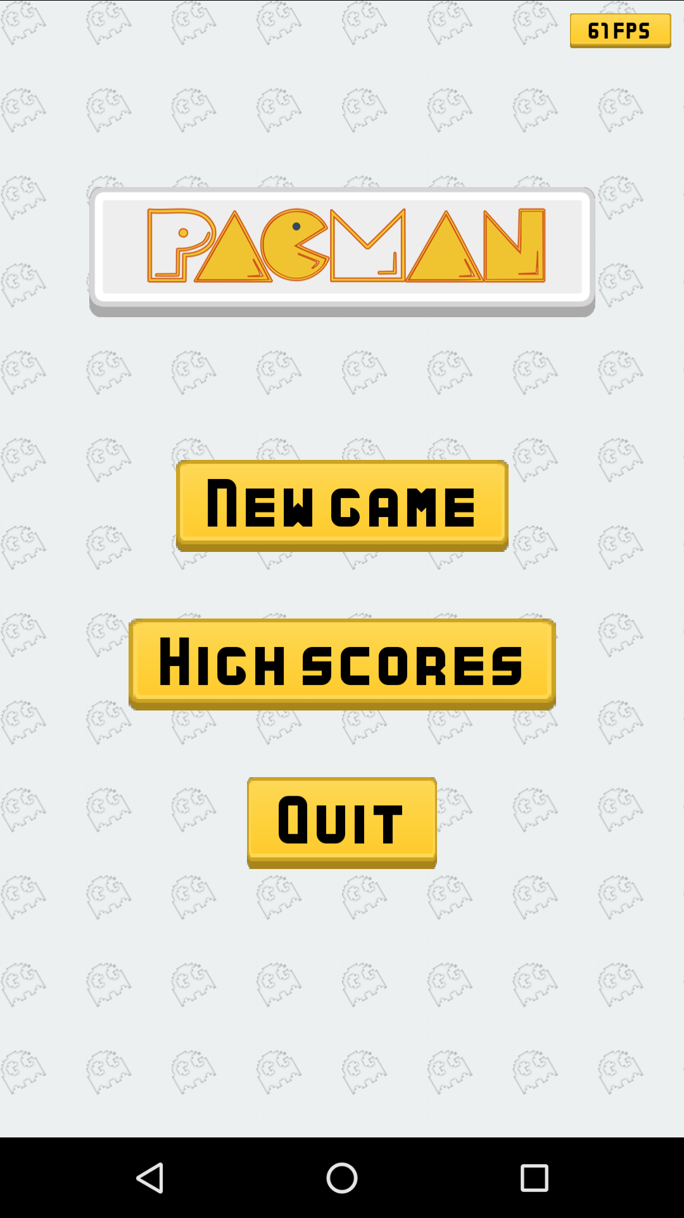
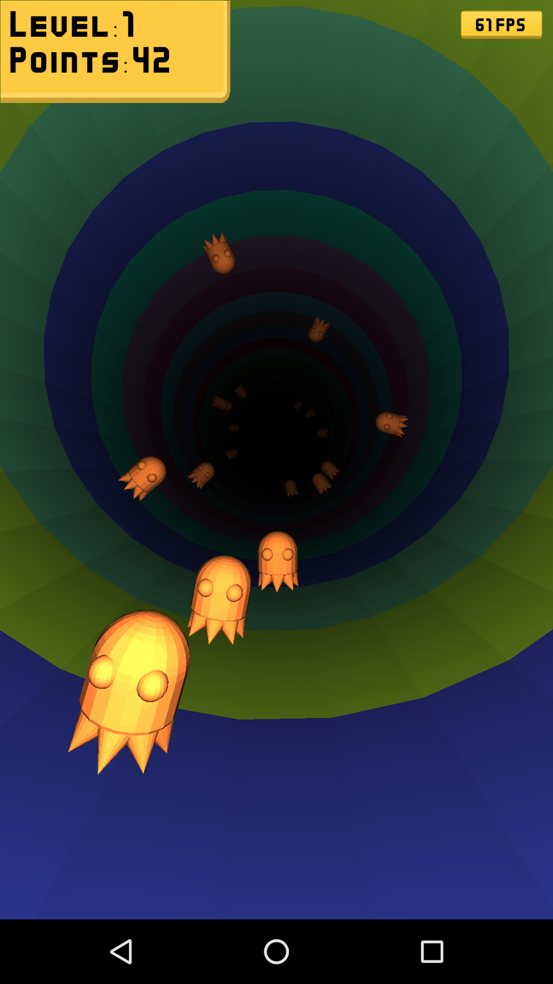
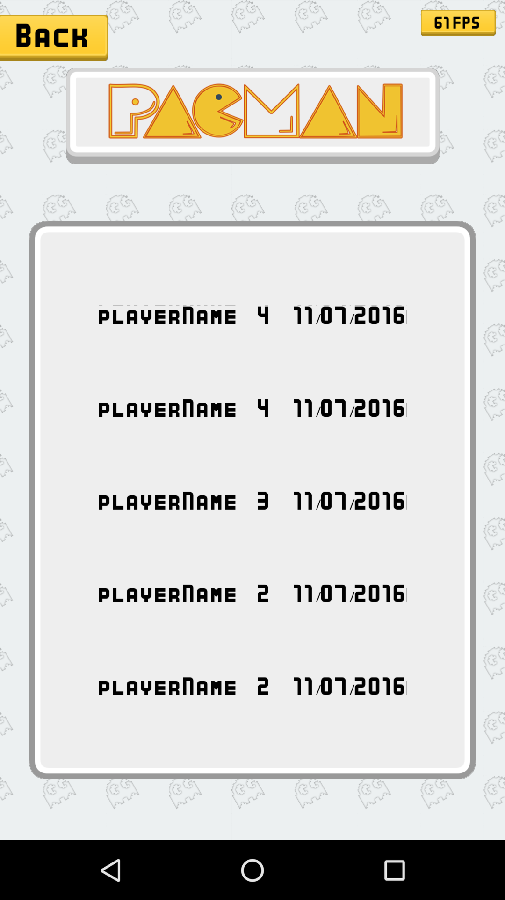
UI: example
Menu view
Game view
Highscore view

Slide 7
New 3D Objects
New collectible Item, to increase final score
One new Items, which produce bonus effects ( Still missing One)
Two new Items, which produce malus effects
Beginning to Texture some of the objects

Slide 8
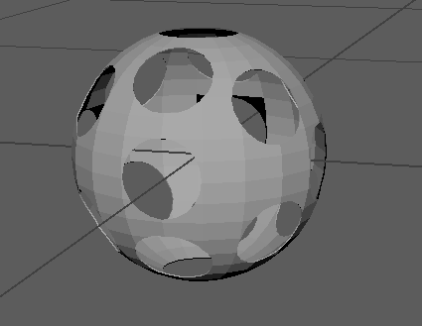
Collectible: Ball
Goal: Collect Item
Contributes Points to Score

Slide 9
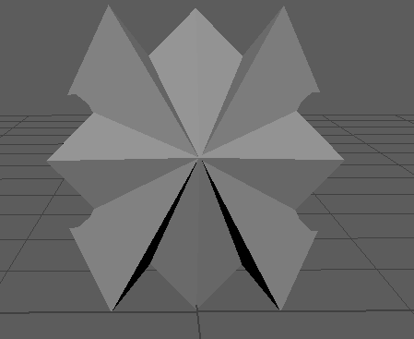
Bonus Object: Shield
Goal: Collect Item
Grants temporary immunity
(against Ghosts and Malus Objects)

Slide 10
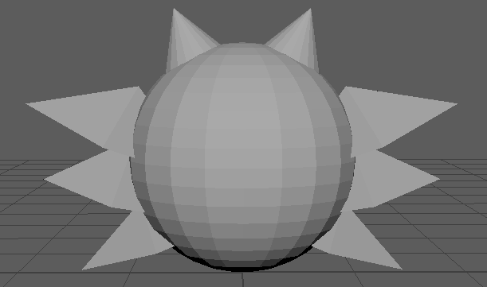
Malus Object: Darkness
Goal: Avoid Item
Brings Darkness to the Tunnel
(Becomes harder to see nearing
Objects)

Slide 11
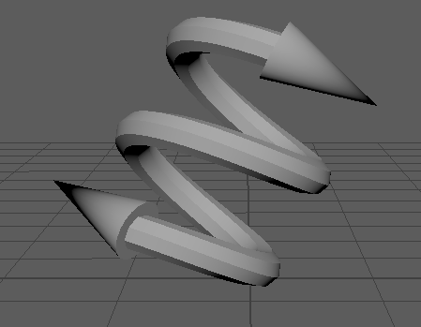
Malus Object: Distortion
Goal: Avoid Item
Inverts User input Directions

Slide 12
ShaderManager
Creates all programs at the beginning
-> program switch between objects to support multiple shaders efficiently
-> further improve performance by sorting objects due to their shader types
Add support for texture input
Adjust attenuation factor to scene

Slide 13
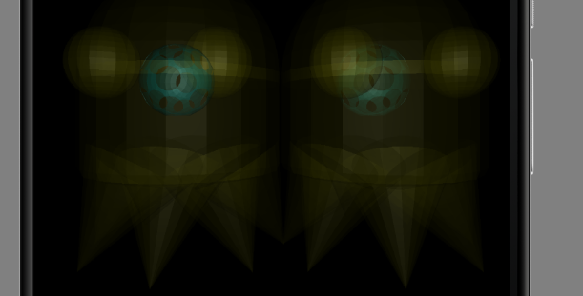
Transparent shader
Transparency can be set by adjusting the a variable of the RGBA value
BUT: order matters! -> need sorting
draw all opaque objects
sort transparent objects
draw transparent objects with
blend function

Slide 14
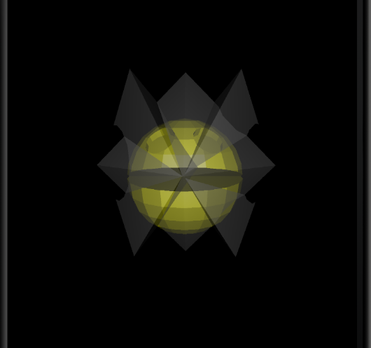
Transparent shader
Transparency used to indicate shield around Pacman

Slide 15
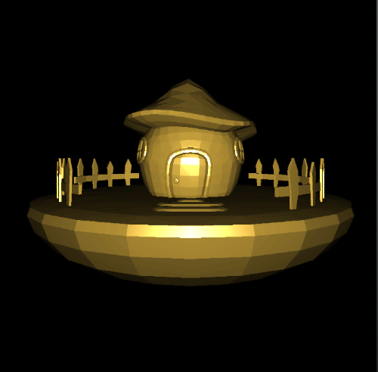
Gold shader
Shader to get a goldish-look
can be used for the coins

Slide 16
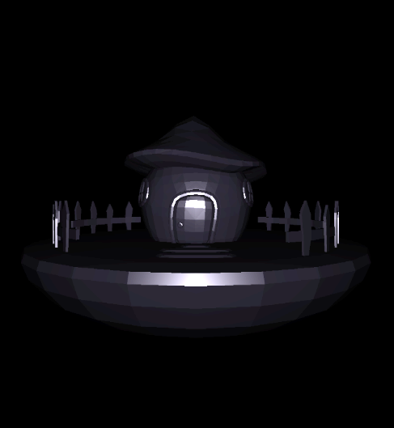
Obsidian shader
Shader to get a darker look :)
…
same shader, just different ambient, diffuse
and specular component colors!

Slide 17
Next Steps
Collision Detection and differentiation between objects
Level manager
Animation on Pacman, Texturing of the missing objects
Inclusion of Light

