Slide 1




Team 1
Bastien Baret
Lou Kramer
Cristoffer Sarevall
Jennifer Tipecska

Slide 2






Project schedule
Sprint 1
Sprint 2
Sprint 3
Sprint 4
Sprint 5
Setup
Graphics
Advanced graphics
Gameplay
Validation
Progress
presentation 1
Progress
presentation 2
Progress
presentation 3
Progress
presentation 1
Final presentation

Slide 3

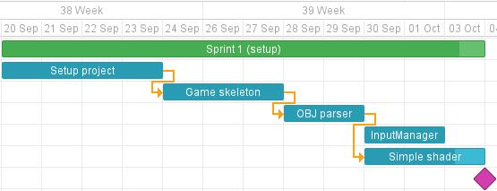
Sprint 1: setup

Slide 4
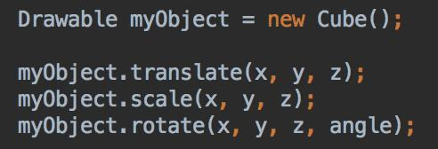
Game skeleton
Game loop: update objects’ position/game state and draw all the scene.
FPS counter (will be removed on release)
Drawable: super class for all objects on the scene.
Each transformation recalculate the model matrix

Slide 5
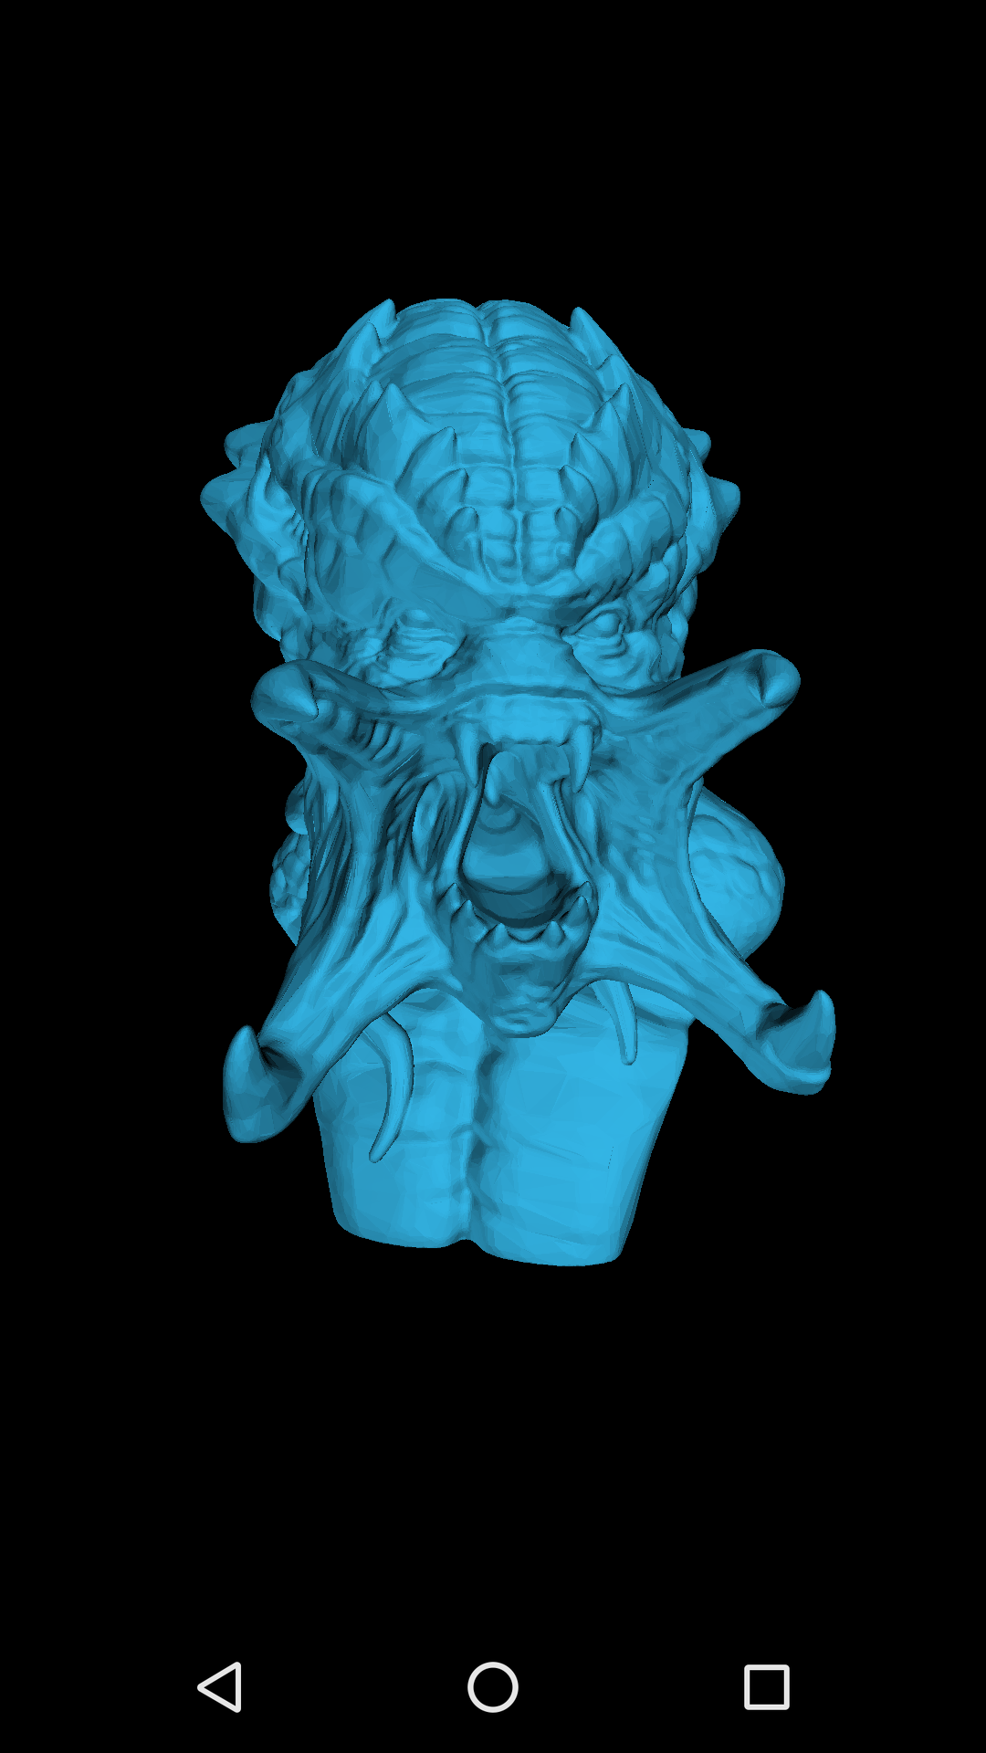
OBJ parser
Parse OBJ file (from Blender, Maya…)
Create vertex and normal buffers with VBO optimisation (indexes)
Import complex 3D object from assets easily :
3D mesh with 385,888 vertices and 378,302 triangles

Slide 6
Input manager
Retrieve all user input/action
Gyroscope: from device’s accelerometer and magnetometer (improve precision)
Touch event: from GLSurfaceView.onTouchEvent
Easy to use in every context (singleton):

Slide 7
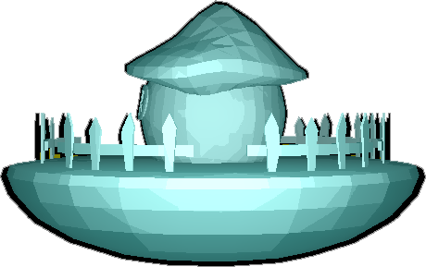
Shader: phong lighting
Added phong lighting in the fragment shader
Pointlight
Attenuation

Slide 8
Shader: toon shader + outlines
Phong with fixed light-levels - toon shader effect
Stencil buffer
2 passes for outline
Still: pointlight + attenuation

Slide 9
Shader: Lessons learned
OpenGLES2.0 does not support multiple render targets
GLSL does not cast automatically, but emulator does not check it
Future work: ShaderManager

Slide 10
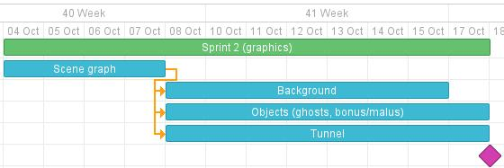
Sprint 2: graphics

Slide 11
Scene graph: Basic idea
Initially Pacman and the camera has fixed positions
Create an invisible root in the center of the pipe around which the pipe, enemies and powerups rotate depending on gyroscope.
Everything moves towards and rotates around Pacman, who doesn’t actually move.

Slide 12
Modelling: create the objects
Create Pacman, the pipe, enemies and powerups.
Potentially add small animations to the objects.

Slide 13
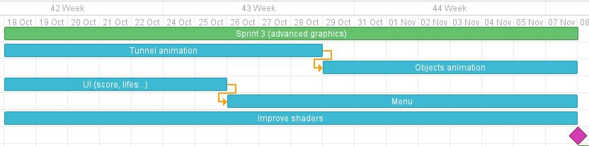
Sprint 3: advanced graphics

Slide 14
Tunnel/ Object animation
Individual animation for different objects, like ghost movement, rotation of collected power ups, etc
Dynamic tunnel generation and joining together of different tunnel sections

Slide 15
UI
Basic implementation of a Scoreboard, point dependent on distance and Bonus/Malus Objects collected
Basic Life/Health concept implementation, reduction through collision with the ghosts

Slide 16
Menu / Shaders
Implementation of a basic menu layout, enables restart, mode selection, etc
Adapt shaders to new object and tunnel animations, and to display in game events like power ups and malus object collection

Slide 17
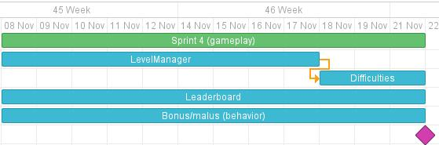
Sprint 4: gameplay

Slide 18
Shader: LevelManager
spawns new objects
ghosts
power ups
...
depending on the level/difficulty

Slide 19
Shader: Leaderboard
Local version: store a leaderboard in a file locally on the phone
Global version: server

Slide 20
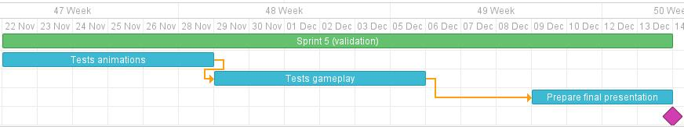
Sprint 5: validation

