Slide 1
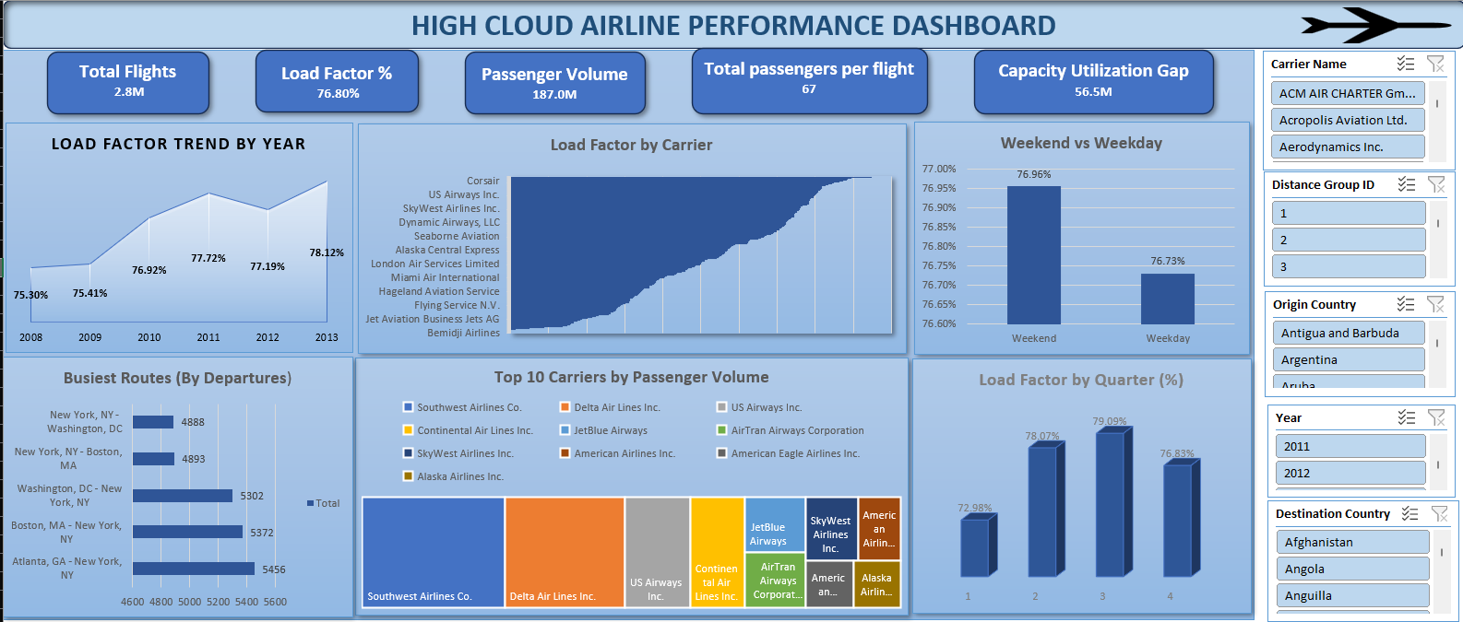
Excel Dashboard Project – High Cloud Airlines Performance Analysis

Slide 2
Key Business Insights
📈 Weekend load factor (76.9%) is higher than weekday (76.7%), indicating stronger leisure demand
🛫Peak load factor observed in 2013 (78.12%) Top routes heavily concentrated around major US hub
📊Capacity utilization gap of 56.5M seats indicates optimization opportunity
⚙ Certain carriers consistently maintain 85%+ seat utilization

Slide 3
Tools & Techniques Used
Power Query (Data Cleaning & Transformation)
Data Model & Relationships
DAX Measures (Load Factor %, KPIs)
Pivot Tables & Pivot Charts
Interactive Slicers
Dashboard Design & Data Storytelling

