Slide 1
Python Pandas Dataframe
https://www.geeksforgeeks.org/python-pandas-dataframe/
https://www.datacamp.com/tutorial/pandas-tutorial-dataframe-python

Slide 2
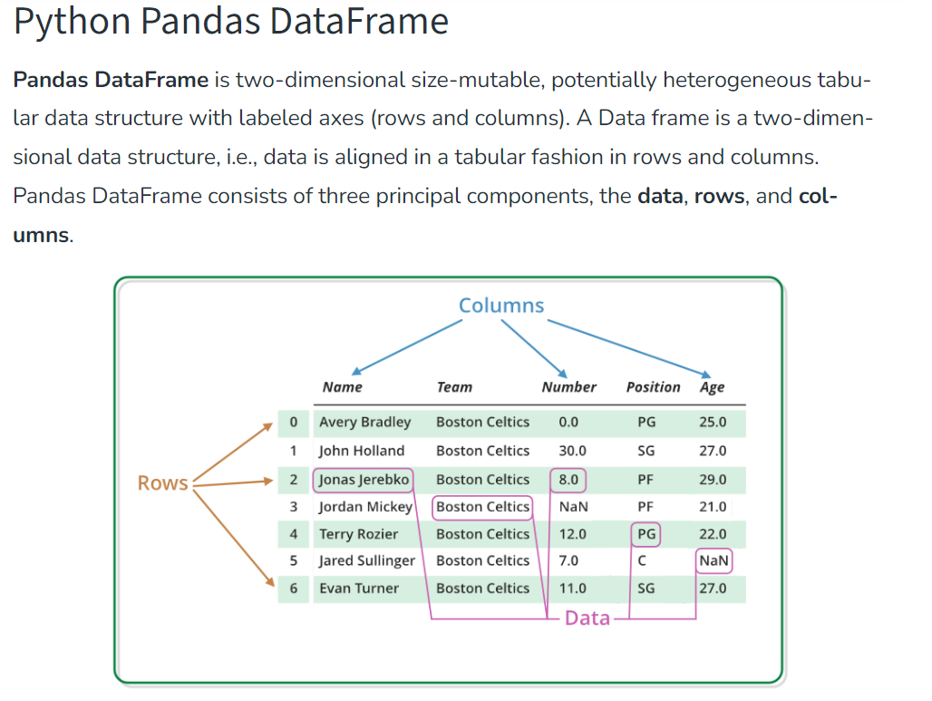

Slide 3
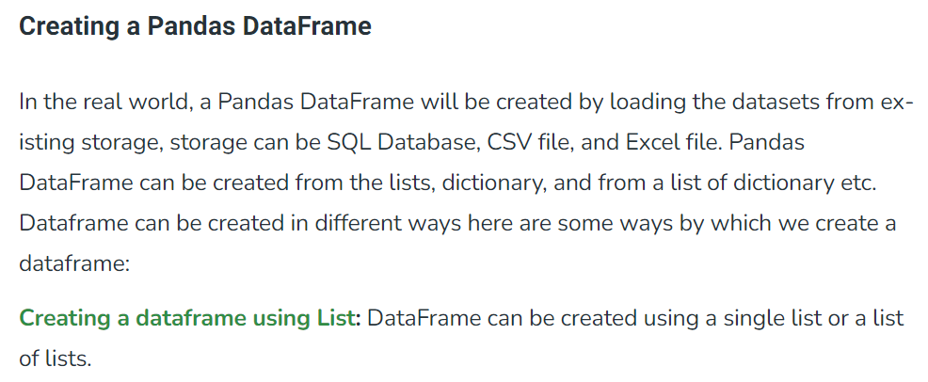
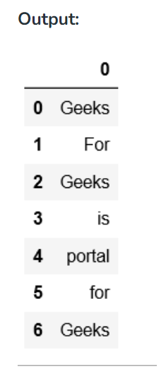
# import pandas as pd
import pandas as pd
# list of strings
lst = ['Geeks', 'For', 'Geeks', 'is',
'portal', 'for', 'Geeks']
# Calling DataFrame constructor on list
df = pd.DataFrame(lst)
print(df)

Slide 4
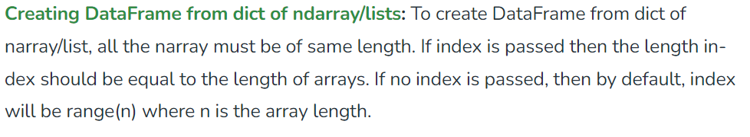
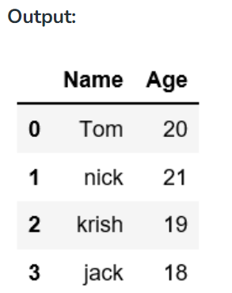
# Python code demonstrate creating # DataFrame from dict narray / lists # By default addresses. import pandas as pd # intialise data of lists. data = {'Name':['Tom', 'nick', 'krish', 'jack'], 'Age':[20, 21, 19, 18]} # Create DataFrame df = pd.DataFrame(data) # Print the output. print(df)

Slide 5
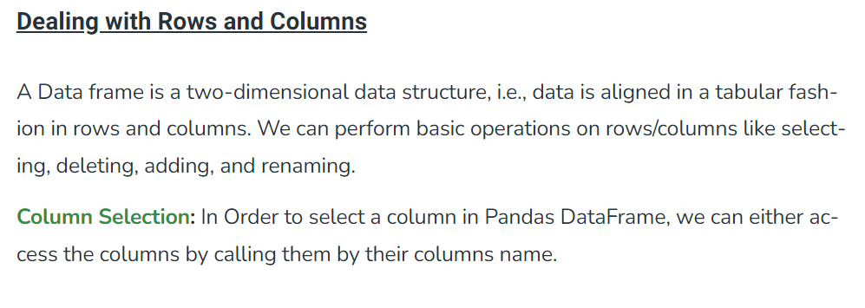
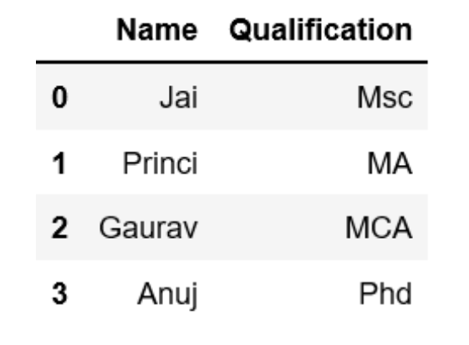
# Import pandas package import pandas as pd # Define a dictionary containing employee data data = {'Name':['Jai', 'Princi', 'Gaurav', 'Anuj'], 'Age':[27, 24, 22, 32], 'Address':['Delhi', 'Kanpur', 'Allahabad', 'Kannauj'], 'Qualification':['Msc', 'MA', 'MCA', 'Phd']} # Convert the dictionary into DataFrame df = pd.DataFrame(data) # select two columns print(df[['Name', 'Qualification']])

Slide 6
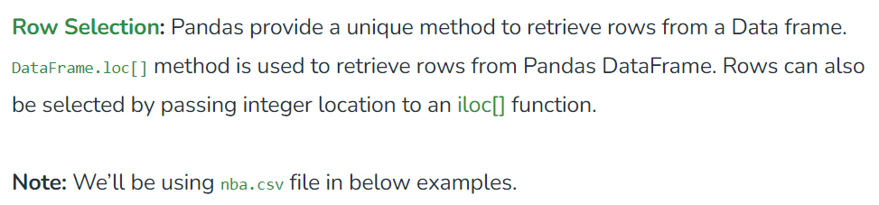
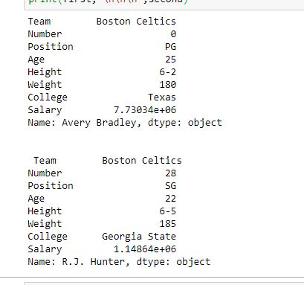
# importing pandas package import pandas as pd # making data frame from csv file data = pd.read_csv("nba.csv", index_col ="Name") # retrieving row by loc method first = data.loc["Avery Bradley"] second = data.loc["R.J. Hunter"] print(first, "\n\n\n", second)

Slide 7
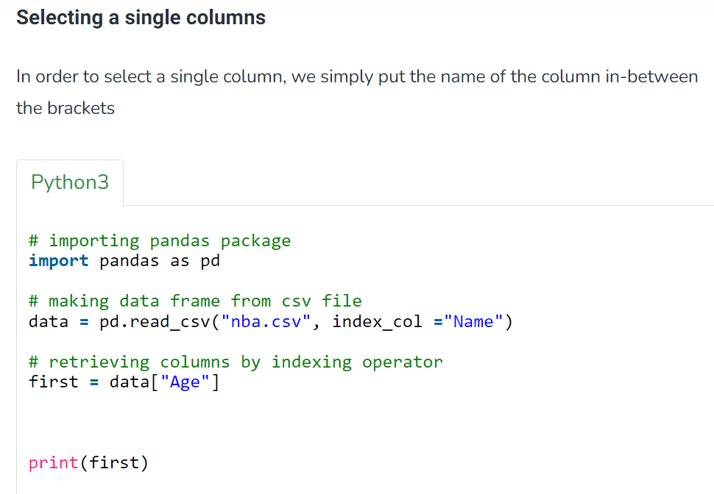
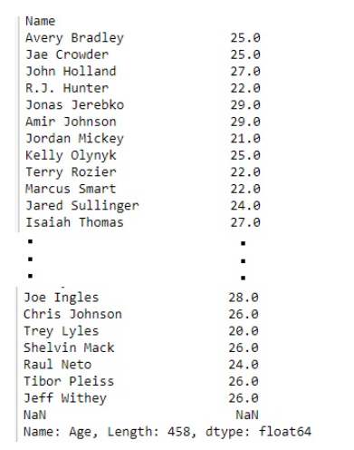

Slide 8
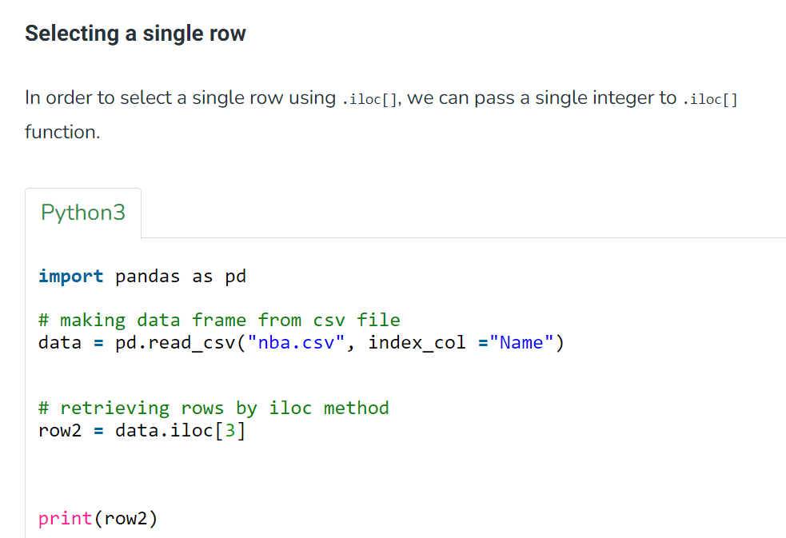
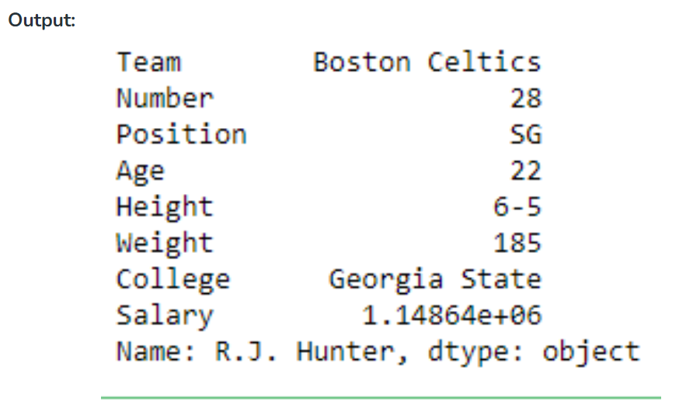

Slide 9
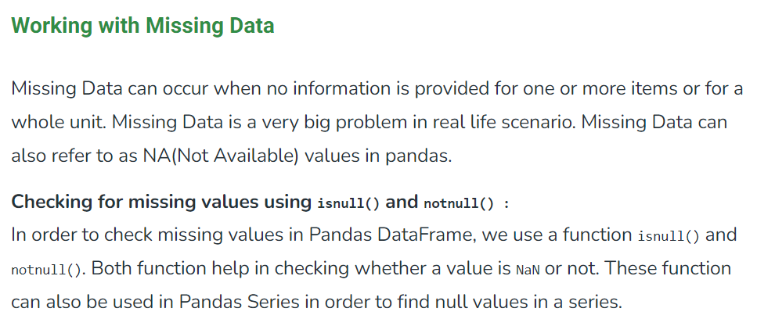
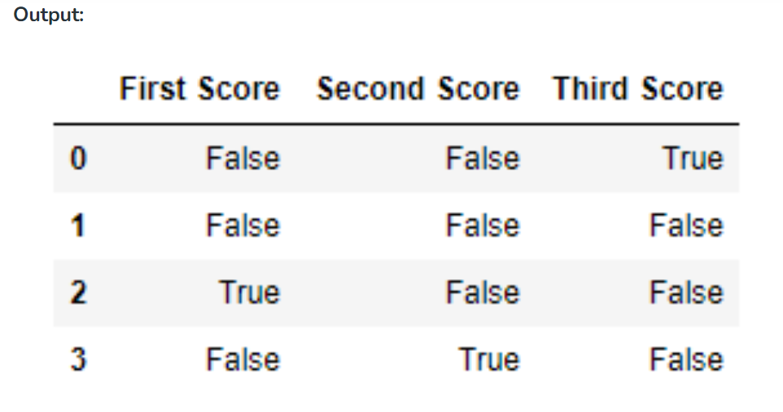
# importing pandas as pd import pandas as pd # importing numpy as np import numpy as np # dictionary of lists dict = {'First Score':[100, 90, np.nan, 95], 'Second Score': [30, 45, 56, np.nan], 'Third Score':[np.nan, 40, 80, 98]} # creating a dataframe from list df = pd.DataFrame(dict) # using isnull() function df.isnull()

Slide 10
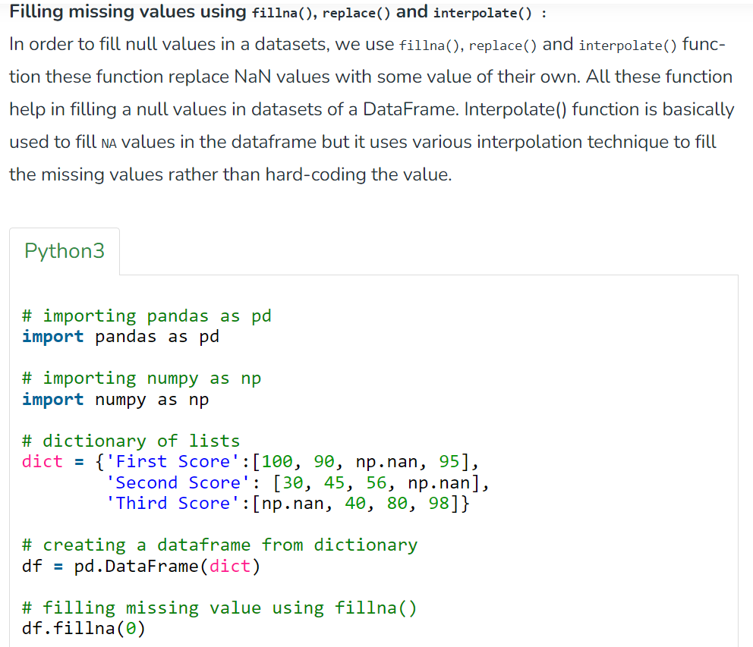
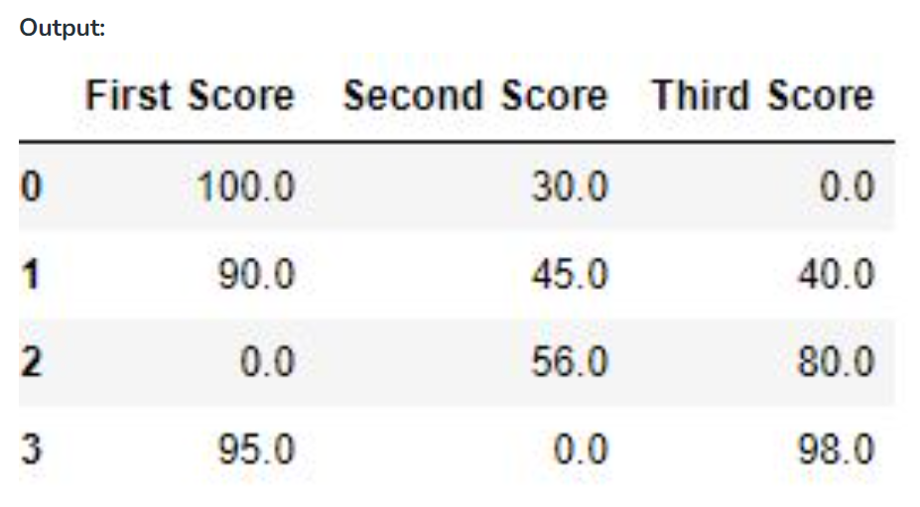

Slide 11
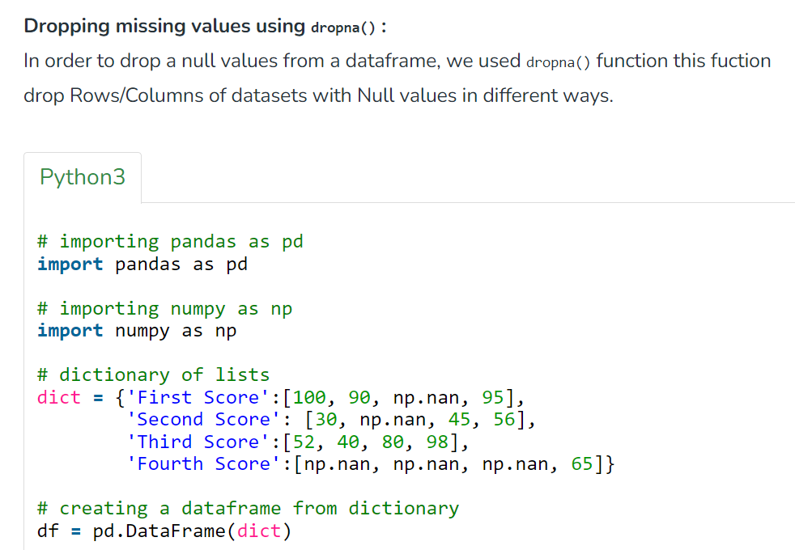
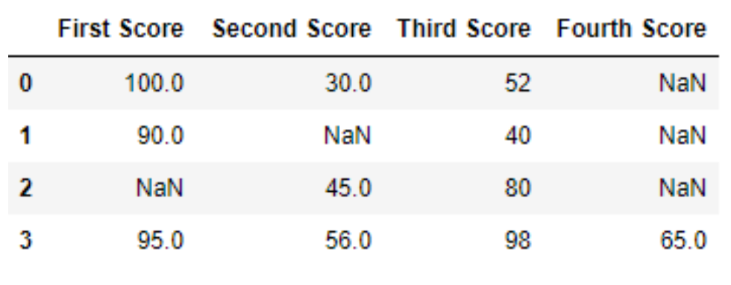

Slide 12
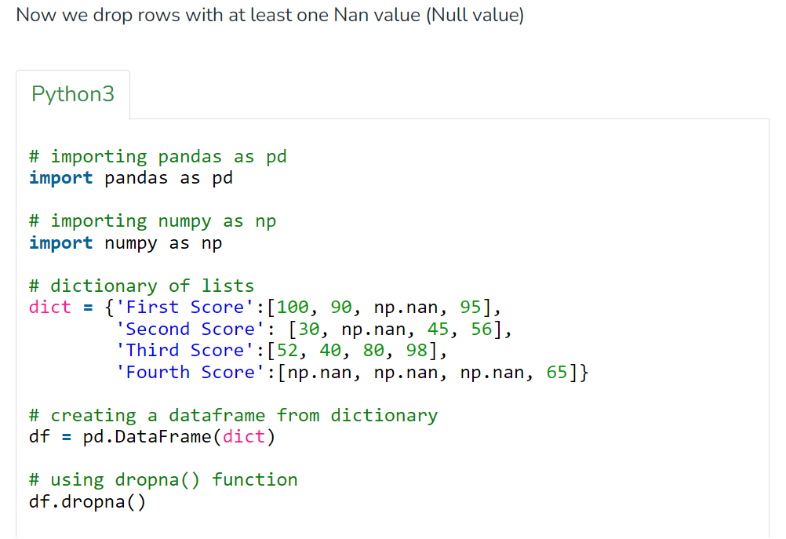
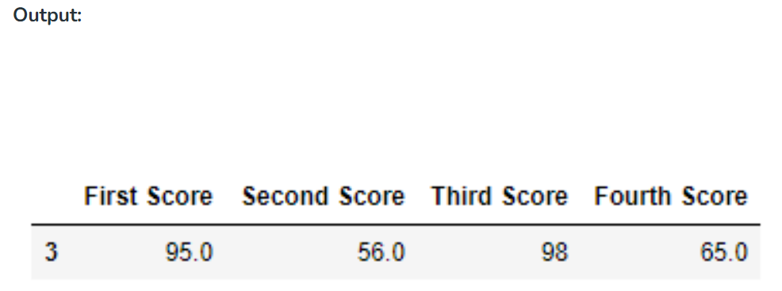

Slide 13
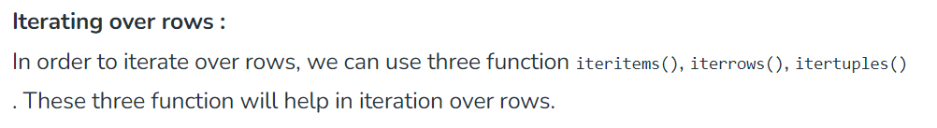
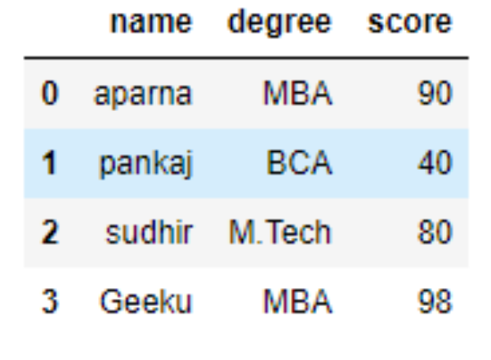
# importing pandas as pd
import pandas as pd
# dictionary of lists
dict = {'name':["aparna", "pankaj", "sudhir", "Geeku"],
'degree': ["MBA", "BCA", "M.Tech", "MBA"],
'score':[90, 40, 80, 98]}
# creating a dataframe from a dictionary
df = pd.DataFrame(dict)
print(df)

Slide 14
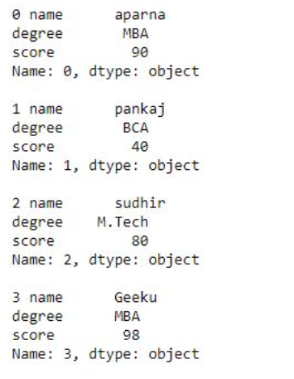
Now we apply iterrows() function in order to get a each element of rows.
# importing pandas as pd
import pandas as pd
# dictionary of lists
dict = {'name':["aparna", "pankaj", "sudhir", "Geeku"],
'degree': ["MBA", "BCA", "M.Tech", "MBA"],
'score':[90, 40, 80, 98]}
# creating a dataframe from a dictionary
df = pd.DataFrame(dict)
# iterating over rows using iterrows() function
for i, j in df.iterrows():
print(i, j)
print()

Slide 15
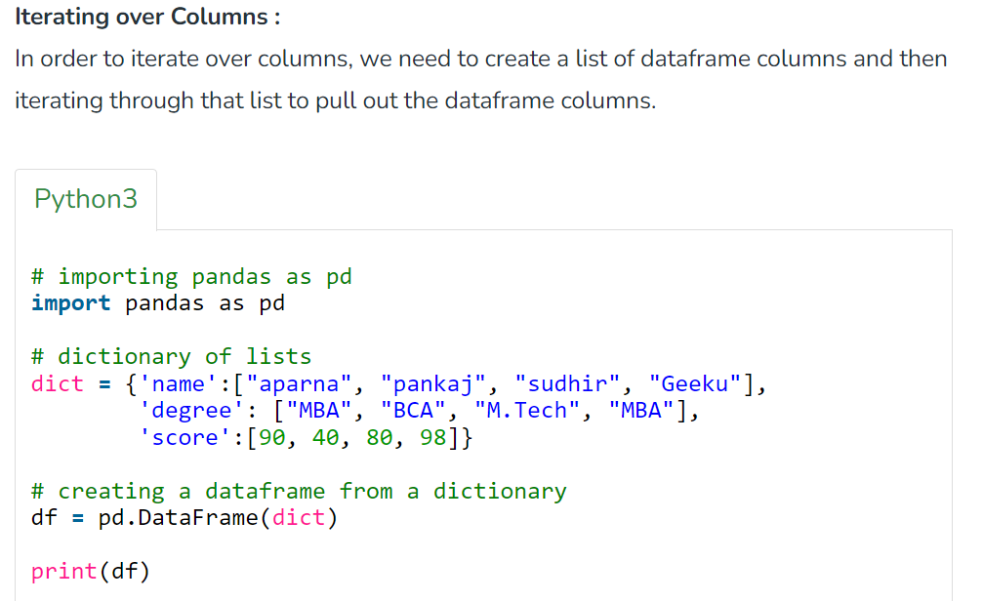
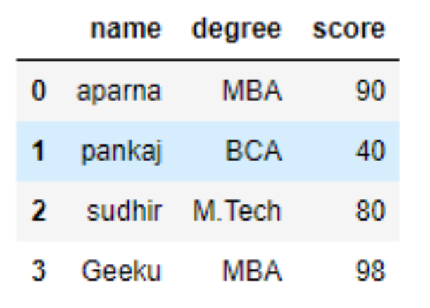

Slide 16

Now we iterate through columns in order to iterate through columns we first create a list of dataframe columns and then iterate through list.
# creating a list of dataframe columns
columns = list(df)
for i in columns:
# printing the third element of the column
print (df[i][2])
Output:

Slide 17
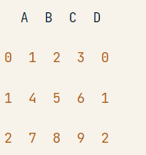
Adding a Column to your DataFrame
df = pd.DataFrame(data=np.array([[1, 2, 3], [4, 5, 6], [7, 8, 9]]), columns=['A', 'B', 'C'])
​
# Use `.index`
df['D'] = df.index
​
# Print `df`
print(df)
This code creates a pandas DataFrame called df with three columns labeled 'A', 'B', and 'C', and three rows of data.
• The data is input using a NumPy array.
• The next line of code adds a new column to the DataFrame called 'D', which contains the index values of the DataFrame.
• The index values are automatically generated by pandas and correspond to the row numbers of the DataFrame.
• Finally, the print function is used to display the entire DataFrame, including the new 'D' column.

Slide 18
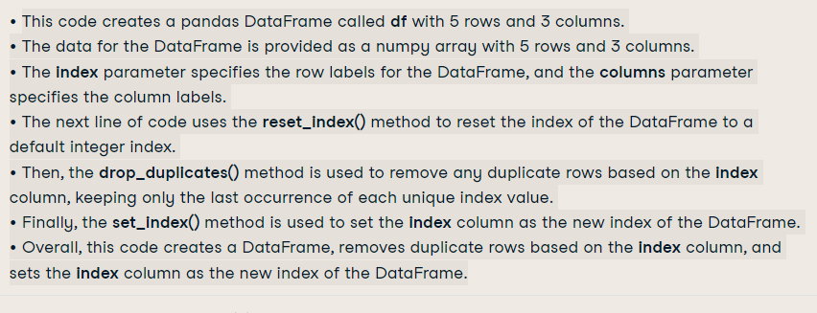
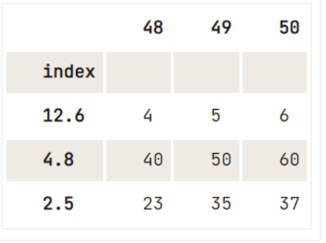
How to Delete Indices, Rows or Columns from a Pandas Data Frame
df = pd.DataFrame(data=np.array([[1, 2, 3], [4, 5, 6], [7, 8, 9], [40, 50, 60], [23, 35, 37]]),
index= [2.5, 12.6, 4.8, 4.8, 2.5],
columns=[48, 49, 50])
df.reset_index().drop_duplicates(subset='index', keep='last').set_index('index')

Slide 19
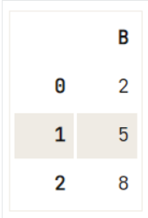
Deleting a Column from your DataFrame To get rid of (a selection of) columns from your DataFrame, you can use the drop() method:
df = pd.DataFrame(data=np.array([[1, 2, 3], [4, 5, 6], [7, 8, 9]]), columns=['A', 'B', 'C'])
# Check out the DataFrame `df`
print(df)
# Drop the column with label 'A'
df.drop('A', axis=1, inplace=True)
# Drop the column at position 1
df.drop(df.columns[[1]], axis=1)
A B C
0 1 2 3
1 4 5 6
2 7 8 9

Slide 20
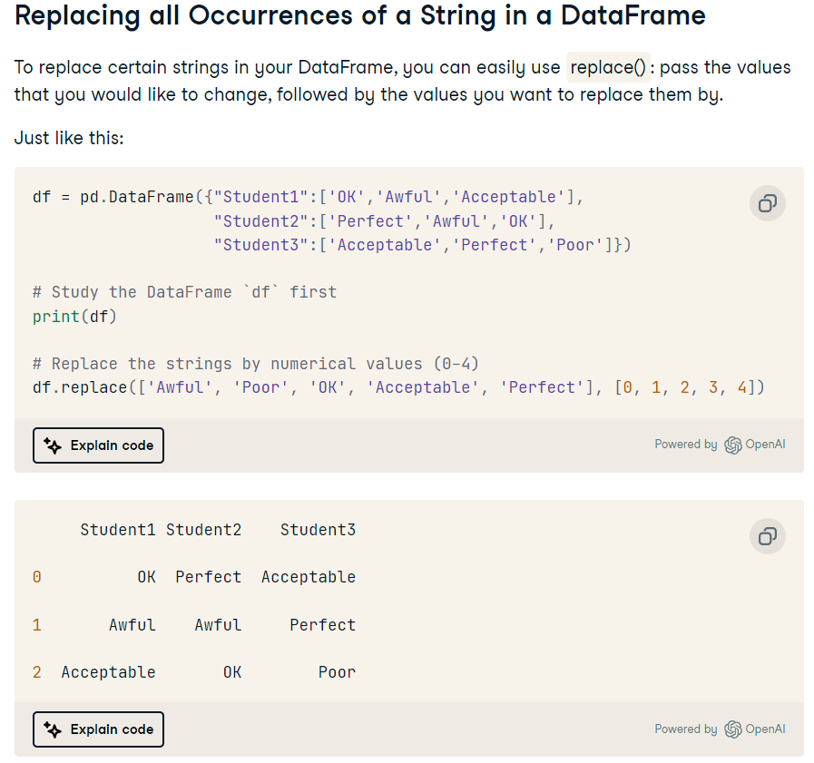
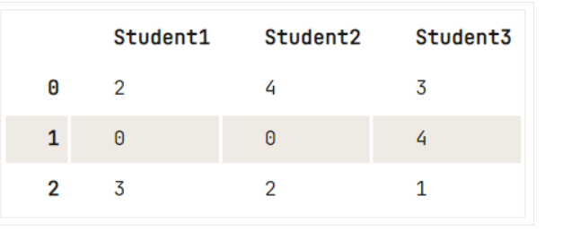

Slide 21
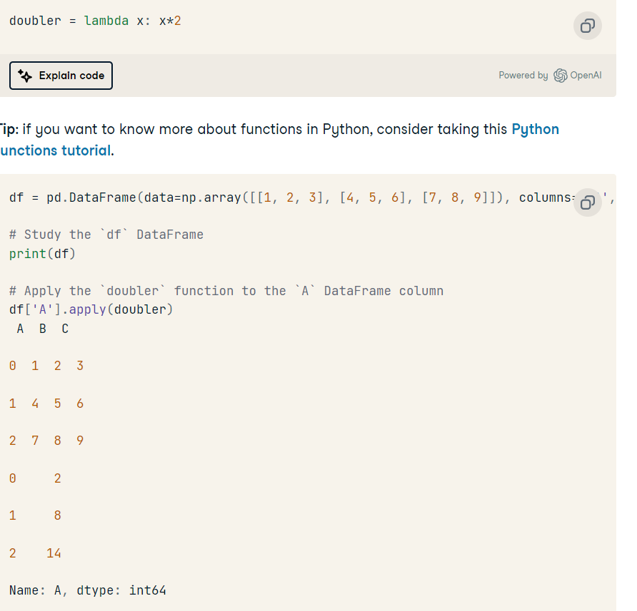
Applying a Function to your Pandas DataFrame’s Columns or Rows
You might want to adjust the data in your DataFrame by applying a function to it. Let’s begin answering this question by making your own lambda function:

Slide 22
Where Clause
data = {
'Name': ['Alice', 'Bob', 'Charlie', 'David', 'Eve'],
'Age': [25, 30, 35, 40, 45],
'Gender': ['Female', 'Male', 'Male', 'Male', 'Female'],
'City': ['New York', 'Los Angeles', 'Chicago', 'Houston’, 'Miami']
}
df = pd.DataFrame(data)
print("Original DataFrame:")
print(df)
print()
# Selecting rows based on column values
# Selecting rows where Age is greater than 30
age_greater_than_30 = df[df['Age'] > 30]
print("Rows where Age is greater than 30:")
print(age_greater_than_30)
print()
# Selecting rows where Gender is Male
male_rows = df[df['Gender'] == 'Male']
print("Rows where Gender is Male:")
print(male_rows)
print()
# Selecting rows where City is Chicago
chicago_rows = df[df['City'] == 'Chicago']
print("Rows where City is Chicago:")
print(chicago_rows)

Slide 23
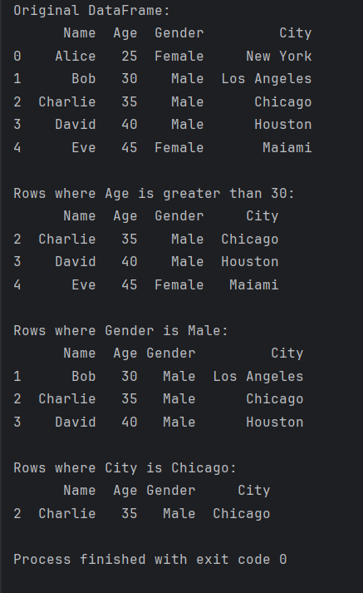

Slide 24
Aggregation Functions
import pandas as pd
# Creating a DataFrame
data = {
'Name': ['Alice', 'Bob', 'Charlie', 'David', 'Eve'],
'Age': [25, 30, 35, 40, 45],
'Salary': [50000, 60000, 70000, 80000, 90000],
'Department': ['HR', 'Finance', 'IT', 'IT', 'Finance']
}
df = pd.DataFrame(data)
print("Original DataFrame:")
print(df)
print()
# Aggregation functions
# Mean of Age
mean_age = df['Age'].mean()
print("Mean Age:", mean_age)
print()
# Sum of Salary
total_salary = df['Salary'].sum()
print("Total Salary:", total_salary)
print()
# Maximum salary
max_salary = df['Salary'].max()
print("Maximum Salary:", max_salary)
print()
# Count of rows in each department
department_count = df['Department'].value_counts()
print("Count of rows in each department:")
print(department_count)

Slide 25
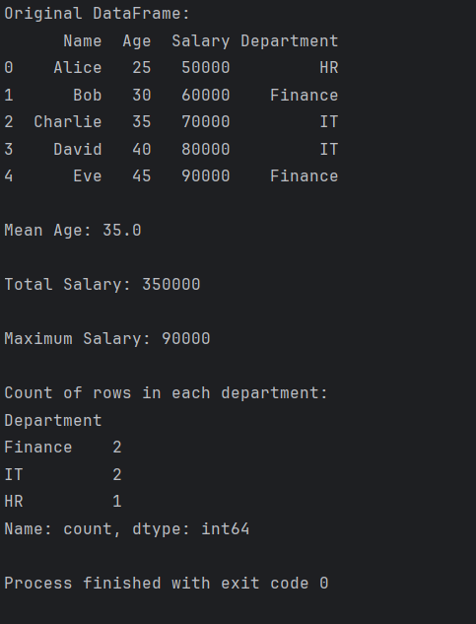

Slide 26
Group By Clause
import pandas as pd
# Creating a DataFrame
data = {
'Department': ['HR', 'Finance', 'IT', 'IT', 'Finance'],
'Employee': ['Alice', 'Bob', 'Charlie', 'David', 'Eve'],
'Salary': [50000, 60000, 70000, 80000, 90000],
'Age': [25, 30, 35, 40, 45]
}
df = pd.DataFrame(data)
print("Original DataFrame:")
print(df)
print()
# Grouping by Department
grouped = df.groupby('Department')
# Applying aggregate functions to each group
# Mean salary in each department
mean_salary_by_department = grouped['Salary'].mean()
print("Mean salary in each department:")
print(mean_salary_by_department)
print()
# Total salary in each department
total_salary_by_department = grouped['Salary'].sum()
print("Total salary in each department:")
print(total_salary_by_department)
print()
# Maximum age in each department
max_age_by_department = grouped['Age'].max()
print("Maximum age in each department:")
print(max_age_by_department)

Slide 27
Original DataFrame:
Department Employee Salary Age
0 HR Alice 50000 25
1 Finance Bob 60000 30
2 IT Charlie 70000 35
3 IT David 80000 40
4 Finance Eve 90000 45
Mean salary in each department:
Department
Finance 75000.0
HR 50000.0
IT 75000.0
Name: Salary, dtype: float64
Total salary in each department:
Department
Finance 150000
HR 50000
IT 150000
Name: Salary, dtype: int64
Maximum age in each department:
Department
Finance 45
HR 25
IT 40
Name: Age, dtype: int64
Process finished with exit code 0

Slide 28
Group by two column
import pandas as pd
# Creating a DataFrame
data = {
'Department': ['HR', 'Finance', 'IT', 'IT', 'Finance'],
'Location': ['New York', 'Los Angeles', 'Chicago', 'Houston', 'Miami'],
'Employee': ['Alice', 'Bob', 'Charlie', 'David', 'Eve'],
'Salary': [50000, 60000, 70000, 80000, 90000],
'Age': [25, 30, 35, 40, 45]
}
df = pd.DataFrame(data)
print("Original DataFrame:")
print(df)
print()
# Grouping by Department and Location
grouped = df.groupby(['Department', 'Location'])
# Applying aggregate functions to each group
# Mean salary in each department and location
mean_salary_by_department_location = grouped['Salary'].mean()
print("Mean salary in each department and location:")
print(mean_salary_by_department_location)
print()
# Total salary in each department and location
total_salary_by_department_location = grouped['Salary'].sum()
print("Total salary in each department and location:")
print(total_salary_by_department_location)
print()
# Maximum age in each department and location
max_age_by_department_location = grouped['Age'].max()
print("Maximum age in each department and location:")
print(max_age_by_department_location)

Slide 29
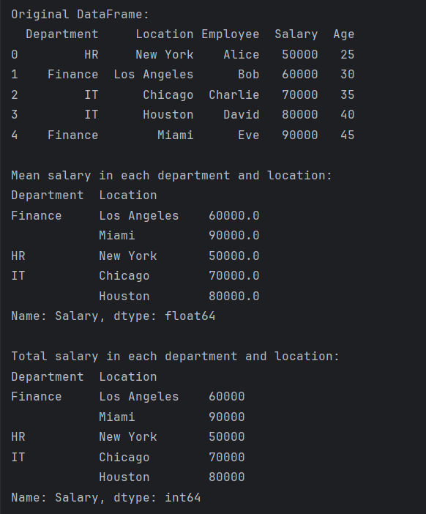
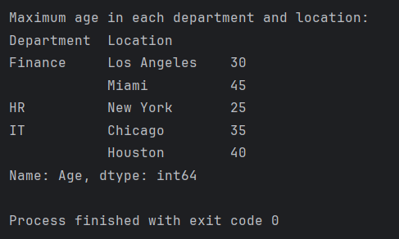

Slide 30
Dataframe Sorting by column Values:
https://www.tutorialspoint.com/python_pandas/python_pandas_sorting.htm

