Slide 1
Vnpy_fxdayu GitHub: https://github.com/ChannelCMT/vnpyEngineFunction
-Channel

Slide 2
Content
EngineFunction(vnpy_fxdayu)
Data
Parameter & Variable
ArrayManager
symboList
posDict
onTick
onBar
BarGernarator
Optimization
Report
Make a completed strategy

Slide 3
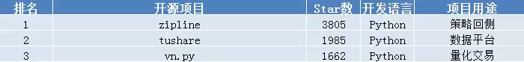
Vnpy_fxdayu
Market | Platform
数字货币 | Binance/Huobip/Okex
外汇 | Oanda
港股美股期权期货 | IB
Strategy | Data
Alpha | Bar
CTA | Bar
Arbitrage | Tick
HighFrequencyTrading | Tick
改良 | 功能
多品种 | symbolList
仓位管理 | posDict
实盘接口 | gateway

Slide 4
1_Data
Mongodb: loadCsv(Bar/Tick)
入BitFinex半年的分钟数据
tBTCUSD:bitfinex
tBCHUSD:bitfinex
入一段Tick数据
数据处理
3张Tick表格

Slide 5
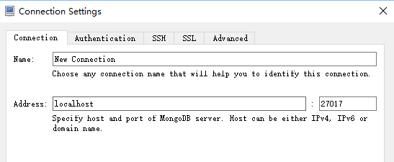
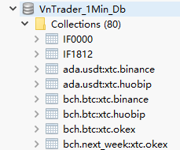
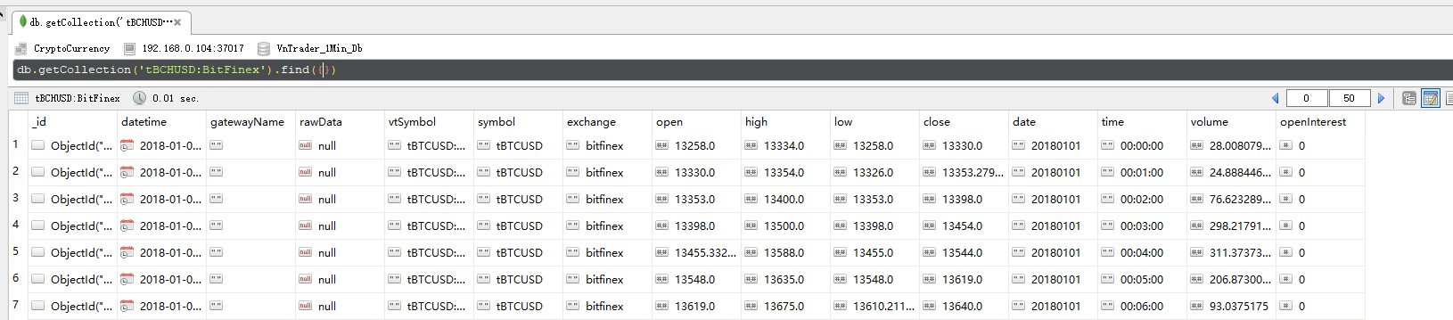
Host
Port
DB
Collection
Symbol

Slide 6
2_Parameter & Varible
SMA = ta.MA(close, 10)
LMA = ta.MA(close, 40)
If SMA[-1]>LMA[-1]:
self.Trend = 1
else:
self.Trend = -1
其中10和40是参数，1和-1是变量。

Slide 7
2_ArrayManager

