Slide 1
Defending Against DDoS
CSE4471: Information Security

Slide 2
Outline
What is a DDOS attack? - review
How to defend a DDoS attack?

Slide 3
What is a DDos Attack?
DoS attacks:
  Attempt to prevent legitimate users of a service from using it
Examples of DoS include:
  Flooding a network
  Disrupting connections between machines
  Disrupting a service
Distributed Denial-of-Service Attacks
  Many machines are involved in the attack against one or more victim(s)

Slide 4
Defending against DDoS attack Strategies
Ingress Filtering
- P. Ferguson and D. Senie, RFC 2267, Jan 1998
- Block packets that has illegitimate source addresses
- Disadvantage : Overhead makes routing slow
Identification of the origins (Traceback problem)
- IP spoofing enables attackers to hide their identity
- Many IP traceback techniques are suggested
Mitigating the effect during the attack
  - Pushback

Slide 5
IP Traceback
- Allows victim to identify the origin (and path) of attackers
- Several approaches
ICMP trace messages, Probabilistic Packet Marking, Hash-based IP Traceback, etc.

Slide 6
PPM
Probabilistic Packet Marking scheme
- Probabilistically inscribe local path info
- Use constant space in the packet header
- Reconstruct the attack path with high probability
Making at router R
For each packet w
Generate a random number x from [0,1)
If x < p then
Write IP address of R into w.head
Write 0 into w.distance
else
if w.distance == 0 then
wirte IP address of R into w.tail
if w.distance != -1 then
Increase w.distance
endif

Slide 7




PPM (Cont.)
legitimate user
attacker
Victim

Slide 8
PPM (Cont.)
legitimate user
attacker
Victim

Slide 9
PPM (Cont.)
legitimate user
attacker
Victim

Slide 10
PPM (Cont.)
legitimate user
attacker
R
R
R
R
R
Victim
V

Slide 11
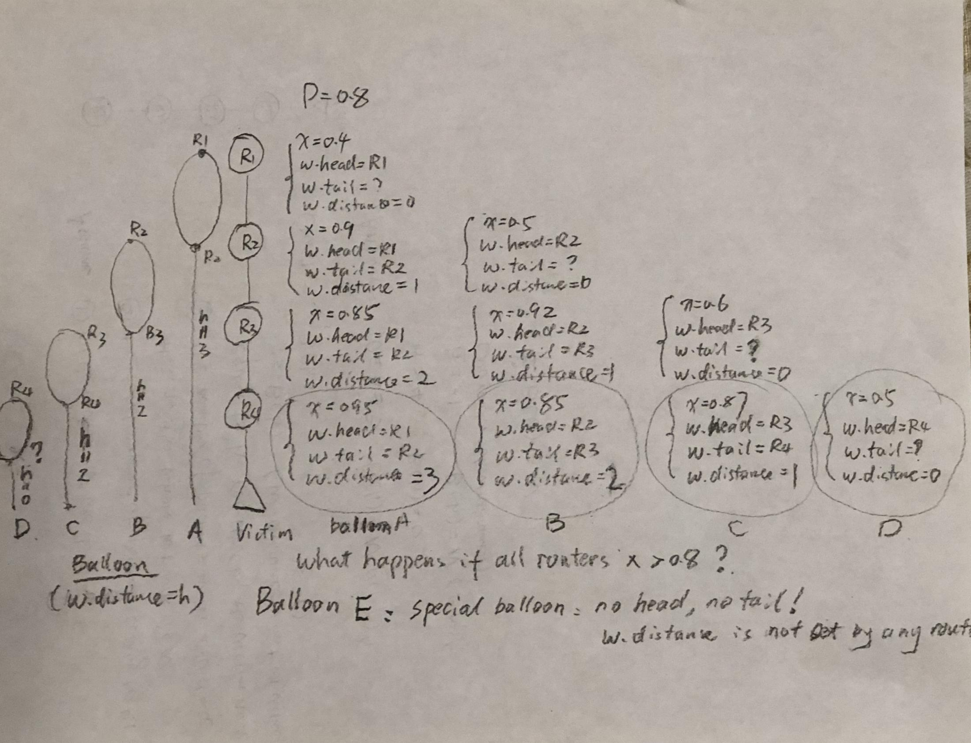
PPM: An Example

Slide 12
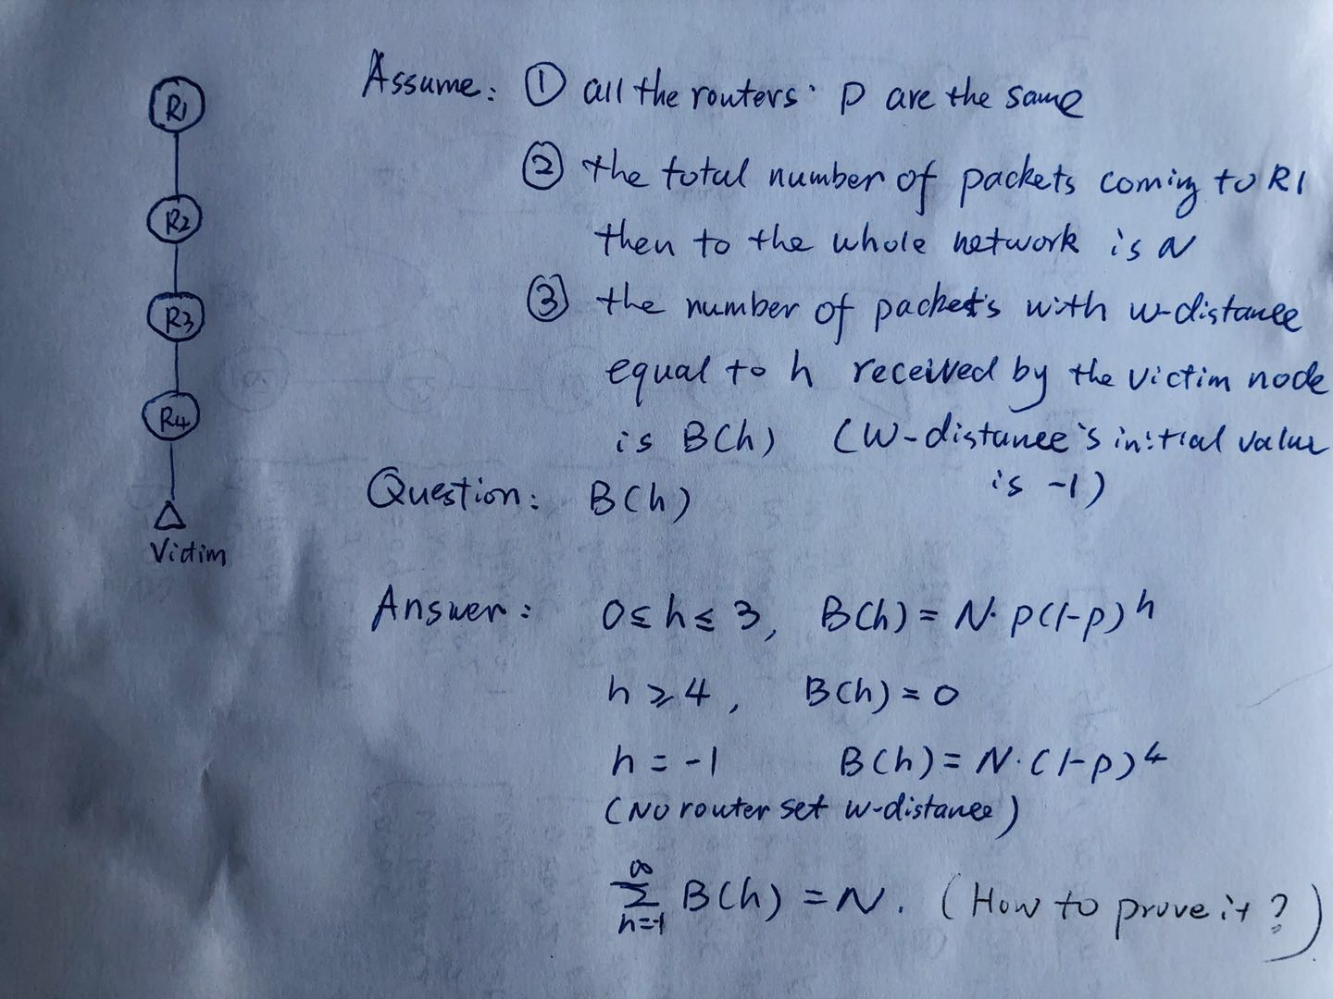
PPM: Computation

Slide 13
PPM Extensions
What if P is not the same among routers?
PPM needs 9 bytes of marking information in a packet (w.head+w.tail+w.distance). Is it possible to have a new PPM with less marking bytes?
PPM assumes all routers are cooperative and run PPM. What would happen if some routers do not run PPM or are even malicious?

Slide 14
What is Pushback?
A mechanism that allows a router to request adjacent upstream routers to limit the rate of traffic

Slide 15
How Does it Work?
A congested router request other adjacent routers to limit the rate of traffic for that particular aggregate.
Router sends pushback message
Received routers propagates pushback

Slide 16
Conclusion
What is a DDoS attack?
Defending a DDoS attack
  Ingress filtering
  Trace-back: PPM
  Push-back

