Slide 1
Mini project
on
Mall customer Segmentation
Presented by:-
Channappa Momdi
Dsft-8

Slide 2
Project goal
The main objective of this statistical analysis is to help the mall owners to identify the different type of customer based on the different parameters like spending score and income etc..
The main object is to help mall owners to offers and discounts and offers to the customers based on their income and spending score

Slide 3
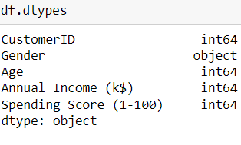
Describe the data and dtypes
The data set contains of 200 rows 5 and attributes of all are predictive data sets
Source of data
  DS3_C6_S3_MallCustomers_Data_Project.csv
The dataset is collected from the shopping malls

Slide 4
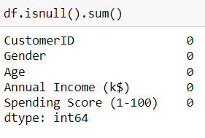
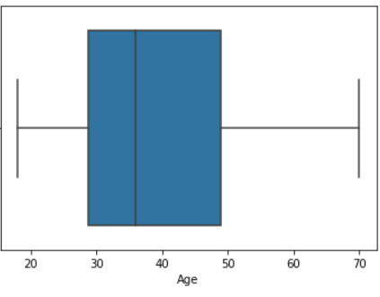
Data preprocessing : Imputation of missing values
  Checking for null values
    No null values found in the data set
  2. Checking for special character
    There is no special characters present in the data set
  3. Treating outlier
    There is no outlier present in the data

Slide 5
Feature Engineering Techniques
Handling the Missing values.
Converting the non-numeric columns to categorical columns.
Using label encoder converting the categorical columns to numerical columns.
Using StandardScaler normalization for scaling the data
Finding the correlation of all the variables
To get a better cluster we used dimension reduction method
Principle component analysis (PCA) for feature selection to get a better clusters

Slide 6
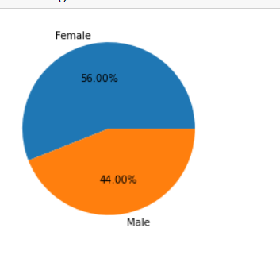
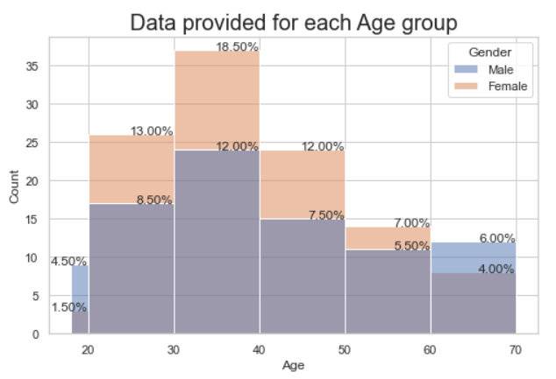
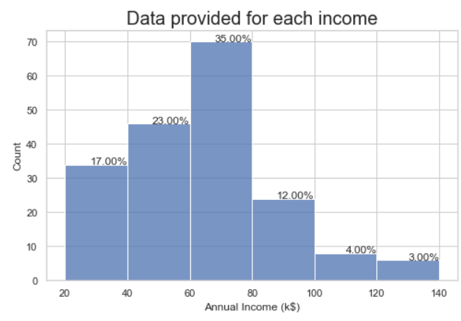
EDA [Exploratory Data Analysis]
The count of female customer is 56.00% more then the male customer of 44.00%
The count of customer are more in the age group 30-40 in the male the 12% customer are in this age group in female there is 18.50% are in this age group
The count of customer is reducing after age 40
More maximum no of customer are with income 60k to 80 k
If salary increases after 80 k the count of customer are decreasing

Slide 7
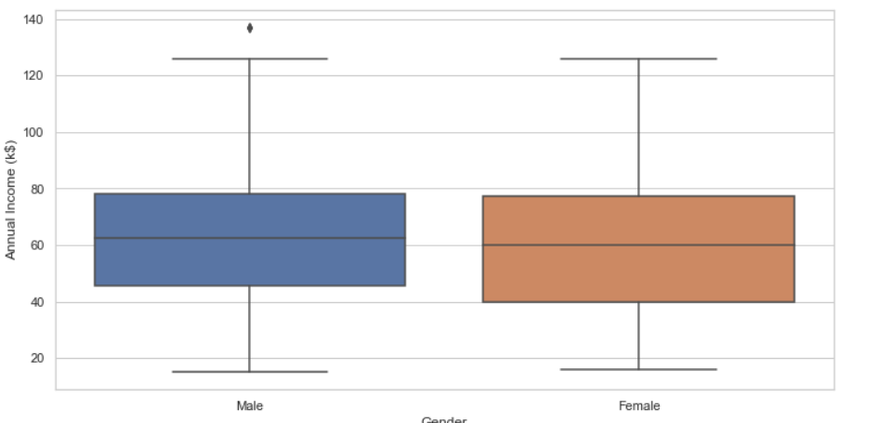
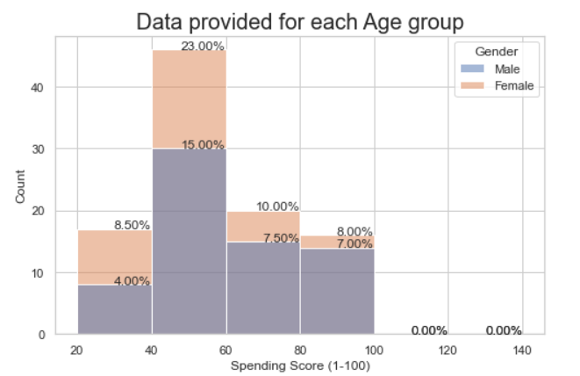
Bivariate Analysis
The spending score in female is more compare to male
The spending score is maximum from 60 to 80 in both male and female
The female customer having more income compare to male customer
The income of female customer ranges from 40k to 80k
The income in male customer ranges from 35k to 80 k

Slide 8
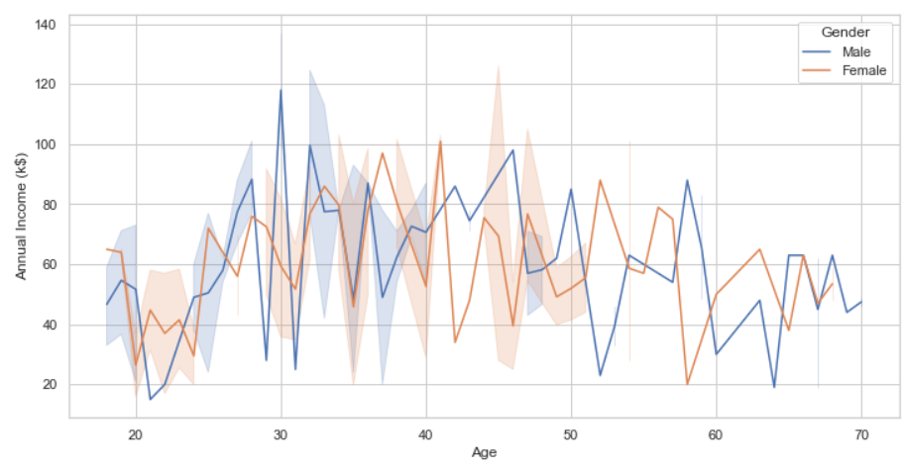
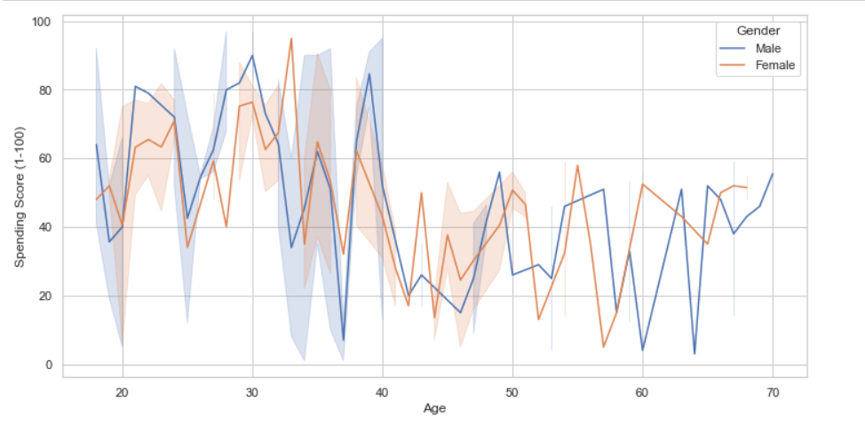
Multivariate Analysis
  When the data involves three or more variables, it is categorized under multivariate.
Interpretation from visuals
    in female customer the salary ranges from 48k to 78 k in female
    the spending score in female is increasing up to 35 age after 35 age its decreasing
    the spending score in females is increasing with age group 40 than after it is increase

Slide 9
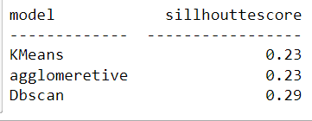
Selecting the best model
Used more than one algorithm ?
  In this project we used more than one algorithm
  In KMeans clustering we observed cluster formation is good compare to other models
  The sillhoutte score is same in both KMeans and Agglomerative but the cluster formation is better in KMeans
Algorithms Used
KMeans
Agglomerative
DBSCAN

Slide 10
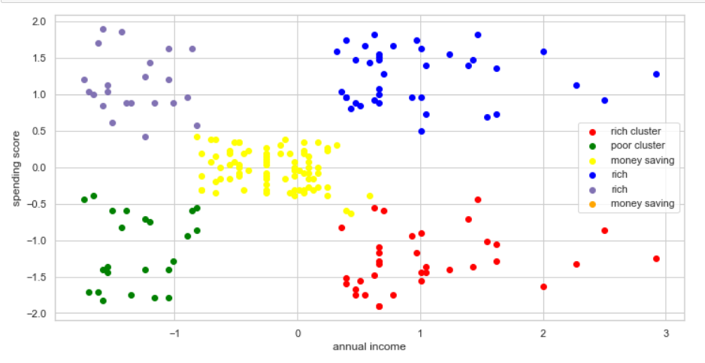
Prediction and Conclusion
Using KMeans algorithm predicted the clusters of the mall customer
Conclusion
The green clusters customer are having low income and low spending score
The red cluster customers are having high income but low spending score
The yellow cluster customers are having medium salary and medium spending score
The green cluster customer are having high income and high spending score
The magenta color cluster customers are with low income and high spending score

Slide 11
Thank
You

