Slide 1
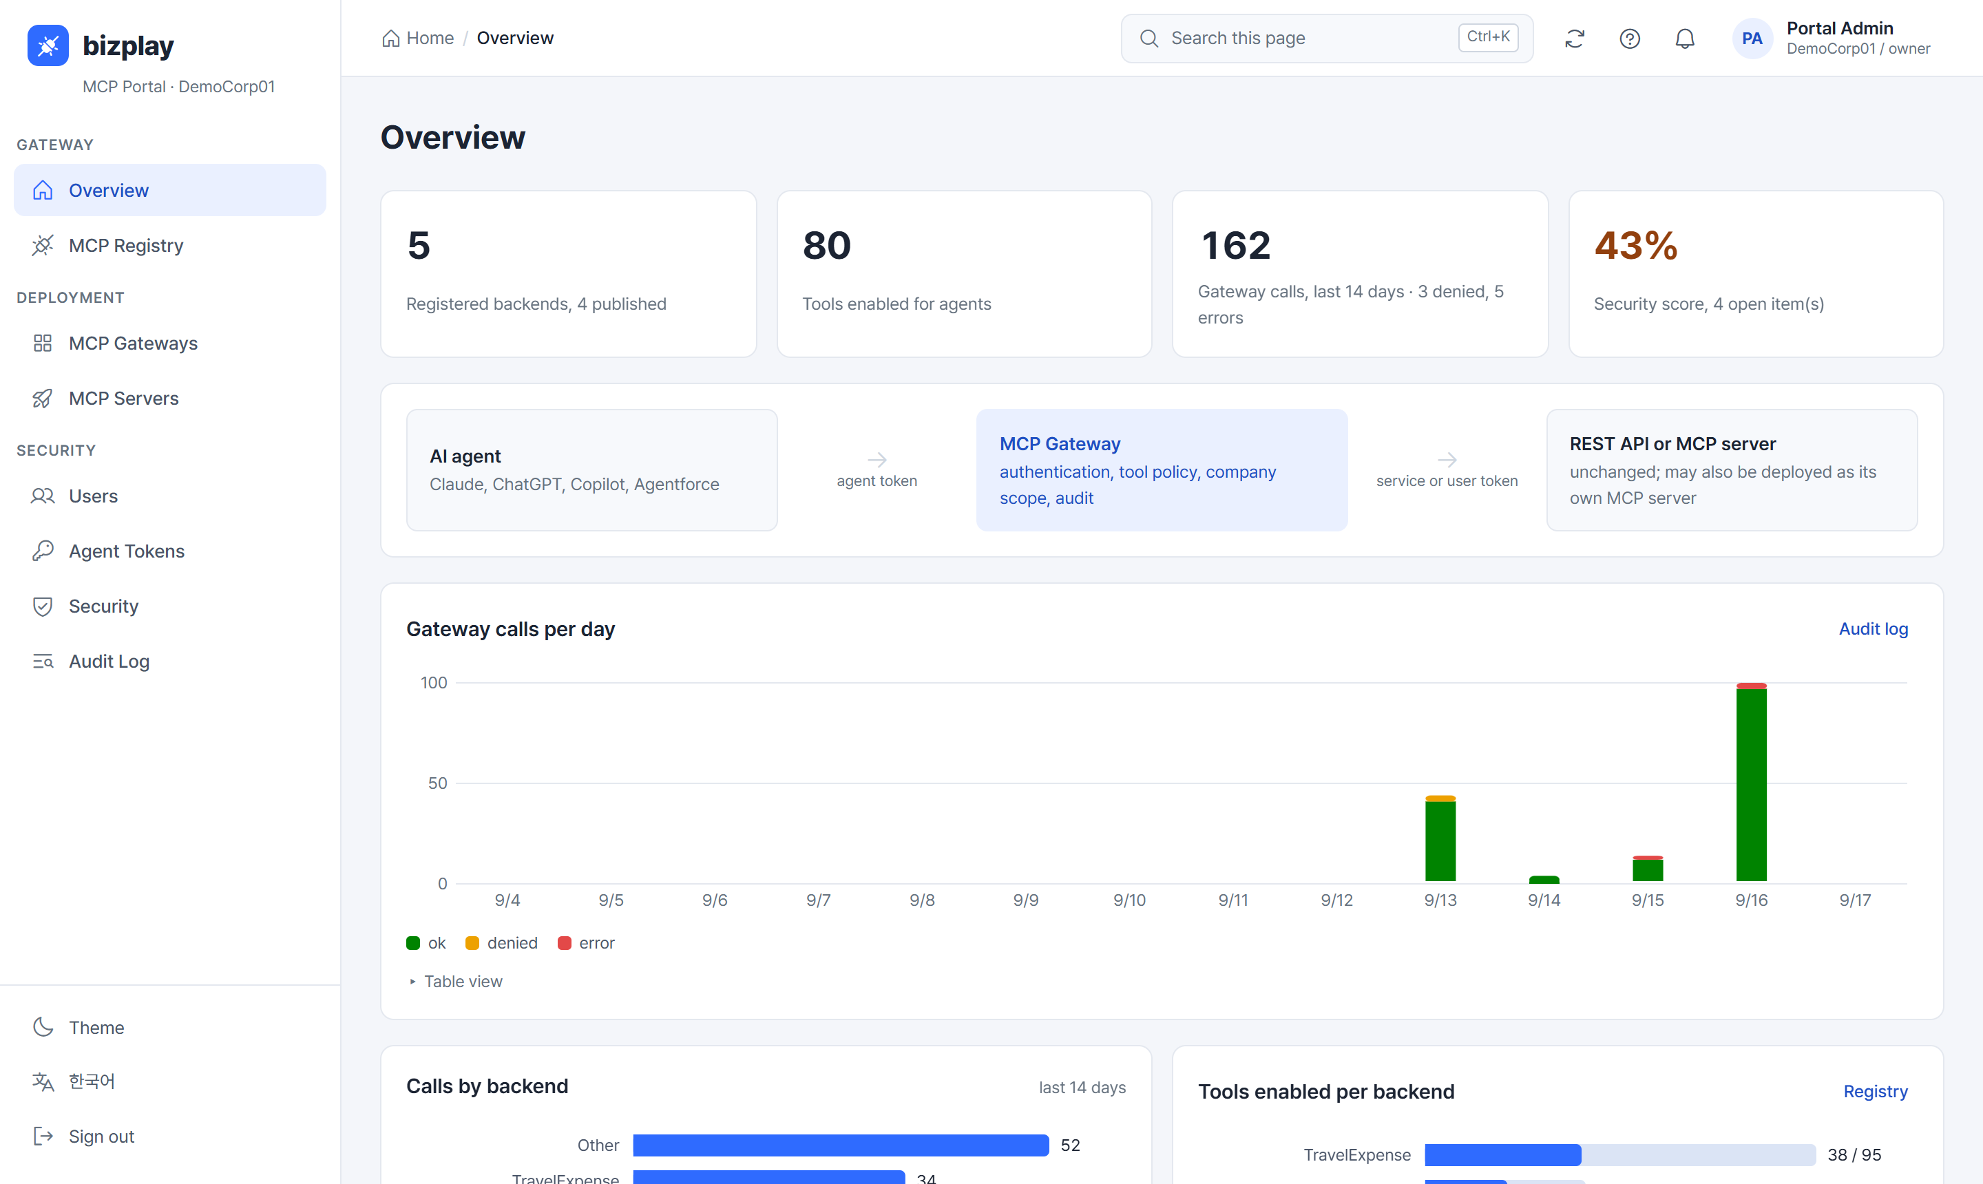
MCP-based AI Gateway
Webcash Group products, inside the AI assistants customers already use
Concept, architecture, control model, and the proposed work
Webcash Group × AI Convergence Lab, Chungbuk National University
September 2026
Notes:
The screen on the right is the running portal, not a mock-up. Everything in this deck is either live or clearly marked as proposed.

Slide 2



WHY NOW
Customers are already working inside AI assistants
The question is not whether Webcash products will be used from Claude or ChatGPT, but whether that happens with the group's controls or around them.
Integration sprawl
No identity, no scope
No control, no record
Every product would need its own AI integration, per AI vendor. Seven products times three assistants is twenty-one projects, each with its own auth and its own drift.
An assistant does not know which customer is asking, which organization they belong to, or what they may see. Today's workaround is pasting tokens into chat settings.
Nothing decides which actions an assistant may take, whether a change needs confirmation, or keeps a record a finance auditor would accept.
A group-level answer: one control layer between every assistant and every product.
MCP-based AI Gateway · Webcash Group × AI Convergence Lab, CBNU
2
Notes:
Frame the problem at group level: integrations built product by product, vendor by vendor, without common identity or audit.

Slide 3
CONCEPT
The idea: one control layer between assistants and products
Every Webcash Group product becomes a set of tools inside the assistant. The group decides who may do what, and records it.
AI TOUCHPOINT
GROUP CONTROL LAYER
GROUP PRODUCT APIS
Where the customer works
MCP Registry + AI Gateway
Domain packages
Claude · ChatGPT
Registry
Product APIs registered once; tools generated from their specs. Descriptions, risk level, activation per customer.
Expense & Collaboration
Bizplay · COOCON · FLOW
Copilot · Agentforce
Identity
The customer signs in once, through the gateway. Every call carries who they are and which organization.
SME Management
Gyeongrinara · COOCON
In-house or local LLM
Corporate Treasury
Policy
Which tools, for whom, at which risk level. Lookups by default; changes only with confirmation; payments inside existing approval lines.
Branch Q · InhouseBank Q · Dashboard
Any MCP-capable client
Research Administration
Credentials & audit
The gateway holds each product's credential for that customer. Every call and refusal is recorded.
rERP Q · RCMS
The customer asks in plain language. Nothing installed, nothing pasted.
Products are not changed. A spec in the registry is the whole integration.
One place to work
tasks that span products finish in one assistant
One place to control
group-wide policy and audit, not per product per vendor
Low marginal cost
adding a product or partner is a registration
MCP-based AI Gateway · Webcash Group × AI Convergence Lab, CBNU
3
Notes:
The whole idea on one slide.

Slide 4
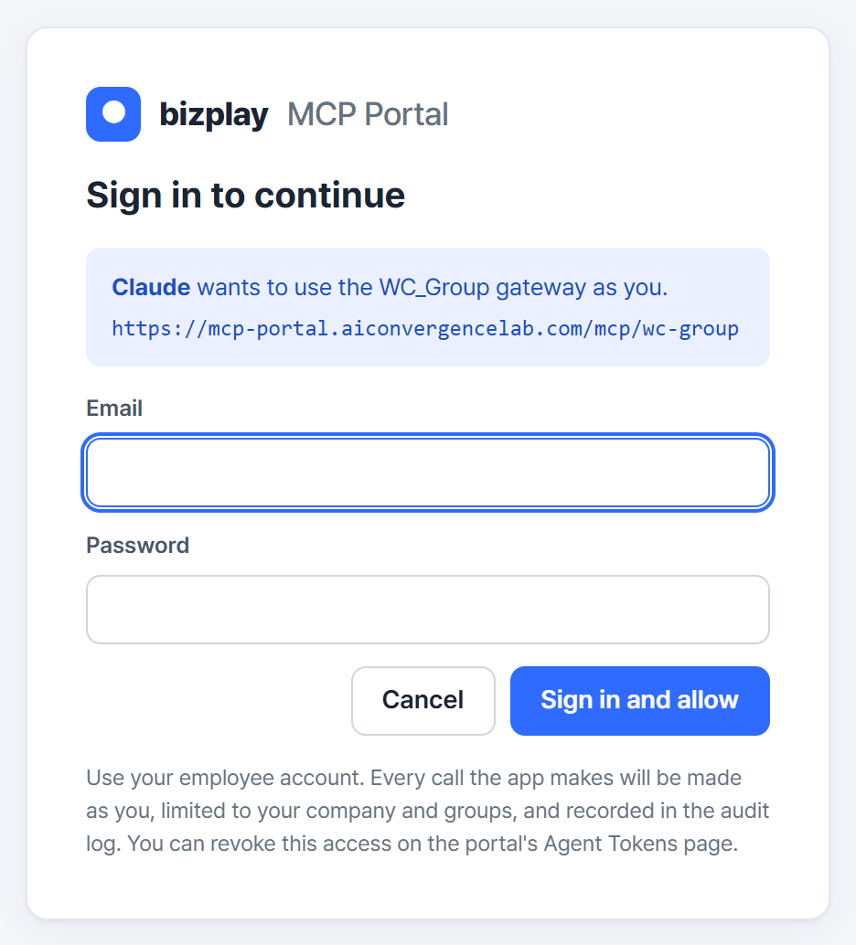




CUSTOMER VIEW
What the customer sees: one sign-in, then nothing new
The only screen the gateway ever shows a customer. After it, every product is just a tool inside their assistant.
The customer adds the gateway to their assistant
In claude.ai or ChatGPT: paste one address. The assistant discovers the gateway's sign-in on its own; no client ids, no tokens.
The group's sign-in page opens
It names the assistant and the gateway asking. The customer signs in with their company account. Admin accounts are refused: an assistant acts as a person.
From then on, the assistant carries a token bound to that person
Short-lived, refreshed automatically, revocable on one page. Every call it makes is limited to the customer's organization and recorded.
Nothing else to install
Products keep their own screens for everything else; the assistant becomes one more place to get work done.
Live sign-in page of the gateway
MCP-based AI Gateway · Webcash Group × AI Convergence Lab, CBNU
4
Notes:
This is the customer's entire onboarding. The screenshot is the real page a Claude connector opens.

Slide 5
CUSTOMER VIEW
The same monthly task, before and after
Nothing about the products themselves changes.
BEFORE
WITH THE GATEWAY
Finding out
Open Bizplay, then COOCON, then FLOW; copy numbers between screens
Ask once. The assistant reads all three and answers with evidence
Signing in
A login per product, a token per integration, credentials in chat settings
One sign-in with the company account; products never see a shared key
Acting
Register the action request by hand in FLOW after checking
The assistant drafts it; the customer confirms; it is registered
Paying
Same approval line as today
Same approval line as today. The assistant prepares and reports, never executes
Accountability
Who looked at what is not recorded
Every call, refusal and sign-in recorded with the reason
MCP-based AI Gateway · Webcash Group × AI Convergence Lab, CBNU
5
Notes:
Ground the idea in one task a finance team does every month. Note that paying does not change, on purpose.

Slide 6
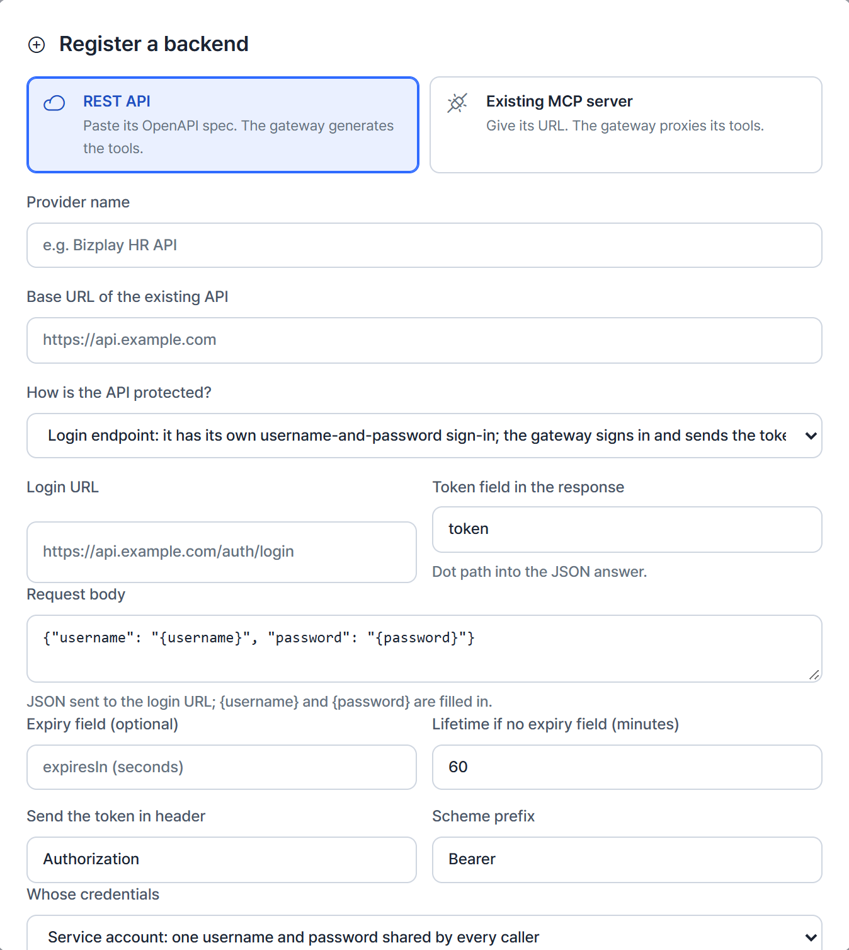
HOW IT WORKS · REGISTER
Registering a product is a form, not a project
The registry turns an API description into tools. No code is written for the product, and it is never modified.
1
Paste the spec, or point at an MCP server
A REST API's OpenAPI document, or the address of a product that already speaks MCP.
2
Say how the product is protected
OAuth per user, a login endpoint with username and password, a service token, or open. The gateway does the rest at call time.
3
Tools appear immediately
One tool per operation. Lookups start on; anything that changes data starts off until an admin enables it.
4
Describe, classify, activate
Edit what the AI reads about each tool, mark its risk, choose which customers and roles see it. Live on the next request.
Registration dialog of the live portal, login-endpoint mode
MCP-based AI Gateway · Webcash Group × AI Convergence Lab, CBNU
6
Notes:
The screenshot is the real registration dialog. In the pilot, COOCON went from spec to a working MCP server in under a minute.

Slide 7
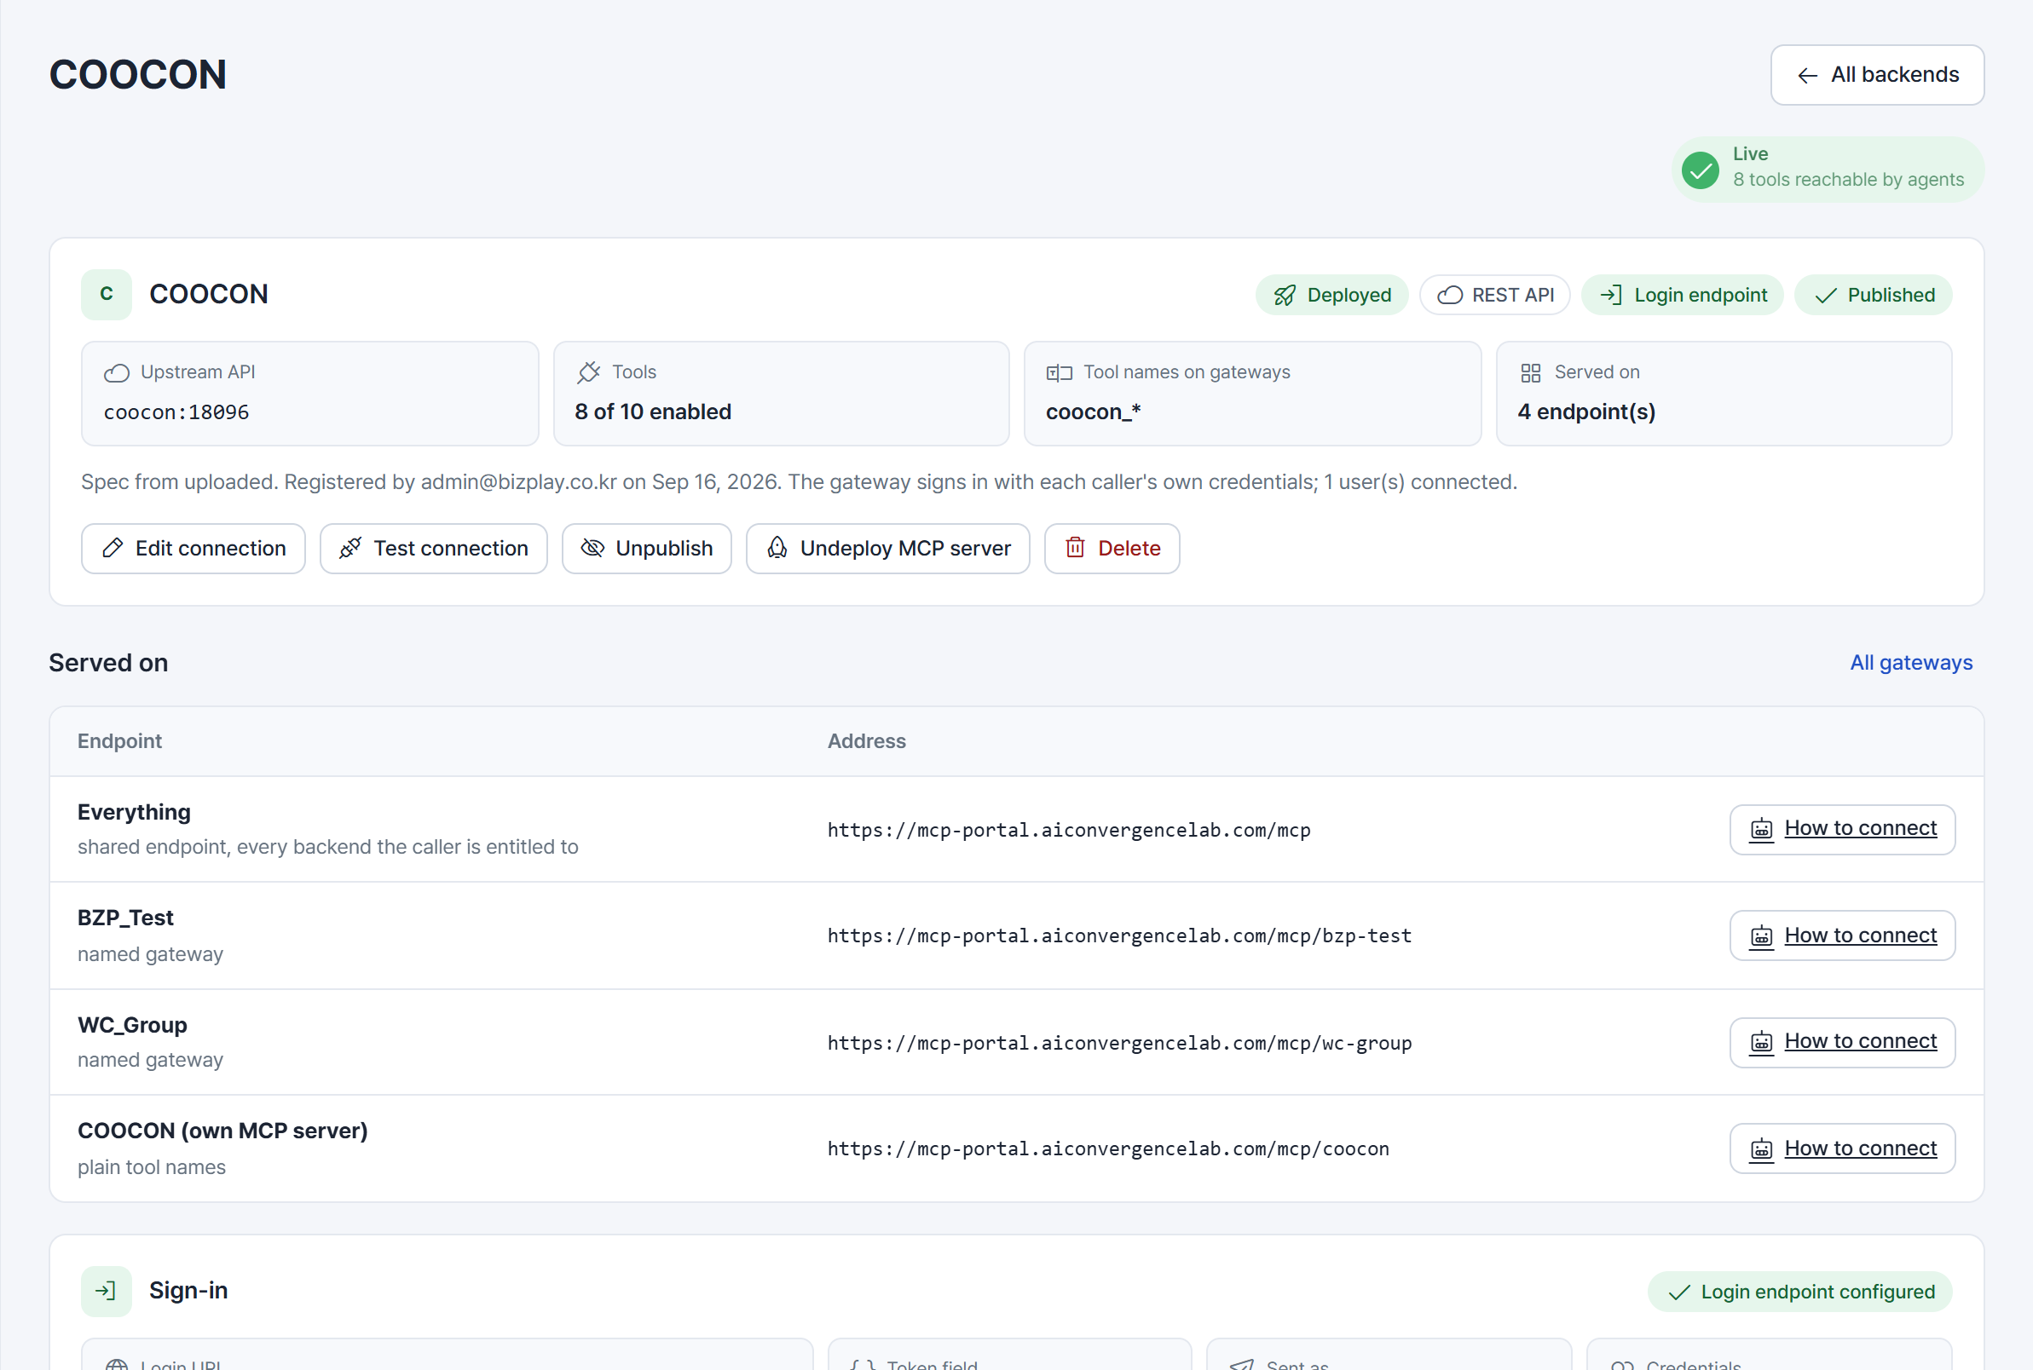
HOW IT WORKS · MANAGE
A registered product, as the group sees it
One page per product: how it is reached, which tools are on, where it is served, who has connected.
1
Tools on, out of tools generated
8 of 10: two write operations stay off until enabled with confirmation.
1
2
2
Served on four addresses at once
The same product, exposed four ways from one process.
3
Each address is a way to expose it
The shared catalogue, two customer packages, and the product's own MCP server. Publishing to one is a routing change, not a release.
3
4
Sign-in the gateway performs
This product has a username-and-password login; the gateway signs in per customer, caches the token and re-signs on expiry.
4
MCP-based AI Gateway · Webcash Group × AI Convergence Lab, CBNU
7
Notes:
The product page of COOCON in the live portal. Point at the four addresses it is served on.

Slide 8




HOW IT WORKS · SERVE
What happens on every single call
Six checks between the assistant and the product, on every request, in this order.
1. Identify
2. Authorize
3. Scope
4. Broker
5. Call and filter
6. Record
The call carries the customer's sign-in. Missing or expired: the assistant is told where to sign in.
Allowed on this gateway, this product, this tool? Refused with the reason if not.
Arguments naming another organization are refused. The organization comes from the token, not the prompt.
The product gets its own credential for this customer. The assistant's token never reaches it.
The product answers. Rows for other organizations are removed before the assistant sees them.
Who, which tool, arguments, outcome, reason. Refusals too.
Measured on the running system: a write refused with “tool is disabled”, a cross-organization lookup refused before it left the gateway, and a chain across four products in one chat. Each is one line in the audit log.
MCP-based AI Gateway · Webcash Group × AI Convergence Lab, CBNU
8
Notes:
Step 4 is highlighted because it is the differentiator: the product receives its own credential, brokered per person.

Slide 9
TECHNICAL VIEW
Architecture
One gateway process serves every address; products are reached with their own protocols and credentials.
CLIENTS
GATEWAY + PORTAL · ONE PROCESS
PRODUCTS
Claude
Endpoints
/mcp shared · /mcp/<group> per customer group or product line · /mcp/<product> a single product as its own MCP server
REST APIs
OpenAPI spec, any auth
ChatGPT
Sign-in
OAuth 2.1 authorization server: discovery, client self-registration, PKCE, refresh. Issues tokens bound to a person and organization
MCP servers
Policy
Entitlement by group or organization at gateway, product and tool level · writes off by default · confirmation · organization scoping in and out
proxied, per-user OAuth
Copilot / Agentforce
Credential broker
Per-user OAuth links with refresh · login-endpoint sign-in with cached JWTs · service tokens · the caller's token never forwarded
Partner SaaS
Claude Desktop, Code
same registry
API to tools
One tool per API operation, generated from the OpenAPI spec · existing MCP servers passed through · descriptions and risk editable by admins
In-house LLM app
Customer systems
Audit & state
Every call, refusal and sign-in step logged · registry, users, tokens and policy in one store
same registry
Runs as one container image behind HTTPS; deploying or exposing a product is a routing change, not a release. Per-product isolation is on the roadmap.
MCP-based AI Gateway · Webcash Group × AI Convergence Lab, CBNU
9
Notes:
The technical slide for engineers.

Slide 10
IDENTITY
Identity: one sign-in, the right key for each product
The assistant never holds a product credential. The gateway does, per person.
Customer side
Product side
A directory holds each person's organization, role and access groups. Tokens copy these, so they are set once.
Assistants cannot carry a static key, so the gateway is itself an OAuth 2.1 server: the assistant discovers it, registers, and opens the group's sign-in page.
The token the assistant receives is bound to that person: short-lived, refreshed automatically, revocable on one page.
Federating that sign-in page to the group's SSO is the production step.
Per-user OAuth
The customer links their own account once; the gateway refreshes it. The product sees the real person.
Login endpoint
Products with a username-and-password API. The gateway signs in, caches the token, re-signs on expiry. Per user or service account.
Service token
One credential the gateway sends and rotates. For products without per-user identity.
Open or network-isolated
The gateway carries all enforcement.
MCP-based AI Gateway · Webcash Group × AI Convergence Lab, CBNU
10
Notes:
Customer side: one OAuth sign-in against the gateway. Product side: four ways the gateway gets in, chosen per product.

Slide 11
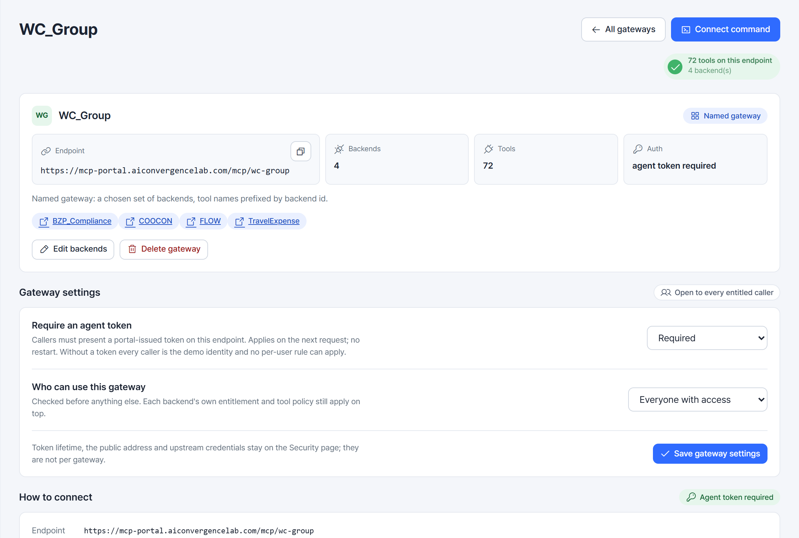
PACKAGING
One registry, packaged per customer group
A named gateway is a chosen set of products on its own address, with its own sign-in rule and entitlement. This one serves four products and 72 tools.
1
One address for the package
Paste it into any assistant. Tool names carry the product prefix so the assistant knows where each one goes.
2
Sign-in required
1
Callers must sign in through the gateway. Without it, no per-person rule can apply.
4
3
Who may use it
Everyone with access, or only listed access groups, or only listed organizations. Checked before anything else.
2
4
Product and tool rules still apply
3
The package narrows; each product's own entitlement and each tool's policy apply on top.
Three ways to expose the same registry: shared catalogue /mcp · package /mcp/<group> · single product /mcp/<product>. All are routing decisions in one process.
MCP-based AI Gateway · Webcash Group × AI Convergence Lab, CBNU
11
Notes:
The WC_Group gateway page in the live portal.

Slide 12
CONTROL MODEL
Control rises with the risk of the action
The same gateway serves lookups freely and keeps money movements inside the approval lines that already exist.
LOOKUP
DRAFT · REGISTER
PAY · SETTLE · EXECUTE
Read and summarize
Prepare a change
Move money, commit
Provided by default within the customer's permission scope. Balances, receipts, tasks, documents.
The assistant prepares; the customer confirms before anything is written. Settlement drafts, task registration, action requests.
Never executed by the assistant alone. The request enters the product's own approval line and limits; the assistant reports the outcome.
Most requests. Value with no new risk.
Confirmation is enforced by the gateway, not by the prompt.
Existing controls stay the controls.
ALWAYS ON, WHATEVER THE TIER
Per-customer activation
Organization scoping
Personal identity
Audit trail
only the tools a customer needs are visible
every call limited to the customer's own data
the product sees the real user, not a shared key
calls, refusals and sign-ins, with reasons
MCP-based AI Gateway · Webcash Group × AI Convergence Lab, CBNU
12
Notes:
Can the AI move money? No. It looks up, it prepares, and execution goes through the same approval line as today.

Slide 13
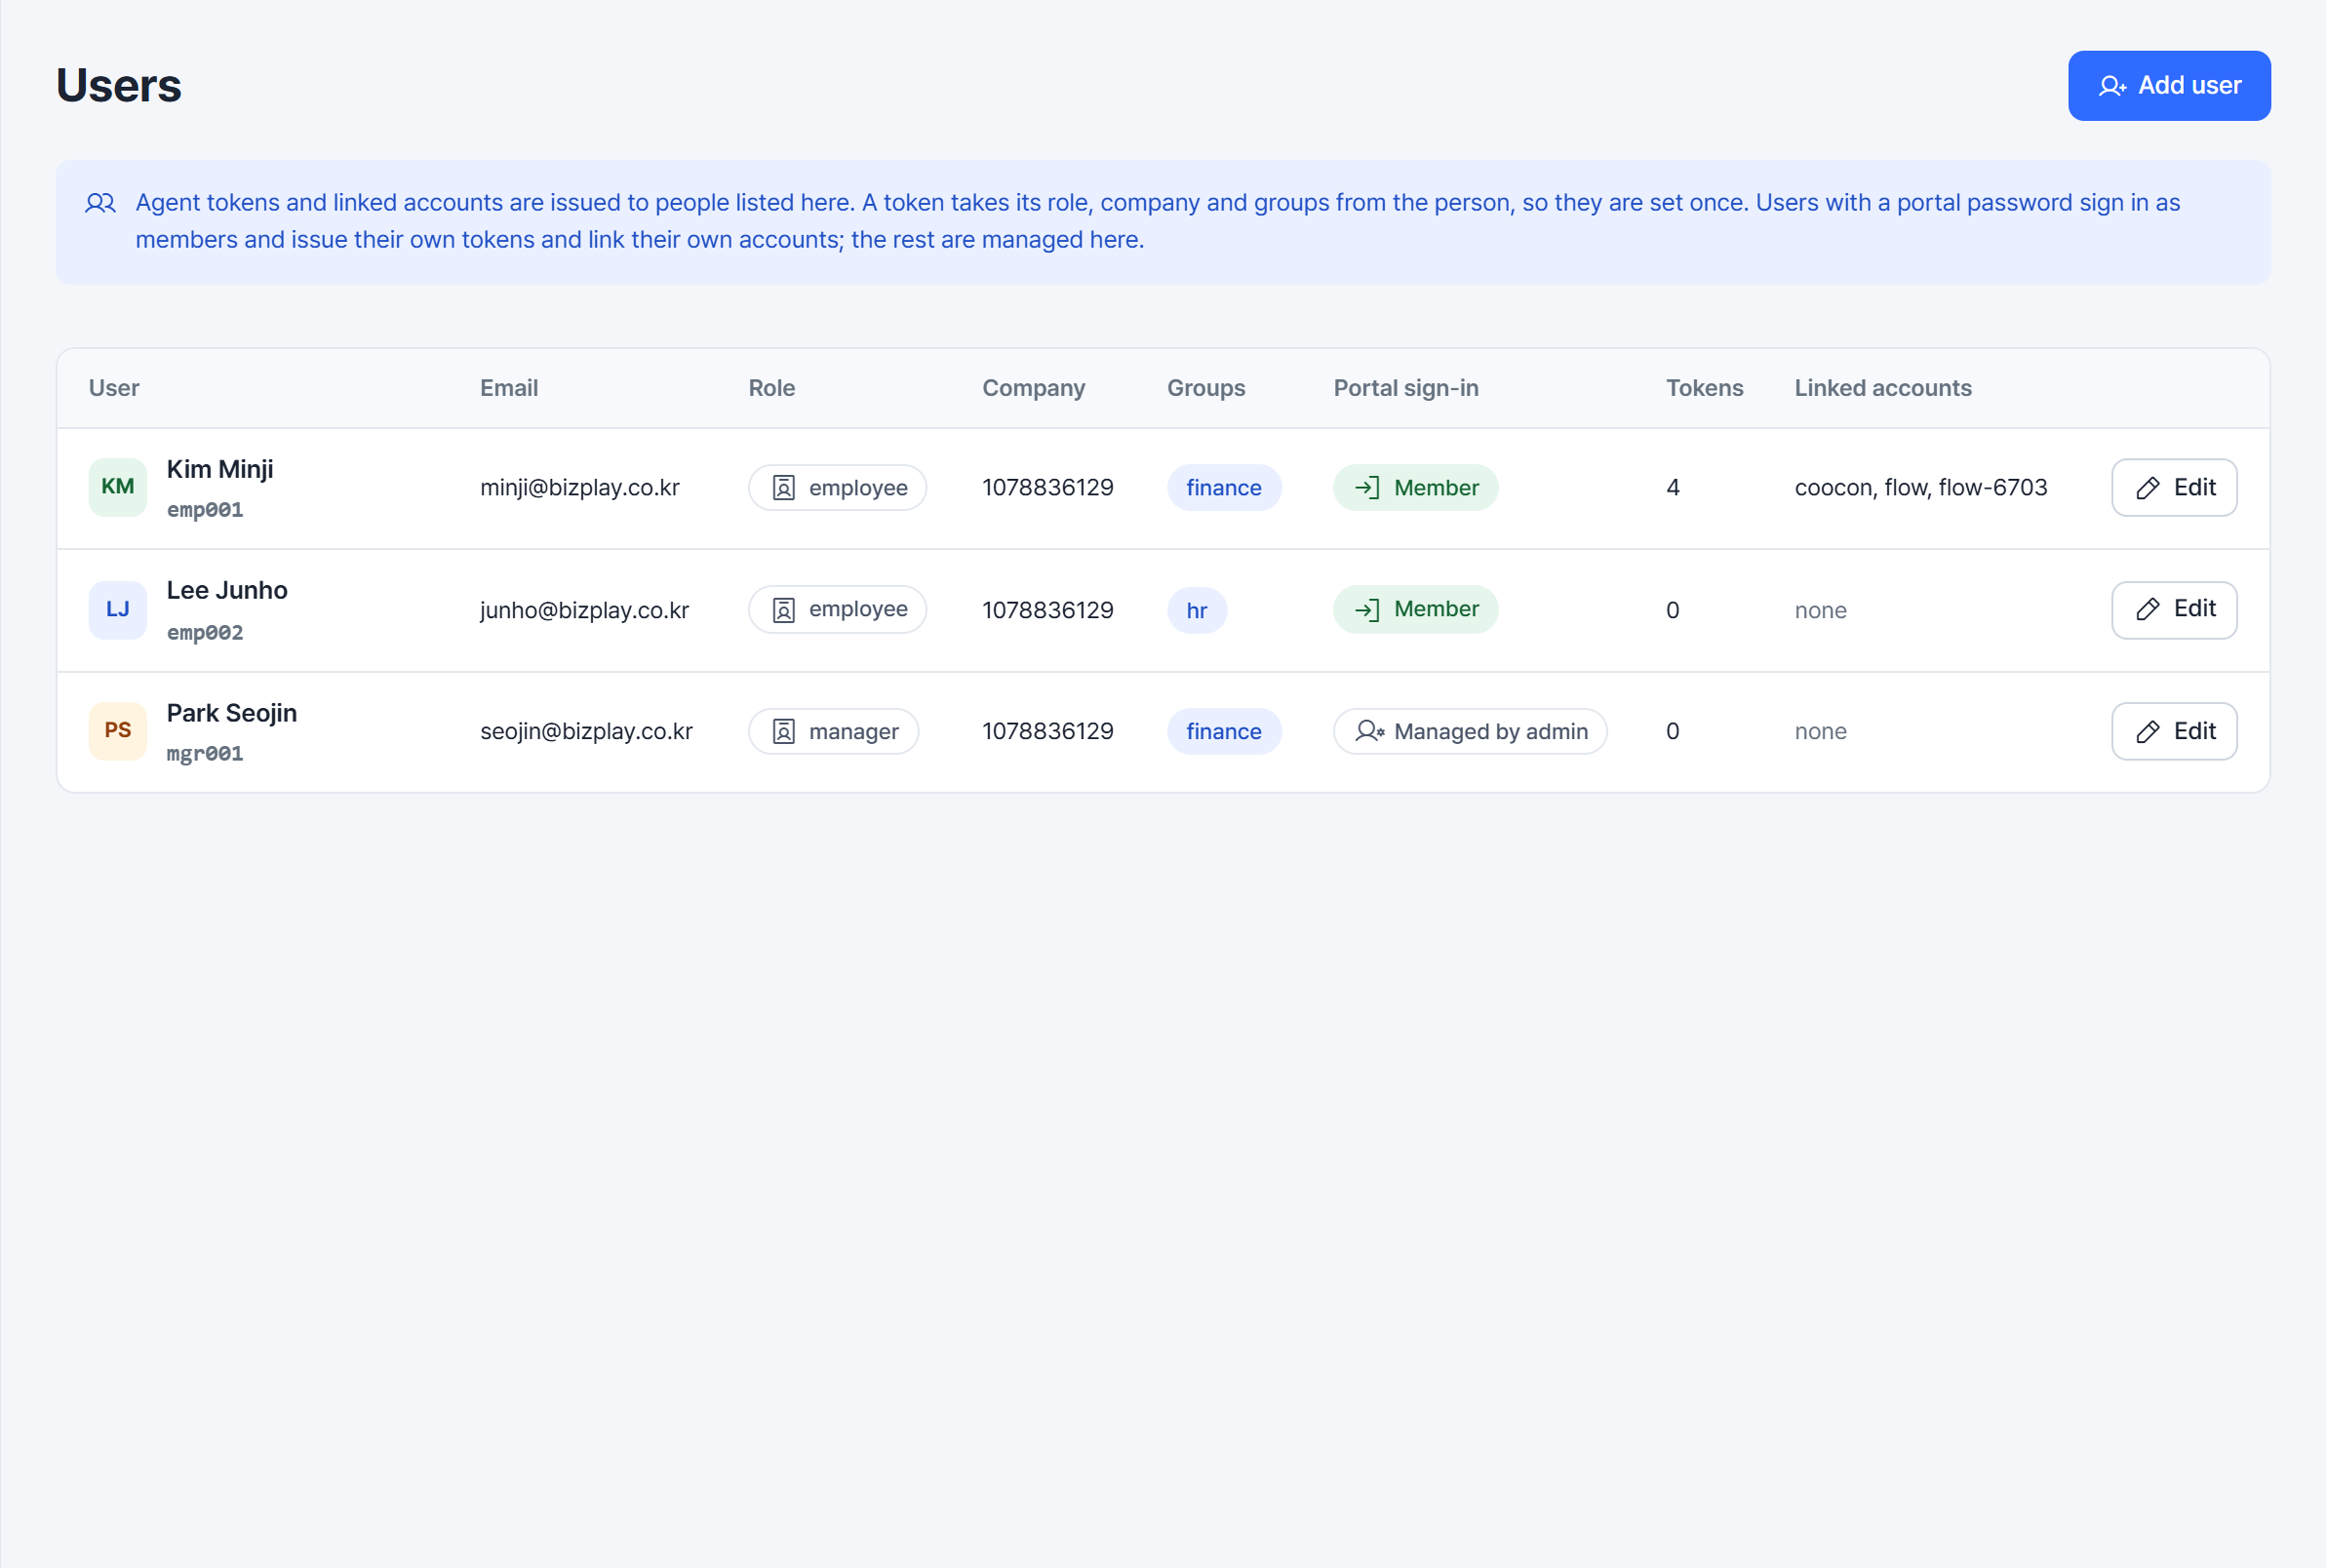
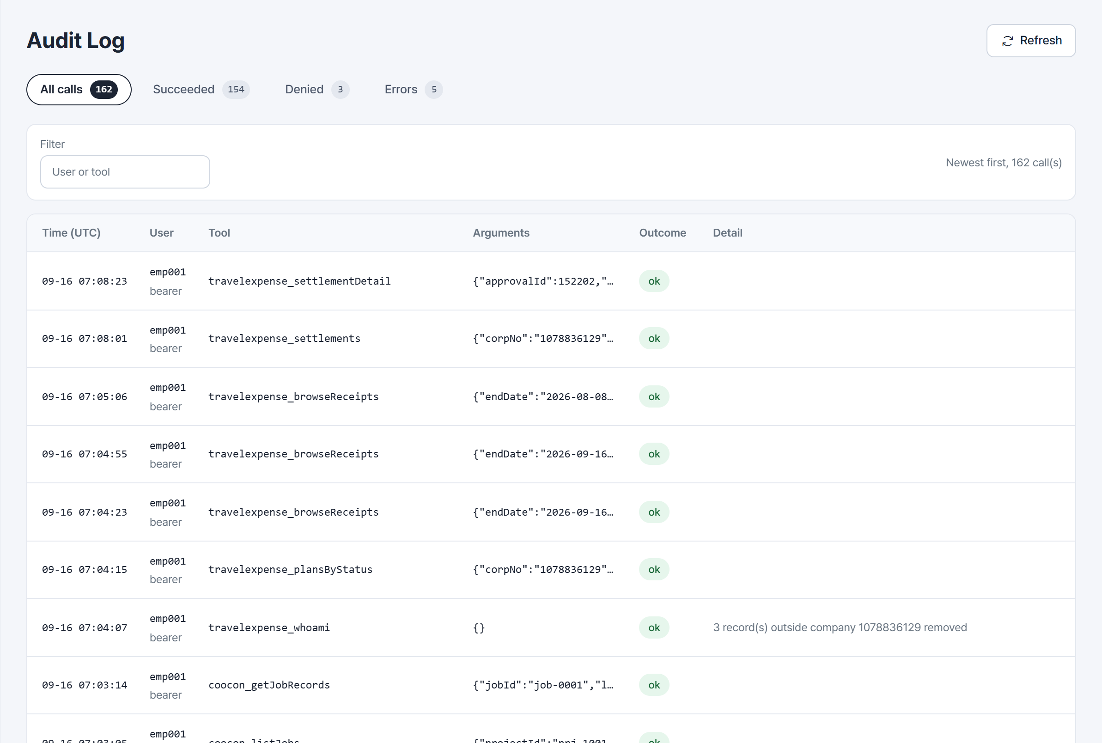
CONTROL MODEL · IN PRACTICE
Governance you can see
People, their organization and groups on one page; every call and every sign-in step on another.
Users: organization, role and access groups set once per person; tokens inherit them
Audit log: who, which tool, arguments, outcome and the reason for every refusal
Also on the Security page: a sign-in log of every step an assistant took to get in, upstream credential rotation, and a checklist scored against the group's policy.
MCP-based AI Gateway · Webcash Group × AI Convergence Lab, CBNU
13
Notes:
Two live pages: the user directory and the audit log.

Slide 14
USE CASES
Proposed use cases: domain packages and what customers ask
Each package is a set of products activated together. These are the use cases we propose; each one is delivered through the same registry and control model.
Package | Products | A customer asks | Control tier
Expense & Collaboration | Bizplay · COOCON · FLOW | “Find this month's items missing receipts, verify the payees, and ask the responsible teams to act.” | Lookup · Draft
SME Management | Gyeongrinara · COOCON | “Summarize this month's sales, outstanding invoices and what is due this week.” | Lookup · Draft
Corporate Treasury | Branch Q · InhouseBank Q · Dashboard | “Cash position across accounts this morning; prepare the transfers that need approval.” | Approval-based
Research Administration | rERP Q · RCMS | “Check this research expense against the rules before I submit it.” | High control · Rules
The tier column is the control model applied per package: what customers may look up freely, what they confirm, and what stays inside approval lines.
MCP-based AI Gateway · Webcash Group × AI Convergence Lab, CBNU
14
Notes:
Use cases at package level.

Slide 15
PROPOSED SCOPE
Proposed scope: three circles of connection
One registry and one control model serve all three. Each circle adds use cases without adding a new kind of integration.
1
Group products
2
Partner SaaS
3
Customers' own APIs
Bizplay, COOCON, FLOW, Gyeongrinara, Branch Q, InhouseBank Q, rERP Q. Domain packages activated customer by customer.
ERP, HR, groupware, tax. Registered in the same registry, governed by the same policy, so a customer's whole workflow completes in one place.
A customer's in-house systems sit beside the group's products. The gateway becomes the customer's AI integration layer.
PROPOSED USE CASE
PROPOSED USE CASE
PROPOSED USE CASE
“Match this month's Bizplay card spending against the Gyeongrinara ledger and list what is not booked yet.”
“Close the month: pull payroll from the HR system, match it to the bank records, and draft the tax filing.”
“Compare our own order system with the settlements received this week and list what is unpaid.”
ECOSYSTEM CONDITION
The registry is open to third parties: a partner adds value by registering a product, a customer by registering its own systems. An ecosystem forms when others build on the control layer, not when Webcash connects everything itself. The group's asset is the control layer: identity, policy and audit that every connection inherits.
MCP-based AI Gateway · Webcash Group × AI Convergence Lab, CBNU
15
Notes:
Group products first, then partners, then customers' systems.

Slide 16


FEASIBILITY
Why the proposed approach is feasible
Three design choices keep the cost and the risk of the proposal low.
Products are not modified
Built on open standards
Existing controls are reused
A product joins by registering the API description it already has. There is no development inside Bizplay, COOCON, FLOW or any other product team, so packages can be added one by one without a roadmap negotiation.
Tools are exposed through the Model Context Protocol and sign-in through OAuth 2.1. Claude, ChatGPT and Copilot already support both, so the group is not tied to one AI vendor and needs no custom client.
Product permissions, credentials and approval lines stay where they are. The gateway adds what is missing on top: who is asking, what they may do, and a record of it. Payments never bypass approval.
Effort per product: a registration and a policy review
One integration serves every assistant
No new path around today's controls
CHECKED IN A LAB PROTOTYPE
A prototype built with the AI Convergence Lab confirmed all three choices with four products and two assistants. The open risks are group single sign-on, approval-line integration, production scale and validation with real customer departments. They are the proposed work on the next slide.
MCP-based AI Gateway · Webcash Group × AI Convergence Lab, CBNU
16
Notes:
Feasibility of the proposal, not a tour of the prototype. The prototype is mentioned once, as the check on the three design choices.

Slide 17


PROPOSED WORK
Proposed work: three tracks
Platform, packages and research run in parallel, each with something measurable at the end.
Platform
Packages
Research & evaluation
Sign-in federated to group SSO (OIDC)
Secrets in a vault, state in a database
Per-product isolation and quotas
Rate limits per customer and product
Operations dashboard and alerting
SME Management: Gyeongrinara, COOCON
Corporate Treasury: Branch Q, InhouseBank Q, Dashboard, with approval-line integration
Research Administration: rERP Q, RCMS, rule-based control
First partner SaaS in the registry
Tool selection accuracy as the catalogue passes 100 tools: curated descriptions vs retrieval
Verifiable policy for agents, not only enforced
Cost and latency of multi-product chains
Pilot with one customer department: time saved per task, refusal and error rates
MEASURED AT THE END OF THE PHASE
Packages live
Time saved
Refusals and errors
Tool selection
and customers onboarded
per task, per department
rates from the audit log
accuracy at 100+ tools
MCP-based AI Gateway · Webcash Group × AI Convergence Lab, CBNU
17
Notes:
The proposal: platform work, package rollout, and research questions the pilot makes measurable.

Slide 18
Customers keep their assistant.
Products keep their APIs.
The group keeps control.
One registry, one sign-in, one audit trail, across every Webcash Group product and, later, its partners and customers.
Prototype: mcp-portal.aiconvergencelab.com · Code: github.com/Chansokheang/MCP_Server_Portal
Notes:
Close on the three-line summary.

