Slide 1
All the right measures

Slide 2
Motivation
Knowing which measures most effectively reduce the spread of the virus is crucial
By now there are many different attempts to fight Covid19 with different measures in different countries
A systemic analysis can reveal more about the measures than a quick look
This could help governments in the decision making process

Slide 3
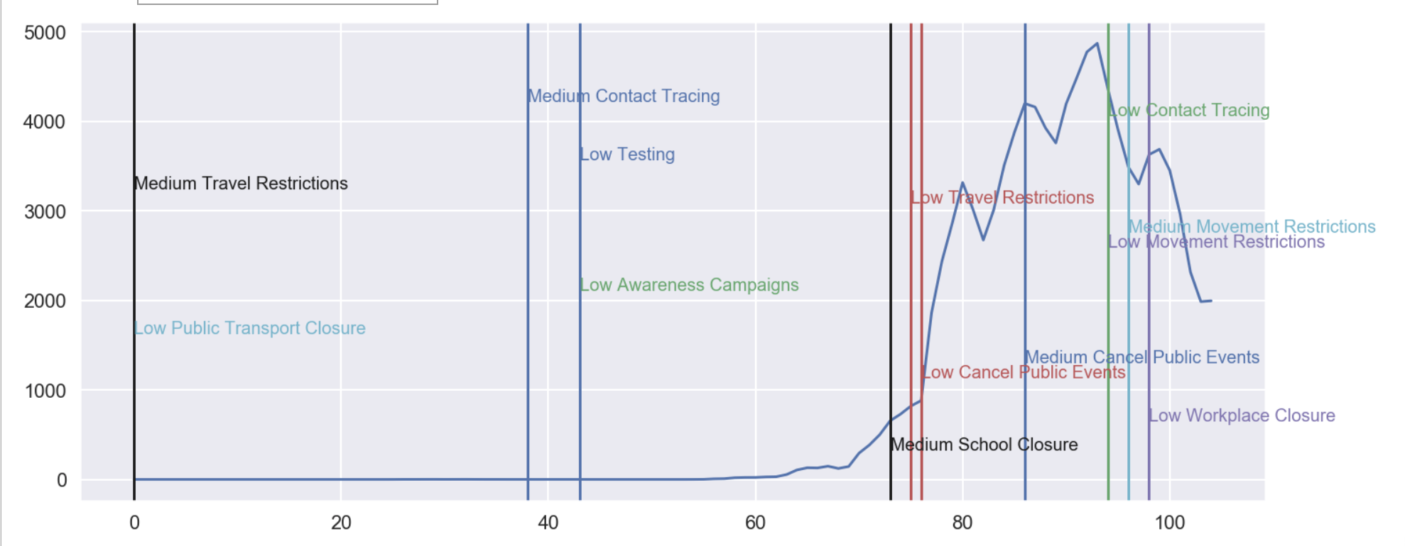
Datasets
Measures of different countries: Oxford Coronavirus government response tracker
Daily new cases per country: WHO data

Slide 4
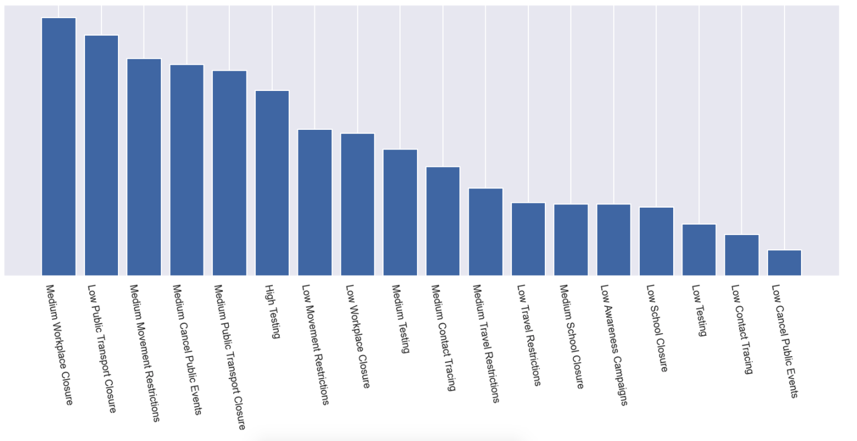
Ranking result

Slide 5
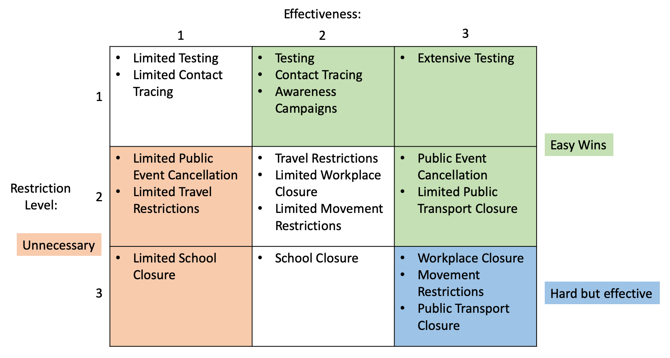
Ranking result

Slide 6
Prediction: Live Demo
Link to Colab notebook for usage:

