Slide 1
All the right measures

Slide 2
Motivation
Knowing which measures most effectively reduce the spread of the virus is crucial
By now there are many different attempts to fight Covid19 with different measures in different countries
A systemic analysis can reveal more about the measures than a quick look
This could help governments in the decision making process

Slide 3
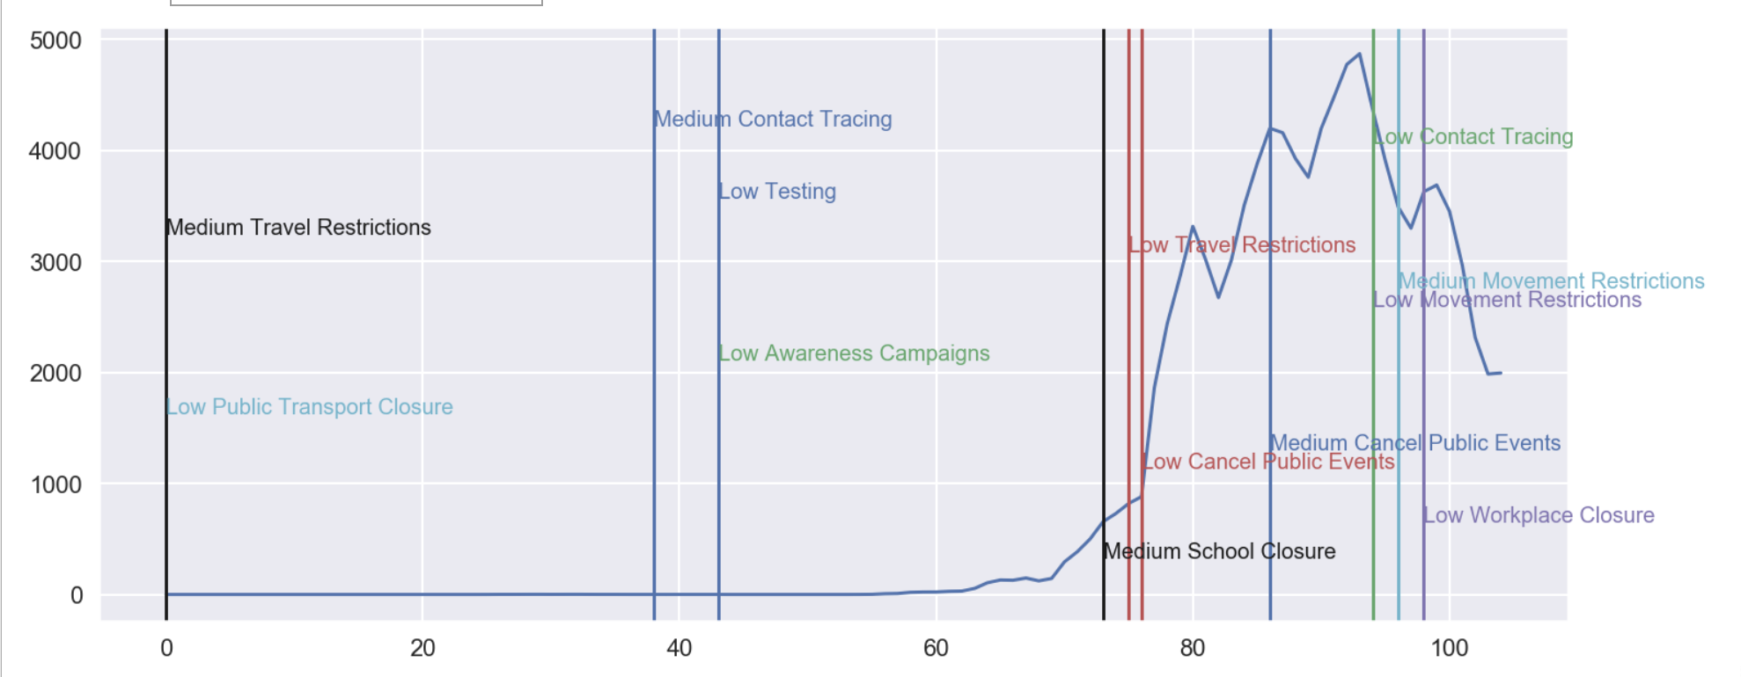
Datasets
Measures of different countries: Oxford Coronavirus government response tracker
Daily new cases per country: WHO data

Slide 4
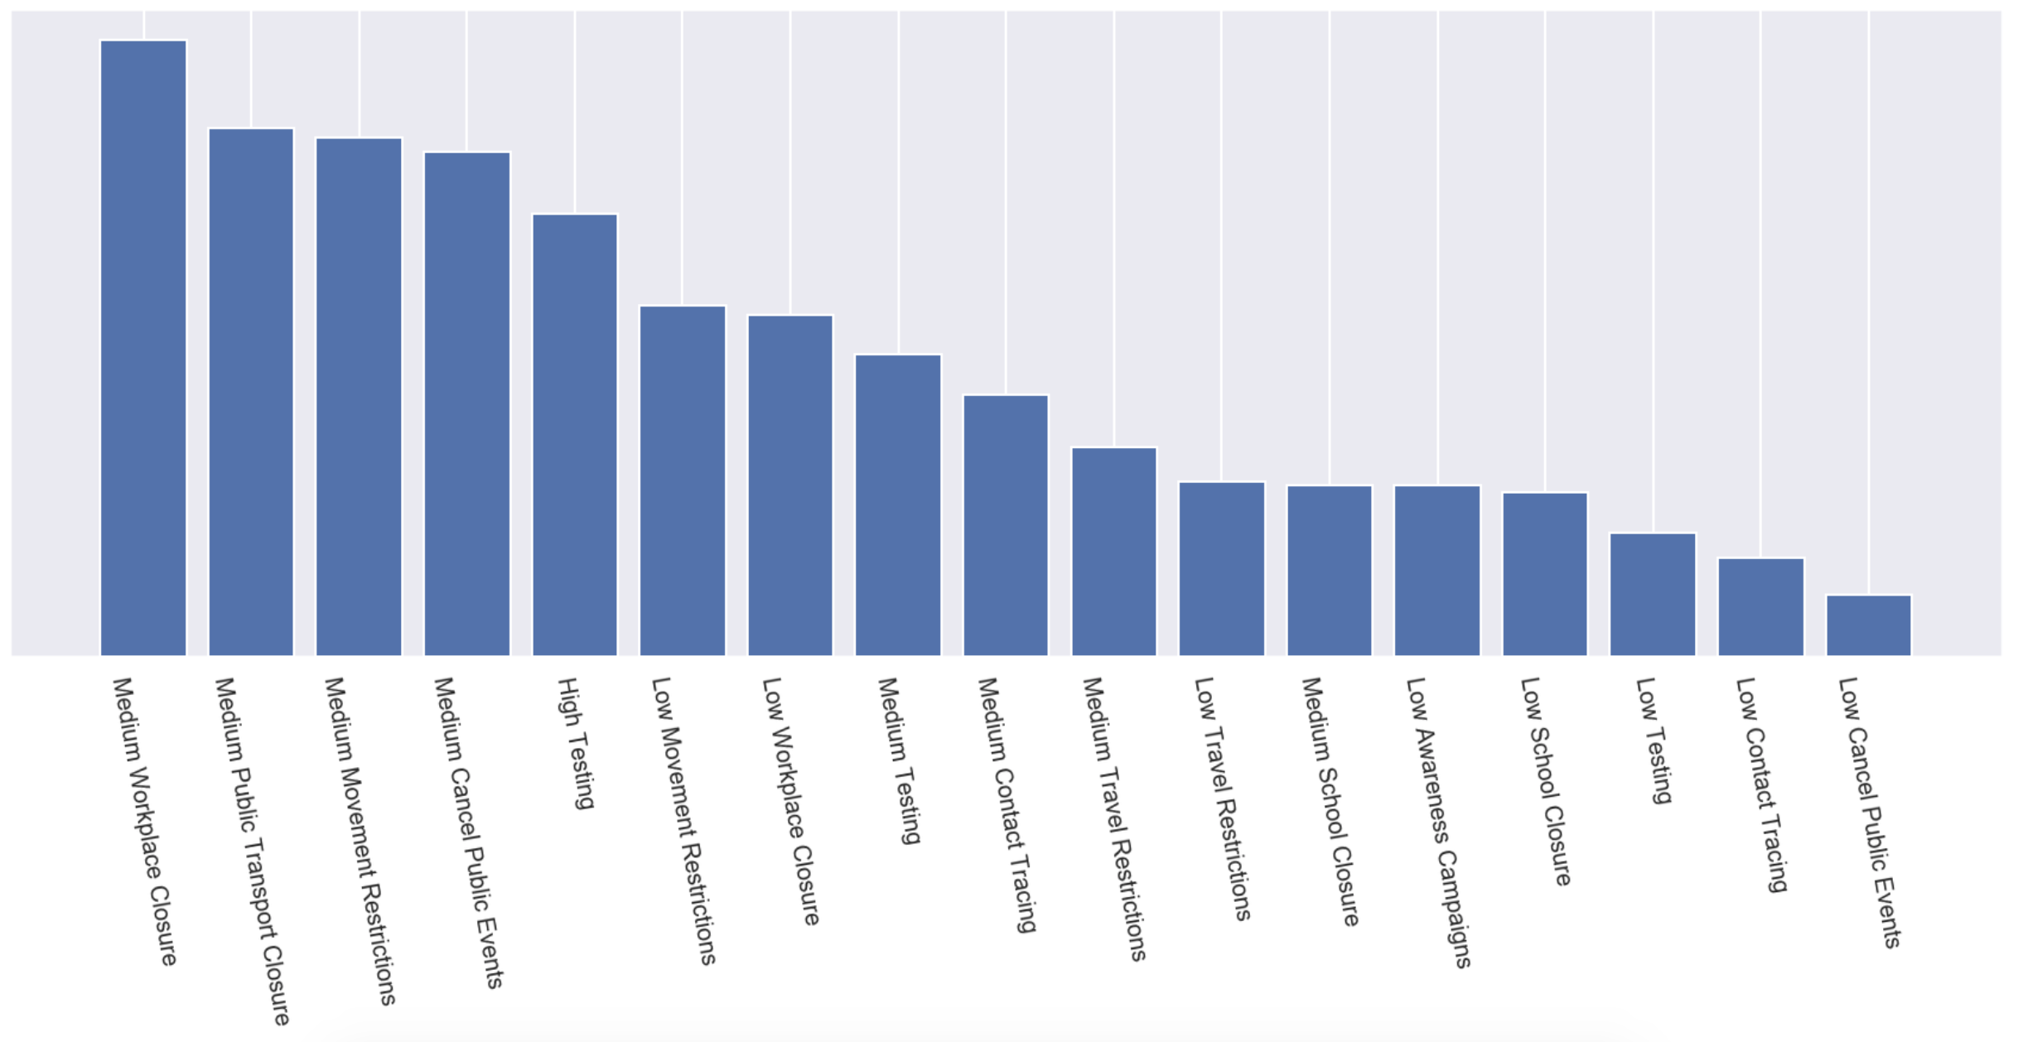
Ranking result

Slide 5
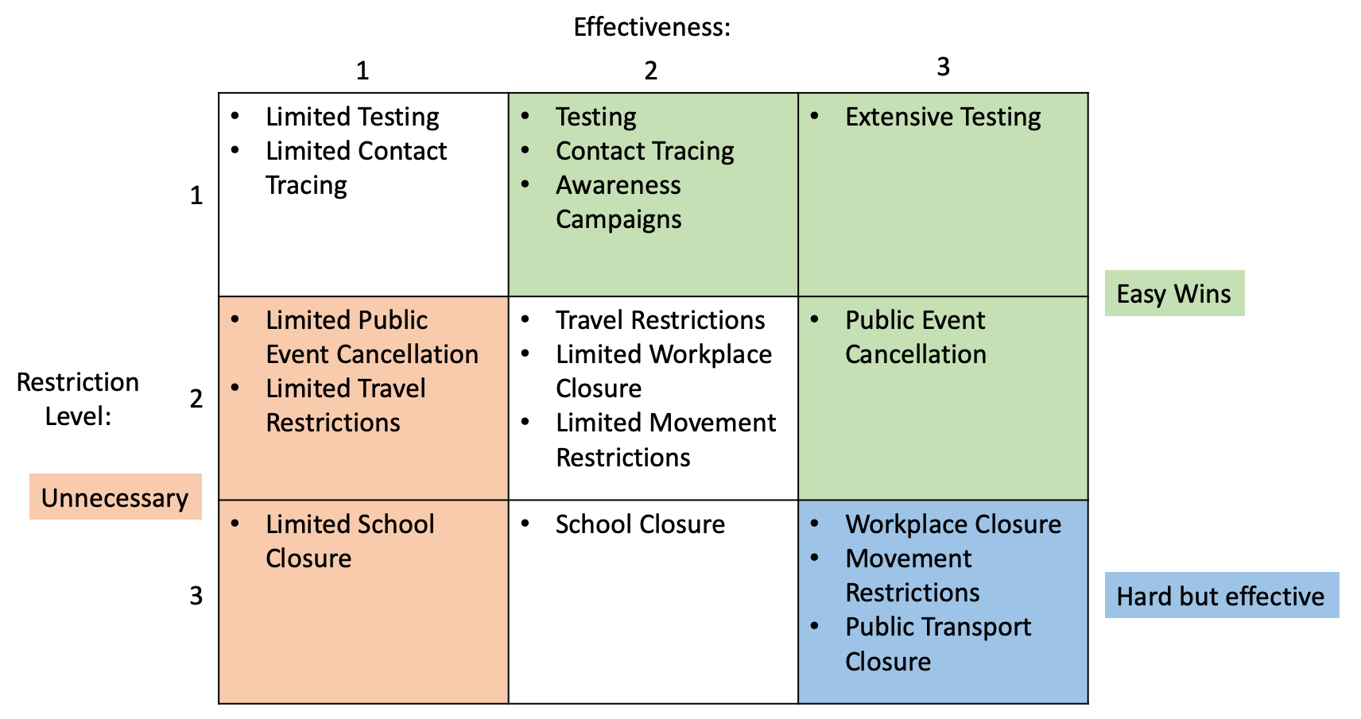
Ranking result

Slide 6
Prediction: Live Demo
Link to Colab notebook for usage:
https://colab.research.google.com/drive/1mJSu31pSD5ua7GqsFVCOf7M6hycTOItv

Slide 7
Thank you!

Slide 8
Backup SlidE: Calculations
Rating:
Assign success score to weeks depending on the change in daily new cases
Connect the success score to measures which have been already active 2 weeks before
Calculate average success score per measure
Prediction:
Success score describes how daily new cases change in a week
Iteratively apply score of the most effective measure to previous daily new cases
Additional measures have a smaller weighted impact as well
Measures that are already contained by other measures are ignored

