Slide 1
Evaluating AIFS Wind Forecasts
A Comprehensive Analysis Across Irish Environments
11 Observation Locations • 3 Forecast Models • 51 Ensemble Members

Slide 2
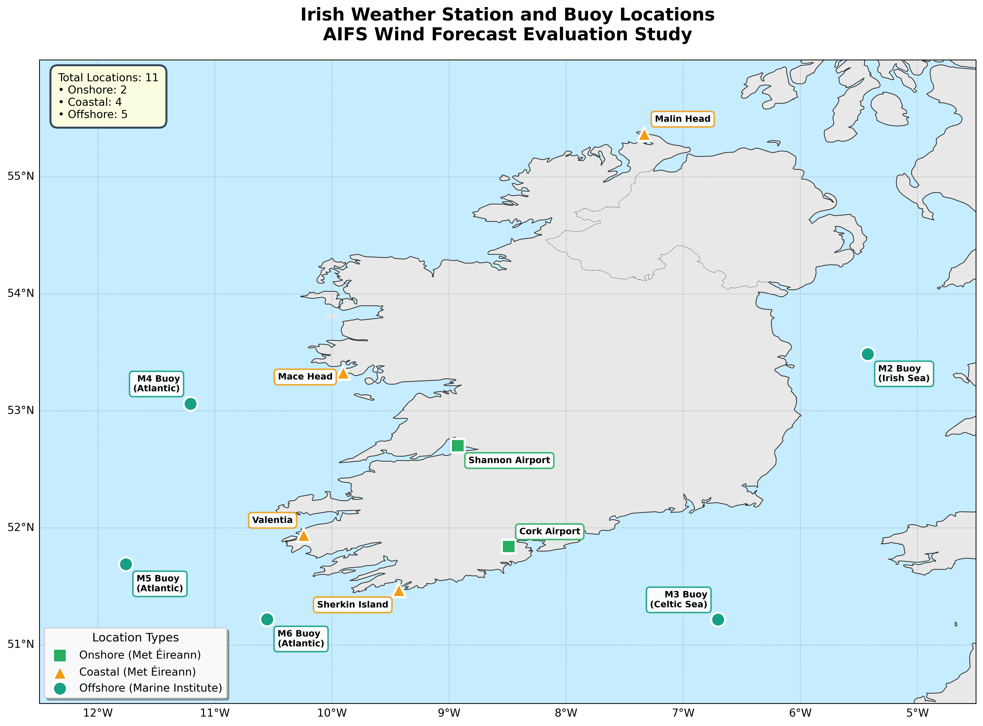
Project Overview
Objective
Evaluate ECMWF's AI Forecasting System (AIFS) for wind speed prediction across diverse Irish environments (onshore, coastal, offshore)
Models Compared
▸ IFS (ECMWF Deterministic)
▸ AIFS Single Member
▸ AIFS 51-Member Ensemble

Slide 4
Data Sources & Motivation
Evaluating AI Weather Models Across Irish Wind Environments
Research Question:
How do AI-based weather forecasts (AIFS) compare to traditional physics-based models (IFS) for wind speed prediction across different Irish environments?
🏛️ ONSHORE
Met Éireann Stations
Shannon Airport
Cork Airport
Typical: ~5 m/s
🌊 COASTAL
Met Éireann Stations
Malin Head
Valentia
Mace Head
Sherkin Island
Typical: 5-10 m/s
⚓ OFFSHORE
Marine Institute Buoys
M2 - Irish Sea
M3 - Celtic Sea
M4 - Atlantic
M5 - Atlantic
M6 - Atlantic
Typical: 8-14 m/s
Total: 11 observation locations • 2 onshore + 4 coastal + 5 offshore

Slide 5
Data Specifications & Methodology
Temporal Coverage Period: December 2024
Forecast Horizon:
6h, 12h, 24h lead times
Temporal Resolution:
Hourly observations
Sample Size:
~720 hours per location
Model Configurations
IFS
ECMWF deterministic physics-based
AIFS Single
Single AI forecast member
AIFS Ensemble
Mean of 51 AI members
Data Sources
Observations:
Met Éireann synop stations (10m wind speed) + Marine Institute wave buoys (sea surface wind)
Model Data:
ECMWF open data (0.25° resolution) extracted via ecmwf-opendata Python API
Evaluation Metrics: Bias (Mean Error) • RMSE (Root Mean Square Error) • MAE (Mean Absolute Error)

Slide 6
Location Selection Rationale
Strategic selection across Ireland's diverse wind regimes
🎯
Wind Energy Relevance
Ireland has ambitious offshore wind targets (7 GW by 2030, 37 GW by 2050). Accurate offshore wind forecasting is critical for grid integration and energy planning.
🌍
Environmental Diversity
Testing across onshore, coastal, and offshore environments reveals model performance under different atmospheric boundary layer conditions and surface roughness characteristics.
📡
Data Availability & Quality
Met Éireann synop stations provide high-quality standardized observations. Marine Institute buoys offer rare open-ocean wind measurements at potential wind farm locations.
🔬
Model Resolution Testing
At 0.25° (~28km), ECMWF data may struggle with Ireland's complex coastal topography. This tests whether AI models better capture local wind patterns than traditional interpolation.

Slide 7
Key Results: RMSE by Environment

Slide 8
Observed Wind Conditions
Buoy | Location | Mean Wind (m/s) | Std Dev | Range (m/s)
M2 | Irish Sea | 13.77 | 4.45 | 1.46 – 17.98
M3 | Celtic Sea | 8.47 | 2.30 | 3.28 – 14.29
M4 | Atlantic NW | 12.77 | 3.24 | 2.40 – 19.50
M5 | Celtic Sea S | 10.08 | 2.77 | 1.70 – 15.05
M6 | Deep Atlantic | 9.96 | 1.82 | 5.10 – 14.23
Environmental Gradient: Onshore (5.2 m/s) → Coastal (7.3 m/s) → Offshore (11.0 m/s)

Slide 9
Deterministic Forecast Performance
Environment | Samples | IFS RMSE | AIFS Single RMSE | AIFS Ens RMSE | Best Model
Onshore | 6 | 1.77 m/s | 1.88 m/s | 2.27 m/s | IFS
Coastal | 12 | 4.57 m/s | 2.97 m/s | 3.15 m/s | AIFS -35%
Offshore | 15 | 3.70 m/s | 3.28 m/s | 3.23 m/s | AIFS -13%
Bias Analysis
• Onshore: IFS +1.16 m/s, AIFS +0.90 m/s (23% improvement)
• Coastal: IFS +3.15 m/s, AIFS +1.58 m/s (62% improvement)
• Offshore: IFS +0.56 m/s, AIFS Ensemble +0.02 m/s (96% improvement - nearly unbiased!)

Slide 10
Ensemble Performance Analysis
Environment | Mean Spread | Mean Error | Spread-Error Ratio | Status
Onshore | 0.20 m/s | 0.47 m/s | 0.42 | Under-dispersive
Coastal | 0.29 m/s | 1.96 m/s | 0.15 | Severely Under-dispersive
Offshore | 0.24 m/s | 0.94 m/s | 0.25 | Under-dispersive
Critical Finding: Ensemble Under-Dispersion
Spread-error ratio should be ~1.0 for well-calibrated ensembles. Ratios of 0.15-0.42 indicate overconfident predictions (spread too narrow).
Limited ensemble members at 12h/24h lead times (only 1 member vs 51 at 6h) contributes to under-dispersion.

Slide 11
Conclusions
1. Environment-Dependent Performance
AIFS excels in coastal (35% RMSE reduction) and offshore (13% reduction) environments. Traditional IFS performs better onshore with complex local physics.
2. Systematic Bias Reduction
AIFS reduces forecast bias by 50-96% across environments. Offshore bias of +0.02 m/s (vs IFS +0.56 m/s) demonstrates excellent calibration.
3. Ensemble Calibration Needed
Spread-error ratios of 0.15-0.42 indicate overconfident ensemble. Calibration methods required before operational deployment.

Slide 12
Thank You
Questions & Discussion

