Slide 1


GAIN Monthly Dialogue Series
Mapping Rice
Affordability in
Ghana Using GeoAI
March 2026
Chantelle Amoako-Atta
AI/ML Engineer | PhD Researcher, Decarb-AI, UCD

Slide 2
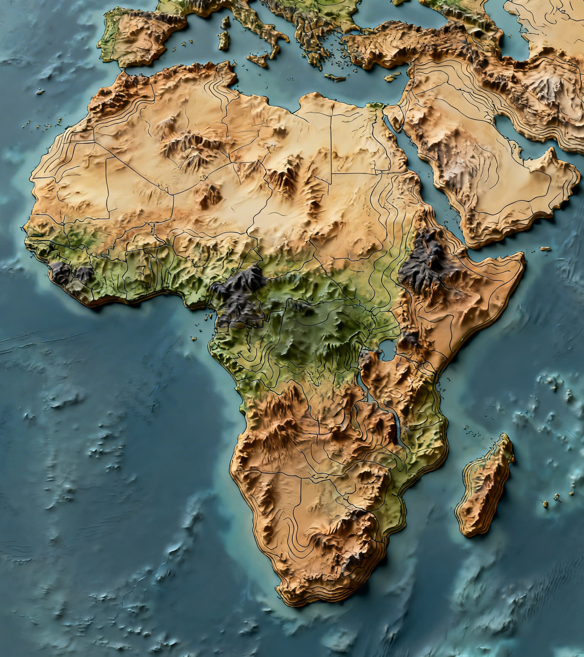



From the Greek "ge"
GEO
Earth. Place. Location.
- Study of Earth's surface, environments, and processes
- Including the context, scale, and how place shapes outcomes

Slide 3


From the Latin "spatium"
SPATIAL
Arrangement. Distance. Shape.
How things are positioned relative to each other
Proximity, boundary, pattern, clustering

Slide 4


Coined 1956, John McCarthy
AI
Machines that learn patterns from data.
Systems that find patterns in large datasets
Use those patterns to predict, classify, or answer questions
Learns from examples, not explicit rules

Slide 5





GEO
SPATIAL
AI
+
+
Earth / Place
Arrangement / Distance
Patterns / Prediction
GeoAI
AI applied to spatial and geographic data, Detects patterns that vary across locations, Reveals why spatial patterns exist, not just where

Slide 6

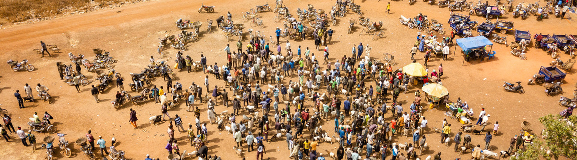



Why Location Changes Everything
The same question. Two different places. Two completely different answers.
vs
Greater Accra
Upper West Region
Near Tema port. Multiple competing markets. Short supply chain. Rice arrives by ship and reaches the shelf within days.
Far from port. Few markets. Long road from Tema. Transport costs compound at every handoff before the rice reaches the buyer.
4.80 GHS / kg
6.60 GHS / kg
Same country. Same commodity. Same day. 38% price difference. That difference is geography.

Slide 7


GeoAI Is Already Around You
Route Navigation
Flood Risk Mapping
Crop Health Monitoring
Google Maps and Waze use real-time location data plus AI to predict the fastest route. Every reroute is a GeoAI decision.
Governments use satellite elevation data plus ML to predict which communities flood when it rains. Evacuation plans are built from these models.
Satellites image farmland weekly. AI classifies crop stress, disease, and yield predictions at field level across sub-Saharan Africa.
Disease Outbreak Tracking
Urban Planning
Food Price Monitoring
The Malaria Atlas Project maps infection probability across every district in Africa using spatial AI to guide where bed nets are distributed.
City governments use GeoAI to identify where new clinics, schools, and transport hubs will serve the most people for the least cost.
The WFP maps food prices across 90+ countries to detect supply shocks before they become crises. This is exactly what we are building today.

Slide 8


How New Is GeoAI?
Compared to other branches of AI, GeoAI as a named, distinct discipline is barely a decade old.
1950s
1980s
2018+
Early AI &
Logic Systems
NLP & Speech
Recognition
GeoAI emerges
as a named field
1960s
2012
Computer Vision
begins
Deep Learning
breakthrough
You are entering this field at its beginning, not its end.
The term GeoAI itself only became widely used after 2018. The intersection of deep learning, satellite data availability, and open geospatial tools is genuinely new territory. The people in this room are among the early practitioners in Africa.

Slide 9
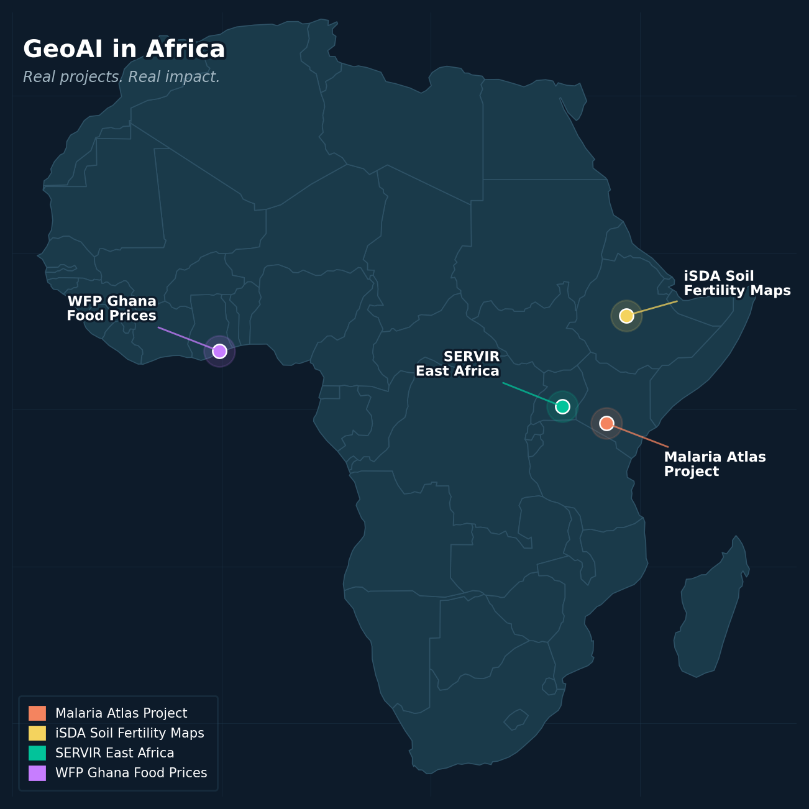

GeoAI in Africa: Real Projects, Real Impact
Malaria Atlas Project
Spatial AI models combine satellite imagery, temperature data, and case reports to predict malaria risk at district level across the continent. Used by WHO and national health ministries to distribute resources where they matter most.
iSDA Soil Fertility Maps
The first AI-generated, field-level soil maps for sub-Saharan Africa. Covers 41 countries. Farmers and governments use it to make fertiliser decisions at the plot level instead of guessing from regional averages.
SERVIR East Africa (NASA / USAID)
Uses satellite GeoAI to monitor forest cover, land use change, and flood risk across East Africa. Used by government agencies for disaster preparedness and natural resource management.

Slide 10


GeoAI in Ghana
Farmerline (Accra)
Ghana Statistical Service
Ghanaian agri-tech company using location data and AI to connect smallholder farmers to inputs, weather data, and markets. Over 2 million farmers reached across West Africa.
Uses spatial analysis to map poverty, census data, and infrastructure gaps at district level. The 2021 Population and Housing Census integrated GIS for the first time.
WFP Ghana Food Prices
Satellite Data on Galamsey
The dataset we use today. WFP monitors food prices at markets across Ghana to detect supply shocks early, feeding into regional food security assessments and humanitarian response planning.
Satellite data analysis detecting illegal mining activity and deforestation from orbit. Geospatial AI techniques used to identify land use change and alert enforcement agencies.

Slide 11



02
SECTION 02
Today's Project
The question. The plan. The full picture before we
write a line of code.

Slide 12
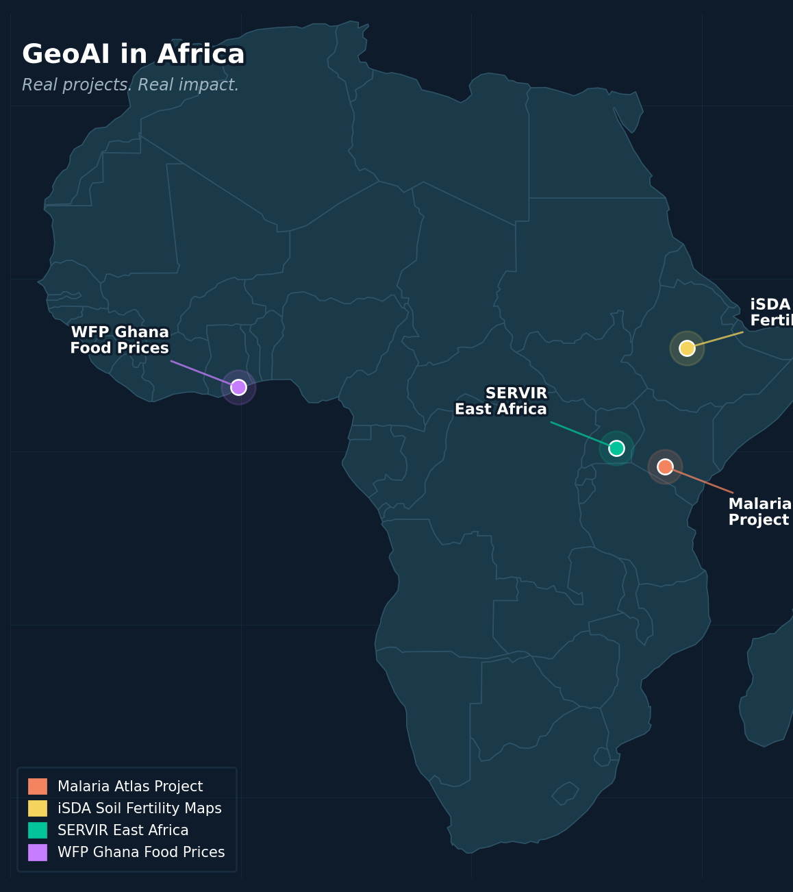


The question we are answering today
"Where in Ghana
is rice most
affordable?"
This is a GeoAI question because the answer depends on location. It is not just a data question. It has a "where" in it.
And it matters because the answer affects real households making real decisions about food every single day.

Slide 13





What We Are Building, Step by Step
Read left to right. Each arrow means "and then". Technical terms are explained in brackets below each step.
01
02
03
04
05
06
07
Get the Data
Focus on Rice
Give It a
Sense of Place
Connect to
a Map
Summarise
by Area
Draw the Map
Let Anyone
Ask Questions
Load WFP prices and Ghana boundary files
Filter to rice only. Clean messy values.
Turn lat/lon numbers into map points Python understands.
Ask: which region does each market point fall inside?
Calculate the typical price per region and district.
Colour each region by its price. Darker means more expensive.
Build a chat interface so anyone can query in plain English.
→
→
→
→
→
→
[CSV: a spreadsheet file. GeoJSON: a file storing map shapes.]
[Filter: keep only the rows we need. Clean: remove blanks and errors.]
[GeoDataFrame: a table that also knows where each row is on Earth.]
[Spatial join: matching based on location instead of a shared ID.]
[Median: the middle value. More reliable than mean when data has outliers.]
[Choropleth: a map where colour encodes a value for each area.]
[LLM interface: AI that routes natural language questions to Python for exact answers.]

Slide 14
03
SECTION 03
Our Tools
Python's geographic upgrade. What each library does
and why we need it.

Slide 15



Your Python Toolkit Gets a Geographic Upgrade
You already know the foundation. We are adding one new layer on top of it.
What you likely already know
What we are adding today
pandas
matplotlib
geopandas
Load CSV files. Filter rows. GroupBy. Merge tables. The workhorse of data analysis.
Draw charts, bar plots, scatter plots. Visualising data you already have in a table.
Everything pandas does, plus a geometry column. Reads map files. Does spatial joins. Draws maps. Think of it as pandas with a GPS attached.
shapely
numpy
requests
Creates and works with geometric shapes: points, lines, polygons. The shape library that geopandas uses under the hood.
Numerical operations. Arrays. The maths layer underneath most data science work.
Fetching data from APIs. Reading structured data formats from the web.
gradio
Turns a Python function into a shareable web interface in three lines of code. How we make our analysis accessible to non-coders.

Slide 16
04
SECTION 04
Our Data
Where it comes from, what else lives there, and why
we chose rice.
10 min

Slide 17
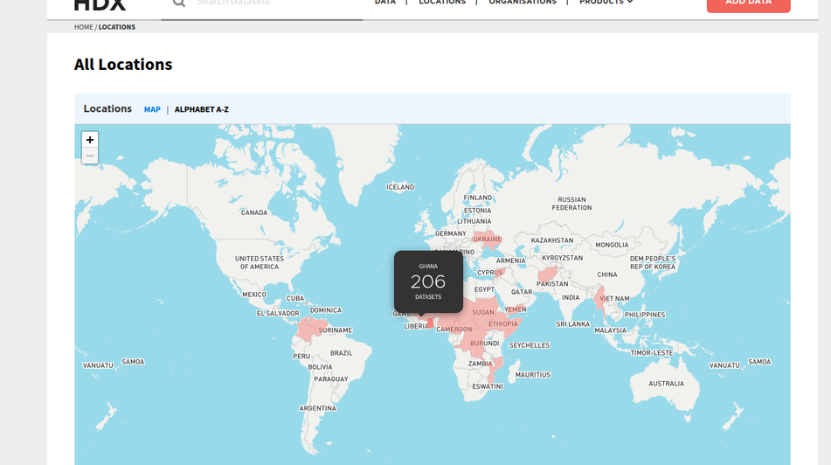



Where Our Data Comes From: The HDX Platform
What is HDX?
The Humanitarian Data Exchange. An open data platform managed by OCHA, the UN Office for the Coordination of Humanitarian Affairs. Everything on it is publicly accessible - no login, no cost.
What kinds of data live there?
Who uses this data?
› Food prices across 90+ countries (WFP)
› Population displacement data (UNHCR)
Humanitarian response planning. Academic research. Policy analysis. Startup products for underserved markets. Anything requiring reliable, standardised data from fragile or developing contexts.
› Health facility locations and capacity
› Administrative boundaries for every country
› Climate, weather, and environmental data
› Infrastructure access and road networks

Slide 18
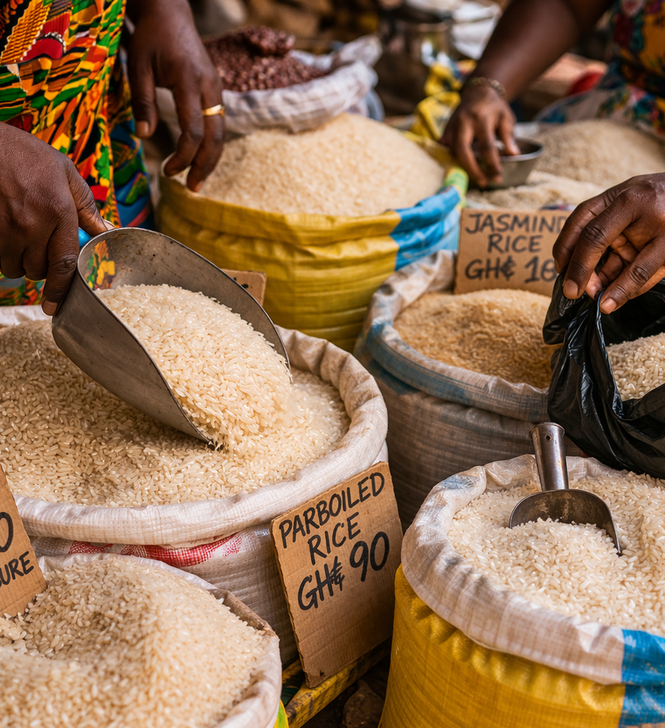

Why Rice?
Of all the commodities in the WFP dataset, why did we choose rice as our focus?
A cultural staple, not just a commodity
Rice is waakye. Rice is jollof. Rice is Thursday lunch. It is consumed daily by millions of Ghanaian households. A price change is felt immediately and personally.
Ghana imports 65% of its rice
This means Ghanaian rice prices are partly set in global commodity markets and affected by the USD/GHS exchange rate. A crisis in Southeast Asia can raise prices in Kumasi within months.
A clean signal for food security
Because rice is consumed consistently across seasons and regions, its price is a reliable indicator of overall food affordability. Policymakers use it as a proxy for household food stress.

Slide 19
05
SECTION 05
Let's Build It
Notebook walkthrough. Each concept introduced
before its code cell.

Slide 20


Step 3: Giving Our Data a Sense of Place
Latitude and longitude are just numbers. Python does not know they represent locations unless we tell it explicitly.
Regular DataFrame (before)
GeoDataFrame (after)
market | lat | lon | price
Accra Central | 5.55 | -0.20 | 5.25
Kumasi Market | 6.69 | -1.62 | 4.80
Tamale Market | 9.40 | -0.85 | 6.40
market | price | geometry
Accra Central | 5.25 | POINT(-0.20, 5.55)
Kumasi Market | 4.80 | POINT(-1.62, 6.69)
Tamale Market | 6.40 | POINT(-0.85, 9.40)
→
Python sees:
Python knows:
"These are just numbers. I have no idea they are locations."
"These are locations on Earth. I can map them, join them, measure between them."
Cannot draw a map. Cannot ask which region a point falls in. Cannot calculate distances.
Can draw a map. Can ask which region each point falls in. Can calculate distances between points.
Key idea: We are not changing the data. We are telling Python what the data means. That is what a GeoDataFrame does.

Slide 21






Step 4: Connecting Prices to Places (Spatial Join)
A spatial join is like a VLOOKUP in Excel, but instead of matching on a shared ID it matches based on: does this point fall inside this polygon?
Markets (before)
Markets (after join)
Then:
with prices, no region info
with prices AND region
→ groupby region
Accra Mkt 5.25 GHS
Accra Mkt Gr. Accra
→ median price
gpd.sjoin()
Kumasi Mkt 4.80 GHS
Kumasi Mkt Ashanti
→ merge geometry
→
"Which region's polygon contains this point?"
→
Tamale Mkt 6.40 GHS
Tamale Mkt Northern
→ draw map
Bolga Mkt 6.60 GHS
Bolga Mkt Upper East
Each market knows its price but does not know which region it belongs to.
Now we can groupby region and calculate the median price per region.
After the join, the rest is standard pandas: groupby region, calculate median, merge back with the boundary geometry, and draw the choropleth map.

Slide 22
06
SECTION 06
So What?
Data gaps as a real finding. The LLM interface.
Real-world applications.

Slide 23
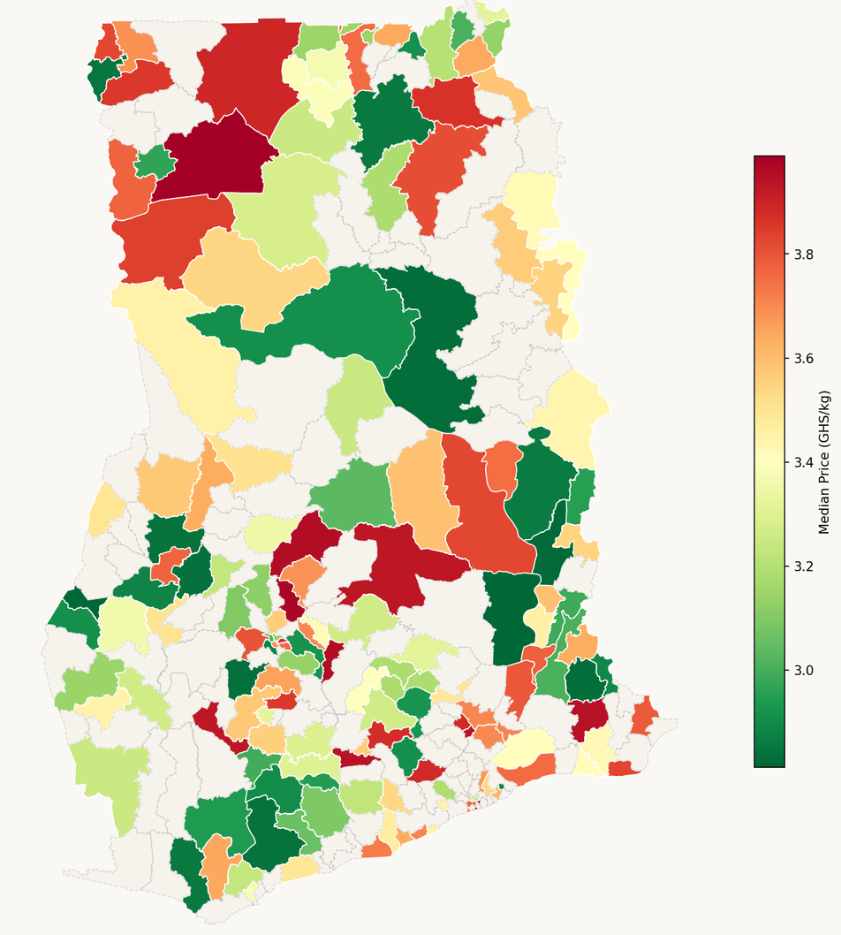

What the Gaps Are Telling Us
Missing data is not a technical problem. It is a finding.
When most of Ghana's 260 districts are grey on the map, that is not an analysis failure. The WFP monitors a sample of markets, not every district. The grey areas are real gaps in knowledge - and they matter.
Resource limits
WFP cannot monitor every market in every district. They sample strategically, focusing on accessible, higher-risk areas.
Accessibility
Remote districts with poor roads or security challenges are harder and more expensive to reach. Monitoring is lower there.
Market structure
Some districts have few formal markets. Prices are set informally, in ways that are not easily captured by standardised surveys.
A grey district does not mean no food security problem. It may mean the district is the hardest to reach and the most in need. Policy must not treat absence of data as absence of risk.

Slide 24

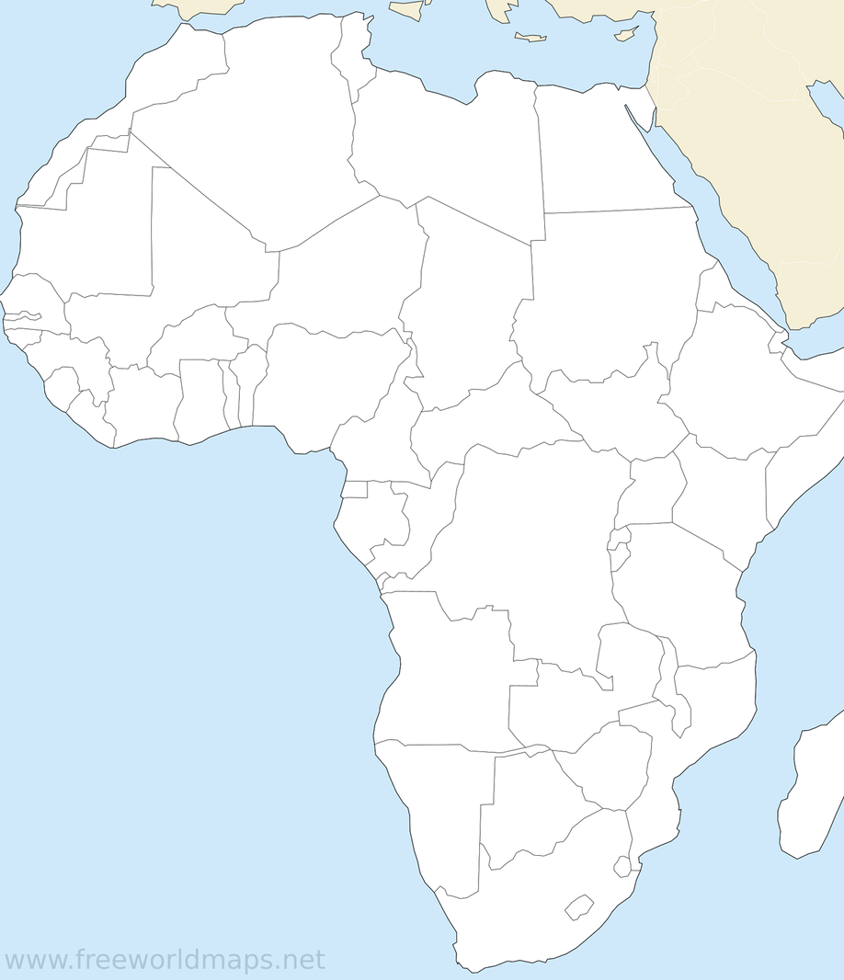





Now Think About Your Problem
You have just completed a full GeoAI workflow on a real problem with real data. The same seven steps work on almost any problem where location matters.
Ask yourself:
› Is there a problem I care about where the answer changes depending on location?
› Can I find data for it on HDX or another open data source?
› Who would benefit from being able to query that data in plain English?
Possible GeoAI projects for Ghana:
Health clinic access gaps
School quality by district
Water access mapping
Road condition by region
Urban heat mapping
Flood risk by community
Maternal mortality clustering
Market price volatility

Slide 25
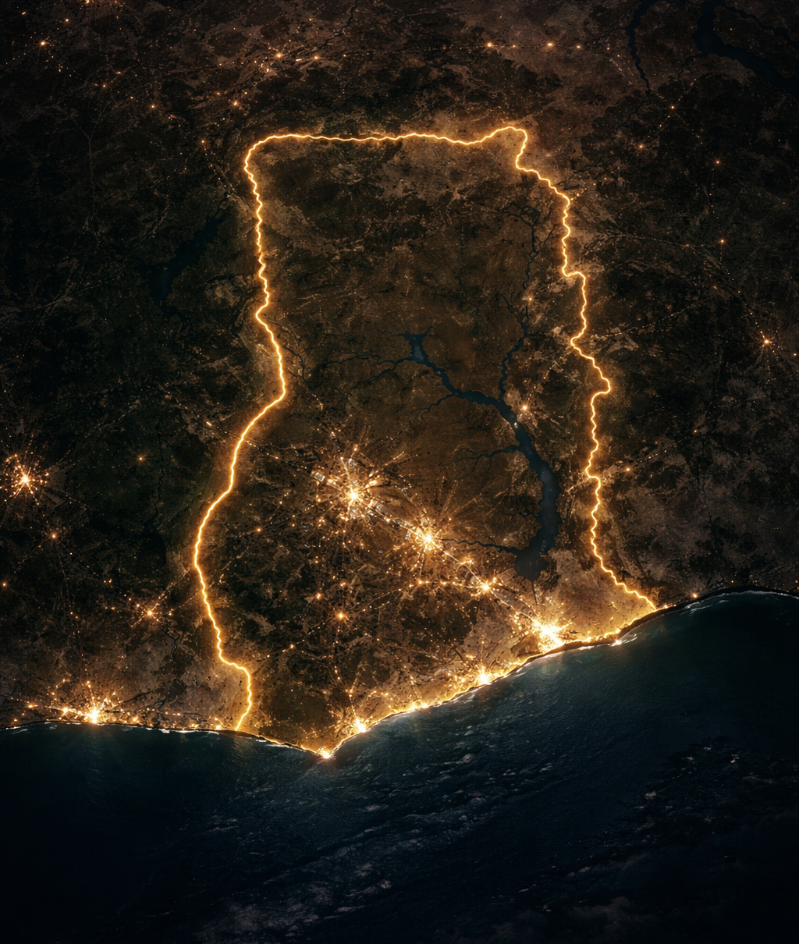



Thank you
Notebook and Data
Go Deeper
github.com/ChantelleAA/gain_geoai_workshop
geopandas.org
data.humdata.org
Spatial Data Science — Gimond (free)
geoboundaries.org
Fast.ai Practical Deep Learning
Extend the Project
Contact
Notebook 02: add population context
Chantelle Amoako-Atta
Swap rice for another commodity
Decarb-AI Programme, UCD
Deploy the Gradio app publicly
linkedin.com/in/chantelleaa
Your ideas and questions help improve this workshop.
Feedback is always welcome.
Chantelle Amoako-Atta | GAIN Monthly Dialogue | March 2026

