Slide 1
Short-Term Extreme Value Prediction
for the IEA 15 MW Floating Offshore Wind Turbine
ERA5 Environmental Data · Joint Distribution Fitting · IFORM Contours · OpenFAST Simulation · Gumbel & ACER Extreme Value Analysis
Chantelle — Supervisor Progress Update | April 2026
Replicating: Chai et al. (2024) Ocean Engineering 306, 118120

Slide 2
The Big Picture: What Is This Work Trying to Answer?
• Core question: Is the IEA 15 MW floating wind turbine structurally safe under the worst 100-year sea conditions?
• To answer that, three problems must be solved in sequence:
1. ENVIRONMENTAL PROBLEM — What is the worst realistic combination of wind + waves?
→ Build a 100-year environmental contour in (Uw, Hs, Tp) space
2. SIMULATION PROBLEM — What loads does that combination produce on the turbine?
→ Run OpenFAST stochastic simulations at the extreme conditions
3. STATISTICAL PROBLEM — What is the single worst load over the full return period?
→ Extrapolate extreme load distribution using Gumbel and ACER
• My work over the past 2 weeks covers ALL THREE stages:
Stage 1 — Validated the joint distribution model (Johannessen) and fitted it to ERA5 data
Stage 2 — Built the IFORM contour, selected ECs, set up OpenFAST simulation pipeline
Stage 3 — Implemented Gumbel and ACER extreme value prediction code
• PhD context — the ultimate goal is a 4th stage:
Stage 4 — Repeat the whole pipeline across time (1950–2025) to track how extremes change with climate

Slide 3
Paper Overview: Chai et al. (2024)
Ocean Engineering 306, 118120 — what they did, step by step
Build 3D environmental contour
Step 1
Used Johannessen (2001) Northern North Sea stats. IFORM sphere (β=4.73) in (Uw, Hs, Tp) space gives Fig. 2.
Slice at 4 hub wind speeds
Step 2
Fixed Vhub = 6.98 · 10.59 · 25.0 · 57.64 m/s → 2D (Hs,Tp) loops at each speed (Fig. 3).
Pick worst (Hs, Tp) per loop
Step 3
Run OpenFAST at several points on each loop → find maximum structural response → that is the design EC.
50 stochastic simulations per EC
Step 4
JONSWAP waves, different random seeds, 4200 s each (600 s transient + 3600 s analysis).
Extreme value prediction
Step 5
Gumbel block-maxima and ACER peak-exceedance applied to mooring tension, tower shear, bending moment.
Safety check
Step 6
Mooring: max tension < 60% MBS (API-RP-2SK). Tower: within Eurocode 3 S355 allowables. Both pass ✓

Slide 4
Key Insight from the Paper: Why the Parked Case Is Worst
EC5 (57.64 m/s, turbine parked) drives the largest tower loads — counterintuitively
• You might expect the operating turbine (blades spinning, converting wind to electricity) to be under more stress.
• But the parked turbine (blades feathered, no rotation) actually produces the LARGEST tower loads.
• Why? When the turbine is operating, the spinning rotor acts like a giant sail that 'catches' the wind
smoothly and converts it to torque — the aerodynamic loads are distributed over the rotor disk.
The controller also actively limits thrust by pitching blades.
When the turbine is PARKED, the blades are feathered (edge-on to the wind) but the wind still
hits the tower and platform directly with nothing absorbing it.
The drag on the tower + platform becomes the dominant structural load.
• At EC5: Vhub = 57.64 m/s, Hs = 14.33 m, Tp = 14.78 s
Tower base shear force: 5.15 × 10³ kN (maximum across all ECs)
Tower base bending moment: 7.82 × 10⁵ kN·m (maximum across all ECs)
Max mooring tension: 4.74 × 10³ kN (safety factor 4.70 — well above minimum 1.67 ✓)
• This shapes our simulation strategy: EC5 (parked, 100-year wind) is the critical design load case.

Slide 5
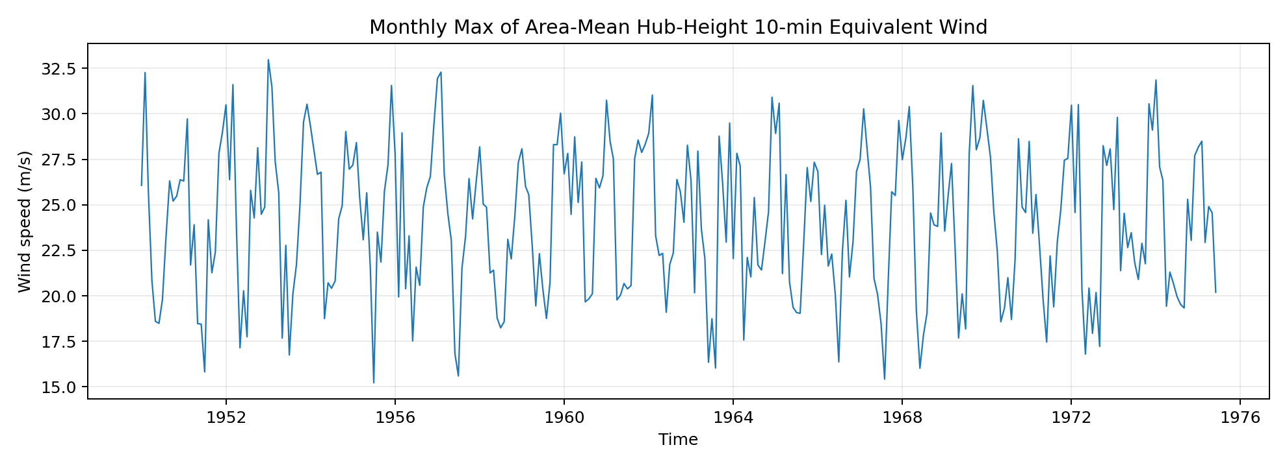
Data Foundation: ERA5 Reanalysis (1950–2025)
75 years of hourly metocean data — the input to everything else
• Source: ECMWF ERA5 global atmospheric reanalysis, downloaded via the Copernicus CDS API
• Variables extracted at each grid point:
u10, v10 → 10 m wind components → W = √(u²+v²) (m/s)
u100, v100 → 100 m wind components (used for validation + sensitivity)
swh → significant wave height Hs (m)
pp1d → peak spectral wave period Tp (s)
• Data summary at validation point (56.5°N, 3.5°E — North of Scotland):
Total records: 666,216 hourly observations (1950–2025, 76 years)
Mean wind W: 8.35 m/s · Weibull shape β=2.35, scale α=9.42 m/s
100-year wind (10 m, 1-h): 28.7 m/s (from fitted distribution)
• 6 Irish Sea / North Sea buoy locations extracted (M1–M6):
M1: 53.13°N, 11.20°W M2: 53.48°N, 5.43°W M3: 51.22°N, 10.55°W
M4: 55.00°N, 10.00°W M5: 51.69°N, 6.70°W M6: 53.06°N, 15.93°W
• Current demo subset used for preliminary EVA: 1950–1981 (31.2 years, 375 files)
Enough for 32 annual maxima → meaningful Gumbel/GEV/POT comparison
Hub wind speed time series (10 m extrapolation, 150 m)

Slide 6
Hub-Height Wind Extrapolation: Formula and Intuition
ERA5 measures wind at 10 m. The turbine hub is at 150 m. Two corrections needed.
• Physical intuition: Wind is slower near the sea surface due to friction.
It increases with height — this is the wind SHEAR PROFILE.
A 150 m hub sits in significantly faster wind than the surface.
• Step 1 — Height correction (power-law profile, IEC 61400-1):
U_hub = U_ref × (z_hub / z_ref)^α with α = 0.11 (offshore standard)
From 10 m: U_hub = U_10 × (150/10)^0.11 = U_10 × 1.369
From 100 m: U_hub = U_100 × (150/100)^0.11 = U_100 × 1.046
• Step 2 — Averaging period (1-hour ERA5 → 10-minute turbine standard):
V_hub (10-min) = U_hub (1-h) × 1.10
A 10-min average is higher than 1-h because shorter windows capture stronger gusts.
• Combined from 10 m: V_hub = U_10 × 1.10 × 1.369 ≈ U_10 × 1.506
Example: U_10 = 38.9 m/s → V_hub = 57.6 m/s ✓ (matches Chai et al. EC5)
• Why larger α means more amplification:
α = 0.05 (very flat profile): (150/10)^0.05 = 1.145
α = 0.11 (offshore standard): (150/10)^0.11 = 1.369
α = 0.20 (onshore, rougher): (150/10)^0.20 = 1.741
→ 10 m extrapolation is HIGHLY SENSITIVE to α choice (large vertical jump)
10 m → 150 m
U₁₀ × 1.369
×1.10 → V_hub
100 m → 150 m
U₁₀₀ × 1.046
×1.10 → V_hub

Slide 7
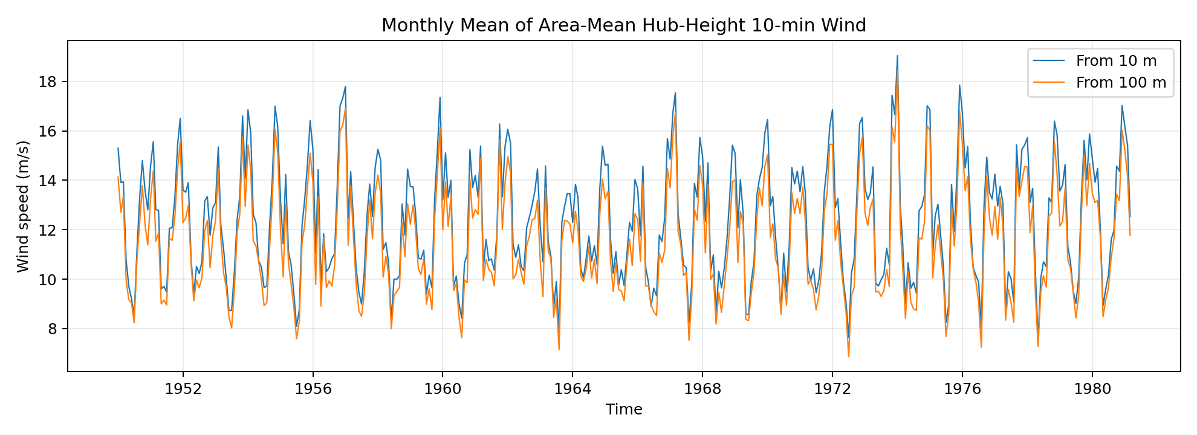
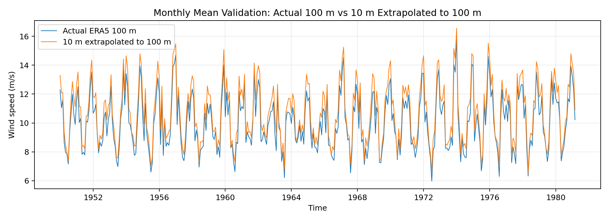
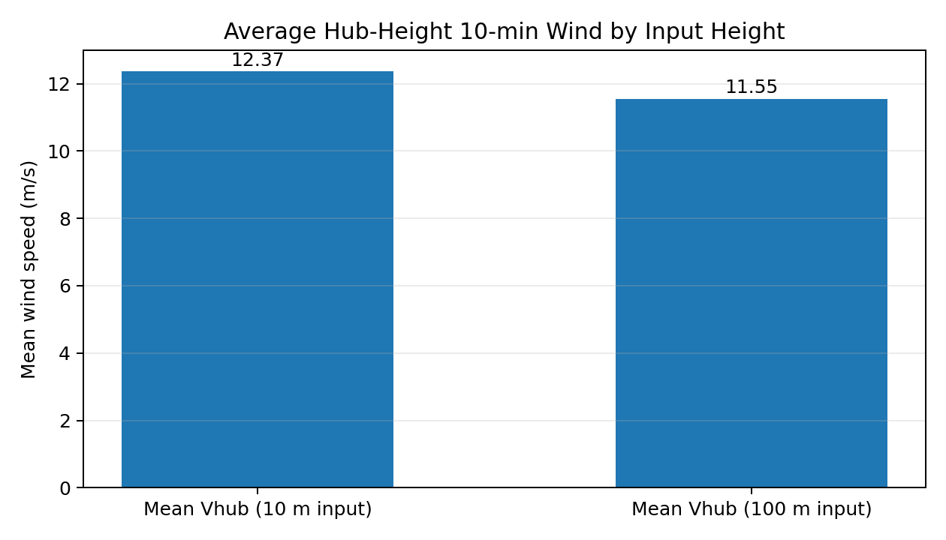
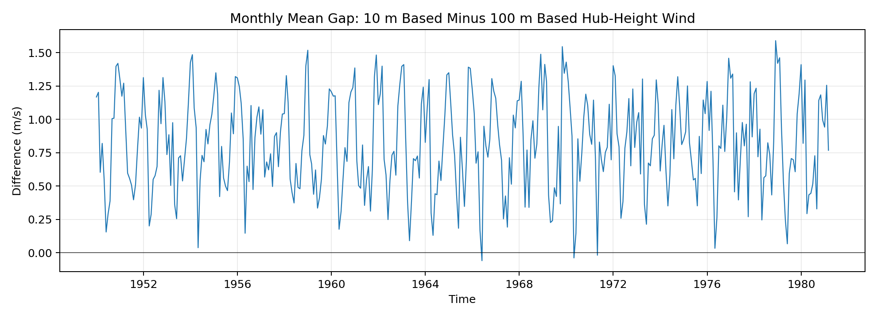
10 m vs 100 m Extrapolation: Which Is More Reliable?
Internal validation against actual ERA5 100 m wind reveals systematic bias in 10 m method
• Two hub-height series computed from the same ERA5 data:
From 10 m: mean V_hub = 12.37 m/s
From 100 m: mean V_hub = 11.55 m/s
Mean absolute difference: 0.96 m/s (8.66% of the 100 m value)
• Internal validation — extrapolate 10 m ONLY UP TO 100 m, compare to actual ERA5 100 m:
Extrapolated 10→100 m mean: 10.75 m/s
Actual ERA5 100 m mean: 10.04 m/s
Bias: +0.71 m/s · MAE: 0.84 m/s · RMSE: 0.97 m/s · MAPE: 9.76%
• Conclusion: 10 m power-law already overpredicts at 100 m
→ likely also overpredicts at 150 m
→ 100 m based extrapolation is the more trustworthy estimate
→ 10 m based extrapolation is kept as the paper-consistent BASELINE

Slide 8
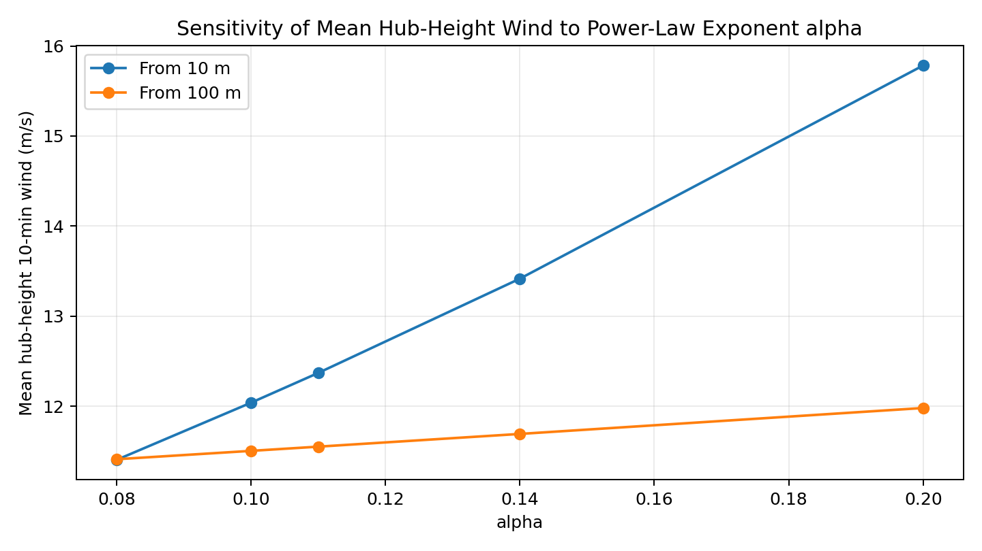
Sensitivity to Power-Law Exponent α
10 m extrapolation is much more sensitive to α than 100 m — quantified here
• α (shear exponent) controls how fast wind increases with height.
Offshore seas: α ≈ 0.10–0.12 (smooth surface, weak shear)
Coastal/nearshore: α ≈ 0.14–0.16
Onshore/rough: α ≈ 0.20–0.25
• Key result from sensitivity analysis:
At α = 0.11: 10 m gives 12.37 m/s · 100 m gives 11.55 m/s
As α increases, 10 m based estimate rises MUCH faster
Because: 10 m spans 10→150 m (15× height ratio) vs 100 m spans 100→150 m (1.5× ratio)
• This is why the 10 m extrapolation is high-risk:
A small error in α (which is often region- and season-dependent)
gets amplified over the full 140 m vertical span
• For thesis: will use α = 0.11 as paper-consistent baseline,
carry α sensitivity as formal uncertainty quantification

Slide 9
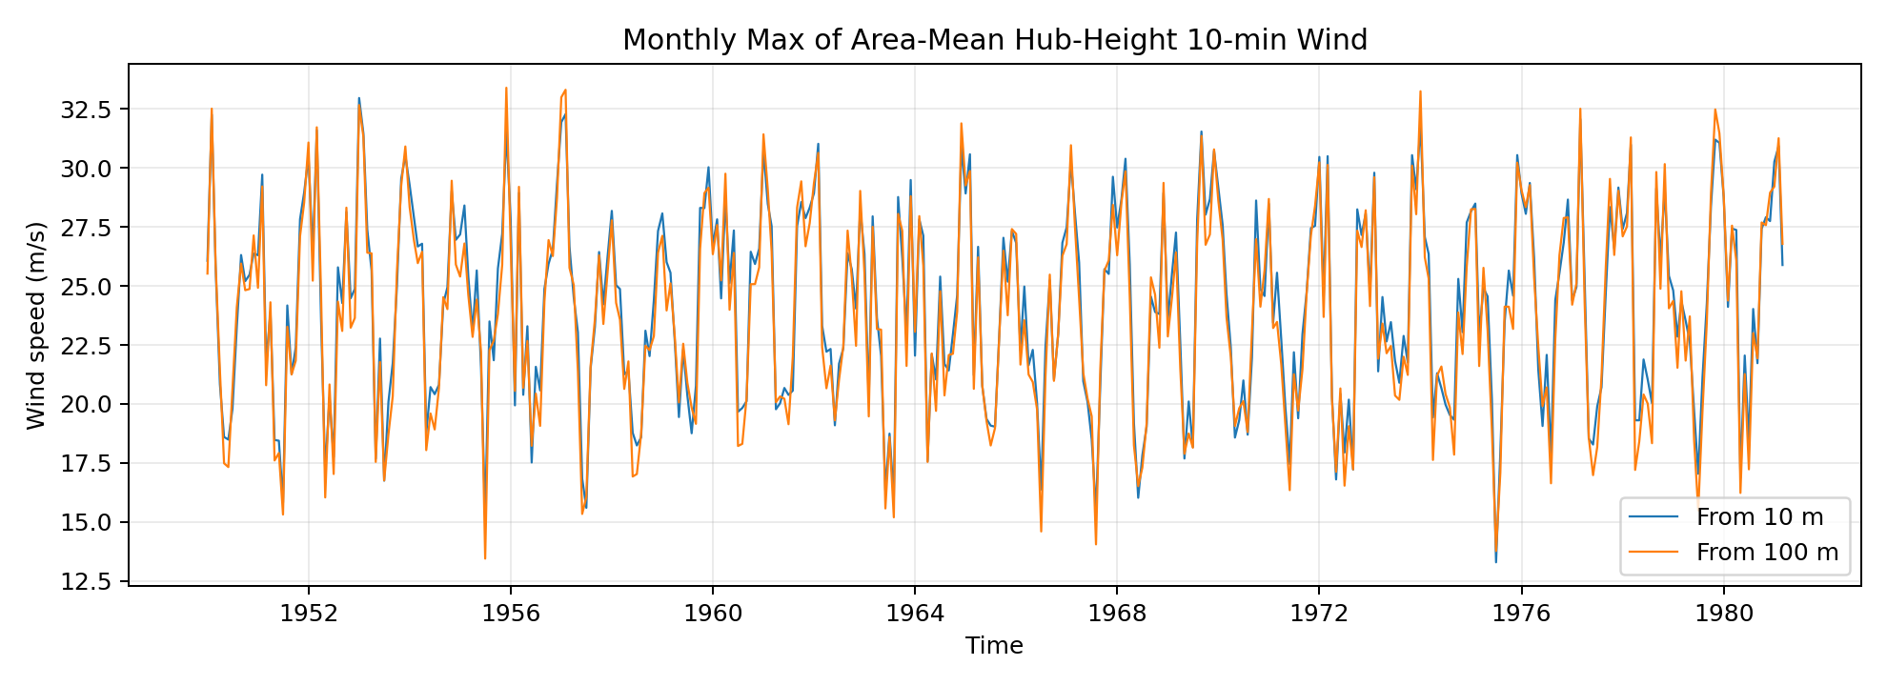
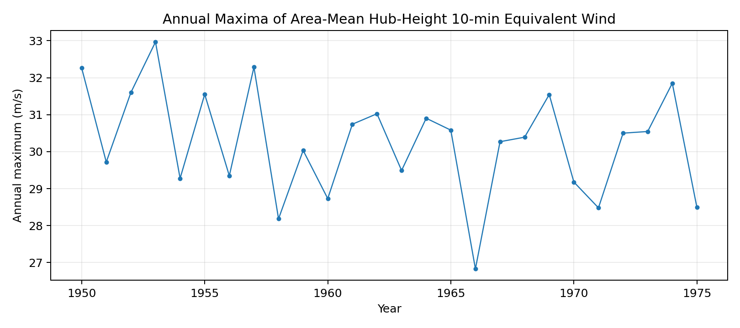
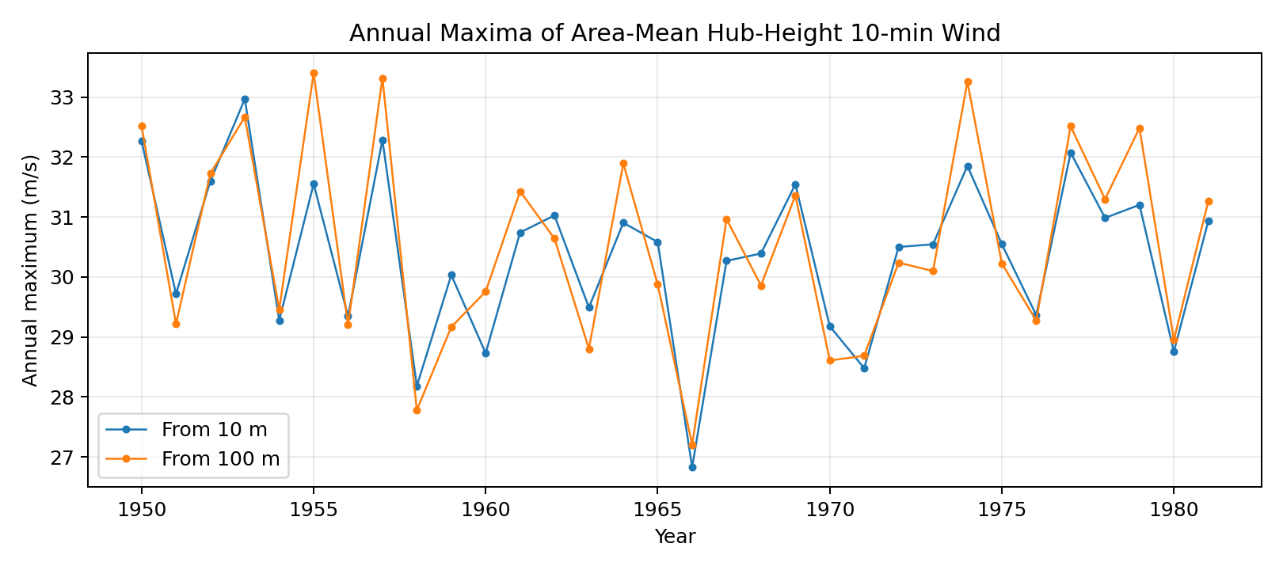
Annual Maxima and Time Series — Input to Extreme Value Analysis
• Top left: full hub-wind time series (10 m vs 100 m paths track closely in shape,
differ by ~0.96 m/s mean offset)
• Top right: annual maxima used as input to Gumbel/GEV fitting
32 years of data → 32 block maxima
Scatter reflects natural interannual variability
• Bottom left: annual maxima comparison between 10 m and 100 m paths
Similar year-to-year pattern — same storm events drive both
10 m consistently higher due to larger extrapolation factor

Slide 10
Five Extreme Value Methods — Quantifying Model-Form Uncertainty
Applied to hub-height wind speed from ERA5 subset (1950–1981, 32 annual maxima)
• Why compare five methods? Any single EVA method embeds assumptions.
Comparing them quantifies model-form uncertainty — how much the estimate depends on model choice.
100-yr RL
Gumbel block-max
F(x)=exp(-exp(-(x-μ)/β))
Simple, transparent, used in paper. CONSERVATIVE.
36.31 m/s
GEV block-max
F(x)=exp(-(1+ξ(x-μ)/σ)^(-1/ξ))
Generalises Gumbel (ξ=0). More flexible.
32.90 m/s
Weibull block-max
F(x)=1-exp(-(x/α)^β)
Practical engineering benchmark for positive vars.
32.88 m/s
Lognormal block-max
ln(X) ~ Normal(μ,σ)
Benchmark for positive skewed variables.
33.68 m/s
POT/GPD
P(Y>y|X>u)=(1+ξy/σᵤ)^(-1/ξ)
Uses more tail data. Threshold u=21.89 m/s, n=746 peaks.
33.16 m/s
Key finding: Gumbel is 9–10% MORE CONSERVATIVE than the other methods (36.31 vs ~33 m/s).
This is exactly why the paper pairs Gumbel with ACER — one conservative, one efficient.

Slide 11
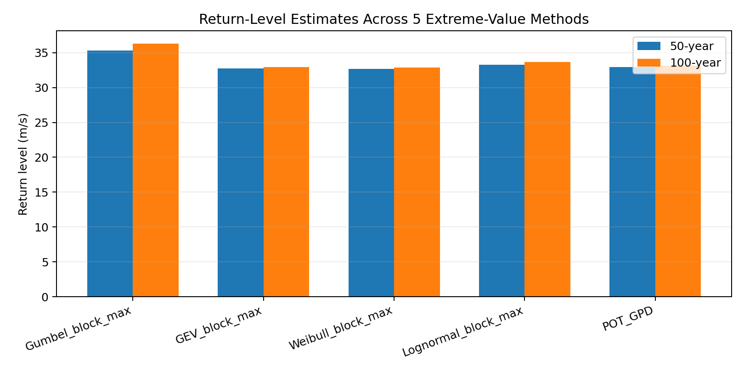
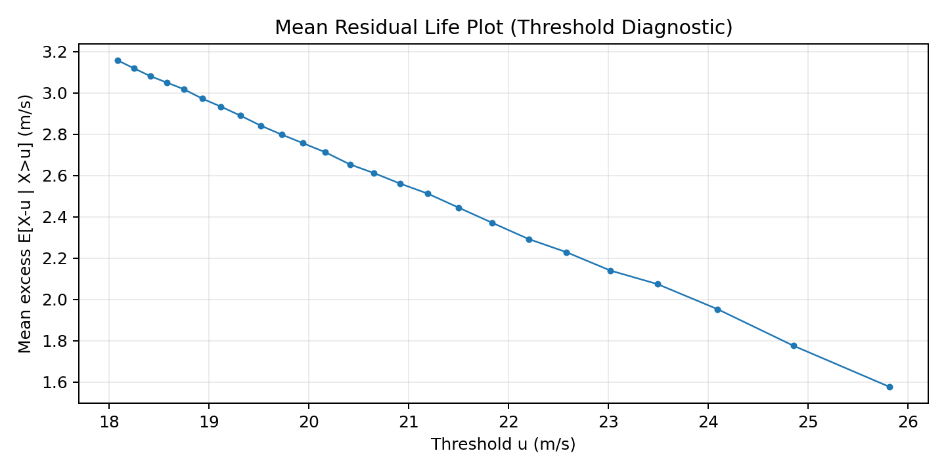
Return Level Comparison and POT Threshold Diagnostic
• Left — Return level plot:
All 5 methods plotted on the same axes
Gumbel diverges upward at long return periods
GEV, Weibull, Lognormal, POT cluster tightly — they agree
Spread at 100 years quantifies model-form uncertainty
• Right — Mean Residual Life (MRL) plot for POT threshold selection:
x-axis: candidate threshold u
y-axis: mean excess (average amount by which exceedances exceed u)
Theory: if data follows GPD above u, MRL should be LINEAR in u
The near-linear region identifies a valid threshold range
Chosen threshold: u = 21.89 m/s (q=0.95), giving 746 declustered peaks
GPD shape parameter ξ = −0.327 (upper tail is bounded)

Slide 12
Joint Distribution Model: (Uw, Hs, Tp) Are Not Independent
Strong physical coupling — wind drives waves, waves set the period
• The three environmental variables are physically linked:
High winds → large waves → long-period swell
Must model them JOINTLY — not independently
• Hierarchical conditional factorisation (Rosenblatt transform):
f(Uw, Hs, Tp) = f(Uw) × f(Hs | Uw) × f(Tp | Hs, Uw)
• Three distributions fitted:
• Johannessen (2001) parameters (benchmark):
Uw Weibull: α=8.43, β=1.71
α_Hs(W) = 1.8 + 0.100·W^1.322
β_Hs(W) = 2.0 + 0.135·W
Tp model: μ_Tp = (4.883+2.68·Hs^0.529)·(1−0.19·Δ)
• Our ERA5 fit (56.5°N):
Uw Weibull: α=9.42, β=2.35
α_Hs(W) = 0.488·W^0.870 + 0.829
β_Hs(W) = 0.011·W^2.106 + 0.995
Variable
Distribution
Parameters depend on
Source
Uw (wind)
Marginal Weibull
— (fitted to all data)
ERA5 10 m wind
Hs | Uw
Conditional Weibull
Scale & shape linear in Uw
ERA5 swh
Tp | Hs, Uw
Conditional Lognormal
μ & σ as power-law in Hs
ERA5 pp1d

Slide 13
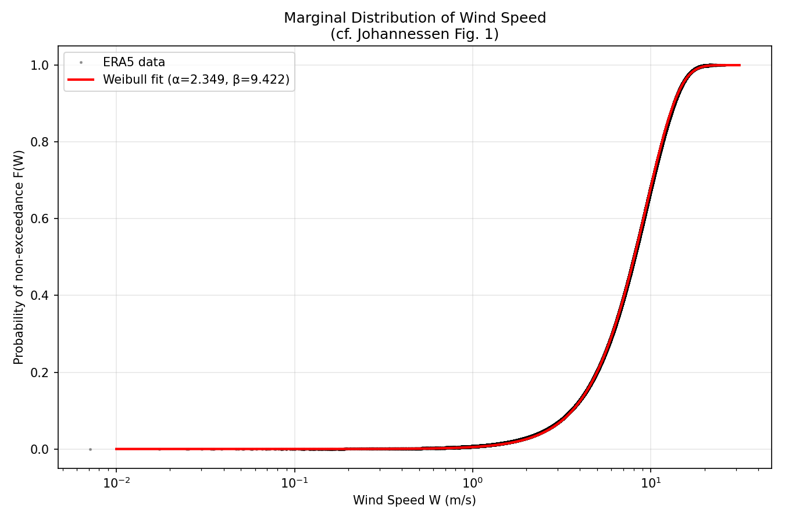
Fitting the Marginal Wind Distribution: Weibull MLE
Method-of-moments initialisation → scipy MLE → validated against empirical CDF
• Procedure:
1. Compute wind speed: W = √(u10²+v10²) from ERA5 components
2. Method-of-moments: estimate shape β and scale α from sample mean and CV
3. Maximum likelihood estimation (scipy weibull_min.fit) refines parameters
4. Validate: overlay Weibull PDF on histogram, CDF on empirical CDF
• ERA5 results at 56.5°N, 3.5°E:
Shape β = 2.35 (heavier than Johannessen's 1.71 — more Rayleigh-like)
Scale α = 9.42 m/s (slightly higher than Johannessen's 8.43 m/s)
• Fitted 100-year return level: 28.7 m/s (10 m, 1-h)
• Johannessen (Northern North Sea): ~39 m/s (harsher, deeper water)
• The difference is real — our sites are in the milder Irish Sea,
not the open, deep Northern North Sea of the Johannessen dataset

Slide 14
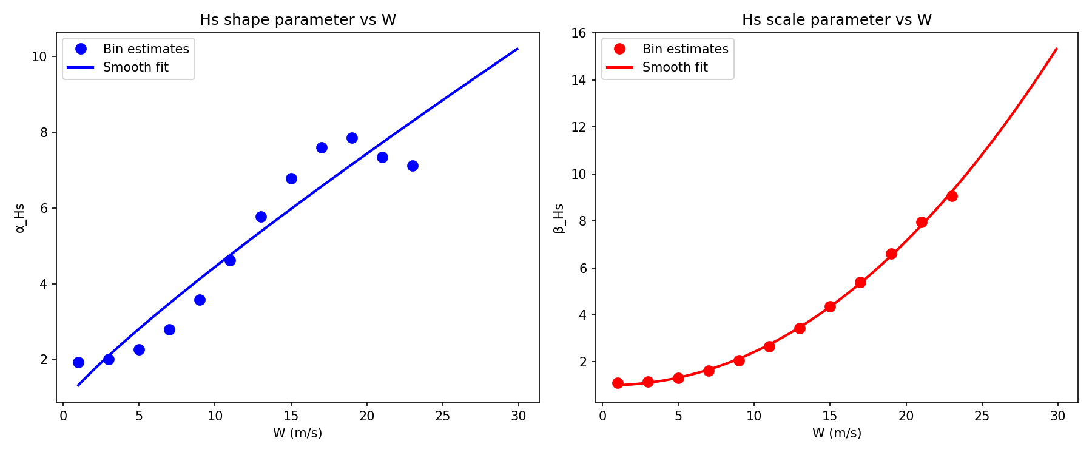
Conditional Wave Height: Hs | Uw
Weibull scale and shape as smooth functions of wind speed — fitted from 14 bins
• For each wind speed bin, Hs follows a conditional Weibull:
F(h|w) = 1 − exp[−(h / α_Hs(w))^β_Hs(w)]
• Fitting procedure:
Bin ERA5 data into 14 wind speed intervals (0–2, 2–4, ..., 24–26 m/s)
Minimum 19,000 data points per bin (dense enough for stable fit)
Fit Weibull to Hs in each bin → get one (α, β) pair per bin
Fit SMOOTH power-law functions through the bin estimates:
α_Hs(W) = 0.488·W^0.870 + 0.829
β_Hs(W) = 0.011·W^2.106 + 0.995
• Physical interpretation:
As wind speed increases, both scale (typical wave height) and shape
(spread of the distribution) increase — bigger and more variable waves
• The smooth functions are what get plugged into the IFORM contour generator

Slide 15
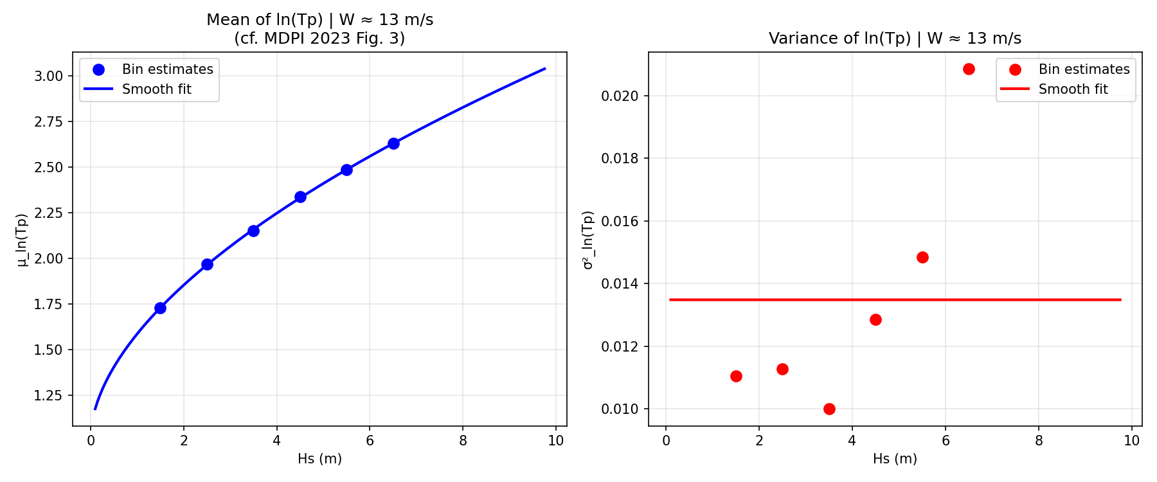
Conditional Peak Period: Tp | Uw, Hs
Lognormal distribution — parameters fitted in (Uw, Hs) double-bins
• Peak period Tp ~ Lognormal given (Uw, Hs):
ln(Tp) ~ Normal(μ_ln, σ_ln)
• Double-bin fitting:
First bin by Uw (6 bins), then by Hs within each Uw bin (6 sub-bins)
Minimum 30 points per (Uw, Hs) cell
In each cell: fit μ_ln and σ_ln of log(Tp)
Then smooth these as power-law functions of Hs:
μ_ln(Hs) = a_μ + b_μ · Hs^c_μ
σ_ln(Hs) = a_σ + b_σ · Hs^c_σ
• Key values:
W=10 m/s, Hs=5 m → median Tp = 13.1 s
W=15 m/s, Hs=8 m → median Tp = 15.2 s
W=25 m/s, Hs=13 m → median Tp = 16.2 s
• Note: extreme (W, Hs) combinations at high wind + low wave height
can cause parameter overflow — flagged and filtered

Slide 16
IFORM: How the Return Period Becomes a 3D Surface
Inverse First-Order Reliability Method — the mathematical bridge from statistics to design conditions
• Step 1 — Map to standard normal space (Rosenblatt transform):
U₁ = Φ⁻¹(F_W(Uw))
U₂ = Φ⁻¹(F_{Hs|W}(Hs | Uw))
U₃ = Φ⁻¹(F_{Tp|Hs,W}(Tp | Hs, Uw))
In (U₁,U₂,U₃) space, all distributions become standard normal
• Step 2 — The 100-year event maps to a sphere of radius β:
β = Φ⁻¹(1 − 1/(T · N_obs/yr))
T=100 yr, N_obs=8766/yr → β = 4.727
Every point on the sphere has the SAME return period — just different combinations
• Step 3 — Parametrise the sphere with (θ, φ) and transform back:
u₁ = β·cos(θ) → Φ⁻¹ of F_W → Uw
u₂ = β·sin(θ)·cos(φ) + Uw → Φ⁻¹ of F_{Hs|W} → Hs
u₃ = β·sin(θ)·sin(φ) + Uw, Hs → Φ⁻¹ of F_{Tp|Hs,W} → Tp
• Result: a 3D surface in (Uw, Hs, Tp) — every point is a 100-year event
• Discretisation: θ ∈ [0,π] × 50 points, φ ∈ [0,2π] × 100 points = 5000 surface points
Standard Normal Space (U₁,U₂,U₃)
Sphere of radius β=4.727 Every point on this sphere = 100-year event
Rosenblatt transform ↕ (Uw, Hs, Tp) physical space

Slide 17
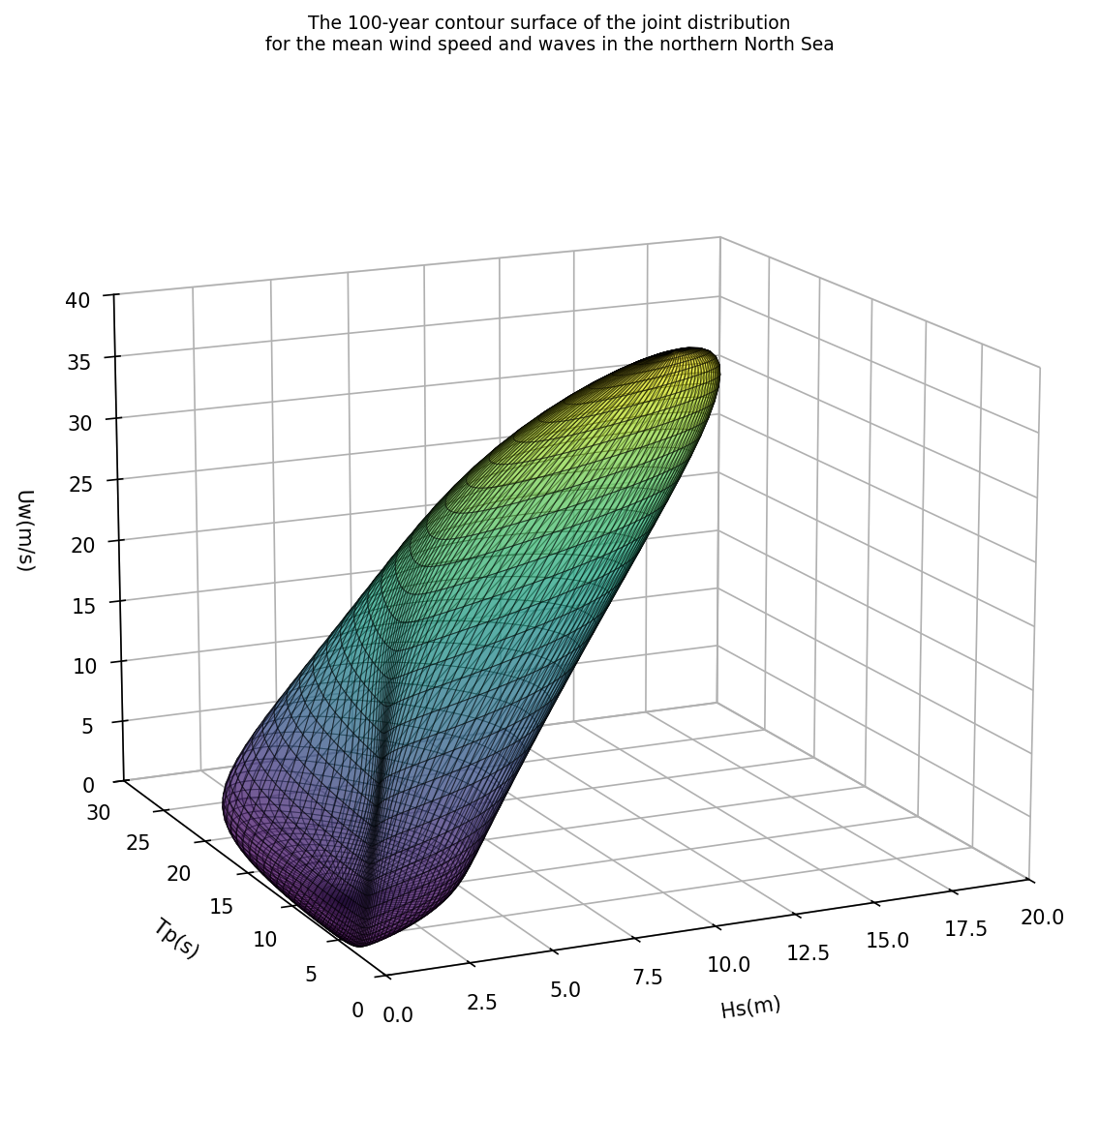
Johannessen 50-Year Contour — Benchmark Validated
Reproduced from parametric model. Max values match published results within 3%.
• Johannessen (2001) Northern North Sea, 1973–1999:
K1Y = 8760 obs/yr · β = 4.584 for 50-year return
• Contour surface results:
Max Uw = 37.8 m/s (10 m, 1-h)
Hub conversion: 37.8 × 1.10 × (150/10)^0.11 = 56.0 m/s
Paper reports: 57.64 m/s → 3% difference ✓
Max Hs = 15.2 m · Max Tp = 23.8 s
• Surface shape (Fig. 2 of paper):
Low winds (left corner) → small waves, short periods
High winds (tall peak) → large waves, long swell
The surface 'wraps' around the IFORM reliability sphere
• Axes are intentionally inverted (Hs axis flips, Tp axis flips)
to match the orientation of Fig. 2 in Chai et al. 2024

Slide 18
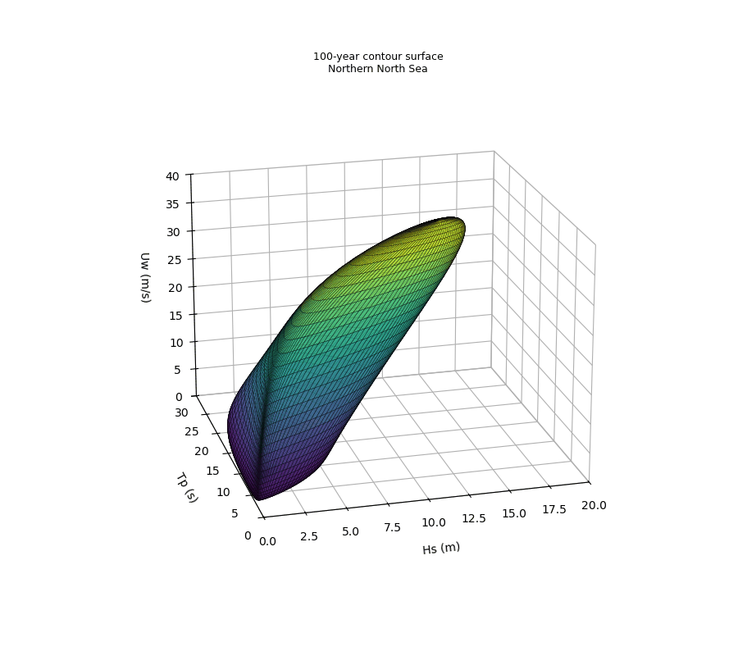
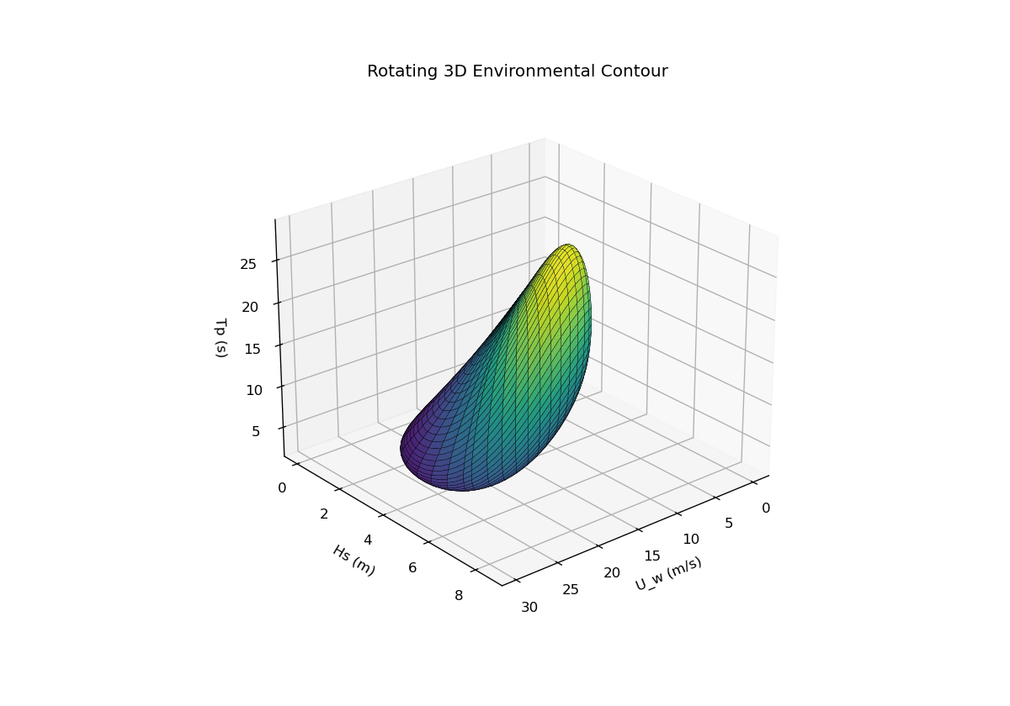
360° Rotating Contour Animations
120 frames · 20 fps · matplotlib FuncAnimation + PillowWriter — full azimuth sweep
Johannessen model — 50-year contour (benchmark, Northern North Sea)
ERA5-fitted model — 100-year contour (our data, Irish Sea buoy M1)
What the animation reveals that a static image cannot:
the surface is a thin shell at low winds, opens into a broad dome at high winds — confirming the physical meaning of the joint distribution

Slide 19
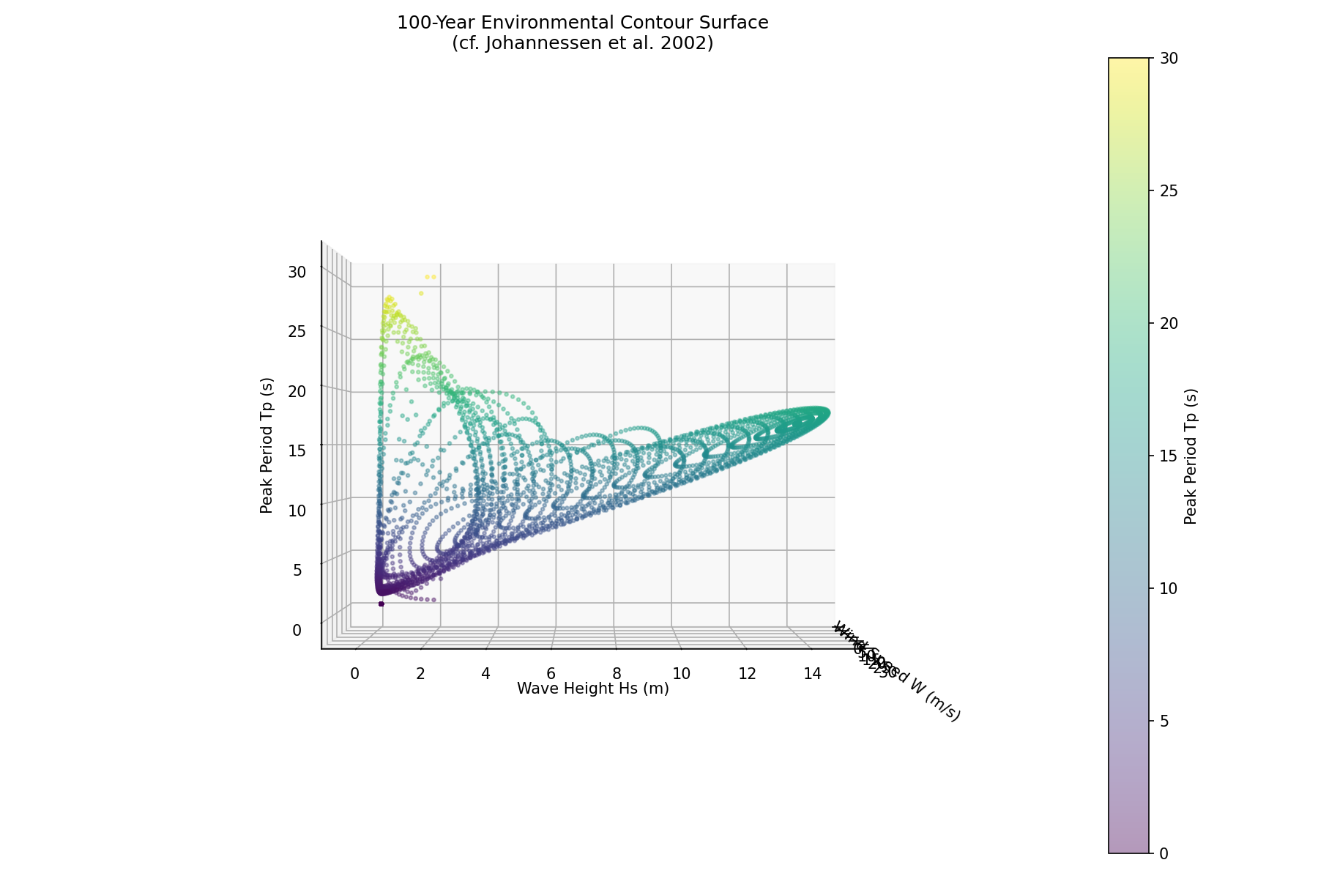
ERA5-Fitted 100-Year Contour — Our Own Data
Fitted independently using 75 years of ERA5 at 6 buoy locations
• All distributions fitted from ERA5 data — not Johannessen's parameters
• M1 (53.1°N, 11.2°W) 100-year results:
β = 4.727 (100 yr × 8766 obs/yr)
Max Uw = 29.5 m/s · Max Hs = 8.49 m · Max Tp = 29.1 s
• Why lower than Johannessen?
Johannessen used the open Northern North Sea (water depth >200 m)
Our M1–M6 locations are in the shallower Irish Sea / Celtic Sea
These are genuinely less severe metocean conditions
• Hs comparison at max Uw:
Johannessen 50-yr: Hs_max = 15.2 m
Our ERA5 100-yr: Hs_max = 8.49 m
Physically consistent — milder sea, even at a LONGER return period
• The 6 buoy locations give slightly different contour shapes,
reflecting regional variation in the Irish/North Sea climatology

Slide 20
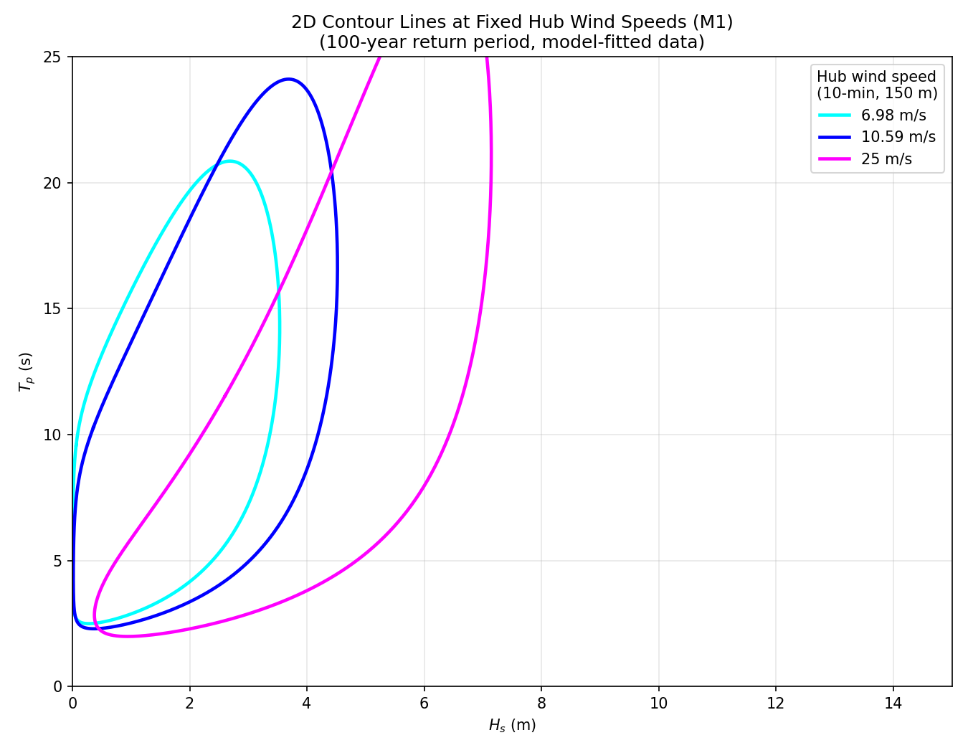
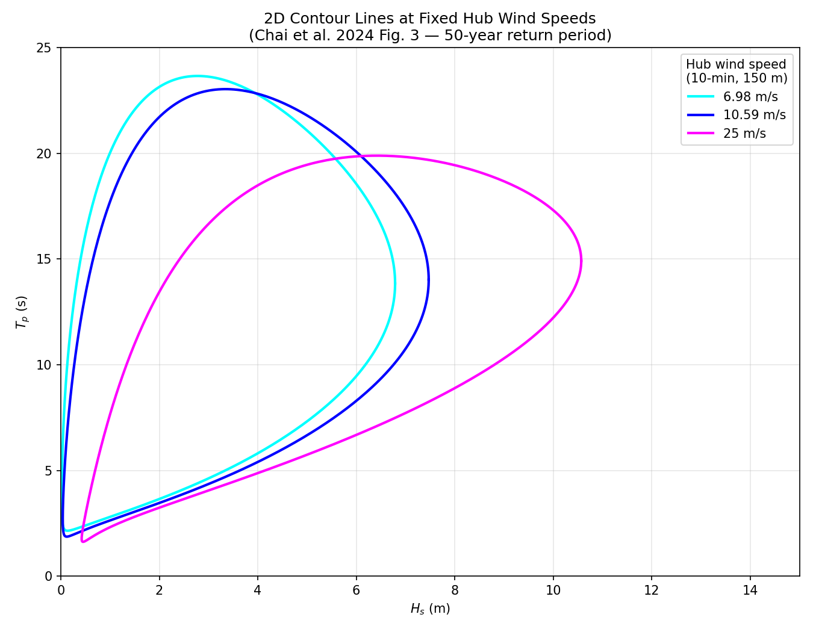
2D Hs–Tp Loops: Slicing the 3D Contour at Fixed Wind Speed
Each coloured loop = one hub wind speed = one 'equally dangerous' family of wave conditions
• Procedure:
Fix V_hub → convert to Uw (10 m, 1-h) using Eq. 9
U_w = V_hub / (1.10 × (150/10)^0.11)
Find the angle θ on the IFORM sphere corresponding to that Uw
Sweep φ from 0 to 2π → trace a closed curve in (Hs, Tp) space
• Hub speeds used: 6.98 · 10.59 · 25.0 · 57.64 m/s
(cut-in, rated, cut-out, 100-year survival)
• Worst-case = point with MAX Hs on each loop
Physically: biggest waves produce the largest structural loads
This is the (Hs, Tp) pair fed into OpenFAST for that wind speed
• Note: 57.64 m/s is right at the edge of the contour sphere
(Uw = 38.9 m/s is near the maximum of the Weibull distribution)
Johannessen benchmark (bottom left) ERA5 M1 fitted (right)

Slide 21
Selected Environmental Conditions (ECs)
One worst-case (Hs, Tp) per wind speed — the simulation inputs
For each hub wind speed, the point with maximum Hs on the 100-year contour loop is selected.
EC
V_hub (m/s) 10-min, 150 m
Uw (m/s) 1-h, 10 m
Hs (m)
Tp (s)
Turbine state
EC1
6.98
4.71
~3–4
~10–11
Operation (below rated)
EC2
10.59
7.15
~5–6
~11–12
Operation (rated)
EC3
25.0
16.87
~9–11
~13–14
Operation (above rated)
EC4
57.64
38.9
~13–15
~14–16
Parked — SURVIVAL
Paper (Chai et al.) EC values for comparison:
EC1: Hs=6.06m · Tp=12.50s · Vhub=3m/s · Op
EC2: Hs=6.80m · Tp=12.70s · Vhub=6.89m/s · Op
EC3: Hs=7.28m · Tp=12.34s · Vhub=10.59m/s · Op
EC4: Hs=10.46m · Tp=14.12s · Vhub=25m/s · Op
EC5: Hs=14.33m · Tp=14.78s · Vhub=57.64m/s · Parked
• EC4 (our) / EC5 (paper): parked turbine in 100-year wind — drives the LARGEST tower loads
• 10 stochastic realizations per EC · TMax = 4200 s (600 s transient + 3600 s analysis)

Slide 22
OpenFAST: IEA 15 MW on UMaine VolturnUS-S Semi-Submersible
Fully coupled aero-hydro-servo-elastic simulation — open-source NREL tool
• Turbine specifications:
Rated power: 15 MW · Cut-in: 3 m/s · Rated: 10.59 m/s · Cut-out: 25 m/s
Hub height: 150 m · Rotor diameter: 240 m · Max rotor speed: 7.56 rpm
• Platform: UMaine VolturnUS-S (4-column semi-submersible steel)
Mooring: 3 catenary chain lines, 850 m length each, MBS = 22,286 kN
Water depth: 200 m · Fairlead depth: 14 m
• Physics modules used in this simulation:
AeroDyn — blade element momentum + generalised dynamic wake aerodynamics
ServoDyn — ROSCO controller (blade pitch + generator torque)
ElastoDyn — structural dynamics: rotor, drivetrain, tower, platform
HydroDyn — potential flow (WAMIT data) + 2nd-order wave forces (QTF)
MoorDyn — dynamic mooring line simulation
SeaState — JONSWAP irregular wave generation (WaveMod=2)
• Validated against: DLW, DIEGO, HAWC2, OpenFAST (Chai et al. Tables 4–7)
All four tools agree within <10% on tower base shear and bending moment ✓

Slide 23
Automated Simulation Pipeline
Python script modifies input files, runs OpenFAST, logs outputs — with caching
• For each EC × realization the script does:
1. Check if .outb already exists → if yes, SKIP (cache hit)
2. Copy the base model directory to a fresh run folder
3. Copy InflowWind file from IEA-15-240-RWT/ to run dir (fixes relative path)
4. Patch HWindSpeed = V_hub in InflowWind (steady wind at hub height, 150 m)
5. Patch WaveHs, WaveTp, WaveTMax, WaveSeed in SeaState (JONSWAP parameters)
6. Patch TMax = 4200 s in .fst
7. Call openfast subprocess, capture stdout
8. Record output file path to run_log for post-processing
• Run directories placed as siblings of IEA-15-240-RWT-UMaineSemi/
(required so ../IEA-15-240-RWT/ relative file paths resolve correctly)
• Caching means the cell is SAFE TO RE-RUN after kernel crash or partial completion
To invalidate and rerun: delete EC*_r* folders manually
• Computation scale:
4 ECs × 10 realizations = 40 runs · ~70 min each → ~47 hrs sequential
Paper: 5 ECs × 50 realizations = 250 runs → ~292 hrs sequential
With 4 CPU cores in parallel: ~12 hrs for our 40-run set

Slide 24
Simulation Outputs: What We Extract and Why
Three structural response channels — chosen to match Chai et al. 2024 Table 9–11
• From each .outb file (binary format, read with openfast_io FASTOutputFile):
Discard first 600 s (transient) → analyse 3600 s per realization
• FAIRTEN1 — fairlead tension in mooring line #1 [N → convert to kN]
Mooring line #1 faces the wave direction alone
Lines #2 and #3 are symmetrically distributed → less loaded
This is the MOST LOADED LINE — critical for mooring integrity
Safety check: max tension < 60% MBS = 0.6 × 22,286 = 13,372 kN
• TwrBsFyt — tower base fore-aft shear force [kN]
Force at the bottom of the tower in the wave/wind direction
Key indicator of overturning risk
• TwrBsMyt — tower base fore-aft bending moment [kN·m]
Most demanding for structural assessment (largest lever arm)
Safety check: must be < LULt_moment (Eurocode 3, S355 steel)
Paper allowables: shear = 1.59×10⁵ kN · moment = 1.08×10⁶ kN·m
• Power spectral density (PSD) of each channel shows which physical
phenomena dominate: pitch frequency, wave frequency, 1P/3P blade

Slide 25
Extreme Value Method 1 — Gumbel Block Maxima
Simple, transparent, used in the paper — but tends to be conservative
• Intuition: if you run 10 simulations and take the maximum of each,
you have a sample from the DISTRIBUTION OF MAXIMA.
The Gumbel distribution is theoretically the limiting distribution of maxima.
• Step 1: extract one block maximum per realization → 10 values per EC per channel
• Step 2: fit Gumbel CDF by MLE:
F(x) = exp{ −exp[ −(x−μ)/β ] }
Two parameters: location μ (shifts the distribution left/right)
scale β (controls how spread out the tail is)
• Step 3: diagnostic — Gumbel probability paper:
y = −ln(−ln(F(x))) plotted vs x should be a STRAIGHT LINE
Deviation from linearity → Gumbel is not a good fit
• Step 4: read off extreme value at λ = 0.01 (1% exceedance per 1-h sea state):
x* = μ − β · ln(−ln(1−0.01)) = μ + 4.60·β
• Known limitation:
Uses only 1 value per run → ignores hundreds of peaks in each time series
This makes it conservative (overestimates the true extreme)

Slide 26
Extreme Value Method 2 — ACER (Naess & Gaidai 2009)
Average Conditional Exceedance Rate — uses every peak, accounts for wave-to-wave correlation
• Motivation: real ocean waves are correlated — a big wave often follows another big wave.
If you just count exceedances ignoring this, you double-count dependent events.
ACER conditions on the PREVIOUS peak to remove this bias.
• Definition: ACER₂(η) = P(Xⱼ > η | Xⱼ₋₁ ≤ η) averaged over all peaks j
This is the rate at which peaks exceed threshold η,
given the immediately preceding peak did NOT exceed η (k=2 Markov order)
• Empirical estimation from R realizations:
ACER₂(η) = (1/R) × Σᵣ #{j≥2: Xⱼ>η, Xⱼ₋₁≤η} / Nᵣ
• Tail fitting (parametric extrapolation):
ê(η) ≈ q · exp{ −a·(η − b)^c } for η ≥ η₀
4 parameters (q, a, b, c) fitted by weighted least-squares in log-space
η₀ = lower bound of the fitting region (upper 20% of peaks)
• Find extreme value η*: set ê(η*) = 0.01 → solve for η*
• Why it works better than Gumbel:
Uses EVERY PEAK (hundreds per run vs 1 for Gumbel) → much more data
Explicitly models peak-to-peak correlation → less bias
Paper: ACER gives lower (less conservative) and more accurate estimates

Slide 27
Gumbel vs ACER — Comparison and Paper Findings
Gumbel
ACER₂
Data used
1 block maximum per run
All local peaks (hundreds per run)
Sample size (10 runs)
10 values
~500–2000 peaks total
Wave correlation
Ignored
Modelled via Markov k=2 conditioning
Tail model
Linear on Gumbel paper
Parametric: q·exp{−a(η−b)^c}
Typical extreme estimate
Higher — conservative
Lower — closer to true value
Uncertainty (paper Table 13)
Larger CI
Most values < 0.10 — very tight
Best use case
Quick check, few simulations
Accurate estimate, more data available
Paper finding (Chai et al. 2024, Section 6):
ACER estimates are consistently smaller than Gumbel. Under extreme conditions (EC5), ACER results are closer to the actual situation and are recommended for short-term prediction.

Slide 28
OpenFAST VTK Animation — Watching the Physics
WrVTK=2, VTK_type=1: exports solid mesh frames every timestep for ParaView
• OpenFAST VTK output flags in the .fst file:
WrVTK = 2 → animation (one .vtp mesh file per frame)
VTK_type = 1 → solid surfaces (blades, tower cylinder, platform)
VTK_fps = 15 → 15 frames per second
• Two sets of .vtp files created in vtk/ folder:
*.ED.*.vtp — ElastoDyn mesh: tower, blades, nacelle (structural deformation)
*.MD.*.vtp — MoorDyn mesh: 3 mooring lines (position as they go taut/slack)
• Load in ParaView:
File → Open → vtk/ folder → select *.ED..vtp (auto-groups as time series)
Click Apply → Press Play ▶ to animate
Load both .ED and .MD groups together in the same scene
• What you can observe:
Platform surge (forward-backward motion with waves)
Platform pitch (tilting due to wave loading + wind thrust)
Blade flex (tip deflection under aerodynamic load)
Mooring lines going taut on upwave side, slack on downwave side
• Used a 60-second test run for visual validation of the simulation setup
Confirmed: turbine spins up, platform responds to waves, mooring holds
[ ParaView 3D View ] Blades: solid surfaces, flexing Tower: cylinder, deforming Platform: pitching & surging Mooring: 3 lines, taut/slack Background: ocean-dark blue Camera: orbit around turbine

Slide 29
PhD Context: How This Feeds the Climate-Change Extension
The replication is Stage 1 — the thesis contribution is the temporal evolution
• What the replication gives us (Stages 1–3):
A validated pipeline: ERA5 → joint distribution → IFORM contour → OpenFAST → Gumbel/ACER
Verified against Chai et al. 2024 EC values and structural response trends
• The PhD contribution — Stage 4 (climate non-stationarity):
Repeat the ENTIRE pipeline using moving 30-year windows across 1950–2025
e.g., 1950–1980, 1951–1981, ..., 1995–2025 (46 overlapping windows)
Track how the 100-year return level of (Uw, Hs, Tp) changes over time
Regenerate ECs per window → how do design conditions shift with climate?
Run reduced OpenFAST campaigns at selected windows (early/mid/recent decade)
Quantify: how much have extreme STRUCTURAL LOADS changed since 1950?
• Questions to answer for the supervisor now:
1. Primary study region: Irish Sea first, then extend to Northern North Sea?
2. 10 m only (paper-consistent) OR carry both 10 m and 100 m as formal sensitivity?
3. Window strategy: 30-year fixed, or decadal blocks?
4. How many OpenFAST runs are feasible per window given compute budget?
1950–1980 Window 1 Early climate
1965–1995 Window N/2 Mid climate
1995–2025 Window M Recent climate
→
→
Trend in 100-year extremes → trend in design loads → climate-driven structural risk

Slide 30
Next Steps and Open Questions
• This week — complete the replication baseline:
Run all 40 OpenFAST simulations (currently code is ready, caching in place)
Apply Gumbel and ACER to all 3 channels × 4 ECs
Reproduce Gumbel probability paper plots and ACER convergence plots
Compare extreme value estimates against Chai et al. Tables 12–14
• Safety check (Section 7 of paper):
Mooring: max tension < 13,372 kN (60% MBS of 22,286 kN, API-RP-2SK)
Tower shear: max < 1.59×10⁵ kN (Eurocode 3, S355 steel)
Tower moment: max < 1.08×10⁶ kN·m
• Extend to all 6 ERA5 buoy locations (M1–M6):
Compare how Irish Sea vs Northern North Sea conditions shift extreme loads
• Scale up to paper methodology:
Increase N_REAL from 10 → 50 realizations per EC
Run 4 ECs in parallel on 4 CPU cores to reduce wall-clock time
• Begin climate extension:
Download full ERA5 to 2025, build sliding-window contour pipeline
• Open questions for supervisor:
• 1) Primary region first: Irish Sea (our ERA5 locations) or replicate
Johannessen's Northern North Sea exactly before extending?
• 2) Carry both 10 m (paper-consistent) AND 100 m extrapolation as
formal sensitivity from the start, or just 10 m baseline?
• 3) Window strategy for climate extension:
30-year rolling windows (standard climate normal) vs decadal blocks?
• 4) How many OpenFAST runs per window are feasible?
Even 10 realizations × 4 ECs × 46 windows = 1840 runs

