Slide 1

my blue planet

Slide 2
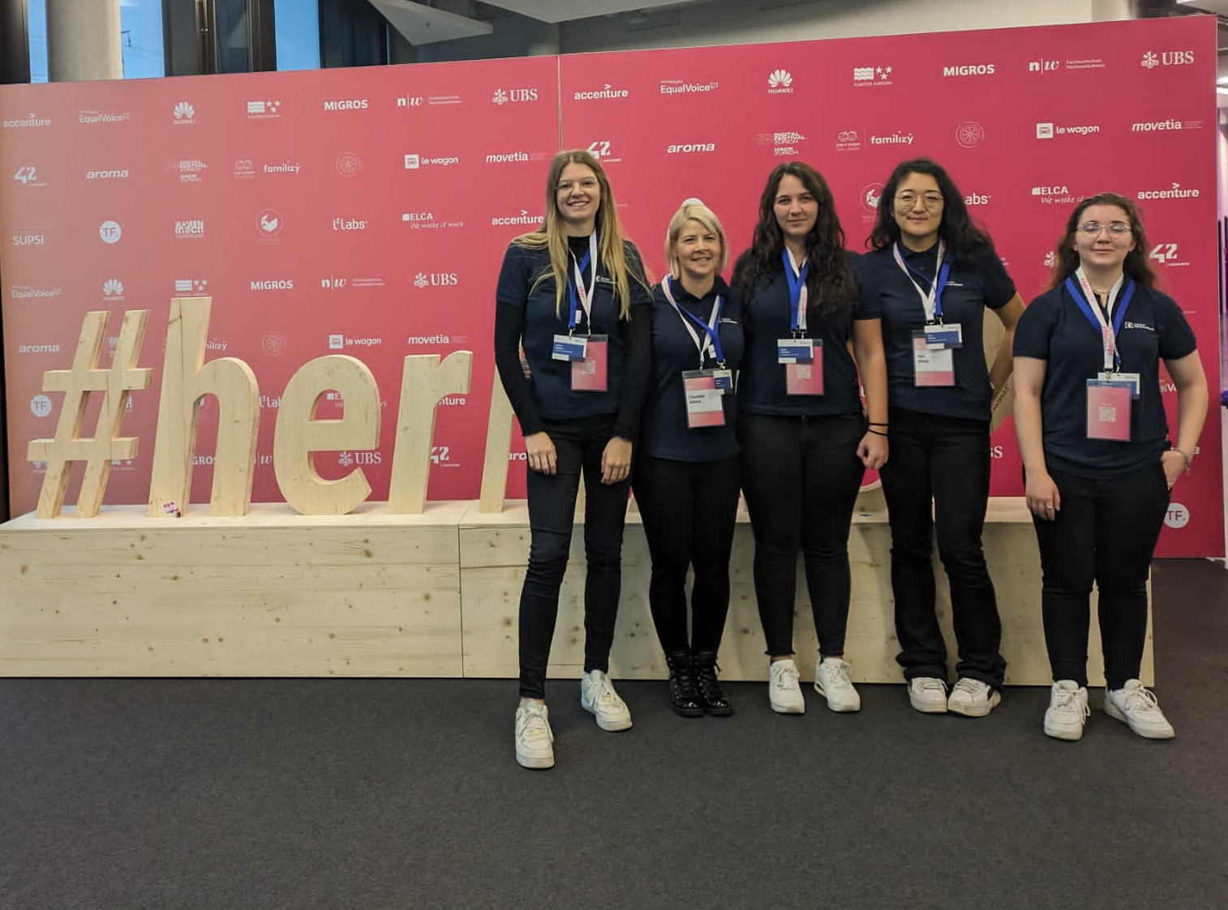
#ITmadeinChreis5 DevOps Engineers at ZKB

Slide 3
Our vision
WHY
HOW
WHAT
Onboarding process with excel outdated
No transparancy between schools
Inspire schools based on technical solutions and high quality input
Build web formular for onboarding and data collection
Receive recommendations based on an integrated api from gis
Instantly find out what measures can be taken by getting an first input from an integrated llm based on given data
An extension of the webapplication klimaschule.ch
See where you stand
Challenge with others and help each other to get sustainable

Slide 4
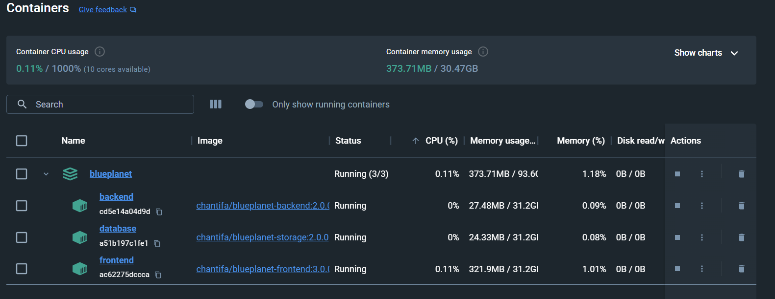
Application build in docker

Slide 5
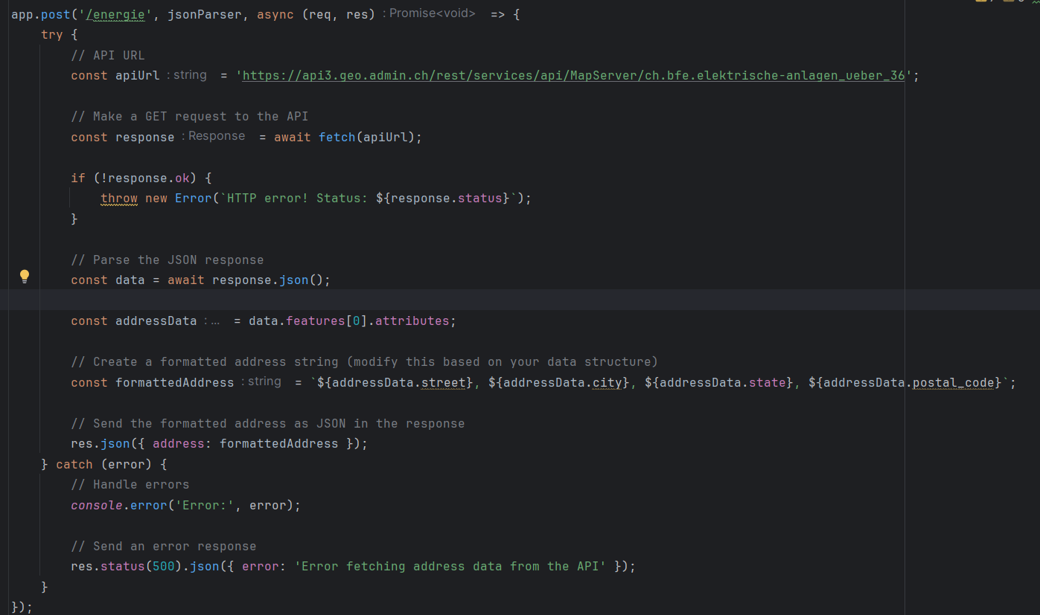
API for GIS-Data

Slide 6
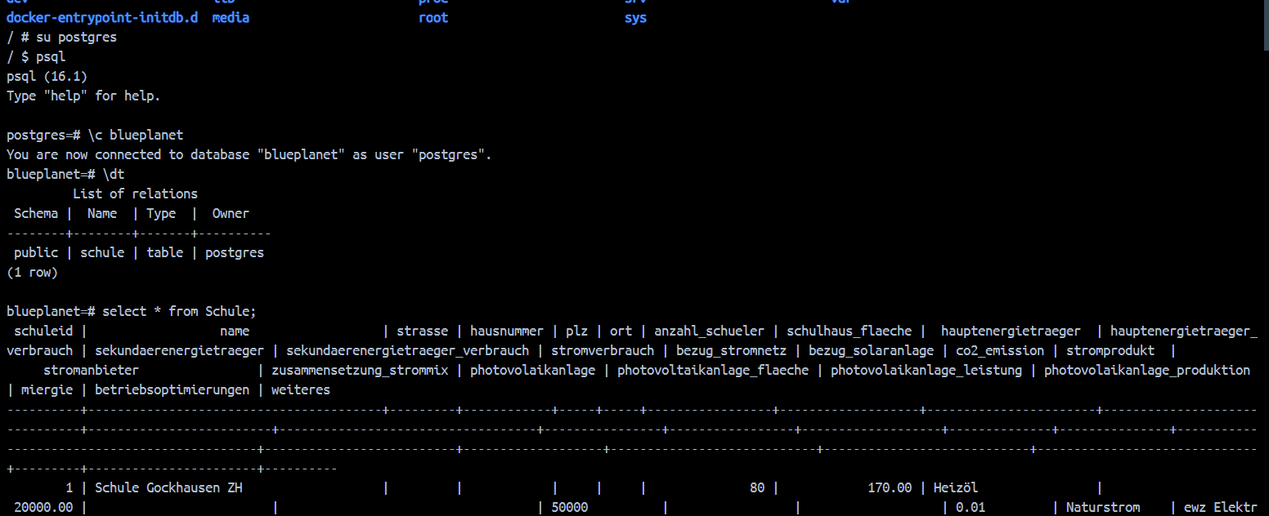
Postgres database

Slide 7
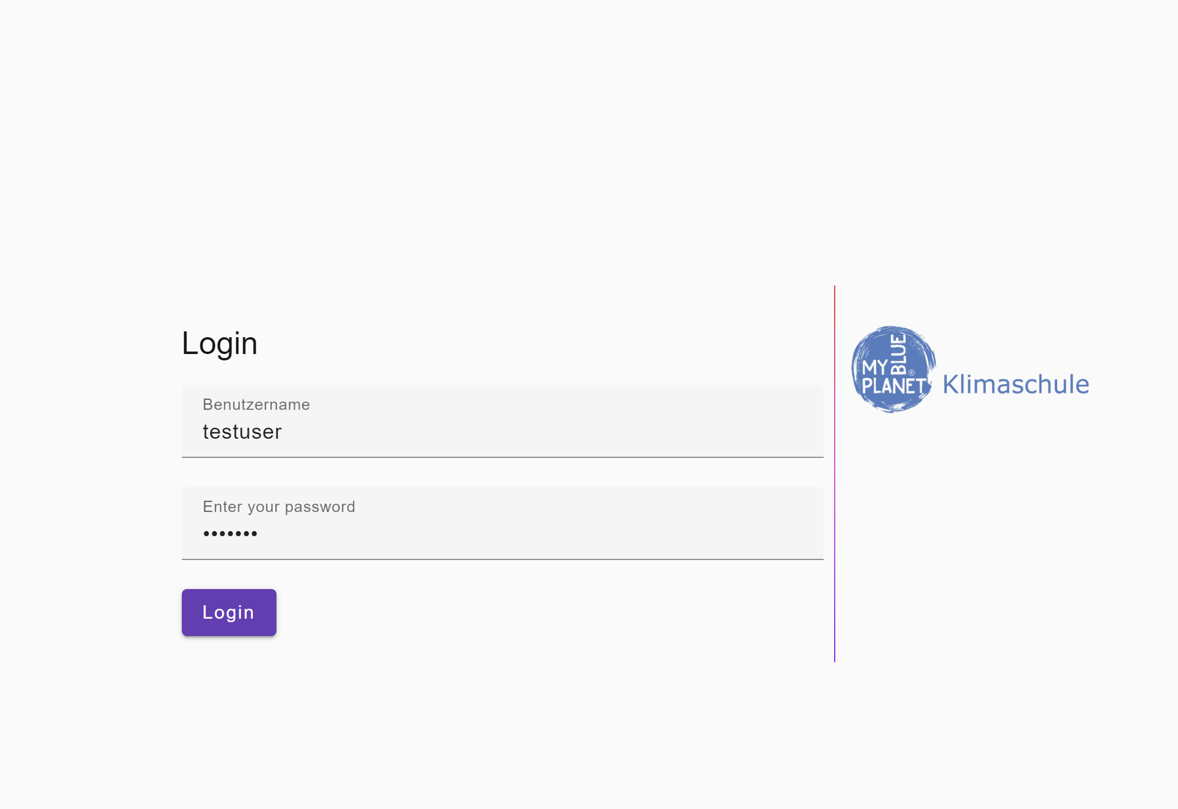
Webformular

Slide 8
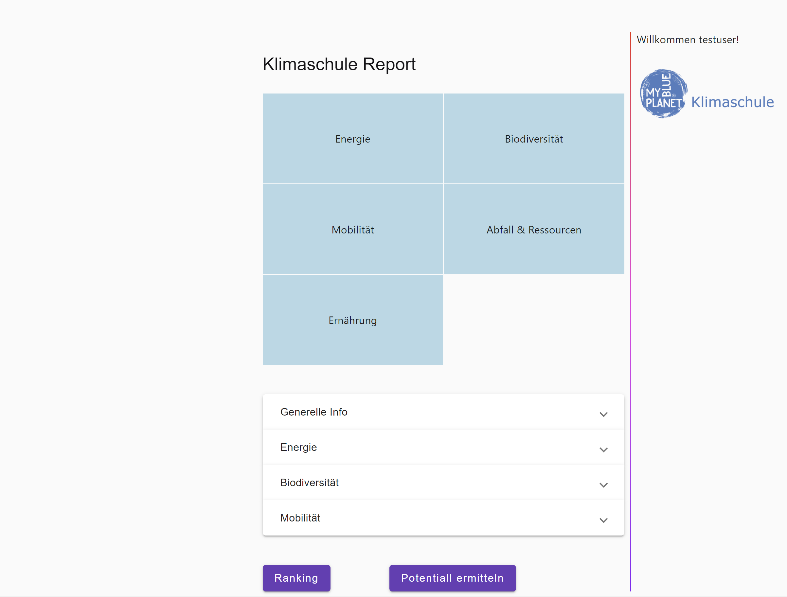
Webformular

Slide 9
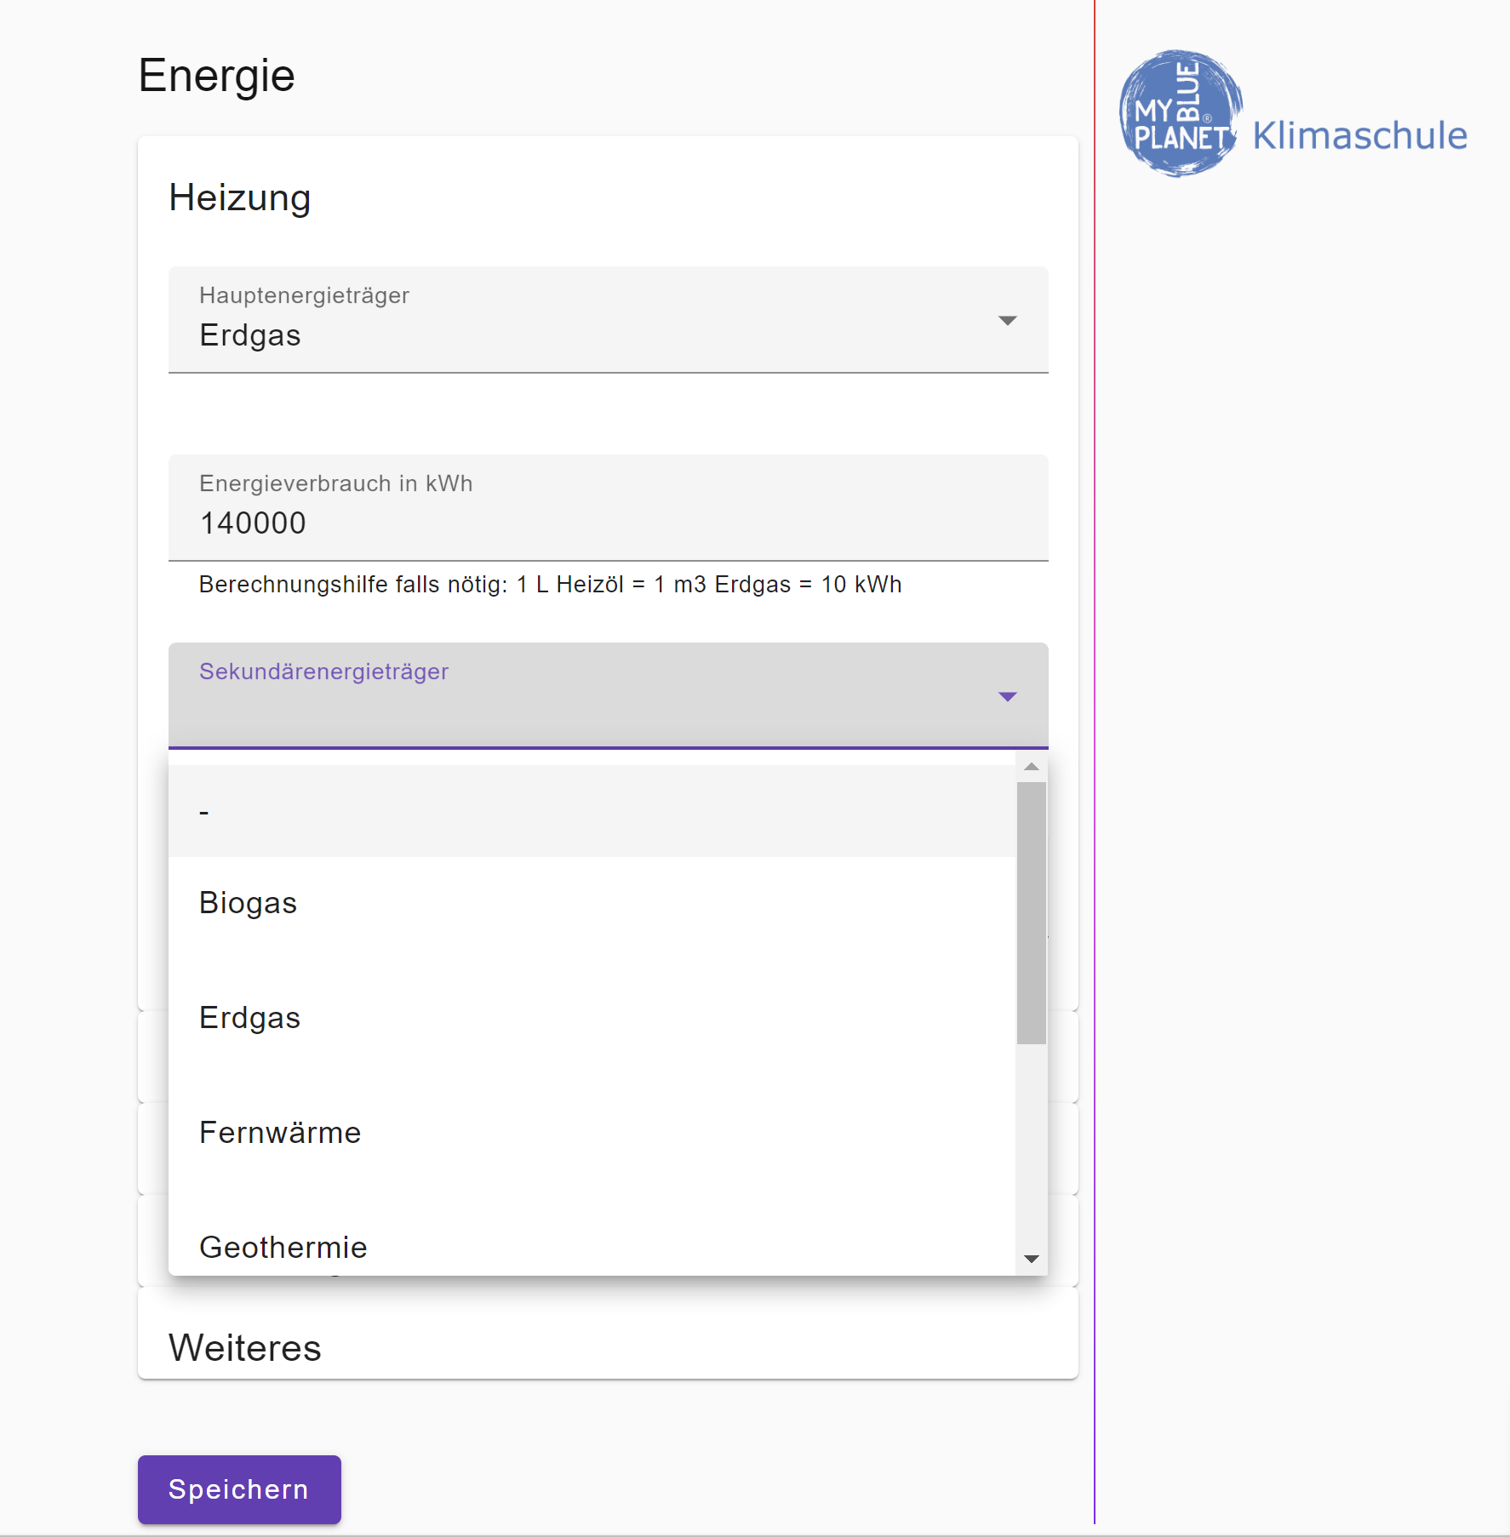
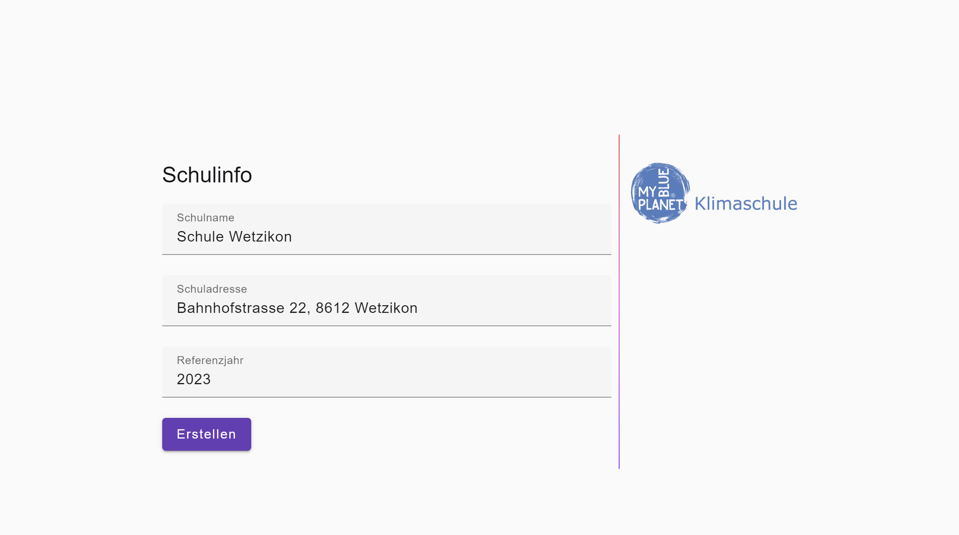
Webformular

Slide 10
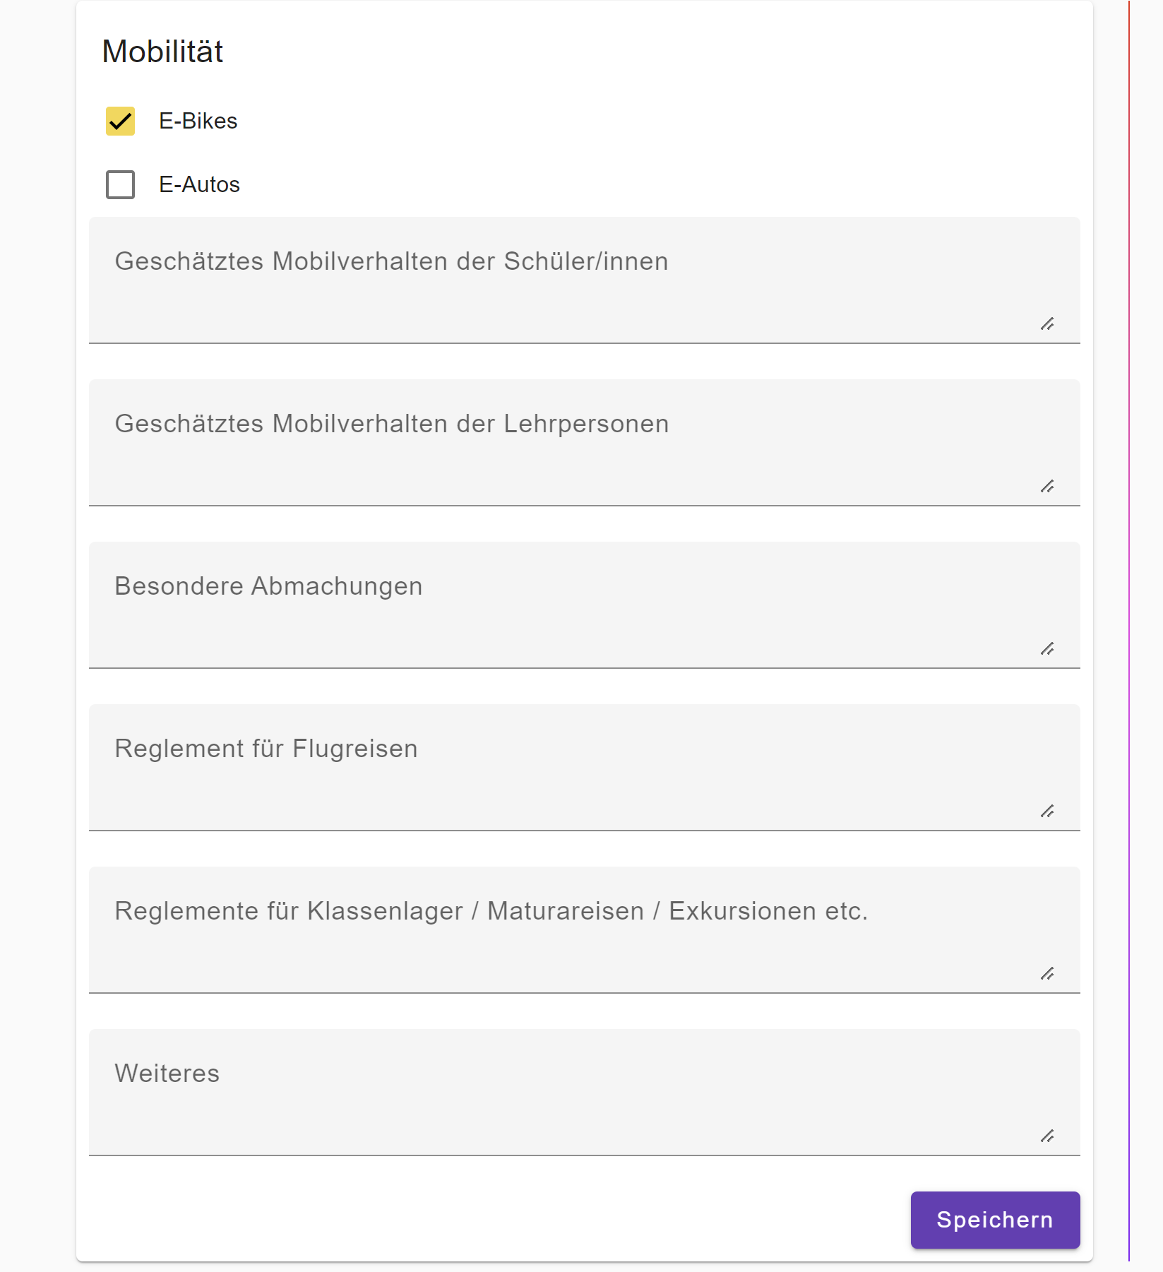
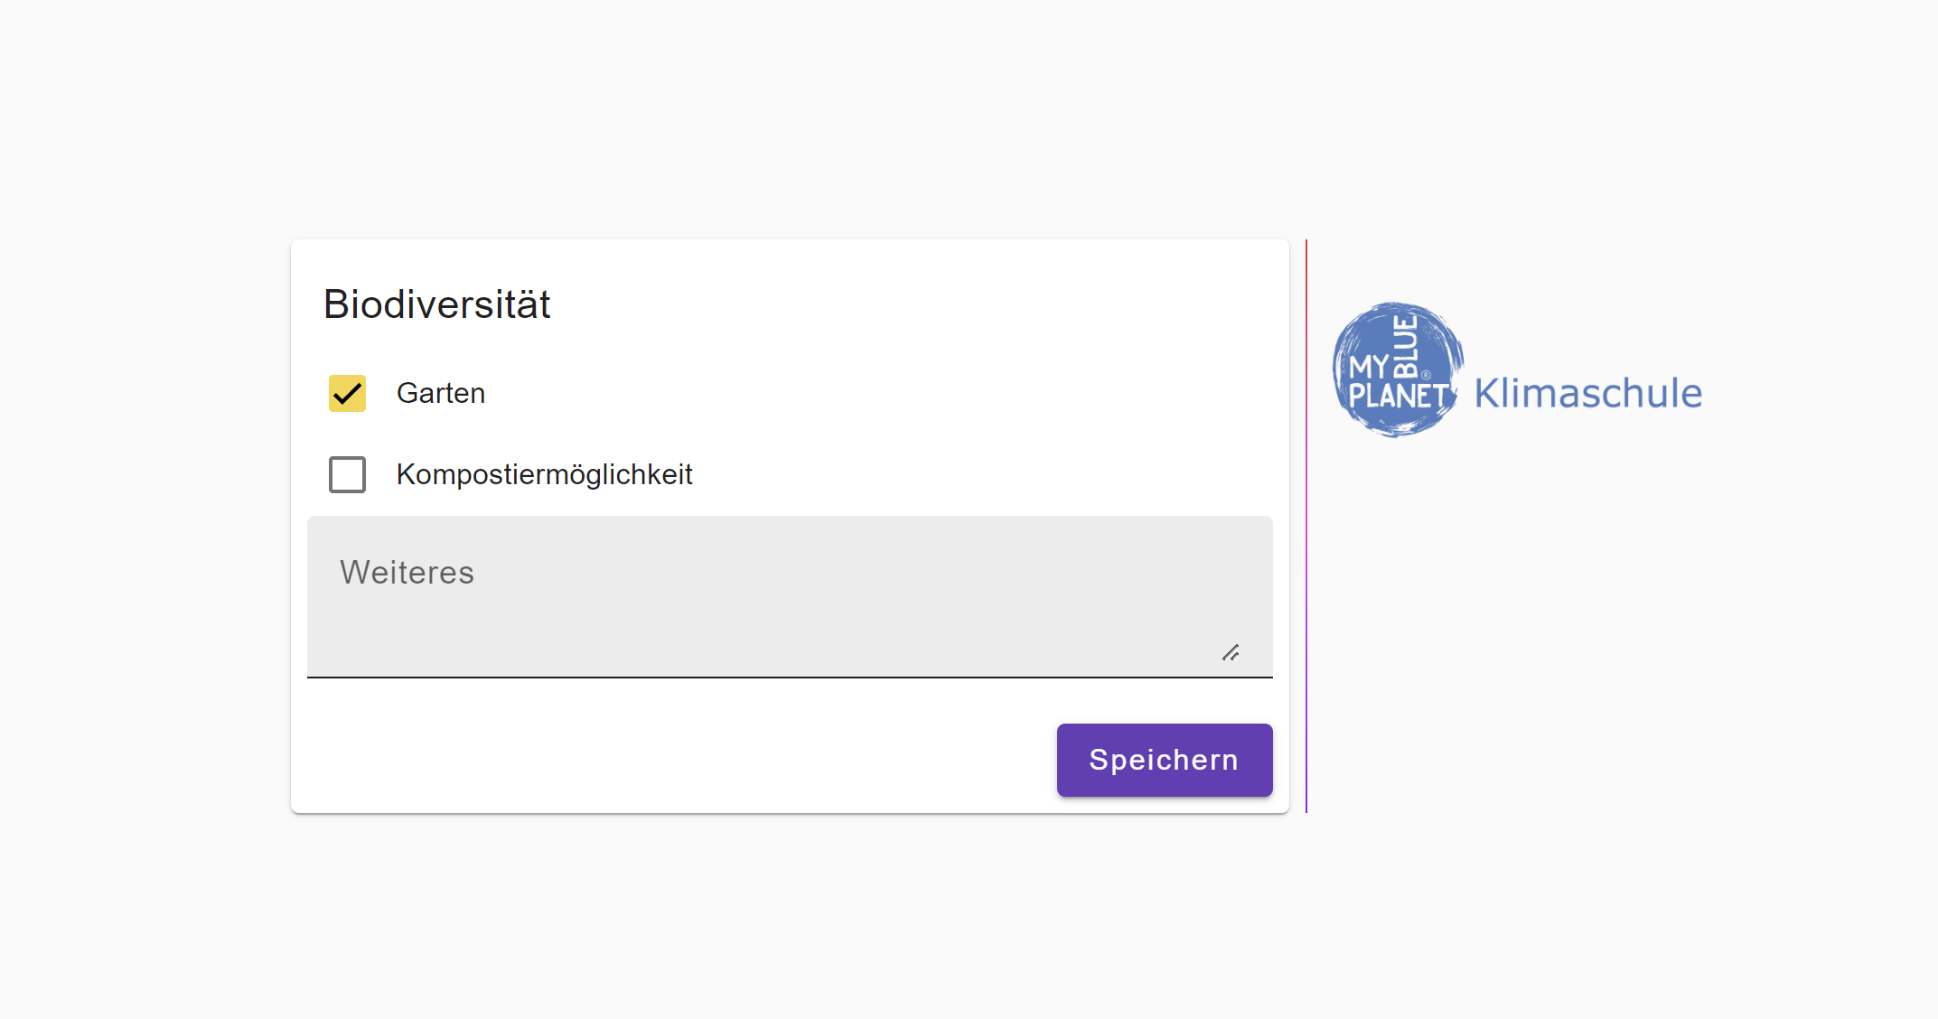
Webformular

Slide 11
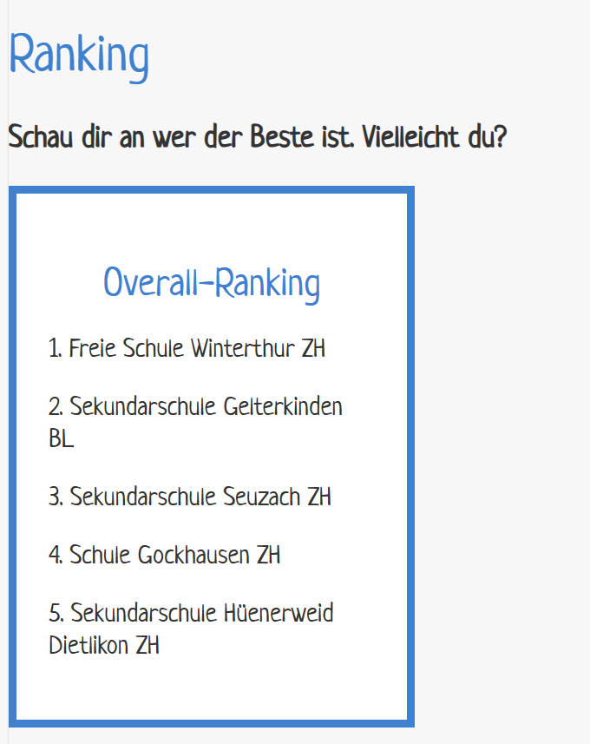
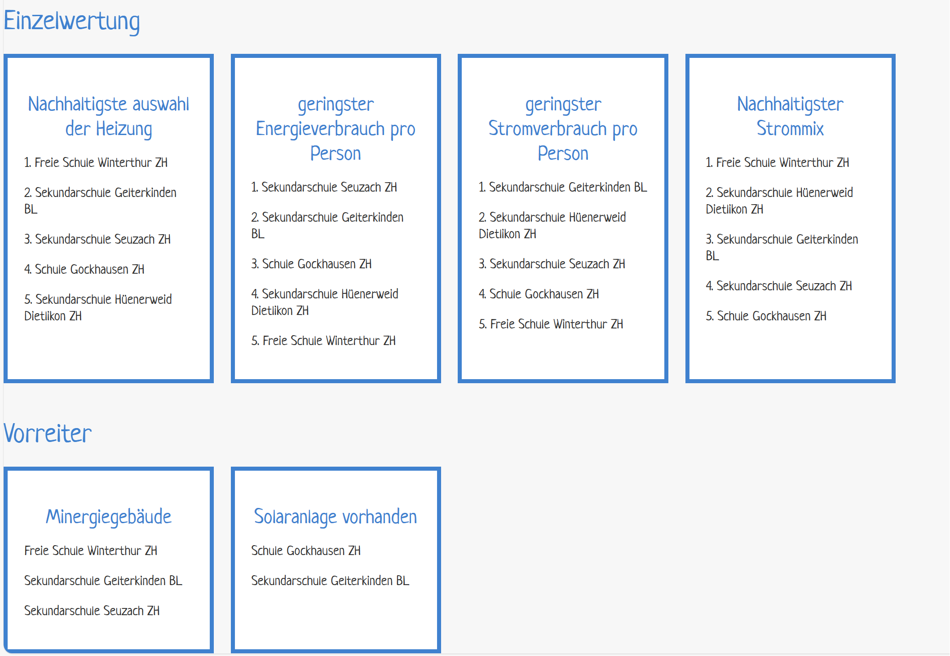
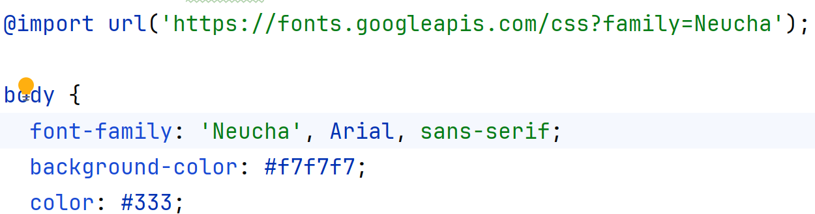
School ranking page

Slide 12
