Slide 1
TEXCYCLE AI
AI-Powered Digital Marketplace
for Upcycling Sri Lanka’s Textile Waste
PROJECT ID: R26-IT-081 | PANEL: IT-P06
IT22281814 • IT22215338 • IT22221278 • IT22281678
Supervisor: [Insert confirmed name] Co-supervisor: [Insert confirmed name]

Slide 2
01 PROJECT OVERVIEW
One platform, four research contributions
TexCycle AI connects textile assessment to sustainability information and marketplace decision support.
IDENTIFY
ASSESS
CONNECT + PREDICT
Understand the uploaded material and visible defects.
Estimate sustainability-related indicators with documented assumptions.
Support price decisions, buyer discovery and marketplace forecasting.
Core contribution
A role-based digital marketplace where AI outputs help users make more informed decisions about textile-waste reuse and upcycling.
TEXCYCLE AI | R26-IT-081 | FINAL RESEARCH PRESENTATION
02

Slide 3
02 RESEARCH TEAM
Four members with distinct, connected responsibilities
MEMBER 01 | IT22281814 | Sandeepa S.A.C.
MEMBER 02 | IT22215338 | Siriwardhana N.S.T.N
Fabric Intelligence
Sustainability Intelligence
MEMBER 03 | IT22221278
MEMBER 04 | IT22281678
Traceability + Commercial Intelligence
Marketplace Predictive Analytics
Supervisor: [Insert official name]
Co-supervisor: [Insert official name]
TEXCYCLE AI | R26-IT-081 | FINAL RESEARCH PRESENTATION
03

Slide 4
03 INTRODUCTION
Why textile waste needs a smarter route to value
MATERIAL INFORMATION
VALUE UNCERTAINTY
FRAGMENTED DISCOVERY
Fabric type and condition may be unclear from a basic listing.
Sellers may need support estimating value and interpreting sustainability indicators.
Relevant buyers and market signals can be difficult to connect consistently.
Research alignment: SDG 12 — Responsible Consumption and Production; SDG 8 — Decent Work and Economic Growth.
Industry impact should be claimed only where supported by measured data or a documented pilot.
TEXCYCLE AI | R26-IT-081 | FINAL RESEARCH PRESENTATION
04

Slide 5
04 RESEARCH PROBLEM & GAP
The challenge is a chain of connected decisions
PROBLEM A
PROBLEM B
PROBLEM C
Material category and condition are not always represented in a structured way.
Sustainability indicators and indicative values need clear calculation and interpretation.
Buyer matching and marketplace predictions need to be connected to listing information.
Research question
How can AI-assisted textile assessment and marketplace intelligence support informed reuse, upcycling and trading decisions?
TEXCYCLE AI | R26-IT-081 | FINAL RESEARCH PRESENTATION
05

Slide 6
05 OBJECTIVES
One main objective is supported by four component objectives
MAIN OBJECTIVE
Develop an AI-powered digital marketplace that helps users assess textile materials and make more informed sustainability and commercial decisions.
01 Identify material characteristics
02 Estimate sustainability indicators
Fabric classification and defect/condition assessment
Scores, grades and environmental estimates with explicit assumptions
03 Support commercial decisions
04 Predict marketplace patterns
Indicative pricing, buyer recommendation and traceability
Listing success, sales time, market trend and demand where implemented
TEXCYCLE AI | R26-IT-081 | FINAL RESEARCH PRESENTATION
06

Slide 7
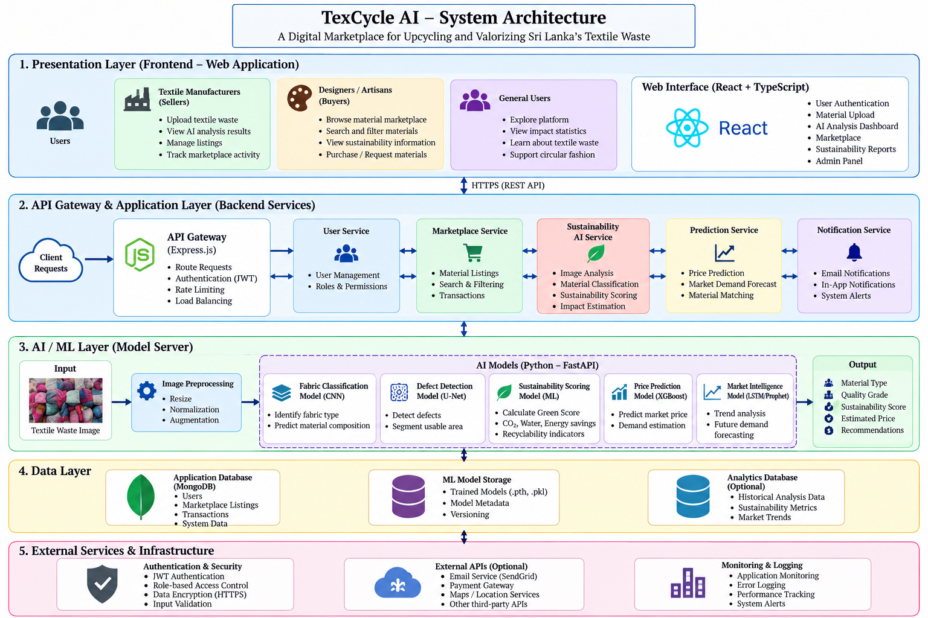
06 FULL SYSTEM ARCHITECTURE
How the website, backend, AI services, and data work together
TEXCYCLE AI | R26-IT-081 | FINAL RESEARCH PRESENTATION
07

Slide 8
07 USER ROLES & MARKETPLACE WORKFLOW
The same platform serves different users
SELLER
BUYER
ADMIN
SUPER ADMIN
Upload material
Analyse and list
View predictions
Manage sales
Browse materials
Choose quantity
Place orders
Track and review
Manage platform activity
Review users/listings
Monitor orders and reports
Platform-level access
Administrative governance
Shared services: authentication • marketplace listings • orders • notifications • reviews/ratings • history (as implemented)
TEXCYCLE AI | R26-IT-081 | FINAL RESEARCH PRESENTATION
08

Slide 9
08 RESEARCH METHODOLOGY
How the team moved from research to a working prototype
1
Literature + requirements
Identify problem, research gap and component targets
2
Dataset preparation
Inspect data sources, schema, labels, cleaning and feature engineering
3
Model development
Train task-specific classifiers, regressors or segmentation models
4
Evaluation
Use task-appropriate metrics on held-out data
5
Integration
Connect inference/results to API and role-based website workflows
6
Testing + analysis
Test workflows, document limitations and interpret results
TEXCYCLE AI | R26-IT-081 | FINAL RESEARCH PRESENTATION
09

Slide 10
09 INDIVIDUAL RESEARCH CONTRIBUTIONS
Four components, four different research questions
MEMBER 01 | Fabric Intelligence
MEMBER 02 | Sustainability Intelligence
What material is it? What defects can be identified?
What environmental/sustainability indicators can be estimated?
MEMBER 03 | Commercial Intelligence
MEMBER 04 | Marketplace Predictive Analytics
What price and buyer options may help the seller?
What marketplace outcomes or trends can be predicted?
TEXCYCLE AI | R26-IT-081 | FINAL RESEARCH PRESENTATION
10

Slide 11
10 MEMBER 01 | IT22281814 | Sandeepa S.A.C.
MEMBER 01
Fabric Intelligence — research focus & solution
RESEARCH INPUT
MODELS REPORTED
USER OUTPUT
Uploaded textile image; image validation and preprocessing.
EfficientNet-B3 for fabric classification; MobileNetV2 for defect-related classification; U-Net for segmentation only if confirmed in final implementation.
Fabric category + confidence; defect result / mask where integrated; condition indicators only where implemented.
Reported result from earlier project notes: EfficientNet-B3 test accuracy 89.68%; MobileNetV2 result 90.87% (verify exact metric and task).
Explain why the model was selected, image size/normalization, class labels, confidence meaning, and how defects are calculated.
TEXCYCLE AI | R26-IT-081 | FINAL RESEARCH PRESENTATION
11

Slide 12
MEMBER 01
11 MEMBER 01 | METHOD
From textile image to a useful result
Upload
Preprocess
Inference
Post-process
Display
Image
Resize / normalize
Trained model
Class/mask
Prediction
Confidence is not correctness
Explain each condition value
A confidence score describes model output certainty; it does not prove the label is correct.
Indicate whether health, repairability, or lifespan is predicted by the model, derived from the formula, or rule-based.
TEXCYCLE AI | R26-IT-081 | FINAL RESEARCH PRESENTATION
12

Slide 13
12 MEMBER 02 | IT22215338
MEMBER 02
Sustainability Intelligence — outputs and calculations
01 Sustainability score
02 Sustainability grade
03 Green score
04 CO₂ saving estimate
Model/target scale
Grade model or mapping
Exact implemented formula
Units + baseline factor
05 Water saving estimate
06 Carbon footprint
07 Environmental impact
08 Recommended pathway
Units + baseline factor
Boundary + units
Inputs combined
Reuse/recycle / upcycle if implemented
Reported R² range in previous project notes: 0.9389–0.9887 across sustainability experiments. Each score must be mapped to its exact model and target.
TEXCYCLE AI | R26-IT-081 | FINAL RESEARCH PRESENTATION
13

Slide 14
MEMBER 02
13 MEMBER 02 | METHOD
How the eight sustainability outputs are produced
MODEL-BASED
FACTOR-BASED
RULE-BASED
Input features → trained regressor/grade model → predicted target.
Material quantity × documented environmental factor/baseline, where that is the implemented equation.
Thresholds or mappings → grade / recommended pathway, if implemented this way.
Name the inputs and units.
Show the exact formula or model.
Identify the source of environmental factors.
Explain rounding, clipping, and grade mapping.
State assumptions and limitations.
TEXCYCLE AI | R26-IT-081 | FINAL RESEARCH PRESENTATION
14

Slide 15
MEMBER 03
14 MEMBER 03 | IT22221278
Commercial Intelligence — pricing and buyer recommendation
PRICE MODEL
BUYER RECOMMENDATION
TRACEABILITY
Prior notes describe Random Forest + XGBoost. Reported matching result: 83.56%; verify how matching quality was measured.
Track analysis/listing/order events and history where implemented. Traceability is a system workflow, not automatically an ML model.
XGBoost Regressor
MAE 12.24 • RMSE 15.40
R² 0.9590 (prior reported result)
Commercial flow
Material + condition + quantity + market features → feature preparation → price estimate/buyer suggestions → seller decision.
TEXCYCLE AI | R26-IT-081 | FINAL RESEARCH PRESENTATION
15

Slide 16
MEMBER 03
15 MEMBER 03 | WORKFLOW
Traceability links the material journey
Material
Analysis
Listing
Order
Feedback
Upload / details
Outputs / history
Published offer
Status / delivery
Review / rating if implemented
Why it matters
What it cannot prove alone
A more structured history can support visibility and accountability.
Records alone do not verify origin or environmental impact.
TEXCYCLE AI | R26-IT-081 | FINAL RESEARCH PRESENTATION
16

Slide 17
MEMBER 04
16 MEMBER 04 | IT22281678
Marketplace Predictive Analytics — model tasks
LISTING SUCCESS
SALES TIME
MARKET TREND
DEMAND
XGBoost Classifier
Reported accuracy: 83.65%
Define the success label.
XGBoost Regressor
Prior notes: MAE 14.53 days; RMSE 20.87; R² 0.76
Increasing / Stable / Decreasing classes. Prior reported accuracy: 98.72%; verify the test protocol.
Present separately only if a distinct trained model and evaluation exist.
TEXCYCLE AI | R26-IT-081 | FINAL RESEARCH PRESENTATION
17

Slide 18
MEMBER 04
17 MEMBER 04 | DATASET
What signals are available to the marketplace models?
Material/condition
Sustainability/price
fabric_type • condition • health_score • defect_area • repairability • remaining_lifespan • weight_kg
sustainability_score • green_score • co2_saving • water_saving • predicted_price • average_market_price
Market context
Seller/engagement
buyer_type • demand_level • listing_month • season • district • province • competition • economic_index
seller_rating • weekly_views • wishlist_count • click_rate • seller_experience • listing_status • days_to_sell
TEXCYCLE AI | R26-IT-081 | FINAL RESEARCH PRESENTATION
18

Slide 19
18 INTEGRATED USER JOURNEY
ALL MEMBERS
How the four components work together on the website
01 • Upload
Seller uploads an image and enters material details.
02 • Identify
Member 01 model classifies fabric and analyses defects where supported.
03 • Assess
Member 02 produces sustainability indicators and environmental estimates.
04 • Commercialise
Member 03 provides indicative price, buyer recommendations and traceability.
05 • Predict + trade
Member 04 provides marketplace predictions; users continue through listings and orders.
Claim automatic data hand-offs only where the current code implements them; otherwise, describe the components as connected through shared workflows.
TEXCYCLE AI | R26-IT-081 | FINAL RESEARCH PRESENTATION
19

Slide 20
19 SUMMARY
Report the metric that matches the model task
Task | Model / method | Prior reported result | Required verification
Fabric classification | EfficientNet-B3 | Accuracy 89.68% | Confirm classes / test split
Defect model | MobileNetV2 / U-Net | 90.87% reported | Confirm exact metric and model
Price prediction | XGBoost regressor | MAE 12.24 • RMSE 15.40 • R² 0.9590 | Confirm currency/unit
Listing success | XGBoost classifier | Accuracy 83.65% | Confirm success label
Sales time | XGBoost regressor | MAE 14.53 days • RMSE 20.87 • R² 0.76 | Weak explanatory power
Market trend | Classifier | Accuracy 98.72% reported | Check generated labels / leakage
Buyer recommendation | RF + XGBoost approach | 83.56% reported | Define evaluation protocol
Sustainability models | Regressors / grade model | R² range 0.9389–0.9887 | Map each value to target
TEXCYCLE AI | R26-IT-081 | FINAL RESEARCH PRESENTATION
20

Slide 21
ALL MEMBERS
21 LIMITATIONS & NEXT VALIDATION
A strong defence explains what still needs real-world validation
DATA
MODEL
ENVIRONMENT
Synthetic marketplace data may not represent real buyer behaviour, actual prices or seasonal demand.
Sales-time R² is weak; other scores need leakage checks and external validation.
CO₂/water estimates depend on boundaries, baselines, and factors; they are not independently certified impacts.
TEXCYCLE AI | R26-IT-081 | FINAL RESEARCH PRESENTATION
22

Slide 22
REFERENCES
ALL MEMBERS
Reference slide — align with the approved thesis bibliography
[1] Ellen MacArthur Foundation, A New Textiles Economy: Redesigning Fashion’s Future, 2017.
[2] United Nations Environment Programme, Sustainability and Circularity in the Textile Value Chain: A Global Roadmap, 2023.
[3] United Nations, The 17 Goals: Sustainable Development Goals, sdgs.un.org/goals.
[4] Tan, M. and Le, Q. V., “EfficientNet: Rethinking Model Scaling for Convolutional Neural Networks,” ICML, 2019.
[5] Sandler, M. et al., “MobileNetV2: Inverted Residuals and Linear Bottlenecks,” CVPR, 2018.
[6] Ronneberger, O., Fischer, P. and Brox, T., “U-Net: Convolutional Networks for Biomedical Image Segmentation,” MICCAI, 2015.
[7] Chen, T. and Guestrin, C., “XGBoost: A Scalable Tree Boosting System,” KDD, 2016.
[8] Breiman, L., “Random Forests,” Machine Learning, vol. 45, pp. 5–32, 2001.
TEXCYCLE AI | R26-IT-081 | FINAL RESEARCH PRESENTATION
25

Slide 23
Thank You!

