Slide 1
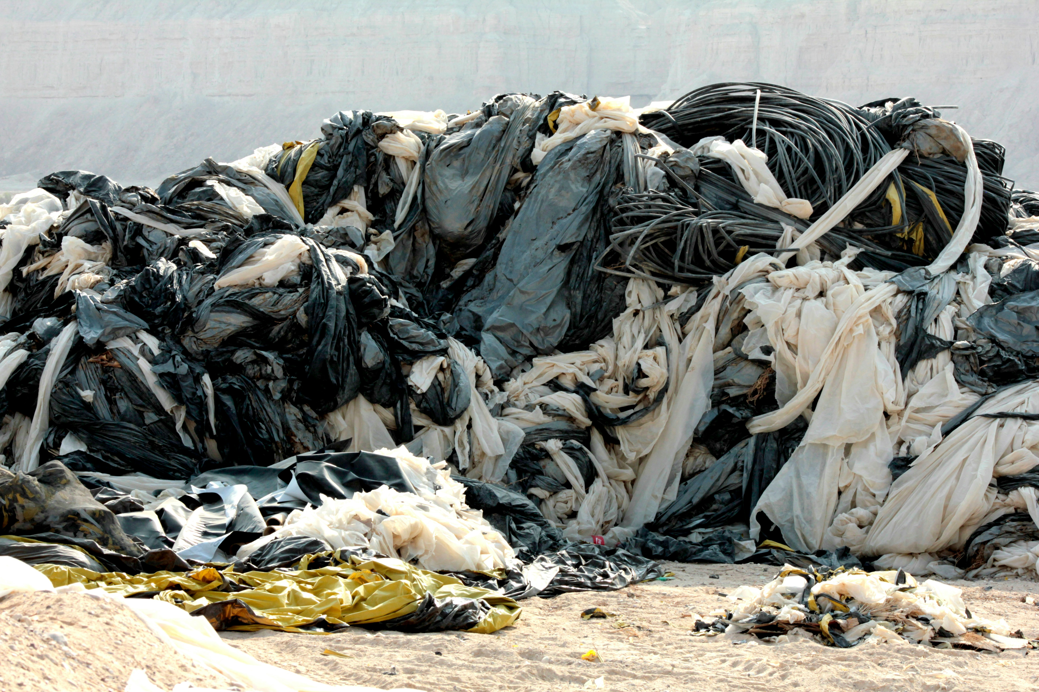


AI-Powered Digital Marketplace for Upcycling Sri Lanka's Textile Waste
BSc (Hons) in Information Technology
Sri Lanka Institute of Information Technology
Project ID: R26-IT-081
01

Slide 2


Our Team
Prof. Dasuni Nawinna
Mr. Nelum Amarasena
Project Supervisor
Project Co-Supervisor

Slide 3




Our Team
Meet the dedicated individuals driving this innovative project:
Sandeepa S.A.C.
Siriwardhana N.S.T.N.
Madushanka H.M.T.G.
Thalagala T.A.D.V.
AI Fabric Classification Module
Environmental Impact Prediction Module
Traceability, Recommendation & AI Pricing Module
Marketplace Platform & Predictive Analytics Module

Slide 4

INTRODUCTION
Introduction to the problem
The main research problem is the lack of an intelligent and integrated digital system for textile waste management in Sri Lanka’s apparel industry. Currently, textile waste is manually sorted and often burned or disposed of in landfills, causing environmental pollution and economic loss. Manufacturers face difficulties in managing and valuing waste materials, while designers, upcyclers, and SMEs struggle to find affordable and reliable reusable fabrics.
Social or research impact of the solution
To address these challenges, this research focuses on developing an AI-powered marketplace that enables automated fabric classification, environmental impact analysis, intelligent pricing, traceability, and predictive analytics to support a sustainable circular economy.
12/05/2026
03

Slide 5

Our Approach to Address Gaps
AI-powered marketplace
CNN fabric classification
Environmental impact prediction
Microservices architecture Traceability system
AI pricing & recommendation
Predictive analytics dashboard
Constraints and Limitations
  Limited availability of Sri Lankan textile waste datasets
  Prediction accuracy depends on image quality and available data
  Environmental impact calculations use secondary LCA data sources
  Limited historical transaction data for AI pricing models
  Time and resource limitations for large-scale deployment and testing
  User adoption may vary based on awareness and technology usage skills
05

Slide 6

RESEARCH QUESTION
How can an AI-powered digital marketplace improve textile waste classification, environmental impact prediction, pricing, traceability, and waste redistribution in Sri Lanka?
9/11/2025
06

Slide 7
RESEARCH GAP
Existing dermatological AI models rely heavily on single-modality image data and provide limited transparency in their decision-making. Many ignore relevant clinical metadata or diagnostic reports, reducing diagnostic accuracy and trustworthiness. Moreover, there is minimal work on underrepresented conditions like tinea and leprosy.
9/11/2025
07

Slide 8
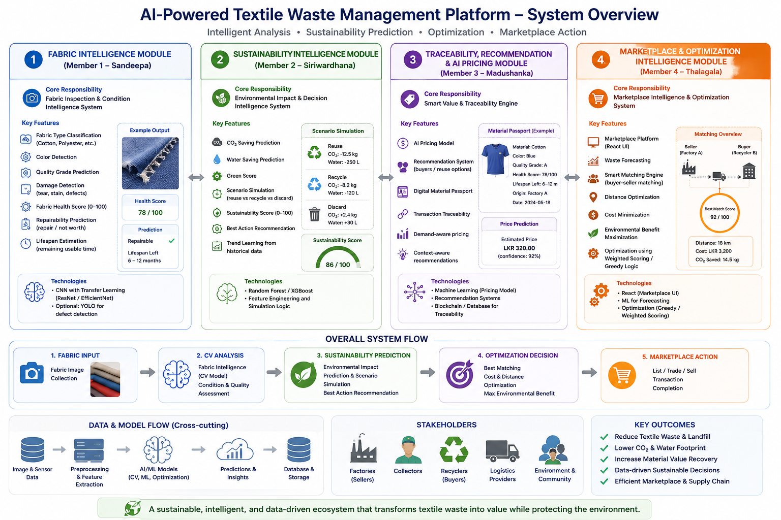
9/11/2025
08

Slide 9



Tools and Technologies
React.js
Tailwind CSS
FastAPI
MongoDB Atlas
Axios
Python
Scikit-learn
Random Forest Algorithm
Git & GitHub
Vite
Postman

Slide 10
Sandeepa S.A.C.
IT22281814
Specialization - Information Technology
AI-Powered Fabric Inspection & Damage Detection System
IT22281814| Sandeepa S.A.C. | Project ID: R26-IT-081
10

Slide 11
INTRODUCTION & RESEARCH PROBLEM
INTRODUCTION
RESEARCH PROBLEM
The Fabric Intelligence Module is an AI-based system developed to automate fabric inspection using Deep Learning and Computer Vision.
The system can:
  Identify fabric types
  Detect fabric damages
  Classify fabrics as Good or Defective
Improves textile quality inspection accuracy
Reduces manual effort
Current Issues
  Manual inspection is slow and inconsistent
  Human errors reduce accuracy
  Difficult to identify small defects
Need for an AI Solution
  Faster inspection
  Accurate damage detection
  Real-time fabric analysis
11

Slide 12
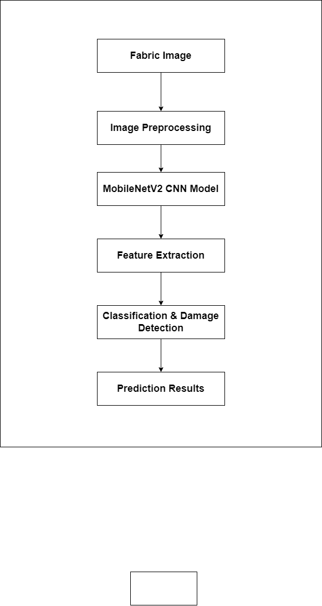
RESEARCH OBJECTIVES & SYSTEM OVERVIEW
SYSTEM OVERVIEW
MAIN OBJECTIVE
Develop an AI-powered fabric inspection system using CNN models.
SPECIFIC OBJECTIVES
  Fabric type classification
  Damage detection
  Good vs Defective prediction
  Improve inspection accuracy
.
Outputs:
  Fabric Type
  Good Fabric / Defective Fabric
12

Slide 13
AI MODEL & TRAINING PROCESS
AI MODEL USED – MobileNetV2 CNN
Pretrained MobileNetV2 with Transfer Learning
Why MobileNetV2?
  High accuracy
  Fast processing
  Lightweight architecture
  Suitable for image classification
TRAINING PROCESS
Step | Description
1 | Dataset Collection
2 | Image Preprocessing
3 | Data Augmentation
4 | Transfer Learning
5 | Fine-Tuning
Technologies: PyTorch, OpenCV, Python, Google Colab
13

Slide 14
FABRIC CLASSIFICATION & DAMAGE DETECTION
FABRIC TYPE CLASSIFICATION
Supported Types:
Workflow:
Fabric Image → CNN Feature Extraction → Fabric Type Prediction
DAMAGE DETECTION
Detected Defects:
  Good Fabric
  Defective Fabric
Acrylic, Artificial leather, Blended, Chenille, Corduroy, Cotton, Crepe, Denim, Fleece, Felt, Leather, Linen, Nylon, Polyester, Satin, Silk, Suede, Terrycloth, Velvet, Viscose, Wool
14

Slide 15
KEY FEATURES & NOVELTY FEATURES
KEY FEATURES
Fabric Type Classification – Automatically identifies different fabric materials
Damage Detection – Detects visible fabric defects automatically
Good vs Defective Prediction – Classifies fabric conditions intelligently
Statistical Analysis – Provides model accuracy and condition analysis
NOVELTY FEATURES
AI-Powered Automated Inspection (replaces manual methods)
MobileNetV2 Transfer Learning (pretrained CNN for efficient learning)
Intelligent Defect Identification (texture & pattern analysis)
Real-Time Fabric Analysis (fast image-based predictions)
.
15

Slide 16
STATISTICAL ANALYSIS & CURRENT PROGRESS
STATISTICAL ANALYSIS
Dataset Statistics
Feature | Accuracy
Fabric Classification | 64.23%
Damage Detection | 86.3%
Category | Percentage
Good Fabrics | 68%
Defective Fabrics | 32%
.
CURRENT PROGRESS
Status | Task
Completed | Dataset Collection
Completed | MobileNetV2 Integration
Completed | Fabric Classification
Completed | Damage Detection
In Progress | Statistical Analysis
In Progress | Design frontend
16

Slide 17
REFERENCES
Sandler et al., MobileNetV2: Inverted Residuals and Linear Bottlenecks, 2018.
https://arxiv.org/abs/1801.04381?utm
Islam, CNN-Based Transfer Learning in Image Classification, 2020.
https://www.researchgate.net/publication/375113224_Study_on_CNN_based_Transfer_Learning_in_Image_Classification
Gondhalekar et al., MobileNetV2 Approach for Image Classification, 2025.
https://www.researchgate.net/publication/389687628_Enhancing_Image_Classification_Performance_through_Transfer_Learning_and_Adaptive_Augmentation_A_MobileNetV2_Approach
17

Slide 18

SIRIWARDHANA N.S.T.N
IT22215338
Specialization - Information Technology
Sustainability decision intelligence
for textile waste routing, ML preparation, and marketplace integration.
IT22215338| SIRIWARDHAANA N.S.T.N | Project ID: R26-IT-081
09

Slide 19
INTRODUCTION & PROBLEM
What is the problem ?
Textile waste is increasing rapidly.
Difficult to decide whether items should be reused, repaired, recycled, or discarded.
Manual decisions are inefficient and inaccurate.
Poor waste management causes environmental pollution.
Need for an AI-powered sustainability decision system.
10

Slide 20
Key Features
Sustainability Assessment
Scenario Simulation
AI-Based Recommendation System
Risk Assessment & Data Quality Analys
Dashboard Analytics
Explainable Recommendation Output
Environmental Impact Prediction
Integration Support for Pricing & Marketplace Modules
.
11

Slide 21
Research Gap
Existing systems mainly focus on waste collection, not sustainability intelligence.
Lack of AI-based decision support for textile waste management.
Most platforms do not provide explainable recommendations or risk analysis.
No integrated system for sustainability prediction and scenario comparison.
Limited use of ML models for textile reuse and environmental impact evaluation.
.
1

Slide 22
Novelty Features
Environmental impact prediction
Scenario comparison across multiple disposal or recovery paths
Explainable recommendation output
Risk and data-quality assessment
Integration payloads for pricing and marketplace matching components
.
11

Slide 23
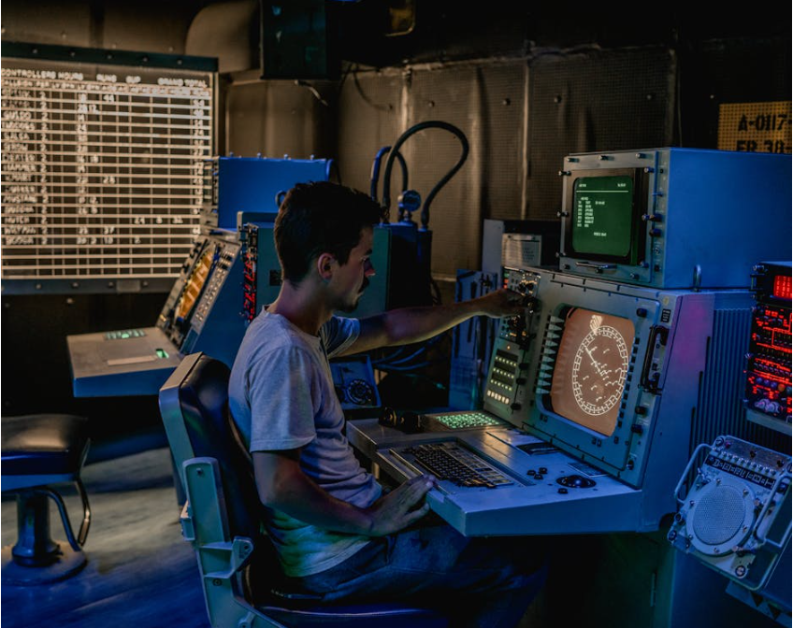
Evaluation and Validation
Regression model evaluated using MAE, RMSE, and R² Score.
  Classification model evaluated using Accuracy, Precision, Recall, F1-Score, and Confusion Matrix
API smoke testing used to verify backend functionality.
Frontend and backend build verification completed successfully.
Manual testing performed for prediction, scenario simulation, dashboard analytics, and ML workflow validation.
System reliability validated through service and integration testing.
IT22629876 | GUNAWARDHANA.D.M.N.P | 25-26J-196
13

Slide 24

Data Availability & Ethical Clearance
The current dataset is synthetic and generated for development and testing purposes.
No personal or sensitive user data was collected.
Data is used only for research and educational purposes.
The system follows responsible AI and sustainability-focused practices.
Future improvements will include real textile waste datasets with proper authorization and validation.
13

Slide 25
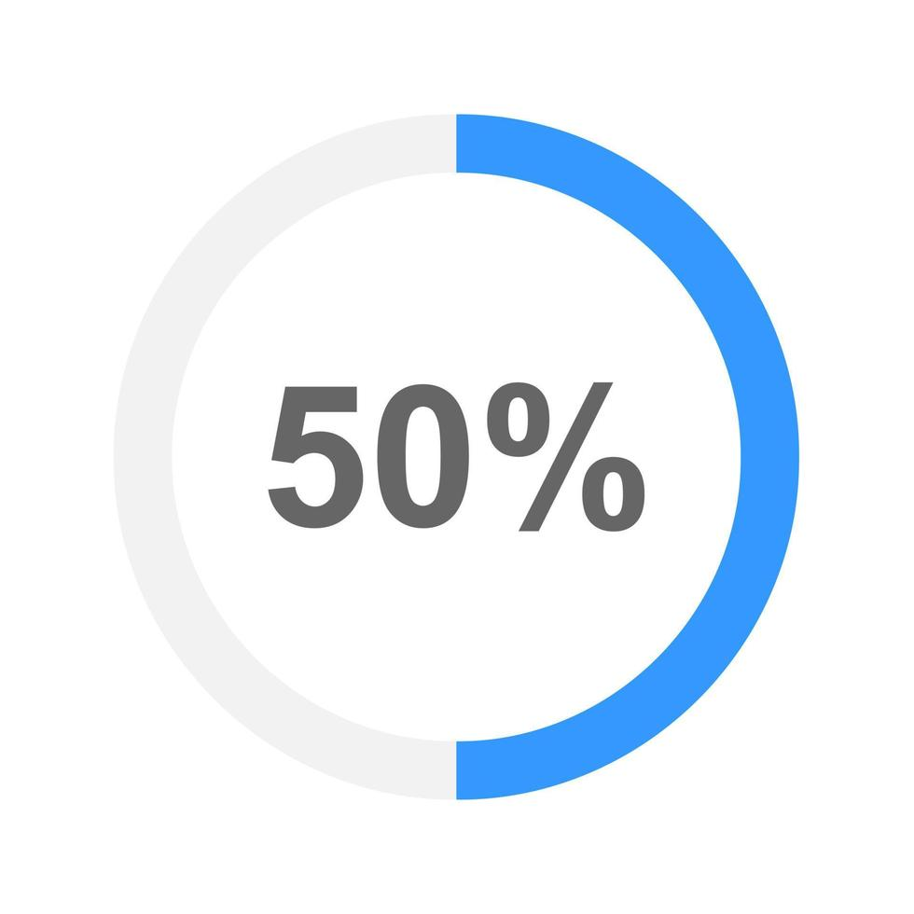
Current Progress 50 %
Completed full-stack implementation using React.js, FastAPI, and MongoDB Atlas.
Implemented sustainability prediction and scenario simulation features.
Added risk assessment and explainable recommendation system.
Developed dashboard analytics and prediction history modules.
Completed frontend-backend integration and testing processes.
Completed frontend-backend integration and testing processes.
13

Slide 26
Next Step
Collect and integrate real textile waste datasets.
Improve ML model accuracy and perform advanced error analysis.
Add authentication and admin authorization.
Integrate Member 01 image analysis outputs into assessment inputs.
Add production deployment configuration and monitoring support.
Connect Member 03 pricing and Member 04 marketplace modules.
13

Slide 27
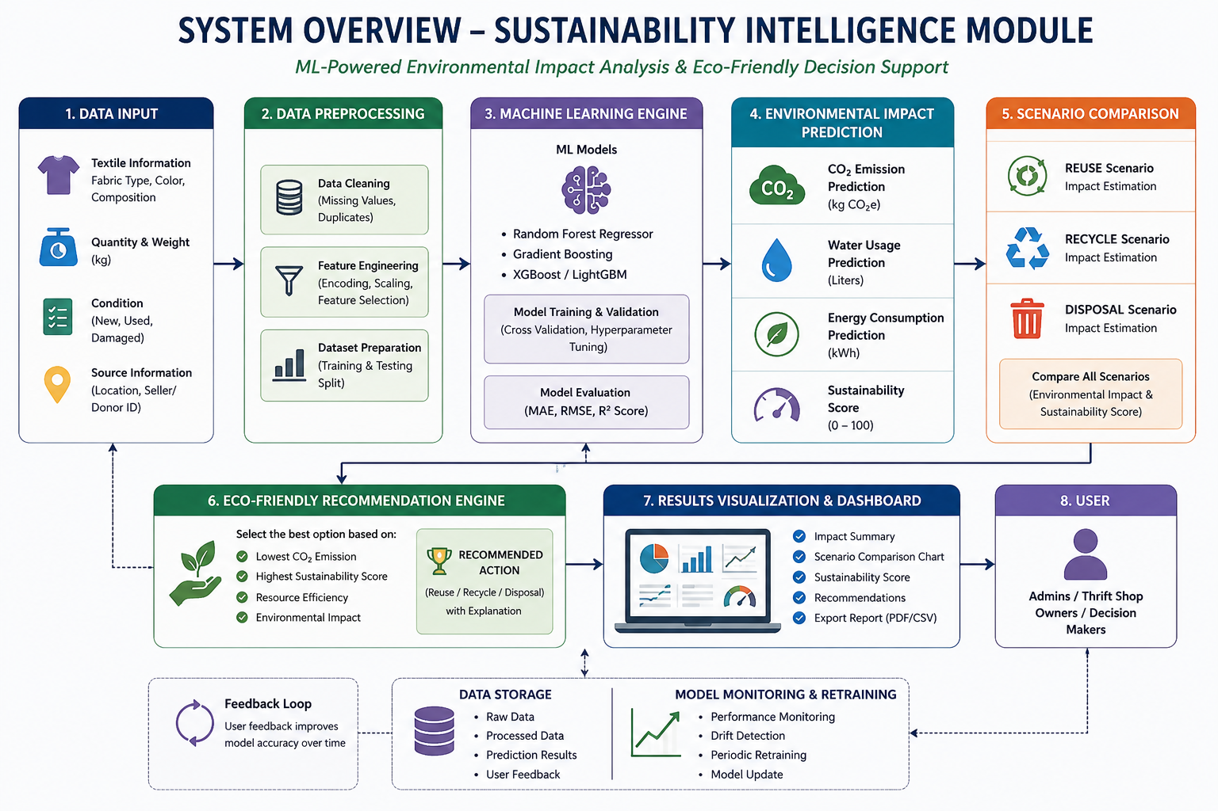
System Overview Diagram
14

Slide 28

H.M.T.G.Madushanka
IT22221278
Specialization - Information Technology
Traceability, Recommendation & AI Pricing Module
IT22221278 | H.M.T.G.Madushanka|
15

Slide 29

INTRODUCTION & PROBLEM
Existing Problems
No standard pricing system for textile waste
Difficult to track material transactions
Limited reuse and recycling recommendations
Lack of transparency in textile waste trading
Market demand changes are not considered
Proposed AI Solution
An AI-powered Smart Value & Traceability Engine that provides:
Intelligent price prediction
Smart buyer/reuse recommendations
Transaction tracking
Digital material records
10

Slide 30
Novelty Features
AI-powered textile waste pricing system
Demand-aware dynamic price prediction
Smart recommendation engine for reuse and recycling
Digital Material Passport for lifecycle tracking
End-to-end transaction traceability
Context-aware buyer and reuse recommendations
Sustainable textile waste management approach
Data-driven decision support system
.
11

Slide 31
AI Pricing Model
Recommendation System
Digital Material Passport
Transaction Traceability
Demand-aware Pricing
Context-aware Recommendations
Buyer & Recycling Suggestions
Material Lifecycle Tracking
Key Features
.
11

Slide 32
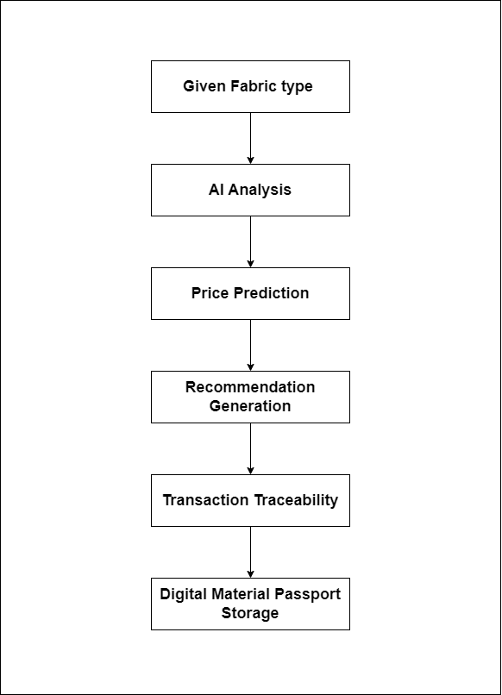
Traceability, Recommendation & AI Pricing Module
System Workflow / Architecture
9//2025
18

Slide 33
Current Progress
Dataset collection
Data preprocessing
Initial AI model development
Model training and testing
13

Slide 34
Next Step
Recommendation logic design
UI development
Backend integration
Transaction tracking implementation
13

Slide 35
Thalagala T.A.D.V.
IT22281678
Specialization - Information Technology
Maraketplace & Optimization
IT22281678 | Thalagala T.A.D.V. | R26-081
9/11/2025
27

Slide 36
Introduction & Problem
What's the problem
Currently, waste management decisions are mostly manual, which leads to:
inaccurate forecasting,
inefficient waste handling,
poor sustainability planning,
and increased environmental pollution.
IT22281678 | Thalagala T.A.D.V.. | R26-081
28

Slide 37
AI-Powered Textile Waste Forecasting and Analytics System
Research Gap
Limited AI-based textile waste forecasting systems
Lack of material-wise waste prediction
Absence of real-time analytics dashboards
Limited integration of AI with waste management
Poor sustainability decision support
Limited research focused on Sri Lankan textile waste
Existing systems focus mainly on historical reporting instead of future forecasting
IT22281678 | Thalagala T.A.D.V..| R26-081
29

Slide 38
Evaluation and Validation
Model accuracy testing using labeled textile waste datasets containing material-wise waste quantity records.
  Cross-validation and performance evaluation using machine learning metrics such as R² Score, Mean Absolute Error (MAE), and Root Mean Square Error (RMSE).
  Comparison of predicted textile waste quantities with historical waste records to evaluate forecasting accuracy and model reliability.
  Validation of material-wise waste forecasting performance for textile materials such as cotton, denim, polyester, nylon, linen, and viscose.
  Analysis of forecasting trends and prediction consistency using historical textile waste data.
Data Availability & Ethical Clearance
Dataset contains material-wise textile waste quantity records
No personal or sensitive user data was collected
Data used only for research and educational purposes
System follows responsible AI and sustainability-focused practices
Future work includes larger real-world textile waste datasets and improved forecasting validation
IT22281678 | Thalagala T.A.D.V. | R26-081
31

Slide 39
Thank You!
9/11/2025
35

