Slide 1
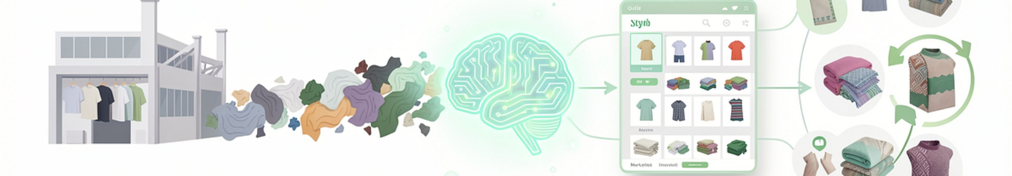

TexCycle AI
AI-Powered Digital Marketplace for Upcycling Sri Lanka's Textile Waste
Research Project
Group ID: R26-IT-081
BSc (Hons) in Information Technology
Specializing in Information Technology
Supervisor: Prof. Dasuni Nawinna
Co-Supervisor: Mr. Nelum Amarasena

Slide 2
Our Team
Sandeepa S.A.C.
Siriwardhana N.S.T.N
Madushanka H.M.T.G
Thalagala T.A.D.V
IT22281814
AI Fabric Classification
IT22215338
Environmental Impact Prediction
IT22221278
Traceability, Recommendations & AI Pricing
IT22281678
Marketplace Platform & Predictive Analytics

Slide 3
The Problem: Textile Waste in Sri Lanka
Sri Lanka's textile and apparel industry generates considerable waste. Reusable textile material often loses its economic value due to several key inefficiencies:
Manual sorting and poor waste visibility
Lack of standardized quality information
Difficult buyer discovery and unclear pricing
Limited traceability and sustainability data
TexCycle AI: Our Impact
TexCycle AI aims to transform this challenge into an opportunity by:
Increasing textile waste reuse
Supporting circular-economy practices
Connecting SMEs to affordable materials
Improving transparency for buyers and sellers
Enabling data-driven waste management

Slide 4





Shortcomings of Previous Research & Existing Solutions
Existing work has demonstrated individual technologies such as:
Textile image classification
Computer vision-based sorting
Life-cycle assessment & Environmental impact calculation
Digital traceability
AI pricing & Recommendation systems
Textile marketplaces & Predictive analytics
However...
These capabilities are commonly handled as separate solutions, creating significant limitations:
Disconnected Identification & Marketplace
Fabric analysis does not integrate with sales platforms, hindering efficient transactions.
Sustainability Data Isolation
Environmental impact metrics are not linked to commercial buying/selling decisions.
Inefficient Buyer Discovery & Pricing
Finding suitable buyers and establishing fair prices remain manual, negotiation-based processes.
Fragmented Lifecycle Traceability
Information about a textile's journey is not consistently tied to its transactions.
Unpredictable Market Dynamics
Demand and sales patterns within the textile waste market are not forecasted.

Slide 5




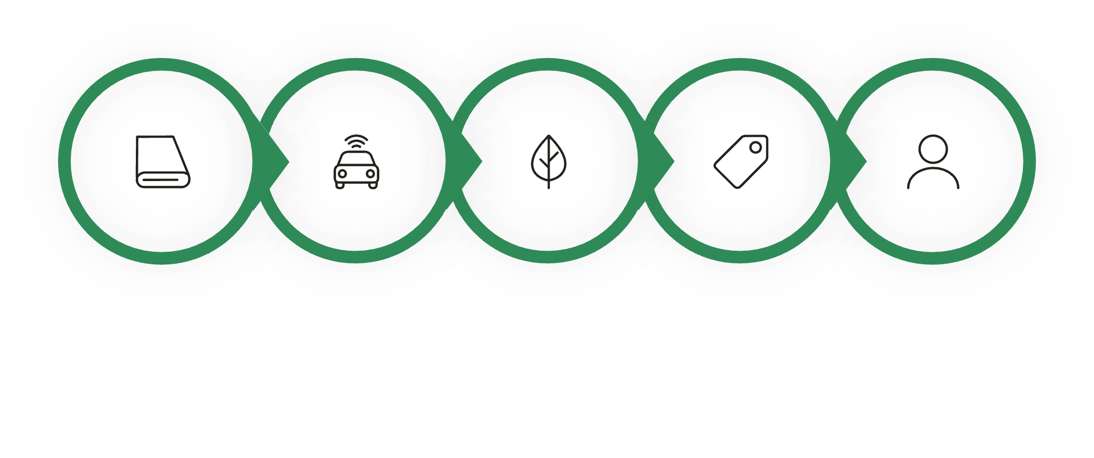
Our Approach to Address the Gap
TexCycle AI addresses existing inefficiencies by integrating four distinct intelligence layers:
1
2
Fabric Intelligence
Sustainability Intelligence
Identifies the textile type and assesses its current condition.
Evaluates the environmental impact and value of the material.
3
4
Commercial Intelligence
Marketplace Intelligence
Determines market worth and suggests potential buyers.
Predicts listing performance and optimizes for efficient transactions.
Integrated Result: A Circular Journey
These layers combine to create a comprehensive, data-driven workflow for textile waste upcycling:
Textile Waste
AI Analysis
Sustainability
Price
Buyer
This integrated four-layer architecture represents the core research contribution of our project.
Constraints & Limitations
Limited real Sri Lankan textile transaction data available for training.
Current dataset for predicting environmental impact is synthetic.
Environmental estimates are highly dependent on accurate source factors.
AI predictions require rigorous real-world validation to ensure accuracy.
Market price and demand for upcycled textiles can fluctuate significantly.
Real-world deployment necessitates continuous model monitoring and adaptation.

Slide 6





Research Question
How can an integrated AI-powered digital marketplace combine textile classification, sustainability assessment, commercial intelligence, and predictive marketplace analytics to support efficient and traceable textile-waste reuse in Sri Lanka?
Sub-questions
Automatic Textile Classification
Environmental Savings Estimation
AI-Powered Pricing & Recommendation
How can textile waste be automatically classified from images?
How can environmental savings from reuse be estimated?
How can AI support textile-waste pricing and buyer recommendation?
Marketplace Behavior Prediction
Integrated Circular Marketplace
How can marketplace behavior such as listing success and sales time be predicted?
How can these capabilities be integrated into one circular marketplace?
Notes:
Introduce the core research question, highlighting the integrated approach. Then, break it down into the five key sub-questions that our project aims to answer, explaining how each sub-question addresses a specific challenge within textile waste upcycling.

Slide 7
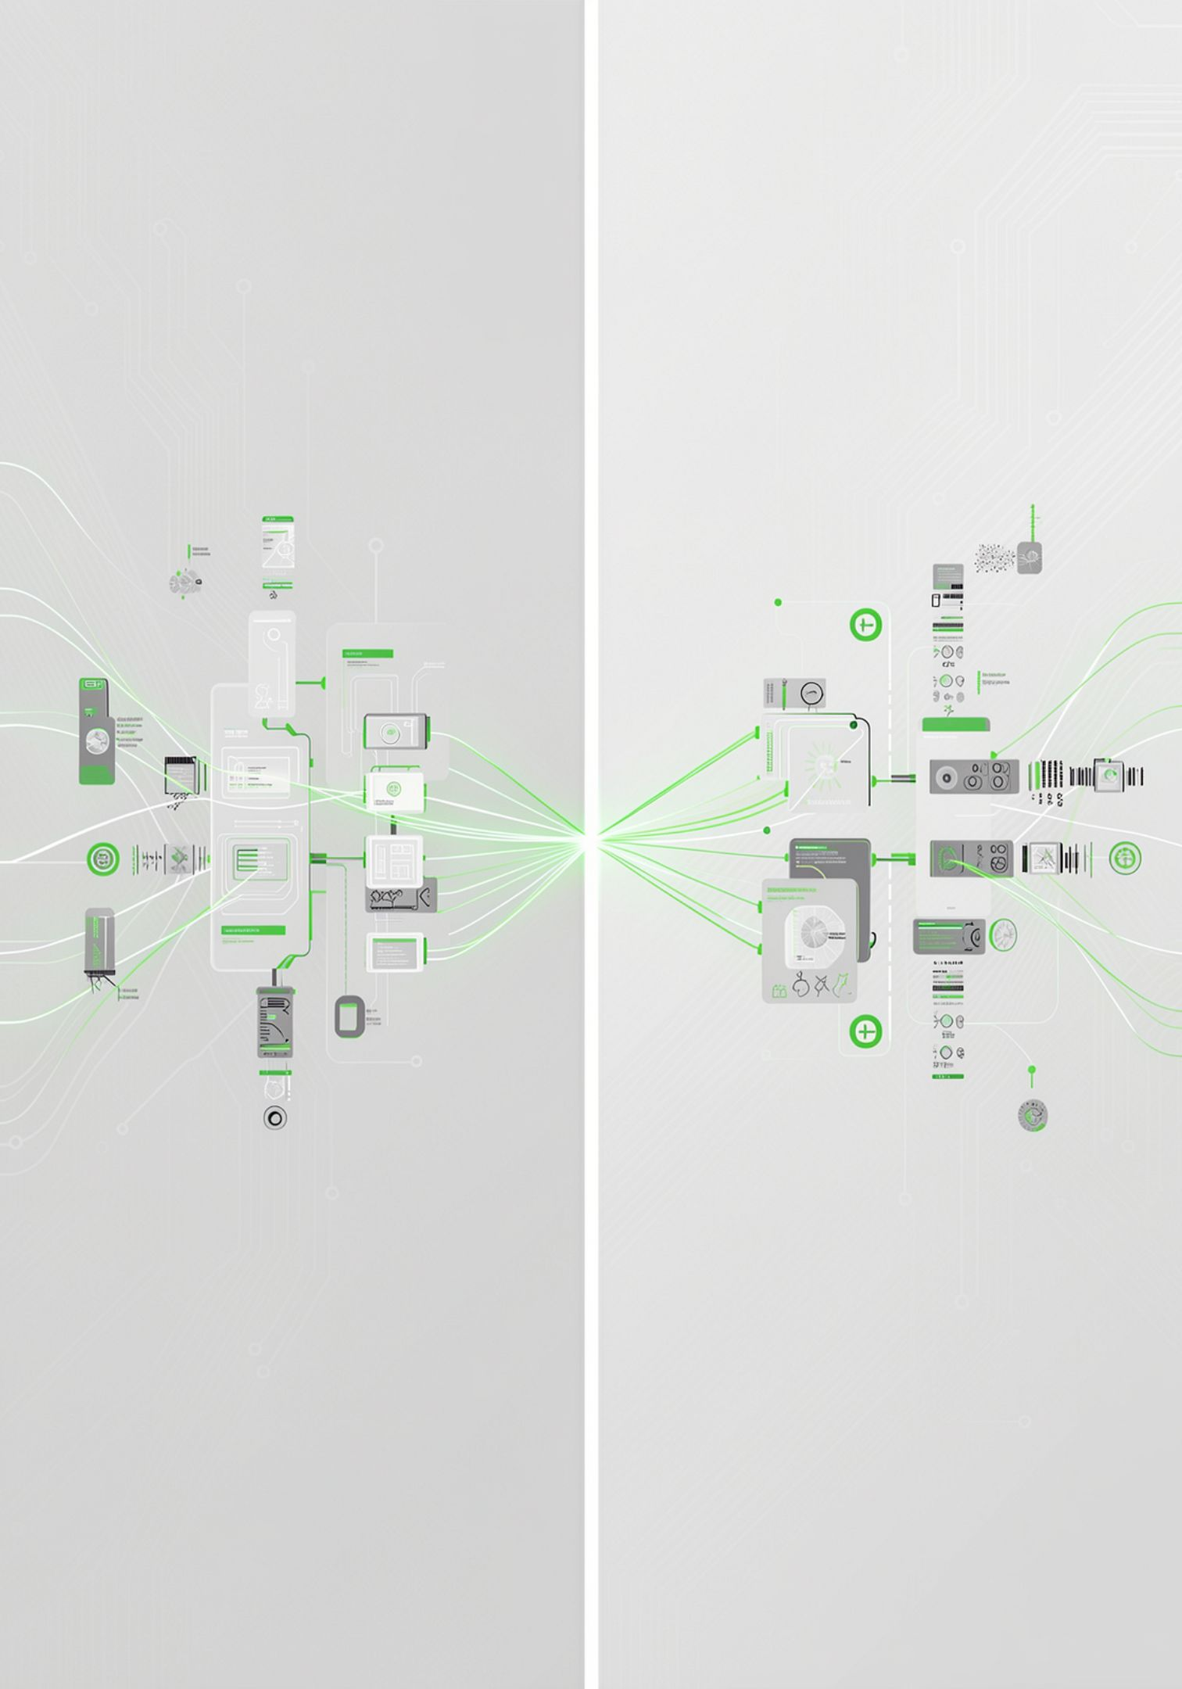





Research Gap
Existing Research
Computer Vision
LCA / Sustainability
Accurate textile material identification
Estimation of environmental impacts
Recommendation / Pricing
Digital Marketplaces
Support for commercial decisions
Connection of textile suppliers and buyers
Predictive Analytics
Forecasting of market behavior
Missing Integration
Integrated AI Textile Circularity Platform
Opportunity for a Sri Lanka-focused platform combining:
Fabric, Sustainability, Commercial, & Marketplace Intelligence
District-aware information & Local pricing
Buyer matching & Traceability
Circular-action recommendations & Marketplace predictions

Slide 8

Four Research Components
Driving one integrated platform
Fabric Intelligence
Sustainability Intelligence
Analyze material properties and production data.
Assess environmental impact and circularity metrics.
Commercial Intelligence
Marketplace Intelligence
Translate insights into market and pricing strategies.
Connect demand signals to product discovery.

Slide 9
AI Fabric Classification & Condition Intelligence
Sandeepa S.A.C. (IT22281814)

Slide 10












AI-Based Textile Fabric Classification & Condition Intelligence
Main Objective
This research component leverages advanced AI to meticulously analyze textile waste, providing critical insights into its composition and usability for circular economy applications.
Our solution utilizes an EfficientNet-B3 16-class classifier to achieve high-precision textile identification.
Key Outputs
Fabric Type
Classification Confidence
Precise identification of material composition (e.g., cotton, polyester, blends) using computer vision.
A probabilistic score indicating the accuracy of the identified fabric type.
Defect Area
Health / Quality Score
Pinpointing specific areas of damage, stains, or wear on the textile.
An overall assessment of the textile's condition, determining its suitability for various reuse pathways.
Repairability
Remaining Lifespan
An evaluation of whether the textile can be repaired and the estimated effort required.
Prediction of how much usable life is left in the textile, guiding reuse decisions.

Slide 11

The Challenge of Textile Identification & Grading
Current Problem: Uncategorized Waste
Textile waste arrives as diverse materials, often mixed.
Variations in fabric types, blends, and colors are common.
Wide range of quality levels, from pristine to heavily damaged.
Different degrees of contamination (e.g., oil, dyes, dirt).
Manual Assessment: Inefficient & Inaccurate
Time-consuming process for large volumes of waste.
Highly subjective, leading to inconsistent grading.
Difficult to standardize quality metrics across different assessors.
Does not scale effectively with increasing waste quantities.
Research Need
There is a critical need for an automated, image-based system that can reliably identify and grade textile waste to facilitate efficient reuse and recycling.

Slide 12
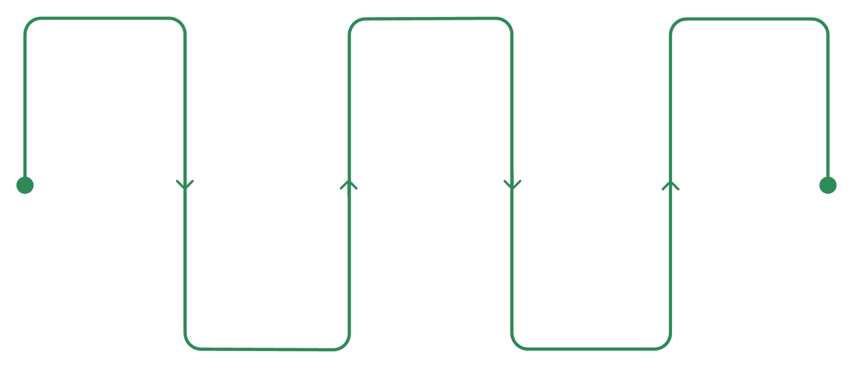
Proposed Solution
AI Fabric Intelligence Pipeline
Our solution employs a sophisticated AI pipeline to comprehensively analyze textile waste, providing detailed insights for effective upcycling.
Upload Image
Classification
Condition & Score
Submit textile photo
Identify fabric type
Assess health and score
Preprocessing
Defect Detection
Clean and normalize image
Locate flaws and stains
Underlying Model
16 Fabric Classes Detected
At the core of our classification system is an EfficientNet-B3 model, fine-tuned for textile analysis.
Blended
Chenille
Corduroy
Cotton
Crepe
Denim
Fleece
Leather
Linen
Nylon
Polyester
Satin
Silk
Terrycloth
Viscose
Wool
Notes:
Explain how the AI pipeline works, step-by-step, from image upload to assessing remaining lifespan.
Highlight the EfficientNet-B3 model as the technical backbone and briefly mention its strengths for image classification.
Emphasize the breadth of fabric types our system can identify (16 classes) to show its versatility.

Slide 13


Research Comparison
Existing Approaches & Limitations
Textile Image Classification
Textile Defect Detection
Textile Material Datasets
Uses computer vision to classify textile/material images.
Limitation: Primarily focuses on material recognition, often lacking condition assessment or marketplace integration.
Employs computer vision for detecting defects like tears, stains, and wear.
Limitation: Defect analysis is typically siloed and separate from broader marketplace intelligence or sustainability metrics.
Large datasets support classification and defect detection research, improving model accuracy.
Limitation: Not specifically integrated with Sri Lankan textile-waste marketplace workflows, limiting local applicability and direct impact.
TexCycle AI: Our Integrated System
Comprehensive Fabric Classification
Detailed Defect Analysis
Overall Condition Assessment
Seamless Marketplace Integration

Slide 14








Latest Technologies Used
Artificial Intelligence & Deep Learning
Model
CNN
Transfer Learning
Computer Vision
Image preprocessing
Fabric classification
Defect detection
EfficientNet-B3
Supporting Technology
Key Domains
Python
PyTorch / ML environment
FastAPI
REST API
React frontend
Computer Vision
Deep Learning
Textile Material Science
Image Processing
Machine Learning

Slide 15
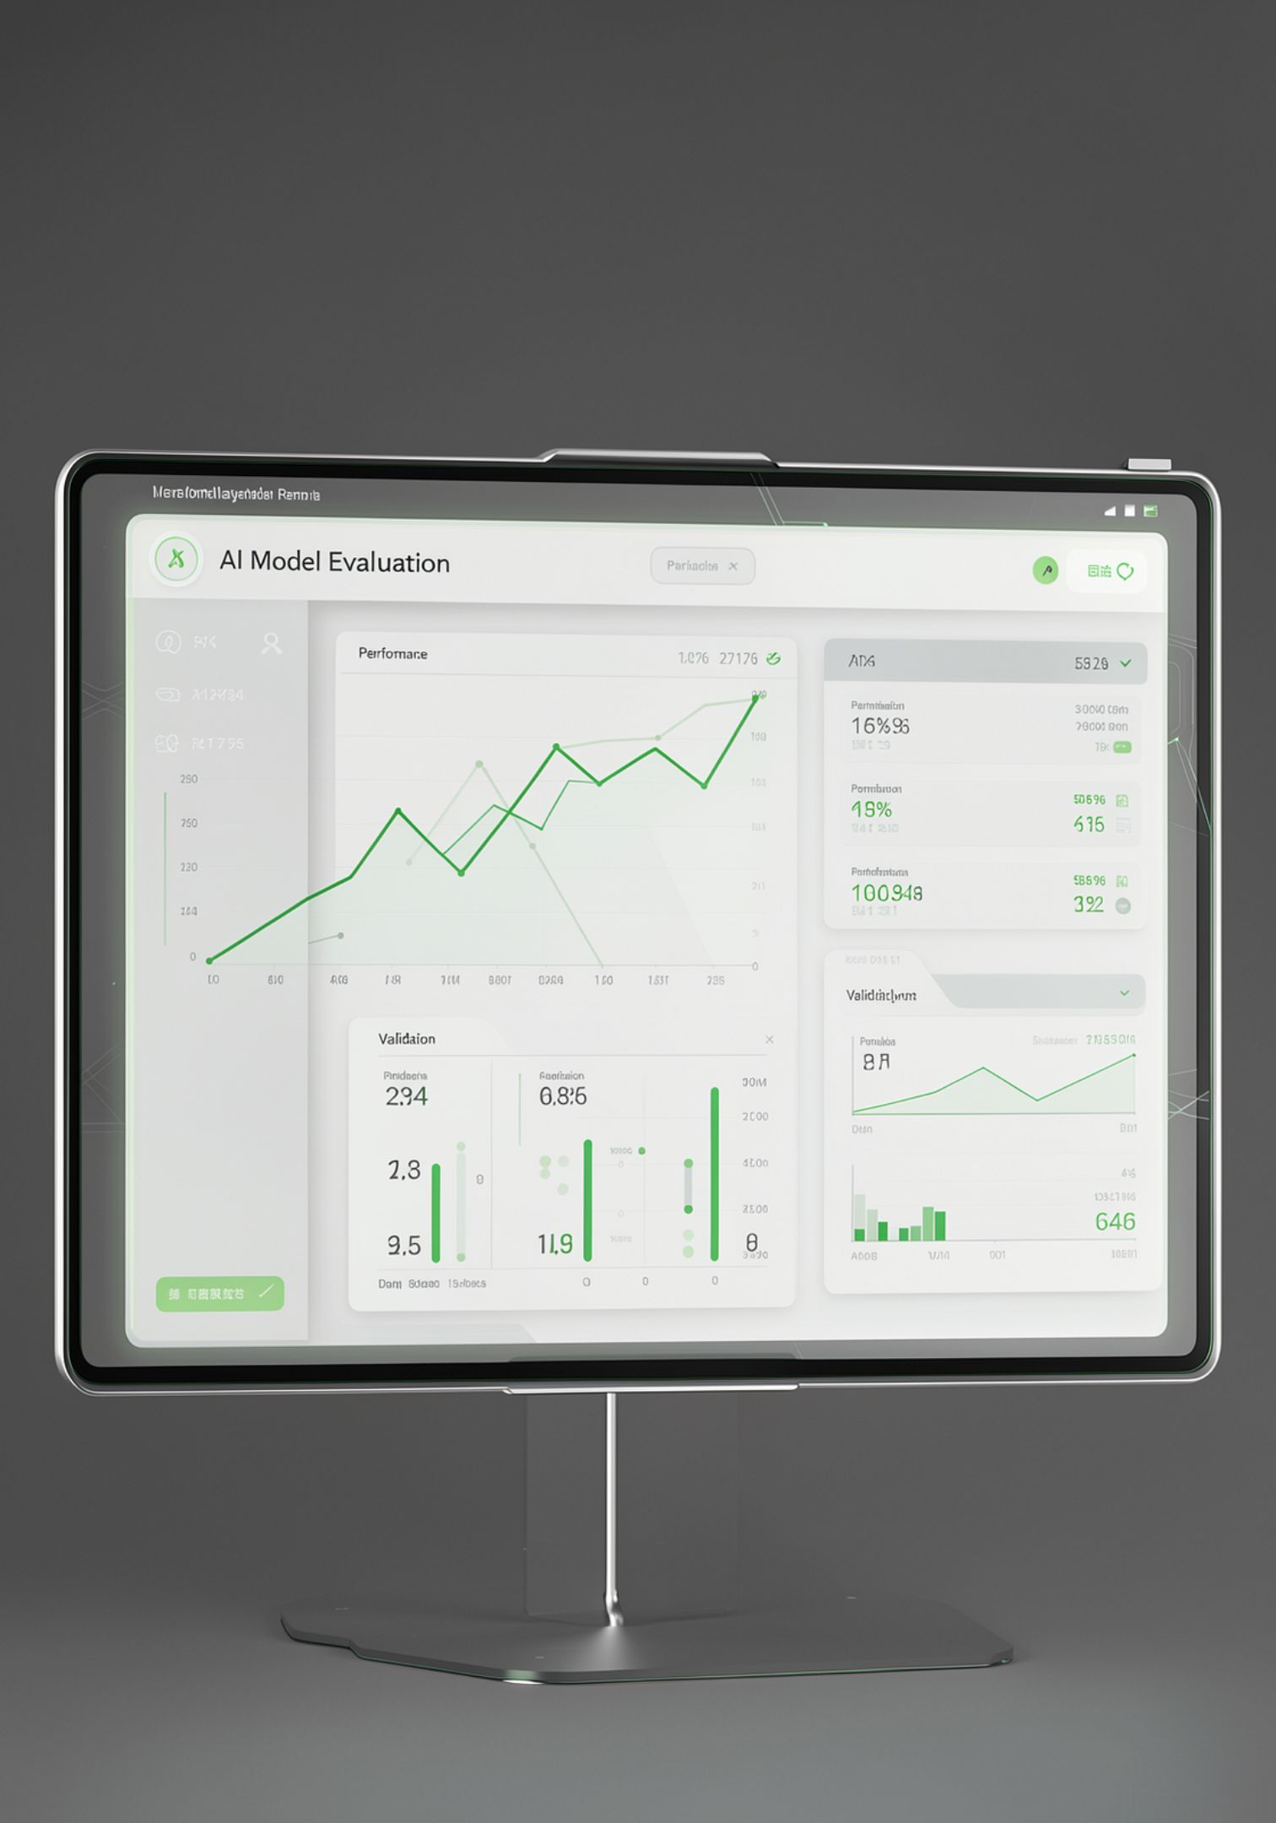


Evaluation and Validation
Model Evaluation Metrics
Accuracy, Precision, Recall, F1 Score
Confusion Matrix
Detailed breakdown of classification outcomes for each fabric class.
Standard metrics for comprehensive classification performance assessment.
Confidence Analysis
Evaluation of the model's prediction certainty, crucial for real-world application.
Defect Analysis Metrics
Defect detection quality
Accuracy of defect-area estimation
Data Utilized
Proprietary textile image dataset
Locally collected textile samples from Sri Lanka
Public textile datasets (where applicable)
Augmented training images for model robustness
Current Implementation
Fabric Classifier: EfficientNet-B3
Defect Model: defect_unet.pth

Slide 16
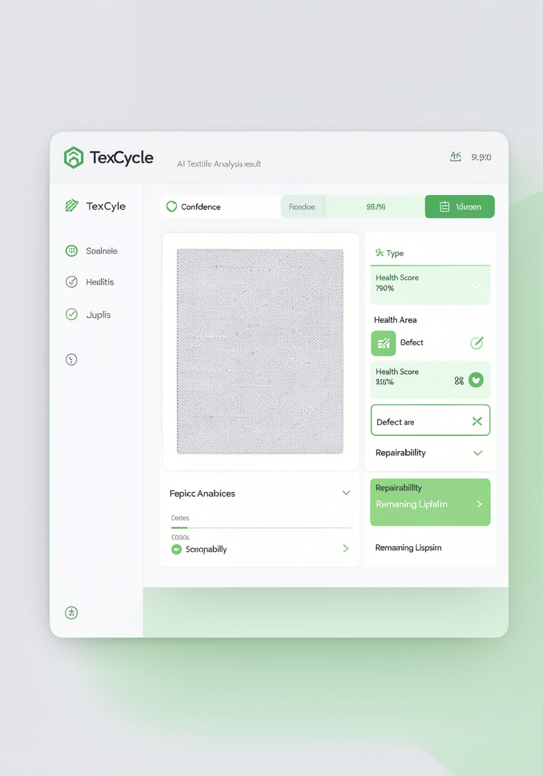



Real-World Usage Scenario
Understanding the journey of textile waste through the TexCycle AI platform, from raw input to actionable insights.
Seller Input
Textile image(s)
Basic textile information
A seller provides visual data and minimal descriptive details of the textile waste.
AI Processing
Identifies fabric type
Detects visible defects
Estimates condition & health score
Estimates repairability & remaining lifespan
Our AI model analyzes the input to generate comprehensive insights.
AI Output
Fabric: Cotton
Confidence: 95%
Health Score: 85
Defect Area: 5%
Repairability: High
Remaining Lifespan: 3 years
Actionable data is provided, enabling informed decisions for reuse and recycling.

Slide 17
Sustainability Intelligence & Environmental Impact Prediction
Siriwardhana N.S.T.N.
IT22215338

Slide 18






Environmental Impact Prediction
This research component focuses on quantifying the positive environmental externalities generated by textile reuse.
Main Question
What measurable environmental value does textile reuse provide within the Sri Lankan context?
Key Outputs
CO₂ Saving
Quantifying the reduction in carbon dioxide emissions achieved through reuse.
Water Saving
Measuring the amount of water conserved by diverting textiles from disposal.
Green Score
A composite index reflecting the overall environmental benefit of a reused textile.
Sustainability Score
An assessment of a textile's contribution to circular economy principles.
Circular-Action Recommendation
Guidance on the most impactful reuse or recycling pathway for a given textile.
Scenario Comparison
Analysis of environmental impacts across different end-of-life scenarios.
Notes:
Explain the importance of quantifying environmental benefits for stakeholders and decision-makers.
Briefly describe each output, emphasizing its relevance to textile sustainability and circularity.
Mention that these metrics will help users understand the direct positive impact of their choices.

Slide 19

The Environmental Cost of Textile Waste
When reusable textile materials are discarded, it leads to a cascade of negative environmental and economic impacts:
Lost Material Value
The inherent value and potential of textile resources are permanently lost, contributing to a linear 'take-make-dispose' economy.
New Raw Material Demand
The continuous production of new textiles requires significant virgin resources, such as water, land, and energy, straining natural ecosystems.
Additional Environmental Impacts
Disposal methods, particularly landfilling, contribute to greenhouse gas emissions and pollution of soil and water bodies.
The Marketplace Gap
Current Problem
TexCycle AI's Value
Traditional marketplace listings typically only address:
TexCycle AI expands this by additionally asking:
Notes:
Introduce the problem with a compelling visual and highlight the key environmental and economic losses.
Explain how current marketplaces fall short by only focusing on price, missing the crucial environmental quantification.
Emphasize how TexCycle AI fills this gap by adding environmental value to the equation, laying the groundwork for the next discussion.

Slide 20
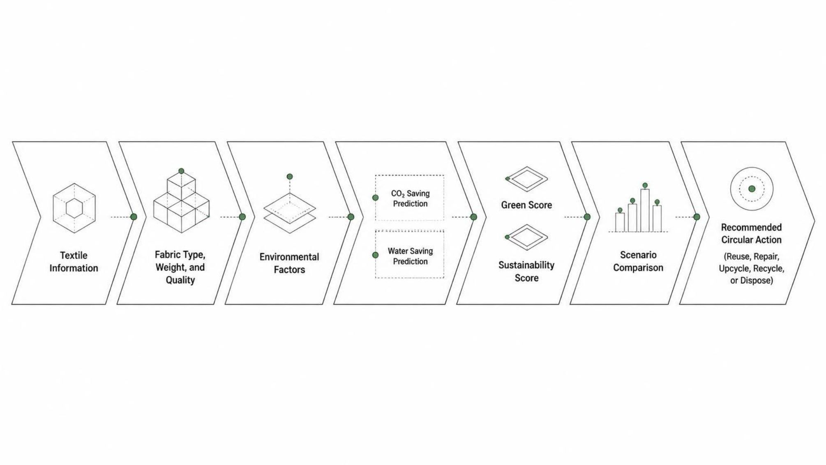
PROPOSED SOLUTION
Sustainability Intelligence Pipeline
Our Sustainability Intelligence Pipeline is designed to transform raw textile information into actionable environmental insights, guiding the most sustainable end-of-life choices for textile waste.
This systematic process ensures that every textile item receives a tailored recommendation, maximizing its environmental value and minimizing waste.

Slide 21

Research Comparison & The Gap
Existing solutions address parts of the textile sustainability challenge, but a critical integration remains unfulfilled.
Research A: Lifecycle Assessment
Provides environmental impact information for textile materials.
Limitation: Usually provides assessment data rather than an interactive marketplace decision layer.
Research B: Textile Sustainability Assessment
Evaluates environmental impacts of textile materials.
Limitation: Not necessarily integrated with individual marketplace listings and buyer/seller decisions.
Research C: Digital Circular Platforms
Provide sustainability/traceability information.
Limitation: Environmental intelligence may not be integrated with all commercial AI components.
Our Proposed System
Environmental Prediction
Scenario Comparison
Explainable Recommendation
Marketplace Integration

Slide 22




Latest Technologies Used
Our platform leverages cutting-edge technologies and deep domain expertise to deliver robust and insightful textile waste management solutions.
Machine Learning
Sustainability Intelligence
At the core of our AI capabilities:
Quantifying environmental impact:
Regression
Classification
Random Forest
Scikit-learn
LCA-based environmental factors
CO₂ calculations
Water-saving calculations
Green Score
Sustainability Score
Core Technology Stack
Key Domains
The foundation of our platform:
Interdisciplinary expertise for holistic solutions:
Python
FastAPI
React
MongoDB
Machine Learning model pipeline
Life Cycle Assessment
Environmental Science
Machine Learning
Circular Economy
Sustainability Analytics

Slide 23





Evaluation and Validation
Our rigorous evaluation framework ensures the accuracy and reliability of both our AI models and the environmental impact predictions, providing trustworthy insights for sustainable textile management.
Regression Metrics
Classification Metrics
Mean Absolute Error (MAE)
Root Mean Square Error (RMSE)
Coefficient of Determination (R²)
Accuracy
Precision
Recall
F1 Score
Confusion Matrix
Sustainability Validation
Data Sources
Environmental-factor verification
Scenario consistency
Recommendation validity
API testing
Frontend workflow testing
Life Cycle Assessment (LCA) sources
Academic literature
Established sustainability databases
Textile-specific environmental studies
Current Model Assets
sustainability_regressor.pkl
sustainability_grade_model.pkl
grade_encoder.pkl

Slide 24



Real-World Usage Scenario
To illustrate TexCycle AI's functionality, consider a practical application:
Input
Processing
Output
Seller uploads textile details:
System calculates:
Recommended Action:
Fabric: Cotton
Weight: 20 kg
Condition: Good
Quality: Medium
CO₂ Saving
Water Saving
Green Score
Sustainability Score
Reuse / Upcycle
This process culminates in a comprehensive sustainability analysis, as shown below:
Notes:
Walk through the scenario step-by-step, explaining how user input translates into TexCycle AI's analysis and leads to actionable recommendations.
Emphasize the practical value of the recommended action and the transparency of the calculated metrics.
Briefly mention that the image is an example of the kind of output the user would see on the Sustainability Analysis page.

Slide 25
Madushanka H.M.T.G.
Traceability, AI Pricing & Buyer Recommendation
IT22221278

Slide 26



Research Component: Pricing & Traceability Intelligence
This component focuses on leveraging AI to determine the economic value of textiles and connect them to the right buyers, while also providing a comprehensive digital history.
1
2
3
Main Question
Key Outputs
Enhanced Traceability
What is the textile worth and who should buy it?
AI price prediction
Price range
Buyer recommendation
Demand-related information
Listing ranking
Digital material history
Notes:
Introduce this section as the core of economic valuation and marketplace efficiency.
Elaborate on how answering "what it's worth" and "who should buy it" is crucial for a thriving circular economy, moving beyond simple listing price.
Emphasize the importance of traceability in building trust and transparency in the textile supply chain, and how a digital material history enhances this.

Slide 27


The Problem: Textile Waste Commercialization Challenge
The current textile waste market is fragmented and opaque, creating significant hurdles for both those looking to sell textile waste and those seeking to acquire it for circular economy initiatives.
Sellers Face:
Buyers Face:
Unclear resale value
Manual price negotiation
Difficulty identifying suitable buyers
Lack of comprehensive market information
Limited visibility into material history and impact
Difficult material discovery
Unclear quality and condition assessment
Unknown environmental value of materials
Difficult comparison between diverse textile lots
Limited seller trust and traceability information
Notes:
Start by highlighting the core issue: inefficiency and lack of transparency in the textile waste market.
Explain how these challenges prevent valuable textile resources from being properly commercialized and re-integrated into the circular economy.
Set the stage for how TexCycle AI addresses these specific pain points for both sides of the marketplace.

Slide 28








Proposed Solution: AI Commercial Intelligence
Our AI-driven system provides comprehensive commercial intelligence, transforming textile waste into valuable resources by accurately assessing its market worth and connecting it with the most suitable buyers.
Textile Attributes
Market Information
AI Price Prediction
Buyer Recommendation
Condition + Weight + Fabric Type
Real-time supply & demand, historical pricing
Recommended Price
Price Range
Confidence Score
Recycler
Furniture Manufacturer
Garment Manufacturer
Fashion Designer
Insulation Producer
Cleaning Cloth Producer
Exporter
Toy Manufacturer

Slide 29







Research Comparison & The Gap
Our solution synthesizes and expands upon existing research, integrating critical components often found in isolation within the current landscape.
Research A: AI Pricing
Research B: Recommendation Systems
Research C: Traceability Platforms
Leverages machine-learning models to estimate product or material prices based on various market factors.
Focuses on suggesting products or partners based on attributes, historical behavior, or user preferences.
Provides mechanisms to track material movement, origin, and lifecycle stages throughout the supply chain.
Limitation: Often lacks integration of textile-specific sustainability metrics and detailed buyer segmentation for waste materials.
Limitation: Traditional systems rarely incorporate nuanced textile condition, environmental impact, or dynamic marketplace demand for waste streams.
Limitation: Typically operates as a standalone function, disconnected from real-time AI pricing models and intelligent buyer recommendation engines.
Our Proposed System: Bridging the Gap
TexCycle AI integrates these disparate functions into a cohesive platform, offering a holistic solution.
AI Pricing
Buyer Recommendation
Accurate, dynamic valuation of textile waste.
Intelligent matching with suitable circular economy partners.
Traceability
Sustainability
Transparent, digital material history from origin to next use.
Integrated environmental impact assessment and green scores.
Notes:
Explain that while these research areas exist, their integration, especially with textile-specific data, is the gap we're filling.
Highlight how each limitation mentioned for Research A, B, and C is directly addressed by TexCycle AI's integrated approach.
Emphasize the unique value proposition of combining all four elements: AI Pricing, Buyer Recommendation, Traceability, and Sustainability, making the system comprehensive and powerful.

Slide 30





Latest Technologies Used
Our platform leverages cutting-edge technologies across multiple domains to deliver intelligent and robust solutions for textile waste management.
1
2
3
AI / ML
Recommendation
Traceability
Regression
XGBoost
Random Forest
Feature engineering
Attribute matching
Buyer-category recommendation
Demand-related ranking
Digital material record
Batch ID
Transaction history
Environmental information
Lifecycle events
4
5
Technology Stack
Key Domains
Python
FastAPI
Node.js
React
MongoDB
Machine Learning
Recommendation Systems
E-Commerce
Supply Chain
Traceability
Circular Economy
Notes:
This slide details the specific technologies and foundational domains that power TexCycle AI.
Highlight how a diverse set of AI/ML techniques allows us to accurately assess textile value, and how sophisticated recommendation algorithms ensure the right matches are made.
Emphasize the robust traceability features, creating a comprehensive digital history for every textile batch.
Mention the modern, scalable technology stack and reiterate how these components collectively support the key domains relevant to circular economy principles.

Slide 31



Evaluation and Validation
Our AI Commercial Intelligence undergoes rigorous evaluation to ensure accuracy, relevance, and data integrity across all its core components, driving trusted insights for the textile waste market.
AI Pricing Metrics
Recommendation Evaluation
Traceability Evaluation
Initial experiment results demonstrate robust performance for our price prediction model:
The integrity and reliability of our traceability system are validated against stringent criteria to ensure a transparent material history:
We continuously assess the effectiveness of our buyer recommendation engine through key performance indicators to ensure optimal matching:
MAE: 12.24
RMSE: 15.40
R²: 0.9590
Correct batch association across the supply chain
Comprehensive transaction history records
Lifecycle-event consistency and accuracy
Overall data integrity and immutability
Recommendation relevance
Buyer-match acceptance rate
Click/selection behavior analysis
Overall ranking quality and precision
These foundational metrics indicate a strong predictive capability, providing reliable valuation for diverse textile waste categories.
Notes:
Explain that the MAE, RMSE, and R² values showcase the model's accuracy in predicting prices, indicating minimal error and high explanatory power.
Highlight that recommendation evaluation focuses on user engagement and the practical utility of the matches proposed by the AI.
For traceability, emphasize the system's ability to maintain a reliable and unalterable digital material history, which is crucial for building trust in circular supply chains.

Slide 32
Real-World Usage Scenario
Witness TexCycle AI in action: from initial textile upload to intelligent price prediction and optimized buyer matching, creating a transparent circular economy.
Seller Input: Textile Upload
Intelligent Outputs Generated
A textile seller uploads details for a batch, specifying criteria like Fabric: Polyester, Quantity: 50 kg, and Condition: Good.
The system generates a Predicted Price, a dynamic Price Range, tailored Buyer Recommendations, and a comprehensive Traceability Record.
1
2
3
4
AI Processing & Analysis
Optimized Placement Example
TexCycle AI instantly processes the data, applying advanced algorithms to evaluate market value, potential applications, and environmental impact.
For instance, the "Good" condition Polyester might be recommended to a Recycler for fiber regeneration or a Garment Manufacturer for upcycling.

Slide 33
Thalagala T.A.D.V.
Marketplace Platform & Predictive Analytics
IT22281678
Notes:
Introduce the next team member, Thalagala T.A.D.V., and their core contribution to the TexCycle AI project: the development of the marketplace platform and its integrated predictive analytics capabilities.
Briefly emphasize the significance of a robust marketplace and accurate predictions for the success of the circular economy model being presented.

Slide 34












RESEARCH COMPONENT
Research Component: Marketplace Predictive Analytics
Main Question:
How will the textile marketplace perform?
Our research component focuses on developing advanced predictive models to forecast marketplace dynamics and provide actionable insights for all stakeholders.
Listing Success Prediction
Sales-time Prediction
Market-trend Prediction
Demand Analysis
Marketplace Analytics
Predictive Dashboard
Notes:
Introduce the specific research component focusing on marketplace predictive analytics.
Emphasize the core question the research aims to answer: forecasting marketplace performance.
Briefly explain each of the main outputs, highlighting how they contribute to a more efficient and predictable textile waste marketplace.
Mention that these outputs directly support buyers and sellers in making informed decisions.

Slide 35
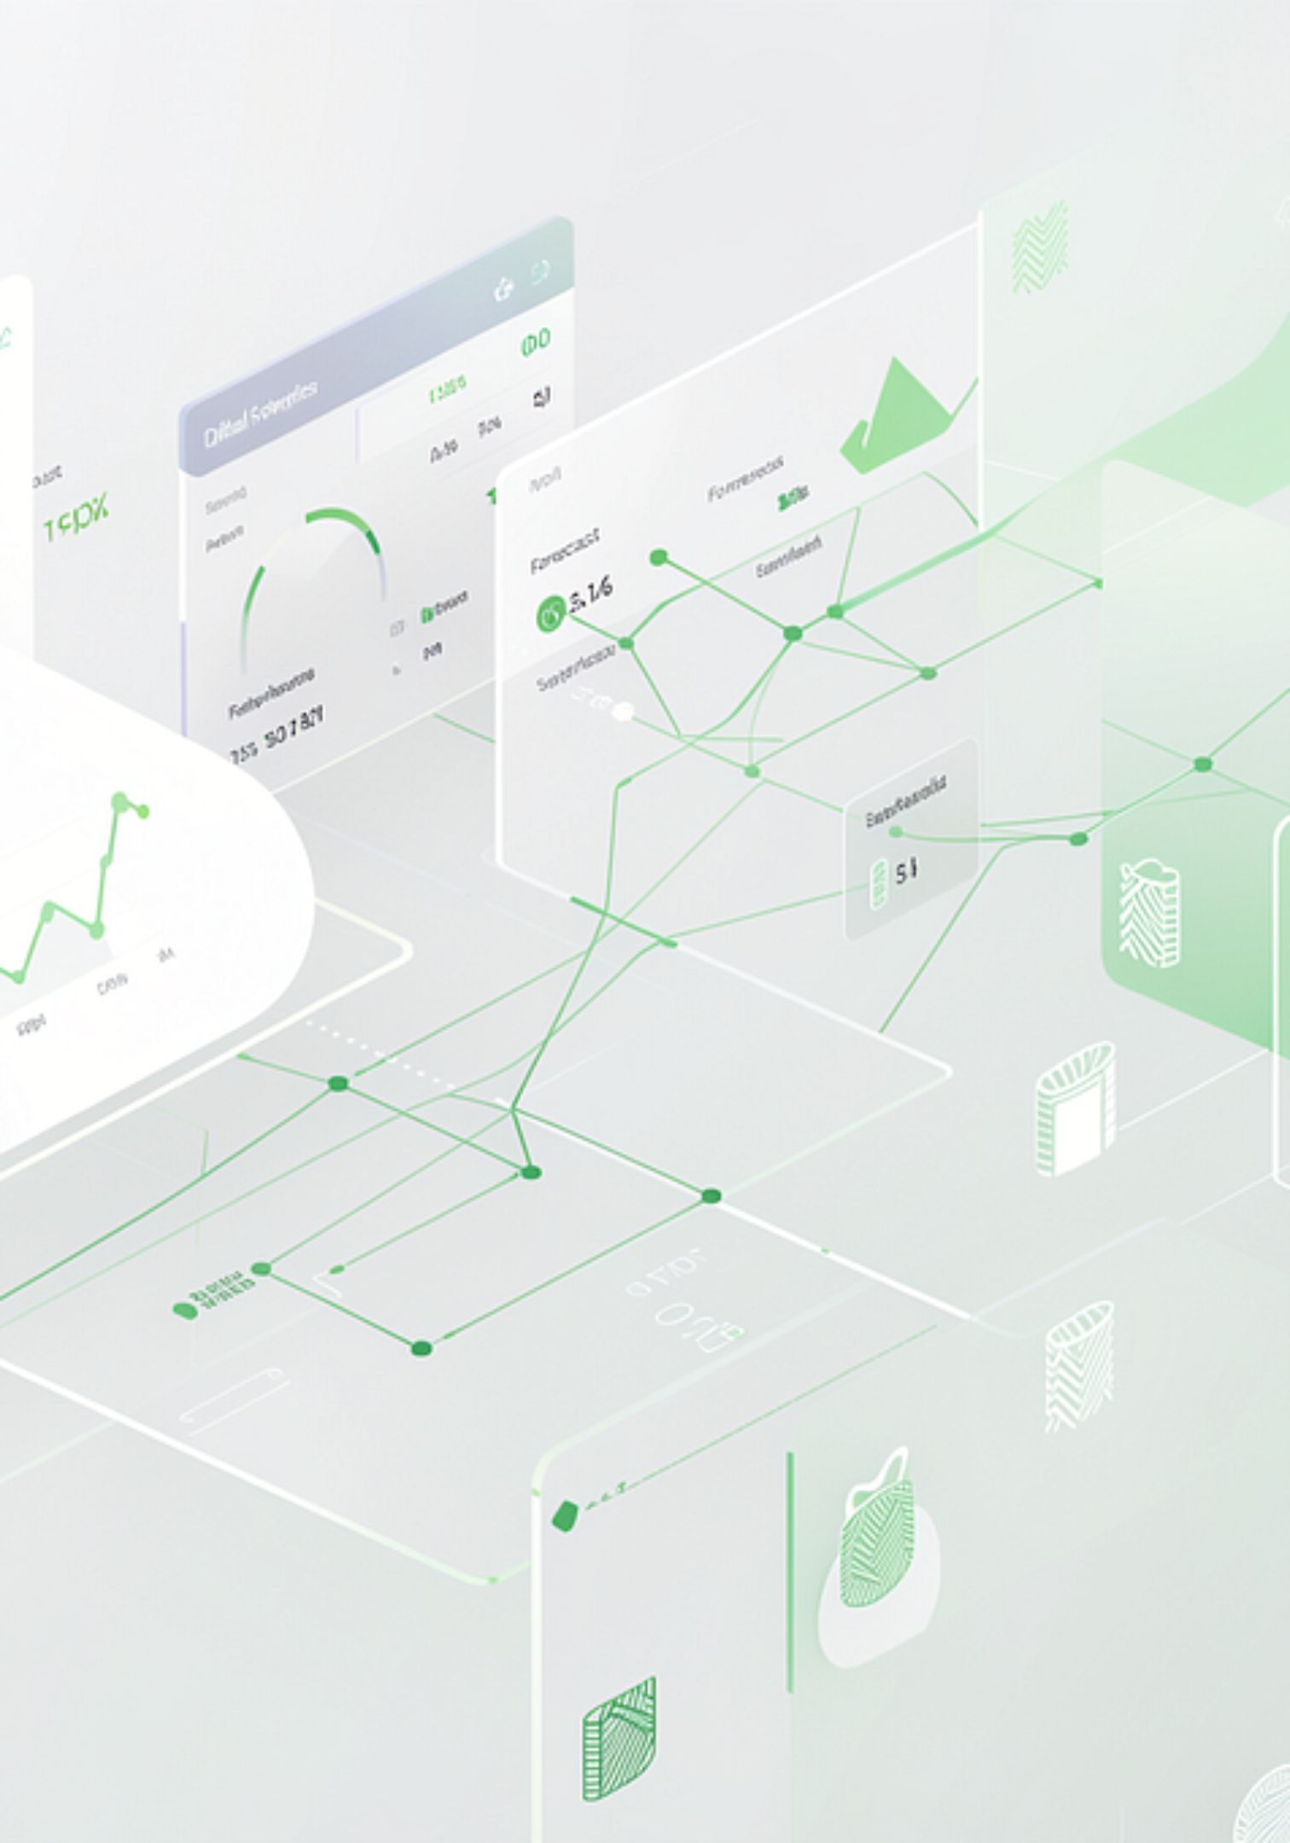



Proposed Solution: Marketplace Predictive Analytics
Our advanced AI models analyze historical data and real-time market signals to provide precise predictions, empowering sellers and buyers with crucial market intelligence for the textile reuse and recycling market.
Listing Success Prediction
Forecasts the likelihood of a textile listing being sold, categorizing it as Sold or Unsold.
Sales Time Prediction
Estimates the Estimated Days to Sell for a given textile batch, aiding in inventory management and sales strategy.
Market Trend Prediction
Identifies the current market trajectory for specific textile types as Increasing, Stable, or Decreasing in demand or value.
Notes:
Introduce the core functionality of Marketplace Predictive Analytics, highlighting how it provides crucial market intelligence.
For "Key Predictive Outputs", briefly explain what each prediction entails (Sold/Unsold, Estimated Days to Sell, Increasing/Stable/Decreasing trends).
For "Algorithm: XGBoost", emphasize that XGBoost is used for all predictions due to its robustness. Specify whether it's a Classifier or Regressor for each prediction, aligning with the type of output.
Conclude by stating how these predictions directly support informed decision-making for both textile sellers and buyers on the platform.

Slide 36





Marketplace Predictive Analytics: Dataset
Our predictive models for marketplace dynamics are developed and demonstrated using a comprehensive, prototype dataset.
Dataset Name: member4_textile_dataset.csv
Size: 100,000 records
Features: 36 distinct features capturing various marketplace aspects
Nature: Synthetic/prototype, specifically generated for model development and demonstration.
Notes:
Explain the details of the dataset used for Member 4's models, including its size and the number of features.
Clearly state that the dataset is synthetic/prototype and used primarily for model development and demonstration.
Emphasize the critical need for real-world Sri Lankan transaction data to validate the models' performance in a live market scenario, reiterating that the current metrics are based on this synthetic data.

Slide 37
Commercialization
Driving adoption and value in the TexCycle AI marketplace to foster a thriving circular economy for textiles.
Target Users
Platform Value
Our platform caters to both ends of the textile lifecycle:
TexCycle AI delivers distinct benefits to all marketplace participants:
Supply Side
For Sellers
Garment factories
Textile manufacturers
Tailors
Textile waste suppliers
Apparel SMEs
Better valuation
Better buyer discovery
AI-assisted listings
Market intelligence
For Buyers
Demand Side
Easier material discovery
Better comparison
Flexible purchasing
Sustainability information
Seller trust information
Textile recyclers
Upcycling businesses
Fashion designers
Furniture manufacturers
Garment manufacturers
Cleaning-cloth producers
Insulation producers
Toy manufacturers
Exporters
Artisans and SMEs
Notes:
Introduce the commercialization strategy for the TexCycle AI platform, emphasizing how it bridges the gap between textile waste generators and those who can reuse or recycle it.
Highlight the diverse range of target users on both the supply and demand sides, showcasing the broad applicability and potential impact of the platform.
Explain the specific value propositions for both sellers (e.g., maximizing revenue through better valuation, efficient sales) and buyers (e.g., easy access to diverse materials, informed decision-making).
Connect these points back to the overall goal of creating a transparent and efficient circular economy.

Slide 38
Business Model & Commercialization Plan
Our commercial strategy leverages a tiered service model, ensuring accessibility while providing advanced features for specialized needs, complemented by diverse revenue streams to sustain growth and impact.
FREE / BASIC
PROFESSIONAL
BUSINESS / ENTERPRISE
Marketplace Access
Browse textile listings
Search & filtering
Basic listing information
Basic buyer/seller profile
Includes all Basic features, plus:
Includes all Professional features, plus:
AI recommendations
Price prediction
Buyer matching
Sustainability information
Marketplace analytics
Bulk procurement
Advanced analytics
Demand forecasting
Digital traceability
Environmental impact reporting
Business dashboards
API / integration services
Potential Revenue Streams
Transaction commission: A small percentage from successful marketplace transactions.
Premium subscriptions: Access to advanced AI analytics for businesses and Professional tier features.
Enterprise services: Tailored solutions for large factories, recyclers, and bulk buyers.
API services: Provision of AI prediction APIs for integration with external organizations' systems.
Verified business services: Enhanced seller/business verification and premium visibility features.
Notes:
Introduce the core business model, outlining the three distinct tiers and their respective feature sets.
Emphasize how the tiered approach balances accessibility with advanced value propositions for different user segments.
Detail each potential revenue stream, explaining how TexCycle AI will generate income from transaction commissions, premium subscriptions, enterprise solutions, API access, and verified business services.
Connect these revenue streams back to the value provided to users and the sustainability of the platform.

Slide 39
Thank You!
TexCycle AI
Turning Textile Waste into Intelligent Resources
AI + Sustainability + Marketplace + Circular Economy
Notes:
Conclude the presentation with a clear and concise thank you message.
Reiterate the core mission and value proposition of TexCycle AI in a memorable way.
Summarize the key pillars of the project: AI, Sustainability, Marketplace, and Circular Economy.
Keep the design clean and impactful, suitable for a closing slide.

