Slide 1
Android Workshop
By
Chan Woo Park
James Hardjadinata

Slide 2
Getting Started
JDK (Java Development Kit)
IDE (Android Studio or Eclipse)
Android SDK
ADT Plug-in (Eclipse users only)

Slide 3
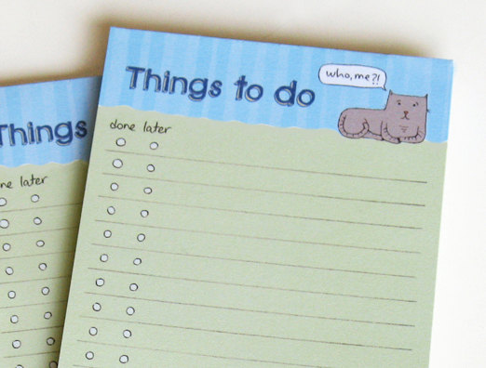
Goal
Memo!
Saves user’s text, notes, etc

Slide 4
Creating a Project
Folders: src, layout, menu
Java: App functionalities
Xml: UI design, values

Slide 5
What is an Activity
A single screen (one state)
Java & XML

Slide 6
Life Cycle

