Slide 1
Advection scheme

Slide 2
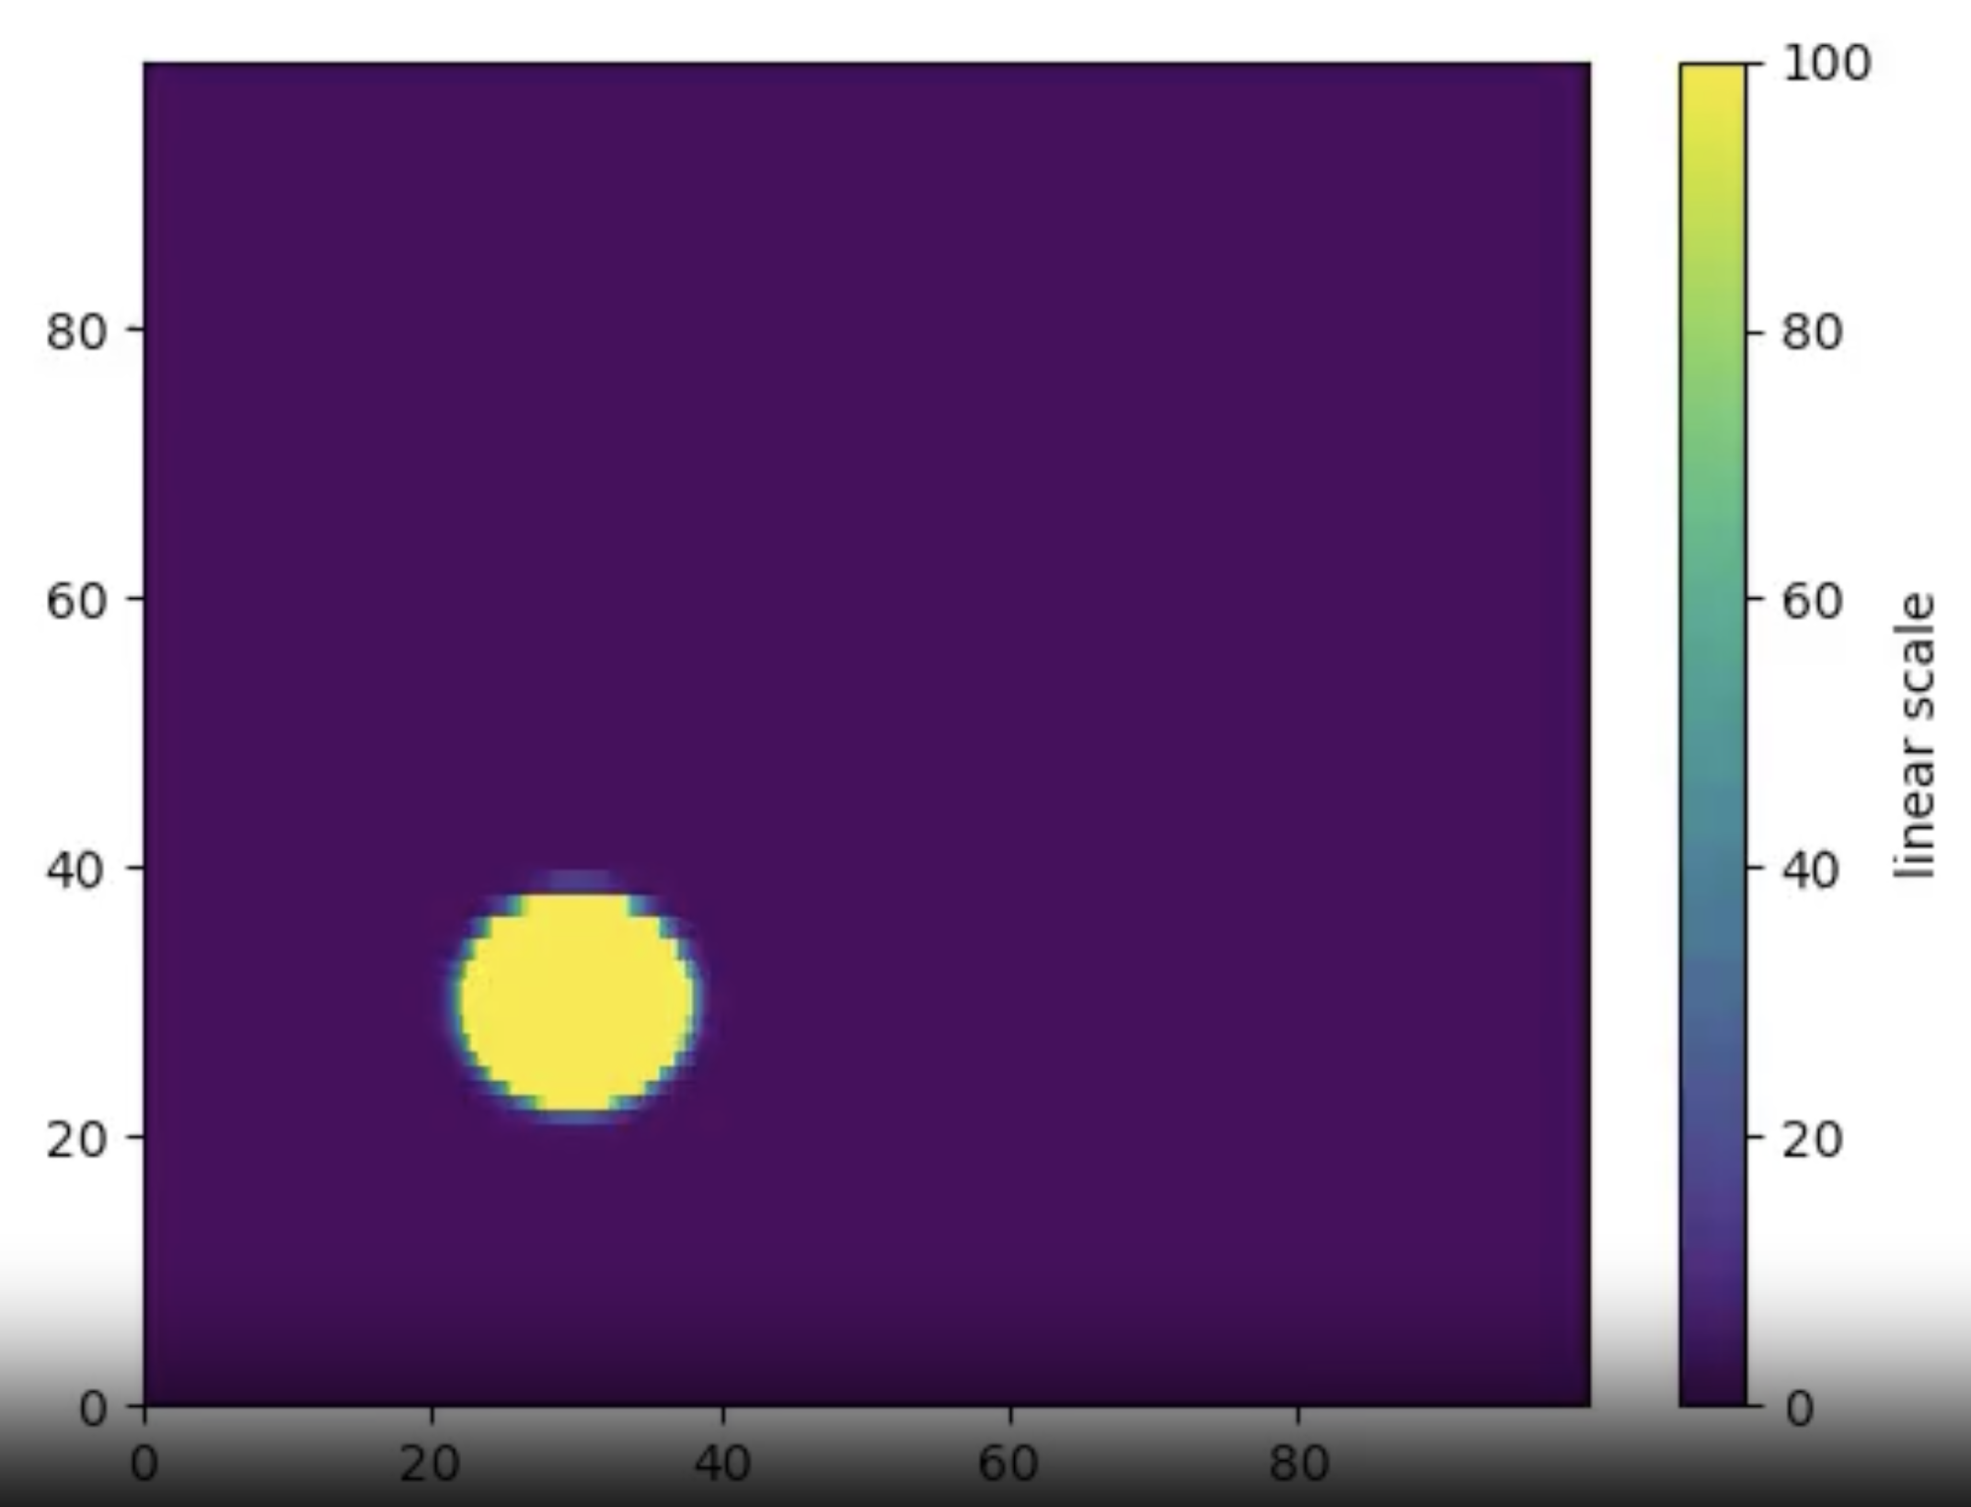
Injection of gaussian source
R_max = 100 kpc, Z_max = 100 kpc
V_R = 0, V_Z = 300 km /s
dx_min = 20 pc
dT = 10000 year

Slide 3
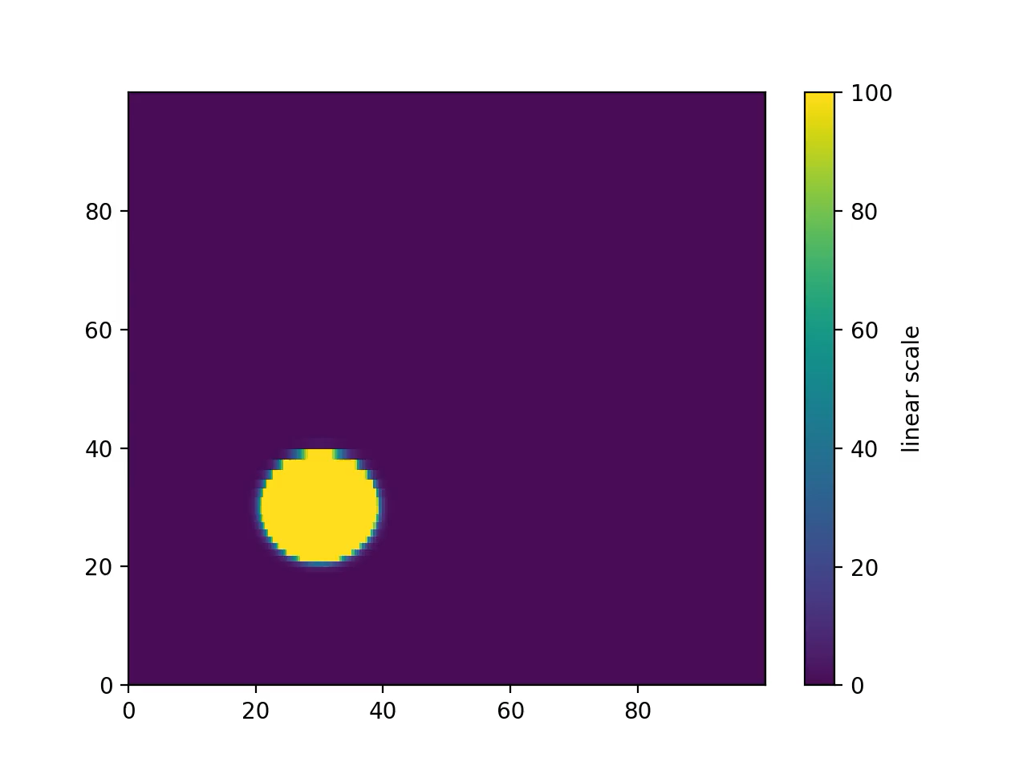
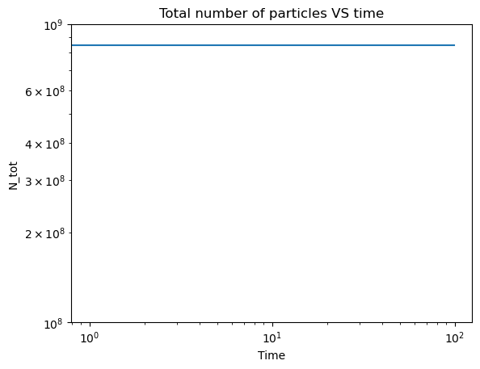
Total variation diminishing + Van leer limiter

Slide 4
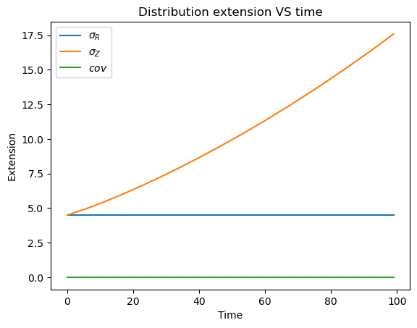
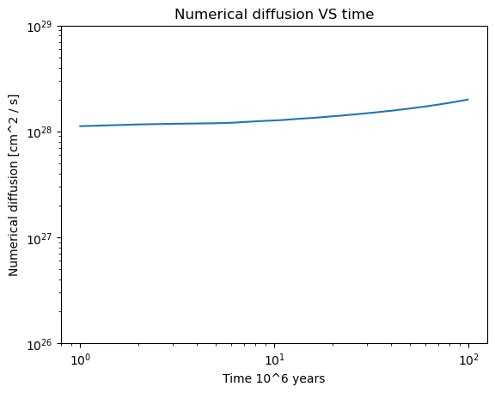
Numerical dissipation

Slide 5
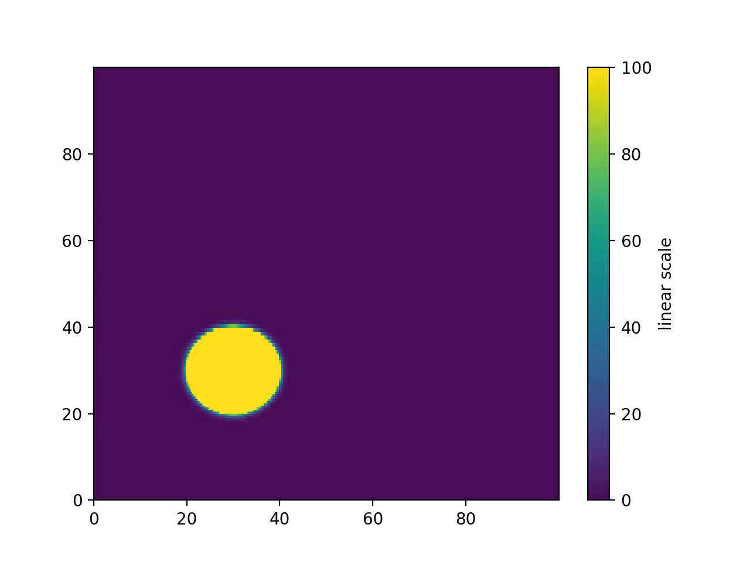
Van leer limiter + increase spatial resolution

Slide 6
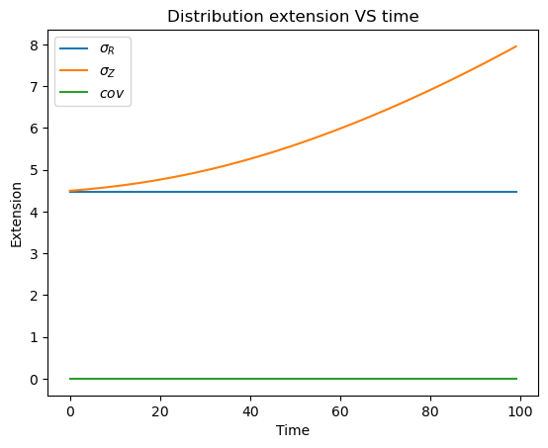
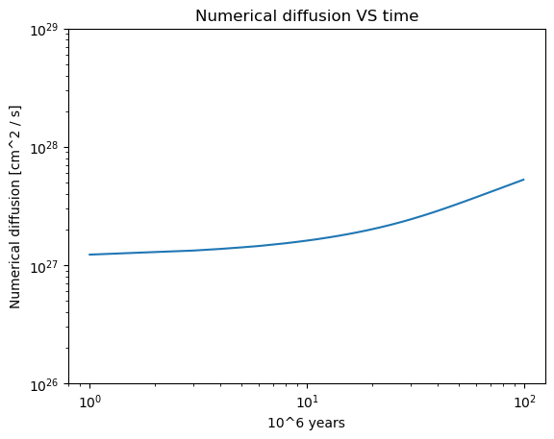
Numerical dissipation

Slide 7

MC limiter + increase spatial resolution

Slide 8
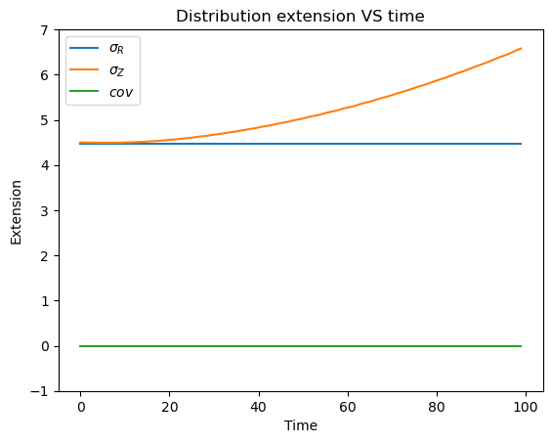
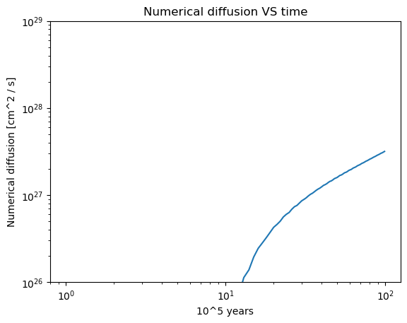
Numerical dissipation

