Slide 1

Day Care Project
Team 3

Slide 2
Group Members
Yifan Chen: Program Design, Function Implementation
Chao Yan: Program Design, Dataset Preparation, GUI
Feng Xiong: Program Design, Try-Catch, Slides

Slide 3
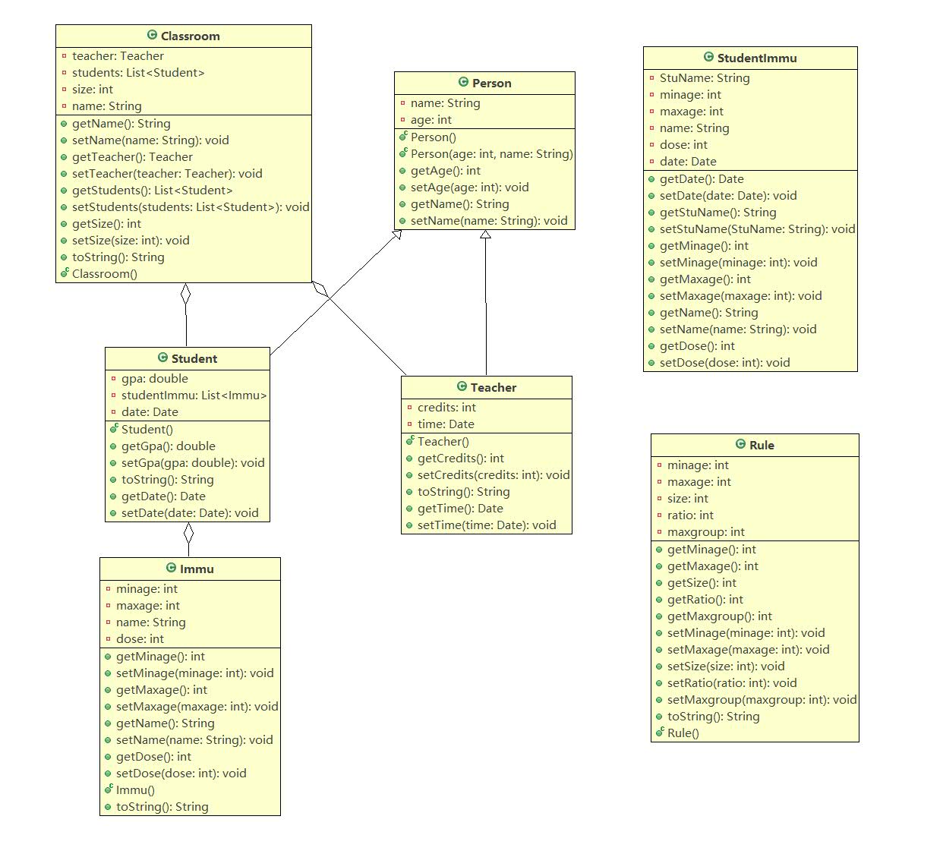
UML Diagram

Slide 4
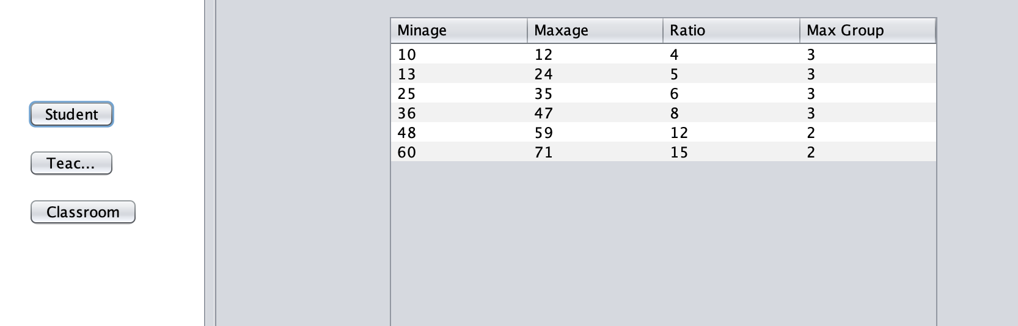
Operation Instructions
When first open up the program, Student Teacher Ratio Rules will first displayed.

Slide 5
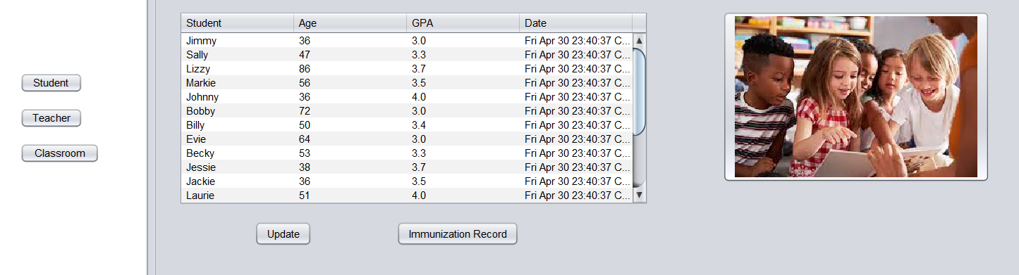
Operation Instructions
When click on Student button, it will display enrolled student information.

Slide 6
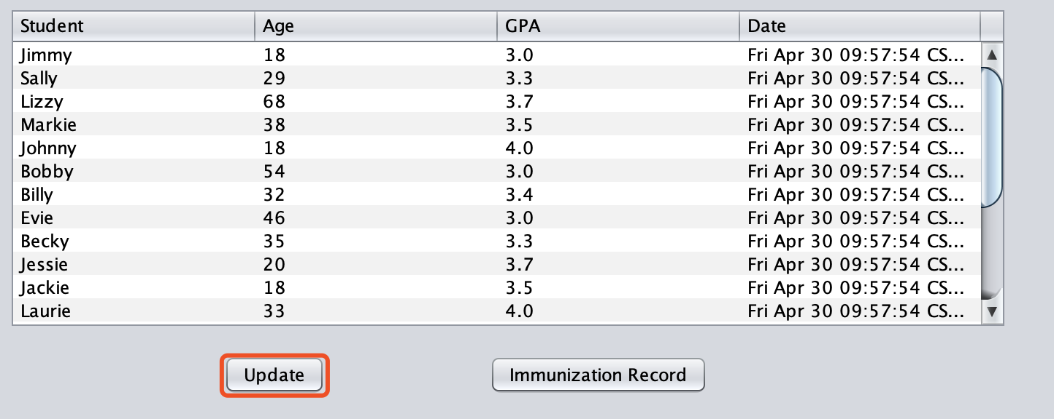
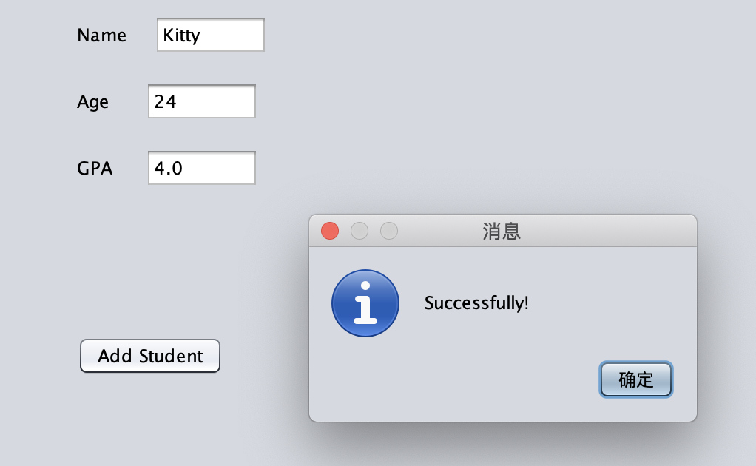
Operation Instructions
Click on Update button to enroll new student

Slide 7
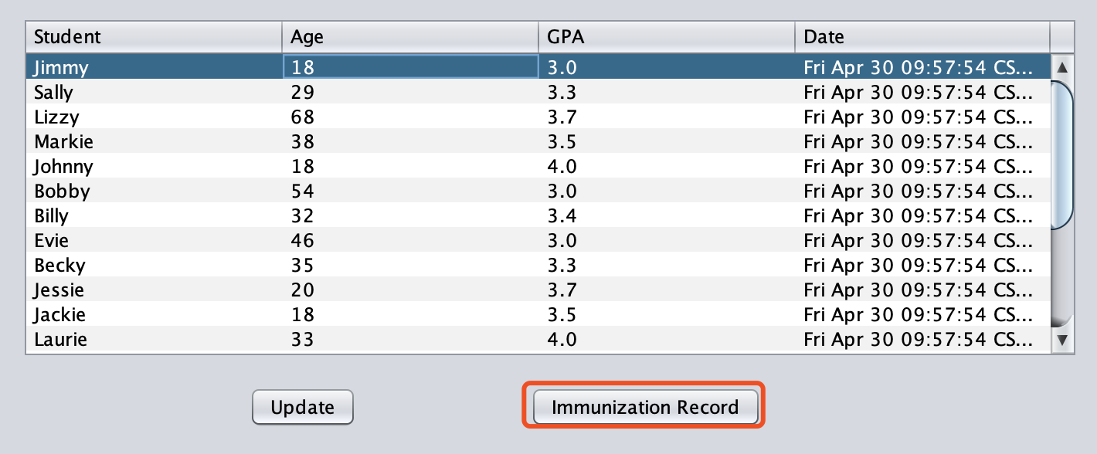
Operation Instructions
1. Select one student first
2. Click Immunization Record button to see his or her Immunization Record

Slide 8
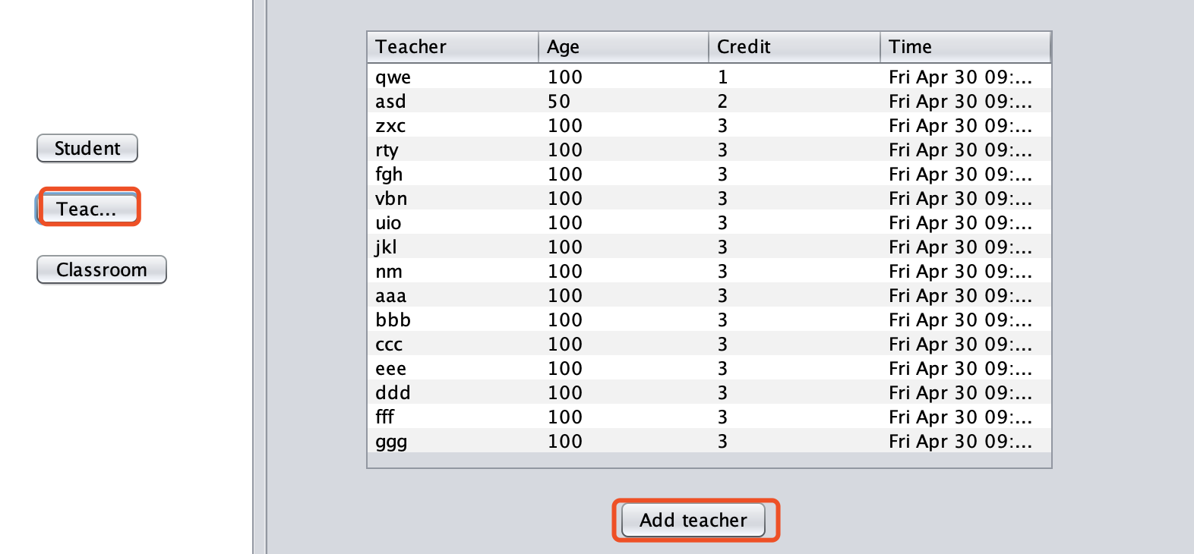
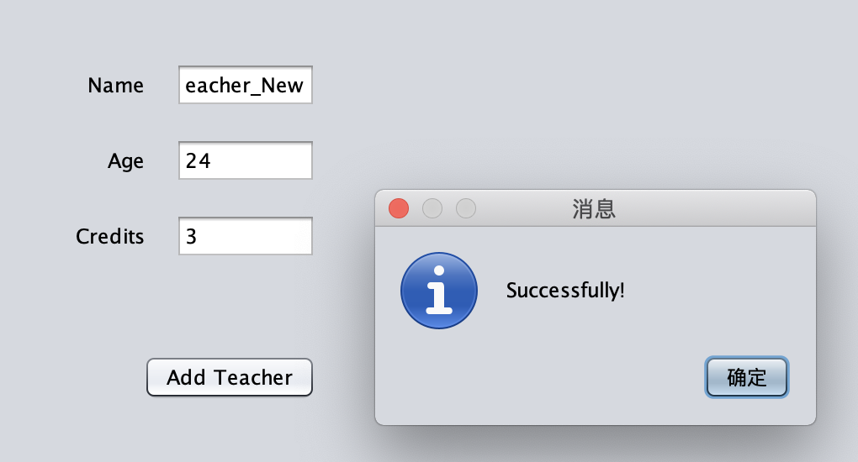
Operation Instructions
1. Similarly, Teacher menu returns all teachers’ information
2. Add teacher by entering Teacher’s Name, Age and Credits

Slide 9
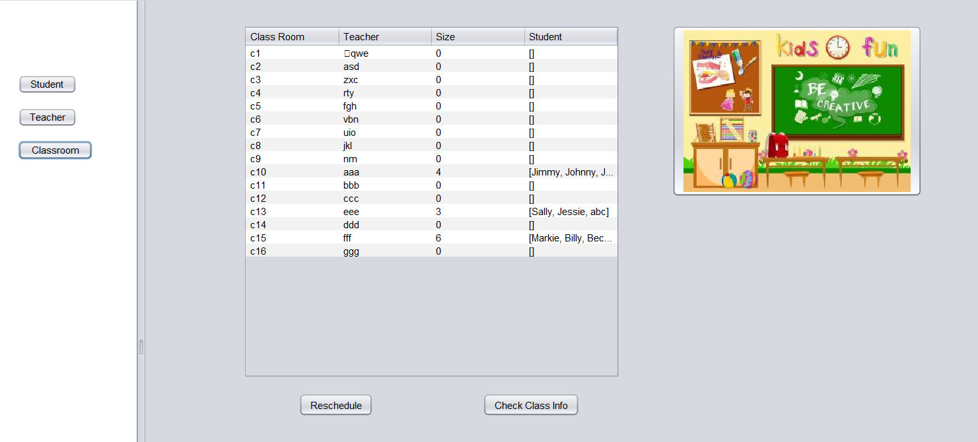
Operation Instructions
When click on Classroom button, it will display all the classroom distribution information.
Reschedule all students.
Check a specific class showing in the next slide.

Slide 10
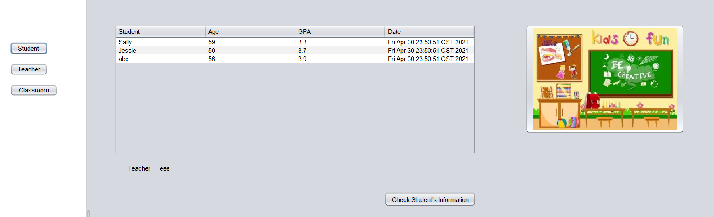
Operation Instructions
When we click on a student row, we can check one student’s information.

Slide 11
Difficulties Encountered and Solutions
The biggest difficulty we met this time was that we had never done a complete project before. Although we understand the concept of OOD, we have never practiced it. But we looked at the experience of others, the cooperation between teammates and finally completed the project. This was our first project, and it had a profound impact on us.

Slide 12
Further Improvements
User login page
Connect with database
Add parent’s information
GUI improvement

Slide 13
Program Demo

