Slide 1










$$y$$
$$θ_{e}$$
$$P$$
$$θ$$
$$x_{e}$$
$$y_{e}$$
$$θ_{r}$$
$$P_{r}$$
$$O$$
$$x$$

Slide 2
















Compute $u_{0}$
Compute $u_{1}$
Compute $u_{2}$
Sample $x\left(0\right)$
Sample $x\left(T\right)$
Sample $x\left(2T\right)$
0
$$T$$
$$2T$$
$$W$$
$$T+W$$
2$T+W$
Activate $\dot{x}=f\left(x\right)+g\left(x\right)u$
$$u_{−1}=0$$
$$Deadline\text{Meet}→u=u_{0}$$
$$Deadline\text{Miss}→u=u_{0}$$
$$Deadline\text{Meet}→u=u_{2}$$

Slide 3






$$a$$
$$b$$
$$a$$
$$b$$
$$a$$
$$b$$
Interval relaxation
LP relaxation
MILP relaxation

Slide 4
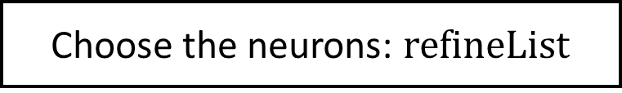
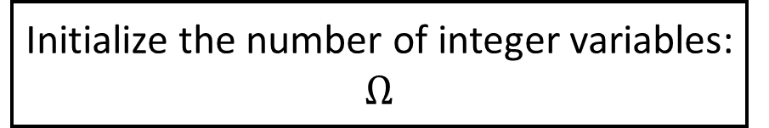
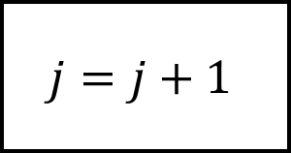
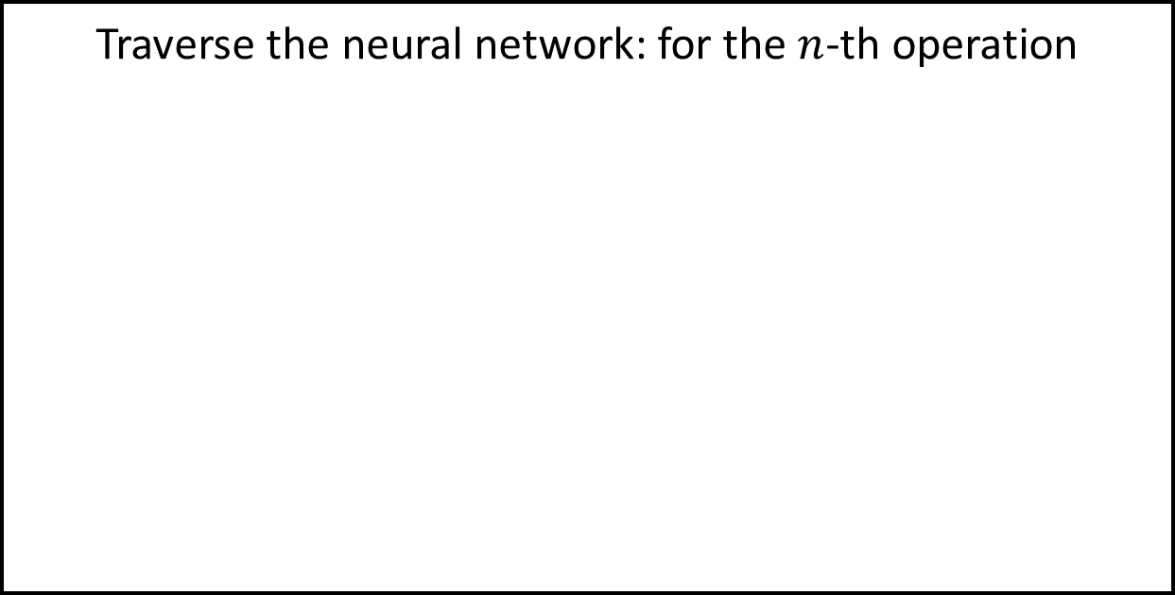
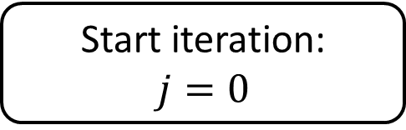
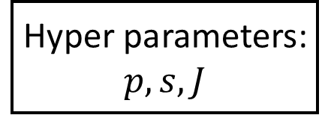
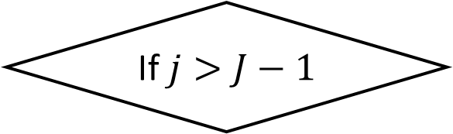
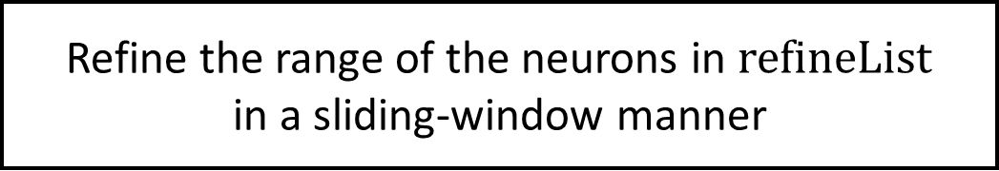
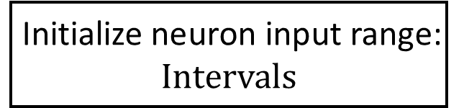
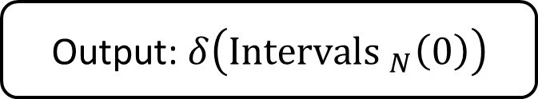
Initialize neuron input range:
$$\text{Intervals}$$
Hyper parameters:
$$p,s,J$$
Initialize the number of integer variables:
$$Ω$$
Initialization
Iteration
Start iteration:
$$j=0$$
Traverse the neural network: for the $n$-th operation
Choose the neurons: $\text{refineList}$
Refine the range of the neurons in $\text{refineList}$
in a sliding-window manner
$$j=j+1$$
Increase integer variables
No
If $j>J−1$
Yes
Output: $δ\left({\text{Intervals} }_{N}\left(0\right)\right)$

Slide 5
No
If reach
iteration bound
Yes
Initial estimation
Layer-wise refinement
MILP modeling
Output range
Hyper parameters setting

Slide 6
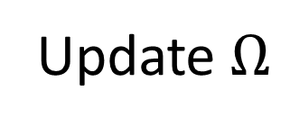
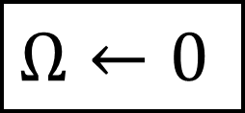
If reach
iteration bound
Output range
Update interval
Yes
No
Update interval
Interval
relaxation
LP relaxation
Layer-wise refinement
MILP relaxation
Update $Ω$
Hyper parameters setting
$$Ω←0$$

Slide 7














$w_{1}$:
1
0
$b_{1}$:
-1
0
2
-1
-1
1
$$\text{ReLU}$$
$w_{5}$:
$b_{5}$:
$$\text{ReLU}$$
0
4
2
1
3
-1
2
1
-1
0
0
0
2
7
-3
8
2
7
0
8
7
-1
0
1
-2
2
1
2
3
4
5
6
-1
4
0
1
0
4
0
1
7
8
8
4
4
3
1
2
0
1
6
9
1
4
6
9
1
4
9
6
9
-1
0
0
1
4
1
2
5
1
6
1
5
1
6
1
6
2
3
1
1
0
[ Convolution ]
[ Pooling ]
[ Flatten ]
[Fully-connected]
-1
-1
2
0
Step 2 (Activation):
$$\text{ReLU}\left( \right)=$$
1
4
Step 1 (Convolution):
1
-1
0
Step 3 (Max):
1
0
$$+$$
-1
$$\text{Max}\left( \right)=$$
$$∙$$
3
$$=$$
6
1
6
7
1
7
7
8
8
1
0
2
-1
8
-1
4
Step 4 (Flatten):
Step 5 (Linear transformation):
$$∙$$
$$+$$
$$=$$
Step 6 (Activation):
$$\text{ReLU}\left( \right)=$$
9
6
$$→$$
9
1
-1
0
0
9
0
-1
-1
0
6
6

Slide 8











$W_{F}$:
1
0
$b_{F}$:
-1
0
2
-1
-1
1
$W_{A}$:
$b_{A}$:
0
4
2
1
3
-1
2
1
-1
0
0
0
2
7
-3
8
2
7
0
8
7
-1
0
1
-2
2
1
2
3
4
5
6
-1
4
0
1
0
4
0
1
7
8
8
4
4
3
1
2
0
1
6
9
1
4
6
9
1
4
9
6
9
-1
0
0
1
4
1
2
5
1
6
1
5
1
6
1
6
2
3
1
1
0
[ Convolution ]
[ Pooling ]
[ Flatten ]
[Fully-connected]
-1
0
1
0
1
4
Step 2 (Activation):
$$\text{ReLU}\left( \right)=$$
Step 1 (Convolution):
1
-1
0
Step 3 (Max):
$$⨀$$
$$+$$
-1
$$\text{Max}\left( \right)=$$
3
1
-1
2
$$=$$
6
1
6
7
7
7
8
8
1
0
2
-1
8
-1
4
Step 4 (Flatten):
Step 5 (Affine mapping):
Step 6 (Activation):
$$\text{ReLU}\left( \right)=$$
9
6
$$→$$
9
$$∙$$
9
$$+$$
$$=$$
-1
0
1
-1
0
0
0
-1
6
6

Slide 9
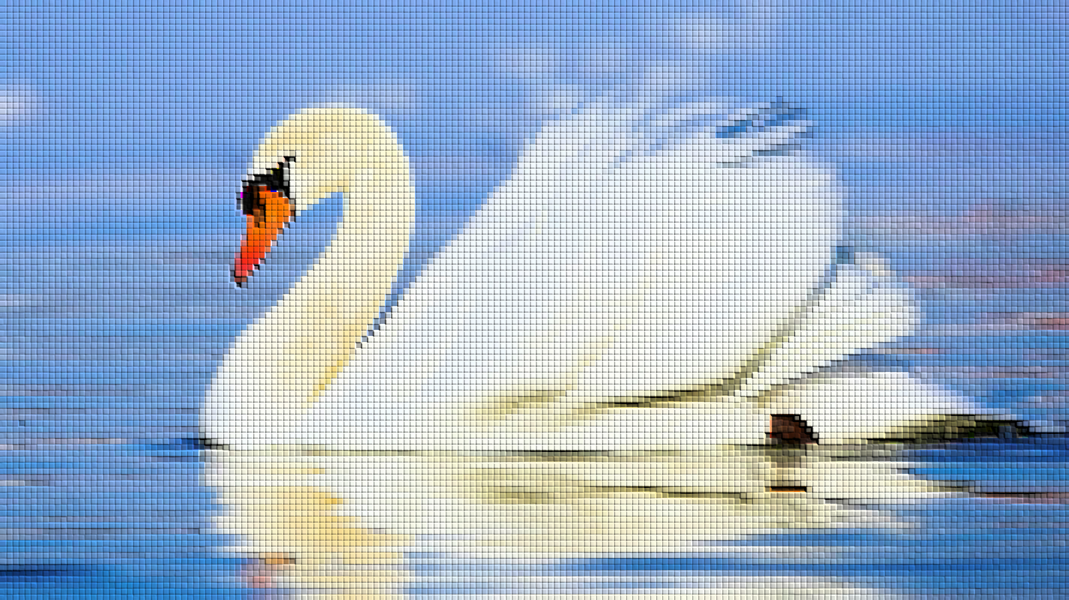
Swan (0.8)
Duck (0.15)
Chicken (0.05)
FC layer
(Linear transformation
+ ReLU)
Convolution layer
(Convolution + ReLU)
Pooling layer
(Pooling)
Convolution layer
(Convolution + ReLU)
Pooling layer
(Pooling)

Slide 10
Input image
Linear transformation
Activation
function
Convolution
Flatten
Linear transformation
Activation
function
Pooling
Activation
function
Convolution
Activation
function
Output

Slide 11


Input
Conv
Activation
Pooling
$$⋯$$
Flatten
Affine
Activation
$$⋯$$
Output
Convolution layer
Fully-connected layer

