Slide 1
INFO6150 Web Design/User
Driving Test Practice Website
Team：BBQ
Chao Ma, Shangrui Xie, Kai Hui, Wei Xu
Do you want to take the driving test only once? Do you want to get a driver's license as soon as possible? Do you want to drive freely in the future?
Come on, start your practice journey!

Slide 2
CONTENTS
GO
Introduction
03
Basic Function
01
02
Additional features

Slide 3
1
Introduction

Slide 4
Project Overview
This project is dedicated to the establishment of a driving test written test practice website.
Users can register for an account and log in. After logging in, the user can participate in the online driving test written practice.
The administrator can manage the question bank at any time according to the user's needs, delete or update the topic.
In addition, user can view their own test results analysis after they finished the practices. Finally, the website will recommend the driving school location to the user.

Slide 5
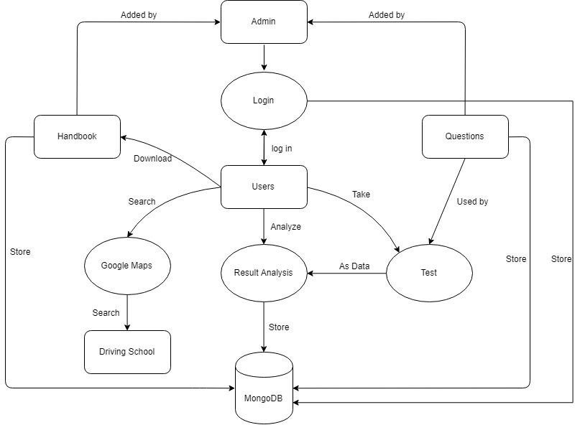
Domain Model

Slide 6
2
Basic Functions

Slide 7



Basic Functions
01
02
03
Registration
Login
Modify Password
As a admin, she/he wants to login the website, so she/he can effectively view his work history and update website information.
As a user, she/he wants to login the website, so she/he can review his own history record every time.
As a user, she/he wants to modify the password, so she, he can avoid the risk of being stolen after a password is compromised.
As a user, she/he wants to register the website, so she/he can have her/his user account, and then she/he can login the website,to view her/his historical test records and analysis, which can help her/him more effectively do the test.

Slide 8


Basic Functions
04
05
User Test Practice
Admin Update Test Questions
As a user, she/he wants to do the test, so she/he can better prepare better before the official exam.
As a admin, she/he wants to manage the test function, so she/he can help the website to attract more users to the website.

Slide 9
3
Additional features

Slide 10

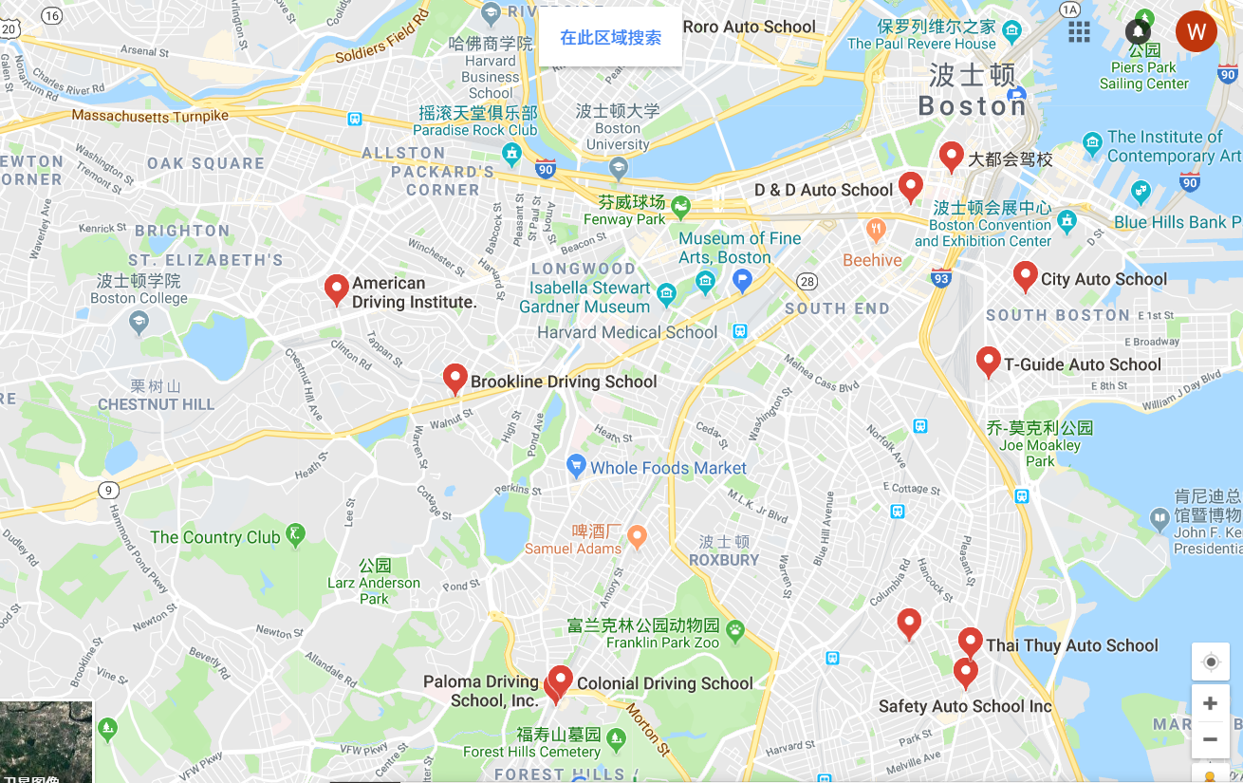
Additioanl features
01
02
Analysis of tests results
School location recommendation
As a admin, she/he wants to know the analysis of tests results, so she/he can more specifically update a specific type of questions and the difficulty of distinguishing them.
As a user, she/he wants to know the analysis of tests results, so she/he can conduct exam review more specifically.
As a admin, she/he wants to recommend the driving school location, so she/he can help the website generate revenue.
As a user, she/he wants to get the information of driving school location, so she/he can know more quickly about his driving school information and then she/he can get a driver's license faster.

Slide 11
Thanks!
Team：BBQ
Chao Ma, Shangrui Xie,Kai Hui, Wei Xu
To the world you may be one person, but to one person you may be the world.

