Slide 1
Tailored resumes
Bryant Biggs
19th August 2016

Slide 2
Overview
Problem Statement
Can I tailor my resume towards a role of interest?
AWS
DATA
20,000 Resumes
Search Terms Used
Engineer
Data
Data Analysis
Analytics
Big Data
Scientist
Indeed.com
MongoDB
PIA Proxies
PhantomJS
Selenium
BeautifulSoup
PyMongo
Scikit-Learn
NLTK
Gensim
BeautifulSoup

Slide 3
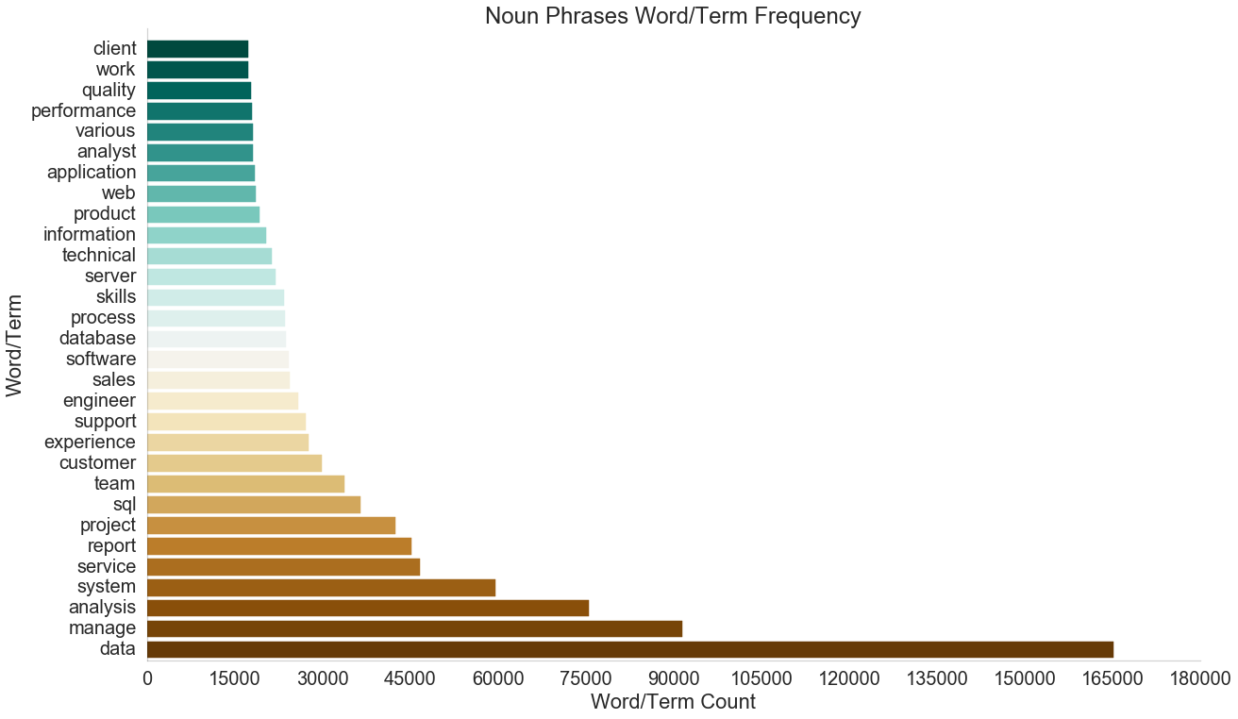
features

Slide 4
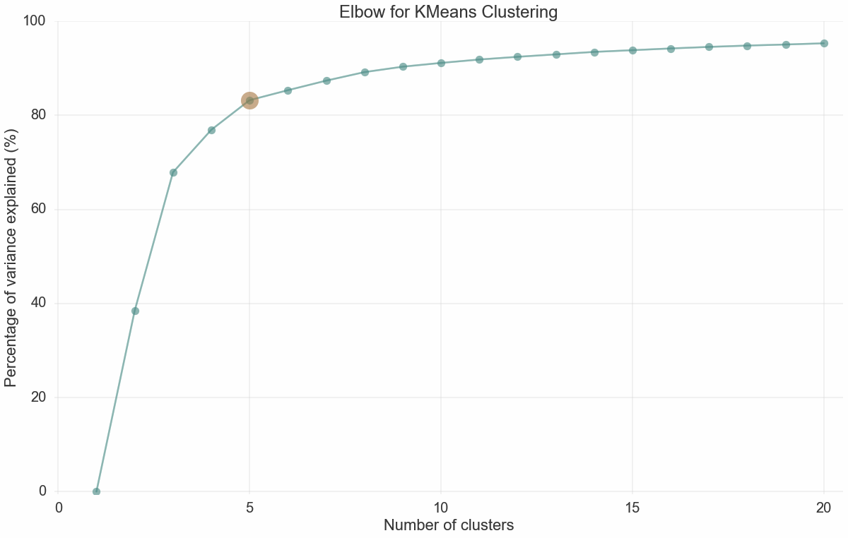
K-Value
Tf-idf => k-means

Slide 5
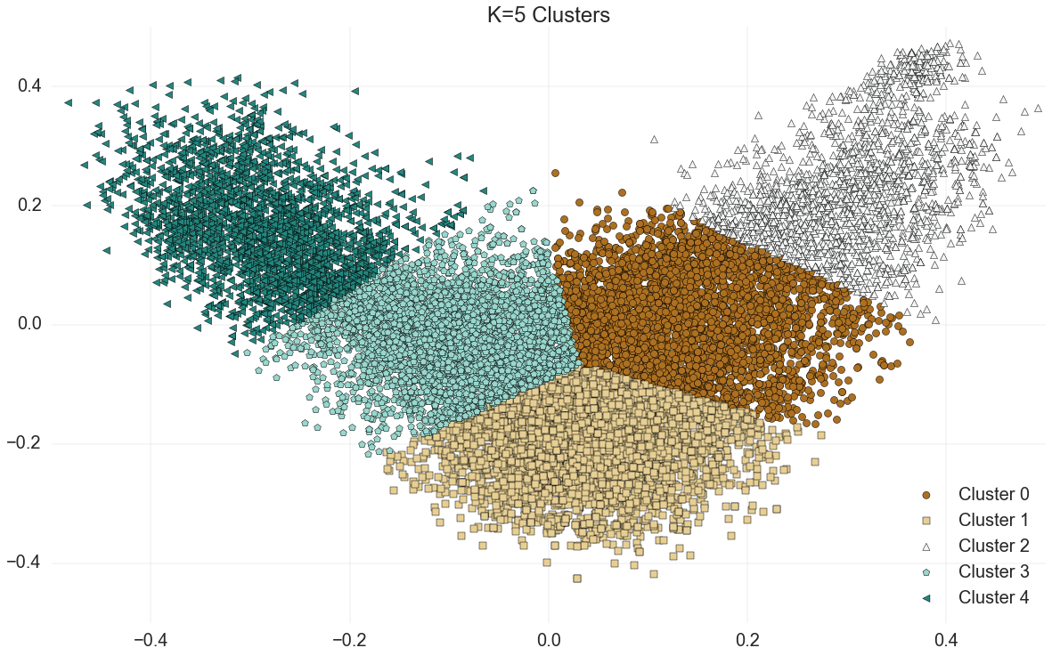
clusters
Science / Research
Engineer
Data /
Analytics
Data Entry /
Program Management
Big Data /
Dev-Ops
Tf-idf => pca => k-means

Slide 6
topics
Manufacturing/engineering
Engineer | Test | Equipment | Mechanical | System | Quality | Analysis | Validation | Machine | Production
Entry | Data | Data Entry | Customer Service | Customer | Service | Skills | Office | Manage | Customers
Analysis | Manage | Data | Report | Sales | Project | Analyst | Team | Product | System
Data | SQL | System | Server | Manage | Database | Project | Software | Analysis | Report
Hadoop | Hive | Pig | Java | HDFS | HBase | Sqoop | MapReduce | Data | Oozie
Scientist | Laboratory | Data | Analysis | Cell | Chemistry | Lab | Environment | Engineer | Clinical
Customer Service / front office
Data Analyst
It / dev-ops
Big data
scientist / researcher
TF-IDF => lda

Slide 7
Comparison to current resume: mechanical engineer
tf-idf => lsi => cosine similarity

Slide 8
Current resume
ID | Cosine Similarity
156 | 0.89467
149 | 0.89316
257 | 0.89077

Slide 9
Current resume
ID | Cosine Similarity
156 | 0.89467
149 | 0.89316
257 | 0.89077

Slide 10
Comparison to updated resume: data scientist

Slide 11
Updated resume
ID | Cosine Similarity
14945 | 0.80436
8007 | 0.80401
9004 | 0.80005

Slide 12
Updated resume
ID | Cosine Similarity
14945 | 0.80436
8007 | 0.80401
9004 | 0.80005

Slide 13
Thank you
For the future
Gather more resumes + diverse resumes
More exploration with pre-processing and transformations
Add similarity comparison between resume and job posting
Put online for others to upload resumes and see their own results

