Slide 1
+ -
+ -
+ -
+ -
+ -
+ -
+ -
+ -
+ -
Ⅰ
Ⅲ
Ⅱ

Slide 2




















$$B$$
c
$$r_{2}$$
b
A
$$a$$
a
b
V
$$b$$
$$r_{1}$$
$$r_{2}$$
$$μ$$
$$A$$
B
$$μ_{0}$$
x
A
$$r_{1}$$
$$μ$$
B
r
$$R_{1}$$
$$R_{2}$$
$$(0,\sqrt{2}a,\sqrt{2}a)$$
$$\sqrt{2}a$$
$$Q$$
$$Q$$
$$a$$
$$a$$
$$a$$
$$a$$
$$\sqrt{2}a$$
$$X$$

Slide 3

















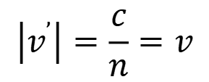







$$P$$
$$E_{i}$$
$$E_{t}$$
$$x$$
$$45°$$
$$R$$
$$k_{i}$$
$$\vec{u}$$
$$k_{t}$$
$$a$$
$$H_{i}$$
•
•
$$\vec{v}$$
$$θ$$
$$H_{t}$$
$$\vec{v}$$
$$I$$
$$E_{r}$$
$$\vec{v^{’}}$$
$$k_{r}$$
×
$$H_{r}$$
n
b
A
$$O$$
$$z$$
$$z$$
$$ε_{1},μ_{1}$$
$$ε_{2},μ_{2}$$
$$\left|v^{’}\right|=\frac{c}{n}=v$$
x
B
r
$$R_{1}$$
$$a$$
$$R_{2}$$
$$∆$$

Slide 4
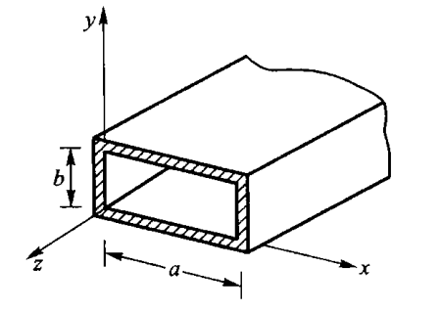


















$$i_{1}$$
$$I$$
$$A$$
•
介质薄层
$$II$$
$$ε,μ_{0}$$
•
介质1
介质2
$$i_{2}$$
$$B$$
$$III$$
$$ε_{1},μ_{0}$$
$$ε_{2},μ_{0}$$
$$φ$$
$$φ$$
$$+Q$$
$$ε_{0}$$
$$ε$$
$$−Q$$
$$a$$
$$b$$

