Slide 1
Bank Loan Analysis

Slide 2
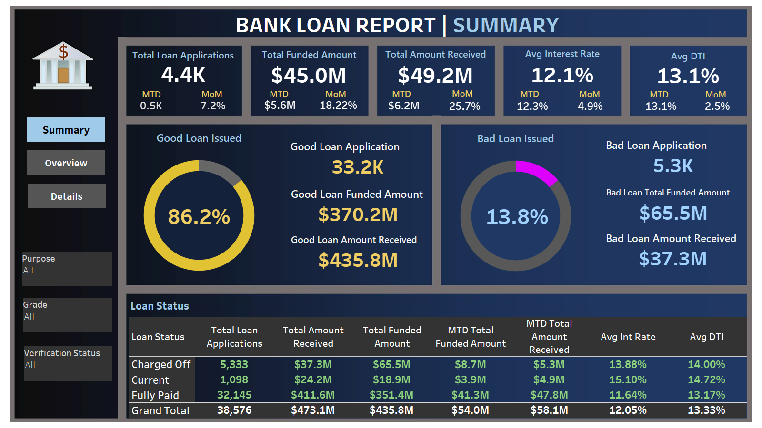

Slide 3
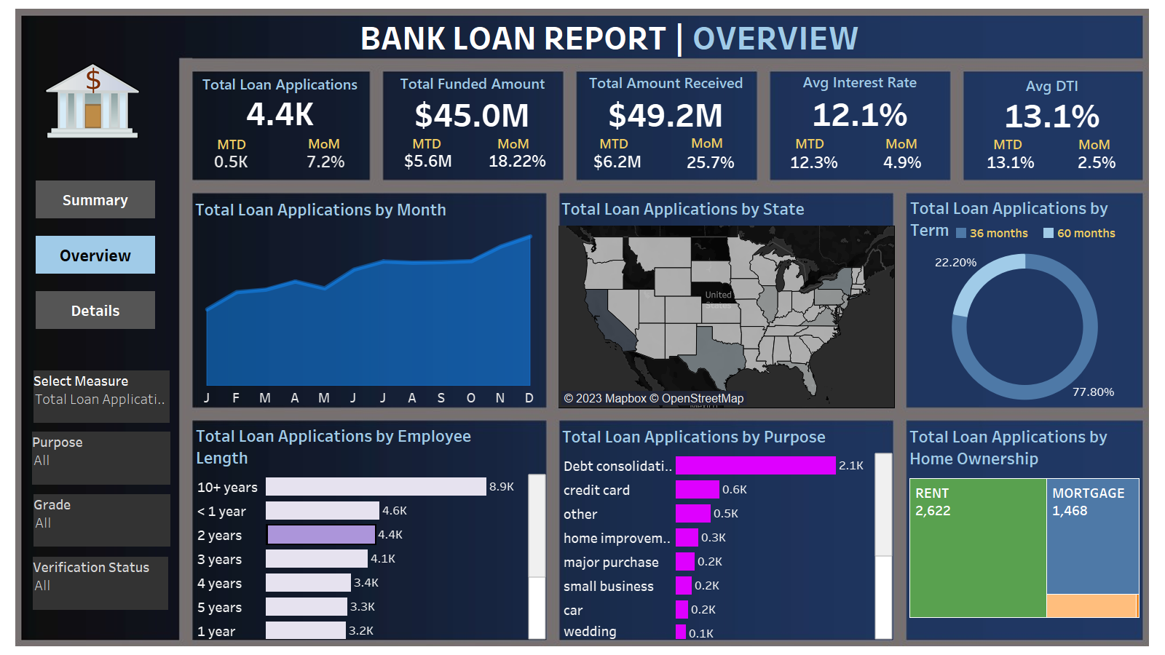

Slide 4
