Slide 1
Computing for Next Generation Biology
Lab: Peter Morrell
Chaochih LiU

Slide 2
Novel Problems in Biology
Hundreds of gigabytes of data
Computationally-intense algorithms
Solution: Use a super computer!

Slide 3
MSI Quirks
Module system
Local user: account on your computer
Login.msi.umn.edu: any of the MSI login nodes
Resource.msi.umn.edu: any one of the systems behind MSI login nodes
i.e. Lab, Mesabi, etc.
MSI queuing system (PBS Queue)
Called PBS (Portable Batch System)
Create PBS job scripts to submit a job
Use ‘qsub scriptname’ to submit a job
Use ‘qstat –u username’ to check on all jobs you have submitted
Use ‘qdel jobIDnumber’ to cancel a submitted job

Slide 4
Scripts
Likely working in a UNIX-like environment (MSI runs Linux)
Specific, optimized tools
Easy-to-parse text files
Pipeline-like flow of data between tools

Slide 5
General Workflow
Tools are given at the end of slides

Slide 6
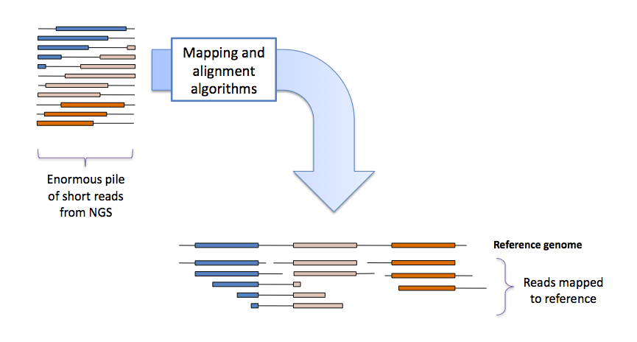
Mapping and Alignment

Slide 7
File Formats
Most are plain text
Well-defined and easy to parse
Pre-built tools for parsing (SAMTools, VCF Tools, etc…)

Slide 8
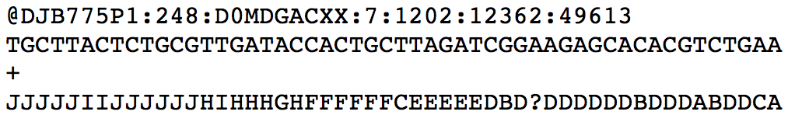
FASTQ File Format
Four Fields
Name (description line) – starts with ‘@’
Sequence data
End of sequence
Quality data – same length as sequence
Notes:
Add image of fastq file fields (data available on Vince Buffalo’s github page)
FASTQ – used to store high-throughput sequencing data, reported with a per-base quality score indicating confidence of each base call

Slide 9
Git
Version Control System
Keep track of changes
Use specific version of code
Free software
Command-line tool or GUI application
Notes:
Like word doc track changes

Slide 10
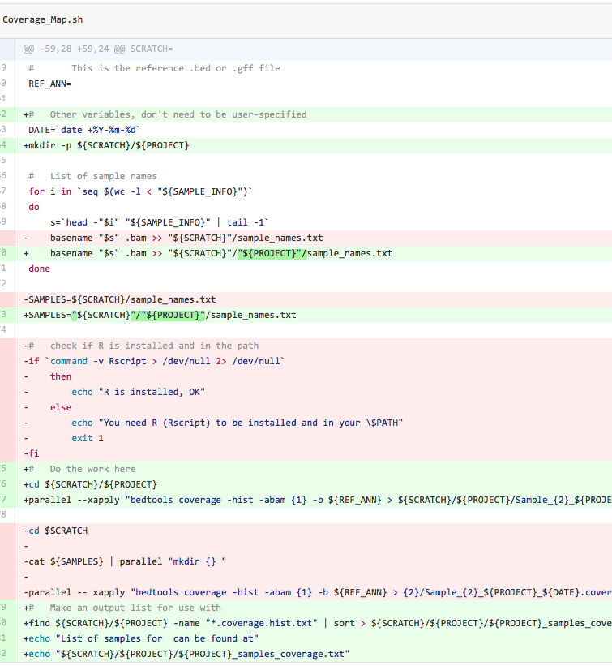
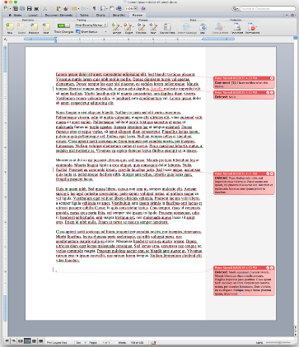
Git Vs. MS Word

Slide 11
Intro to GitHub
Collaboration
Review changes
Comment on code
Report issues
Sharing of code
Get feedback
User friendliness
Web-based graphical interface
READMEs and Wiki pages
An account is not necessary to view and download public repositories
Notes:
Track changes
Example: sequence handling repository

Slide 12
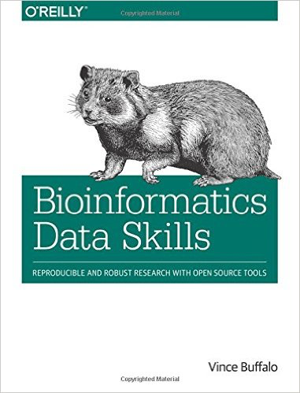
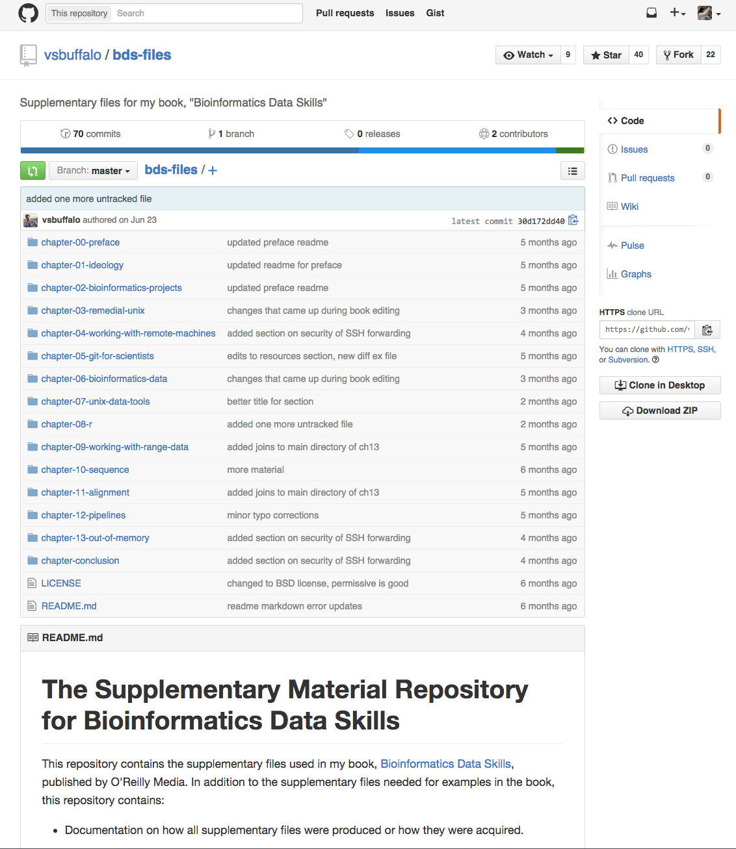
Notes:
Vince’s BDS book
Vince’s GitHub page
Repositories
Readme in markdown format

Slide 13
Useful Git Commands
Create Repositories
To obtain a repository from an existing URL
$ git clone [url]
To create a new repository
$ git init [project_name]
Synchronize Changes
Downloads history and updates changes
You must be in the repository before you run this command
$ git pull
Uploads all local changes (use all three commands in order)
You add the change, commit the change, and push the change
$ git add
$ git commit –m “commit message”
$ git push
For more git commands, refer to Git Cheat Sheet

Slide 14
Exercise 3.1: Downloading Dataset from GitHub
Dataset used: from Vince Buffalo’s book “Bioinformatics Data Skills” – Chapters 10 and 11
Vince Buffalo's GitHub Page is open to the public
Creating an account is free but not necessary for today
Use the following git commands in terminal:
# Make sure you are in the directory ~/Itasca
# To download files in Vince’s GitHub repository (this may take a couple minutes)
git clone https://github.com/vsbuffalo/bds-files.git
# Now check to make sure it has been downloaded to ~/Itasca
Notes:
Can I distribute only Chapters 10 and 11 to them? Or just tell them to buy their own copies

Slide 15
Exercise 3.2: Viewing FASTQ File
# Now that we have a directory called ‘bds-files’ in ~/Itasca with Vince’s dataset
#Go into bds-files and see what’s there (hint: use ‘cd’ command)
# We will use the ‘find’ command we used in Lec 1 to find which directory the .fastq files are located in
# Don’t remember the exact command? Use a combination of ‘history’ and ‘grep’ commands to find it
# We will search through our entire history with ‘history’ and pipe the STDOUT to ‘grep’
history | grep '*.fasta’
# Once we find the command we will change the ‘*.fasta’ part to ‘*.fastq’
Notes:
History – then copy paste command
Use up arrows
Or use grep and search by key word

Slide 16
Exercise 3.2: Viewing FASTQ File
# The .fastq files seem to be located in chapter-10-sequence
# We will use the .fastq file from Ch 10 called ‘contam.fastq’
# Go into the directory called ‘chapter-10-sequence’
cd chapter-10-sequence
# Let’s open up a fastq file called contam.fastq in the directory called ‘chapter-10-sequence’
head contam.fastq

Slide 17
FASTQ File Format
Four Fields
Name (description line) – starts with ‘@’
Sequence data
End of sequence
Quality data – same length as sequence
Notes:
FASTQ – used to store high-throughput sequencing data, reported with a per-base quality score indicating confidence of each base call

Slide 18
BED/GFF3 Format
Describe regions or intervals
Must be paired with a reference
BED: usually just intervals. Useful for masking or extracting pieces of sequence
BED12 format is more modern version and more descriptive
GFF3: intervals and qualifiers. Used in genome browsers to list mRNA, CDS, UTR, repeat regions, restriction sites…

Slide 19
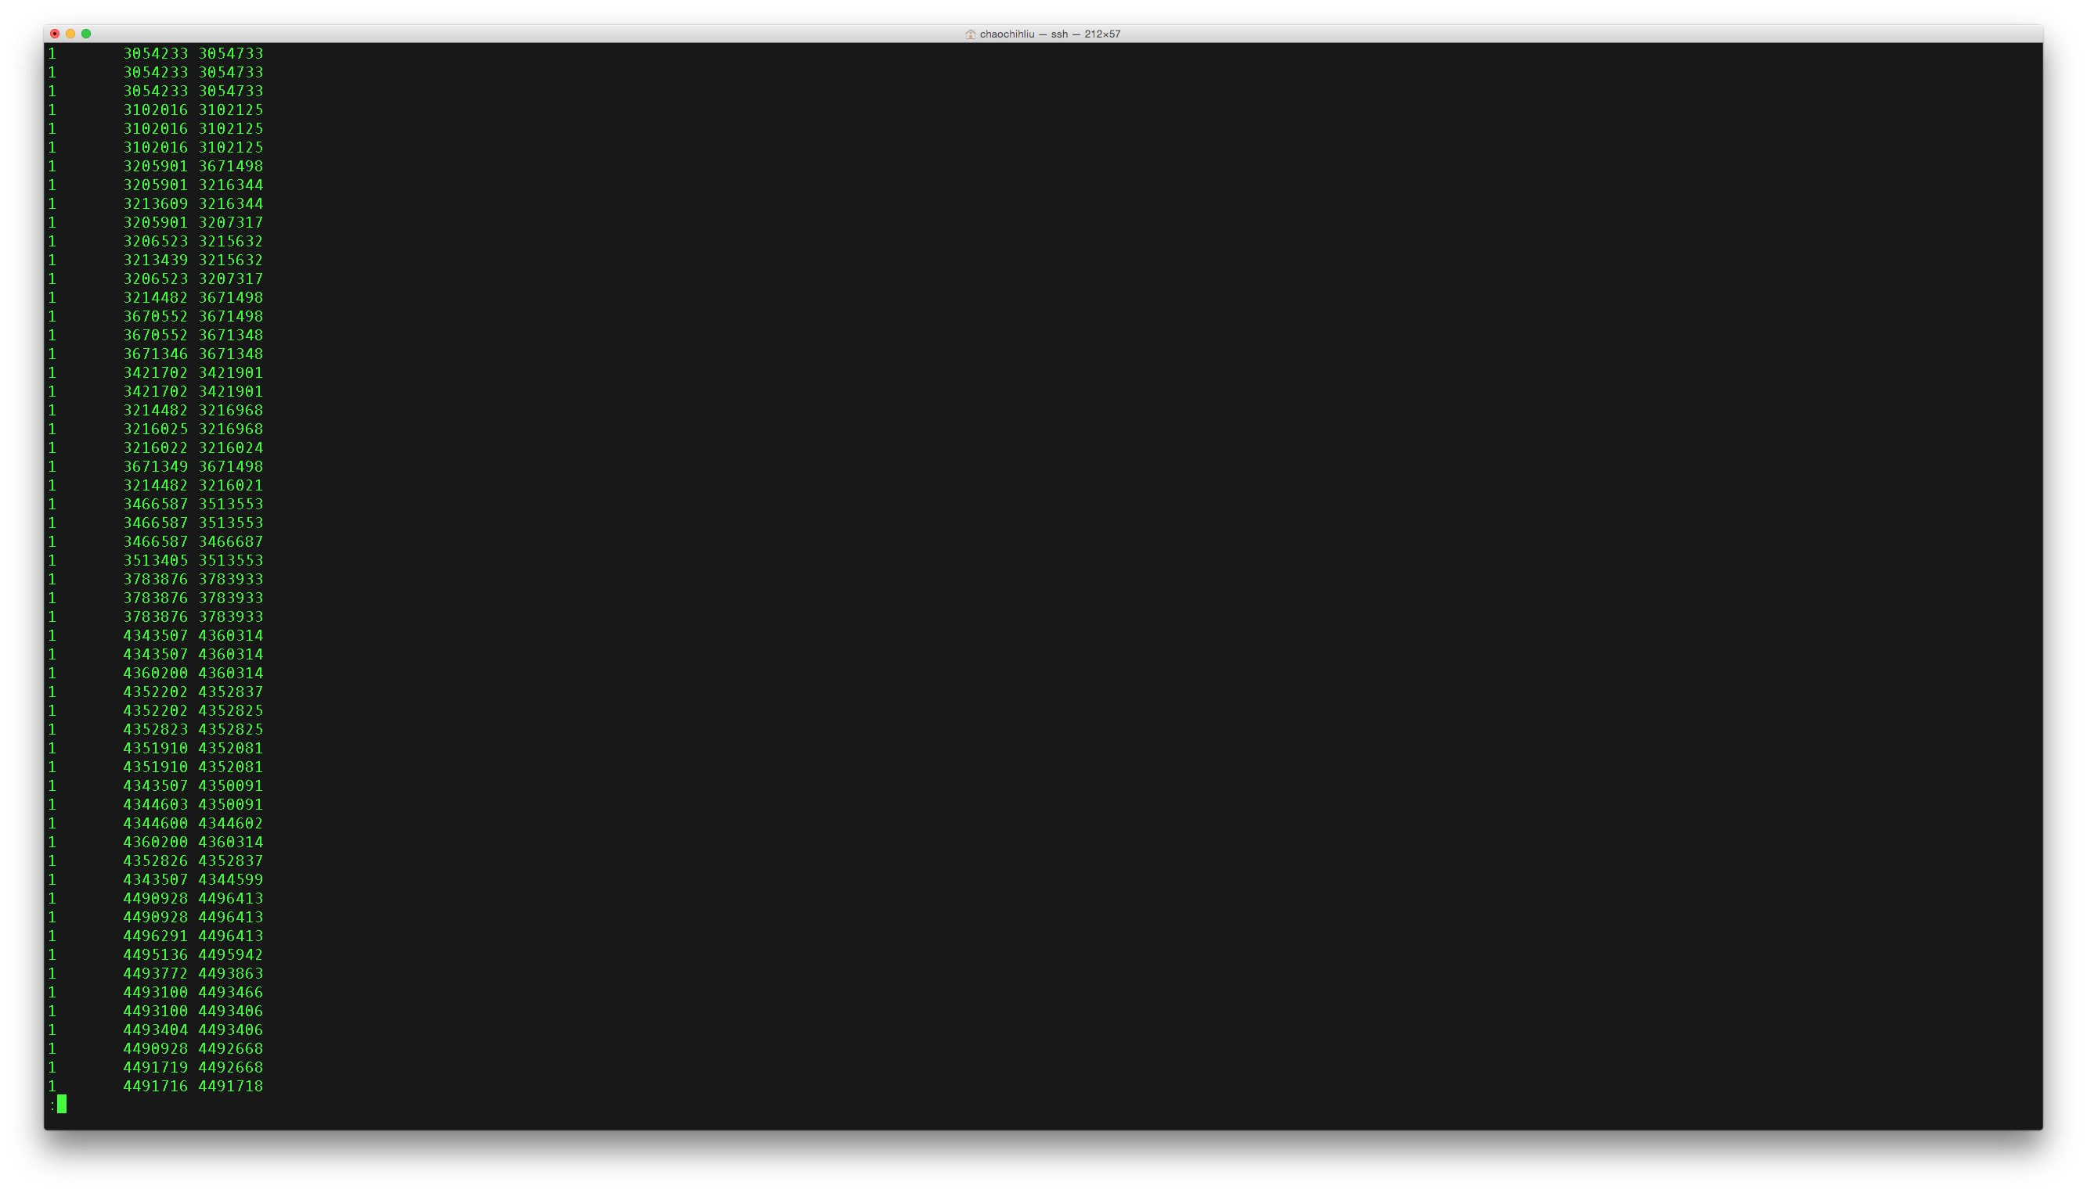
BED file format

Slide 20
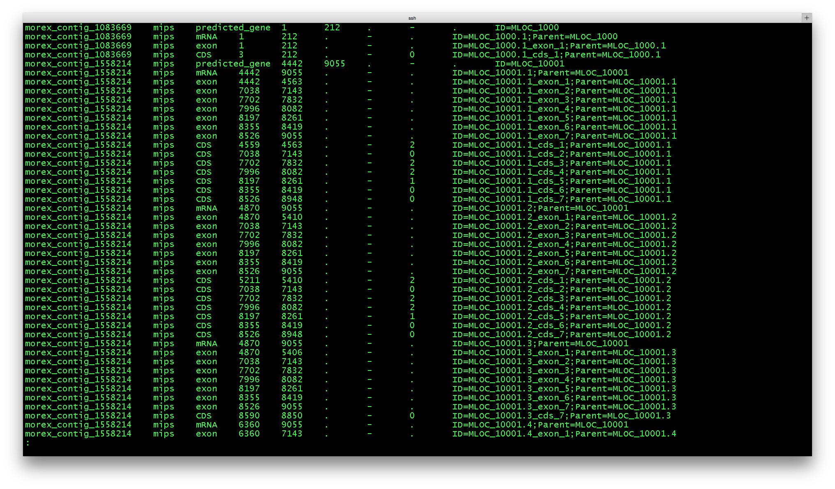
GFF File Format
Notes:
Morex_Annotations_WithPhase.gff
Seqname: name of chromosome
Source: name of program that generated feature
Feature type name: i.e. Gene, Variation, Similarity
Start position
End position
Score – floating point value
Froward (+) or reverse(-) strand
Frame: either 0 (first base of codon),1 (2nd base of codon) or 2
Additional info about each feature

Slide 21
Exercise 3.3: View BED Files
# Go back to the bds-files directory
cd ..
# Run the same find command we've been using to find where the BED file is located
find `pwd` -name "*.bed" | sort
# Where are the .bed files located?

Slide 22
Exercise 3.3: View BED Files
# We see the .bed files are located in chapters 6, 7,8, 9 and 11
# We’ll use the .bed file in ‘chapter-11-alignment’ called ‘USH2A_exons.bed
# Go into that directory and find a file called ‘USH2A_exons.bed’
# View the file using the ‘less’ command
less USH2A_exons.bed

Slide 23
SAM/BAM Format
Contains alignment information
Start/end coordinates
Mapping quality
Mates
And so on
SAM: Plain text human readable format (cut, grep, sed, etc…)
Use SAMTools view to view SAM files
BAM: Binary (Compressed)

Slide 24
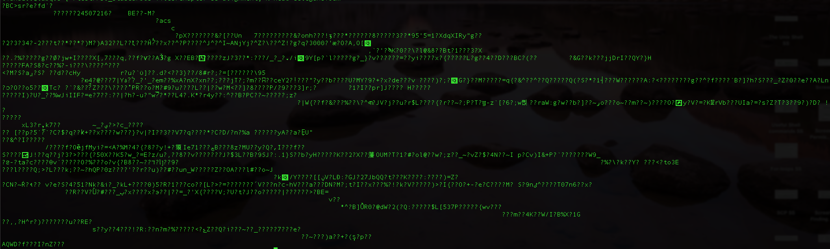
BAM Format
Order of magnitude smaller than SAM file
Computer readable (gibberish)

Slide 25
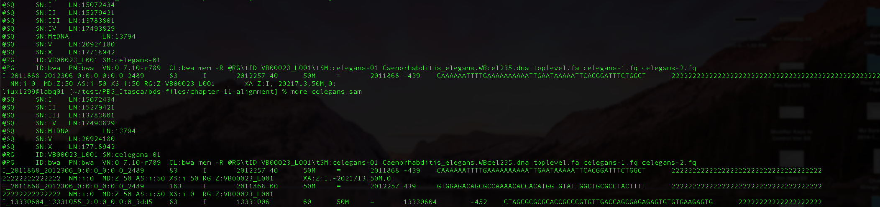
SAM Format
@SQ header: stores info about the reference sequence
@RG header: contains read group and sample metadata
@PG header: metadata about programs used to create/process SAM/BAM files
First line of alignment section – doesn’t begin with ‘@’
Note: some programs need SAM files to have an @HD header at the beginning to work

Slide 26
Exercise 3.4: View SAM/BAM Files
# Run the same ‘find’ command we’ve been using to find where the .sam file is located
find `pwd` -name "*.sam" | sort
# We see the .sam files are located in ‘chapter-11-alignment’
# Go into ‘chapter-11-alignment’ and look for .sam file

Slide 27
Exercise 3.4: View SAM/BAM Files
# view head of SAM file celegans.sam with ‘head’ command
head celegans.sam
# In class work:
# Now try to view celegans.bam using the ‘head’ command
# Try using ‘samtools view celegans.bam | head –n 10’ to view celegans.bam
* Note: .sam and .bam files are typically relatively large in real datasets so using ‘less’ command or opening .sam/.bam files in text editors takes too long

Slide 28
VCF/BCF Files
Describes mismatches from reference
Must be paired with reference sequence
Information includes:
Type (SNP, MNP, Indel…)
Chromosome (or contig)
Position
Quality, depth…
Notes:
Vcf file in ch. 11

Slide 29
Exercise 3.5: View VCF Files
# If you are not already in the directory
# ‘cd’ into directory containing .vcf file
# Since the file extension is .gz we will have to unzip the file first
# to unzip gzipped file use ‘zcat’ command (If using a local Mac, use 'gzcat' instead)
# then pipe to ‘head’ to view beginning of file
zcat NA12891_CEU_sample.vcf.gz | head
# In Class Work:
# Run the same command without piping to head and see what happens

Slide 30
Tools
Aligners
BWA
Bowtie/Bowtie2
MOSAIK
SAM/BAM handlers
SAMtools
Picard
BamTools

Slide 31
Tools
Refining Assemblies
GATK
Picard
SAMtools
Some Analysis
SNP calling, FreeBayes (https://github.com/ekg/freebayes)
Splice-aware mapping, Tophat

Slide 32
PacBio RS II
Newer sequencing technology than NGS
Single Molecule, Real-Time (SMRT) DNA sequencing system
High consensus accuracy
Long read lengths
Ideal for:
de novo assembly
Characterization of genetic variation
Methylation analysis
Microbiology studies
And more…

Slide 33
Exercise 3.6: More Useful Commands to Know
# Go into directory with ‘contam.fastq’ file
# We’ll use the one from ‘chapter-10-sequence’
# Now we’ll copy 'contam.fastq' from chapter-10-sequence to ~/Itasca and rename the file
# Use 'cp' command to copy
# We will rename by specifying the directory the file will be copied to and giving it a new name 'contam1.fastq'
cp contam.fastq ~/Itasca/contam1.fastq

Slide 34
Exercise 3.6: More Useful Commands to Know
# Now go into ~/Itasca to view the copied file
# There is already an existing file 'contam.fastq' that we used wget to download earlier
# Let's see if there are any differences between the file we just copied and the original file
# We will use 'diff' command to compare differences between files
# The format will be 'diff -y file_1 file_2’
diff -y contam.fastq contam1.fastq

Slide 35
Exercise 3.6: More Useful Commands to Know
# Let's create differences and use 'diff' again to compare the files
# We will be using Vim as our text editor for today
# To do this, type 'vim' followed by the file you want to edit
vim contam1.fastq

Slide 36
Exercise 3.6: More Useful Commands to Know
# In vim you won't be able to use your mouse to make changes
# type ':' to start entering command
# hit 'i' to enter INSERT MODE to edit file
# We will delete lines 16-19
# Let's jump to line 16
:16
# Use 'dd' to delete current line
# repeat this four times
dd

Slide 37
Exercise 3.6: More Useful Commands to Know
# If you accidentally delete too many lines use the undo command to undo your last change
:u
# If you type ':u' again it will undo 2 changes before that and so on
:u
# Now let's redo our last undo
# Use 'CTRL+r' to redo last two changes
# Now that we have made changes to our file, we will save and exit
# ':w' saves the file, ':q' exits out of vim
:wq

Slide 38
Exercise 3.6: More Useful Commands to Know
# Now let's use 'diff' again to see if there are any differences between contam1.fastq and contam.fastq
diff -y contam.fastq contam1.fastq
# The ‘>’ symbol denotes where the differences in the file are

Slide 39
Additional Resources
Vince Buffalo’s “Bioinformatics Data Skills” – Ch. 10 and 11
Answer key to today’s exercises can be viewed and downloaded from my Gist repository:
https://gist.github.com/liux1299/af6fffc5d96e8d44dc9b

