Slide 1



Slide 2
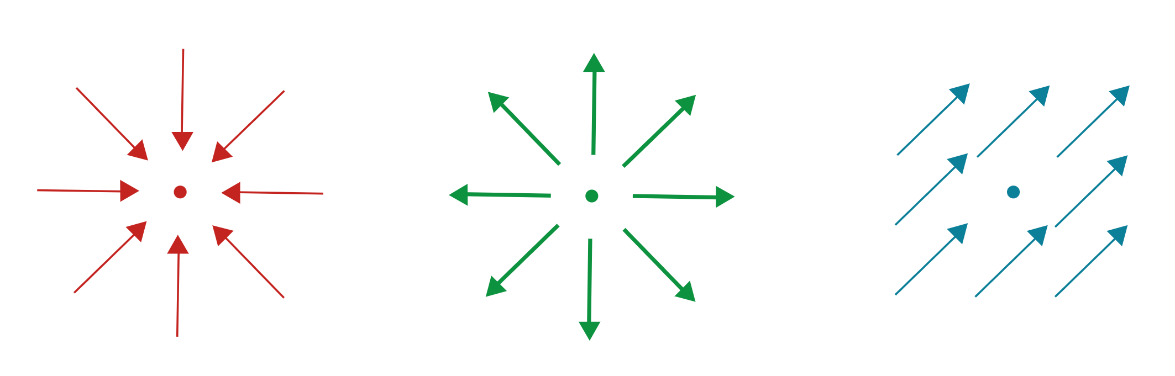



$$div \left(A_{L}\right)<0$$
$$div \left(A_{L}\right)>0$$
$$div \left(A_{L}\right)=0$$
In 2D
In 1D

Slide 3




















$$=l$$
$$=l$$
$$=l$$
…
…
$$A_{n}^{left}$$
$$A_{n}^{right}$$
$$=1m$$
$$p_{0}$$
$$p_{n−1}$$
$$p_{n}$$
$$p_{n+1}$$
$$p_{N}$$
$$I_{n}^{left}$$
$$I_{n}^{right}$$
$$x$$
$$=1m$$
$$V_{0}$$
$$V_{n−1}$$
$$V_{n}$$
$$V_{n+1}$$
$$V_{N}$$

Slide 4


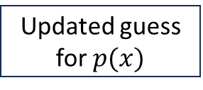
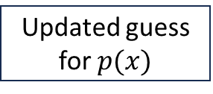

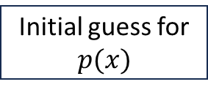
Iteration 0:
Initial guess for
$$p(x)$$
determines
Estimation
of $k_{eff}(x)$
Allows for
Iteration 1:
Updated guess for $p(x)$
determines
Updated estimation
of $k_{eff}(x)$
Allows for
Iteration 2:
Updated guess for $p(x)$
determines
Updated estimation
of $k_{eff}(x)$
…
…
…
Allows for

