Slide 1

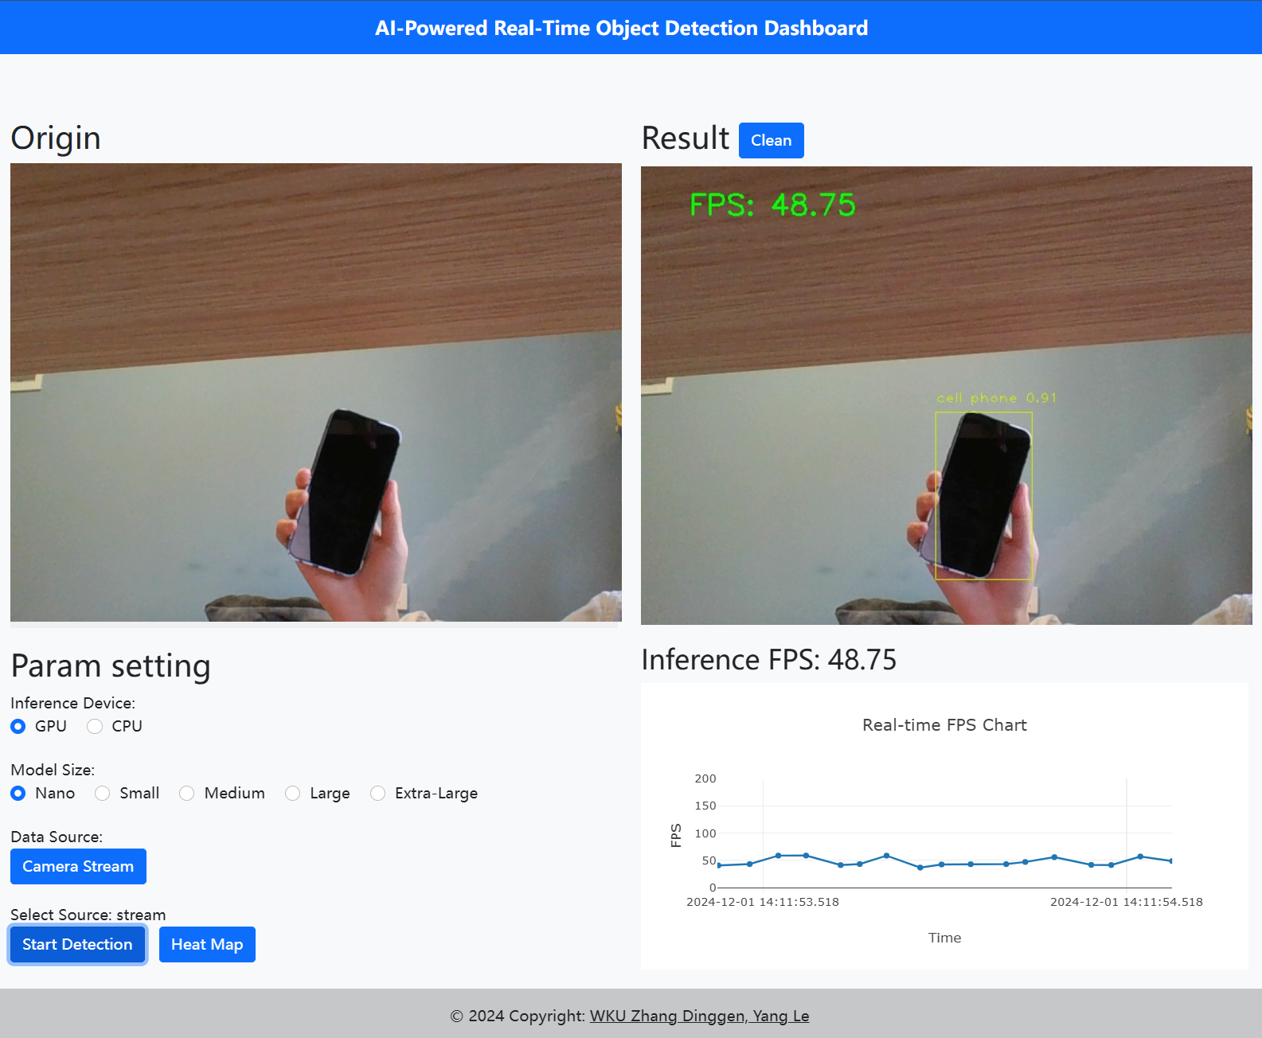
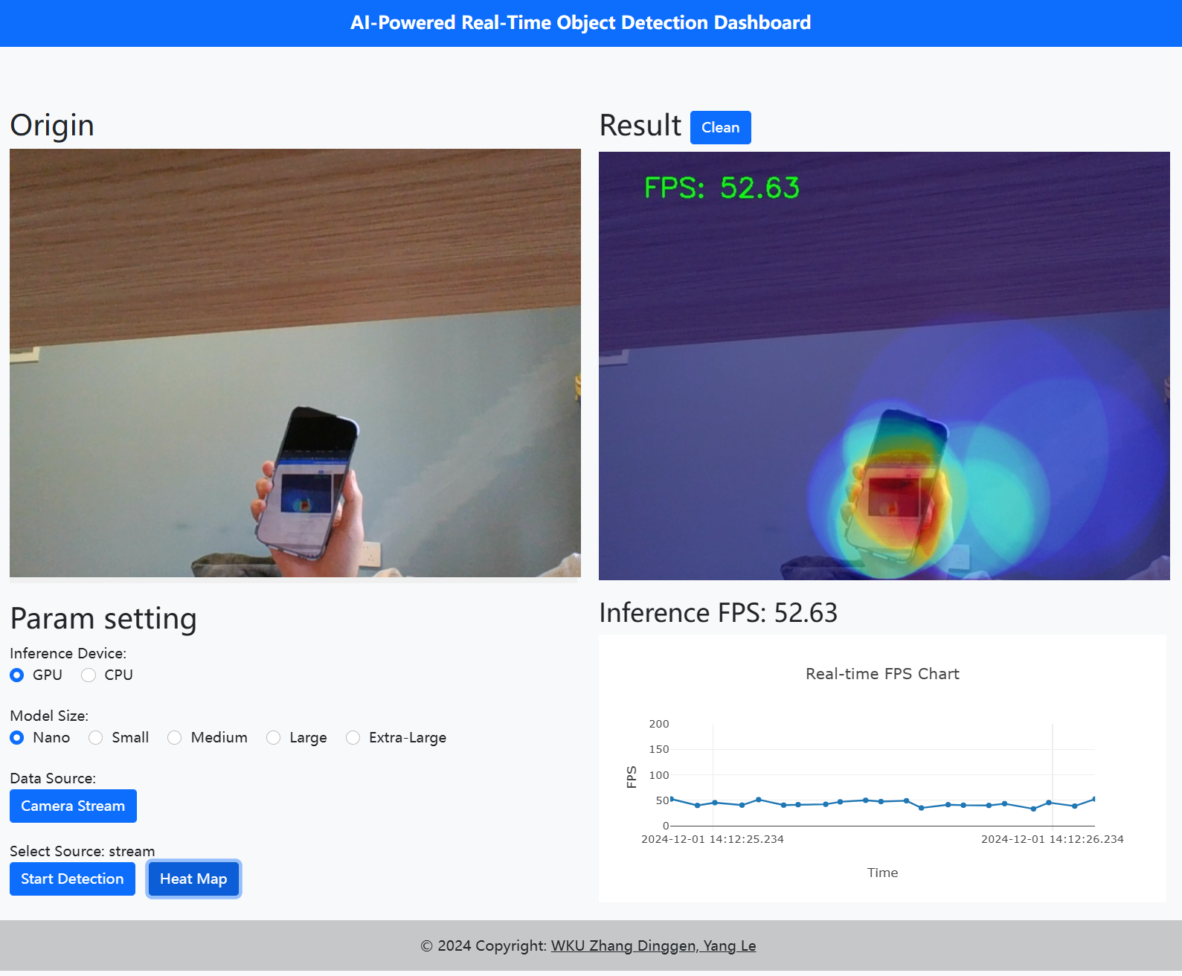
AI-Powered Real-Time Object Detection Dashboard
Group members: Zhang Dinggen Yang Le
Introduction
Technical Workflow
Results
In today’s data-driven world, AI is transforming how we perceive and process information. This project uses AI models to analyze live video streams, detect objects, and help users better understand the visual data by showcasing key insights such as object count, detection frequency, and movement patterns.
1. AI Model Setup: We implemented state-of-the-art object detection models like YOLO v11. These models are capable of accurately detecting multiple objects in a single frame.
2. Real-Time Video Processing: OpenCV is used to process video feeds frame by frame, enabling real-time object detection with bounding boxes around the detected objects.
3. Dashboard Development: We designed an interactive dashboard using tools like Plotly. The dashboard provides:
- Real-Time Detection: Live display of detected objects with bounding boxes.
- Statistical Analysis: Charts showing the frequency of detected objects over time.
- Heatmap Visualization: Heatmaps to illustrate movement patterns and hotspot areas.
4. Data Management: The backend, built with Flask, manages data flow, stores historical trends, and allows users to analyze past detection patterns.
Objective
References and Technologies Used
Future Scope
The goal of this project is to demonstrate how AI can extract meaningful information from live video feeds in real-time and visualize it through an easy-to-use dashboard. It provides users with an intuitive way to interact with and analyze the detected data.
Frontend:
- HTML: Used to structure the web interface.
- CSS: Applied for styling and layout design.
- JavaScript: Facilitated interactive elements and logic on the client side.
- Bootstrap: Ensured responsive design and styled components effectively.
Backend:
- Flask: A lightweight framework employed to handle server-side logic and manage API endpoints.
Model:
- YOLO v11: A state-of-the-art real-time object detection model utilized for detecting objects in live video feeds.
Visualization:
- Plotly: Utilized to create interactive charts and visualizations for presenting data on the dashboard.
This project has immense potential for future development, including:
- Object Tracking: Enhancing the system to track objects over longer periods.
- Cloud Integration: Leveraging cloud platforms for better performance and scalability.
- Industry Applications: Expanding use cases in sectors like security surveillance, traffic management, and retail analytics.

