Slide 1
SC.01 / 13
SCENE 01 · TAKE 01
CS215 · Data Analysis and Interpretation presents
THE BUDGET ILLUSION
Why Bollywood's “safe bets” may not be safe
Course
CS215 · Open Project
Written & directed by
Team 05
Starring
1,698 films
Ajay Reddy · Bhargav Mende · Rushmith Bandari · Aryan Balabadrula
Notes:
Hello! We are Team 05. Our project asks a simple question about Bollywood: when a film succeeds, is it the strategy — festival timing, franchise, stars — or just the money and screens behind it? We call our finding the budget illusion.

Slide 2
SC.02 / 13
SCENE 02 · THE QUESTION
One question, four hypotheses
Four hypotheses, defined before any analysis was run.
Conventional wisdom: festival releases, franchises and remakes are “safe bets”; new actors and directors are risky.
Our suspicion: big budgets buy holidays, franchises and remakes — raw comparisons measure size, not strategy.
H1
H2
Festival timing
Franchise / remake
Do holiday slots earn more, like-for-like?
Do “safe bets” keep the premium at equal scale?
H3
H4
Genre
Star power
Do some genres out-earn at comparable scale?
Is revenue concentrated among a few names?
Research question — after accounting for a film's scale (budget + screens), do timing, franchise/remake status, genre, and crew novelty still explain box-office performance?
The Budget Illusion · Team 05 · Scene 02 of 13
Notes:
Four hypotheses, each tested with a four-stage ladder: unadjusted, content-adjusted, scale-adjusted, and full model — so we can watch how much of each premium is really scale.

Slide 3
SC.03 / 13
SCENE 03 · THE MATERIAL
1,698 films, one industry
One row per film — complete before cleaning even started.
Films counted
1,698
Mean vs median revenue
Rs 23.8 cr / Rs 1.25 cr
Distinct stars · directors
761 / 1,045
Columns after cleaning
29
Cleaning — boolean encodings, 13 genre dummies (action = reference), derived ROI, revenue-per-screen and a 1–10 Movie_Scale composite, verified row-by-row against the raw file. Zero nulls, zero duplicates.
Source — Bollywood Movies Data, Premkumar (2020) · Mendeley · DOI 10.17632/3c57btcxy9.1 · CC BY 4.0.
Why India — India's largest film industry; all figures in INR; festival calendars (Diwali/Eid), star-driven economics, multiplex-wide openings.
The Budget Illusion · Team 05 · Scene 03 of 13 · Source: Bollywood Movies Data (Premkumar 2020) · Mendeley V1 · n = 1,698
Notes:
The dataset arrived complete — zero nulls, zero duplicates — so cleaning was about encoding and feature design rather than repair. Movie_Scale, our composite of budget and screens, is the central idea: films are compared within its nine bands.

Slide 4
SC.04 / 13
SCENE 04 · THE METHOD
Five notebooks, one command
Every number regenerates from the raw CSV in one command.
01
02
03
04
05
CleanUp
EDA
Distribution fitting
Linear regression
Hypothesis testing
encode flags & genres, derive ROI + Movie_Scale, verify vs raw data
summary stats, distributions, group comparisons — descriptive only
χ² contests, MoM vs MLE, parametric bootstrap CIs
log(ROI) models, HC3, mediation, train/test
4-stage ladders, permutation tests, Gini
Reproducibility by design — pinned environment: pandas 3.1.0 · numpy 2.5.4 · scipy 1.18.1 · statsmodels 0.15.0 · matplotlib 3.11.2 · scikit-learn 1.9.1 · seed 215. Notebooks execute in order from the raw CSV; a Makefile rebuilds every document.
One command: make all
The Budget Illusion · Team 05 · Scene 04 of 13
Notes:
The pipeline is five notebooks in strict order. Every number you will see regenerates from the raw CSV with one command — we pinned package versions and seeded all randomness so our results are exactly reproducible.

Slide 5
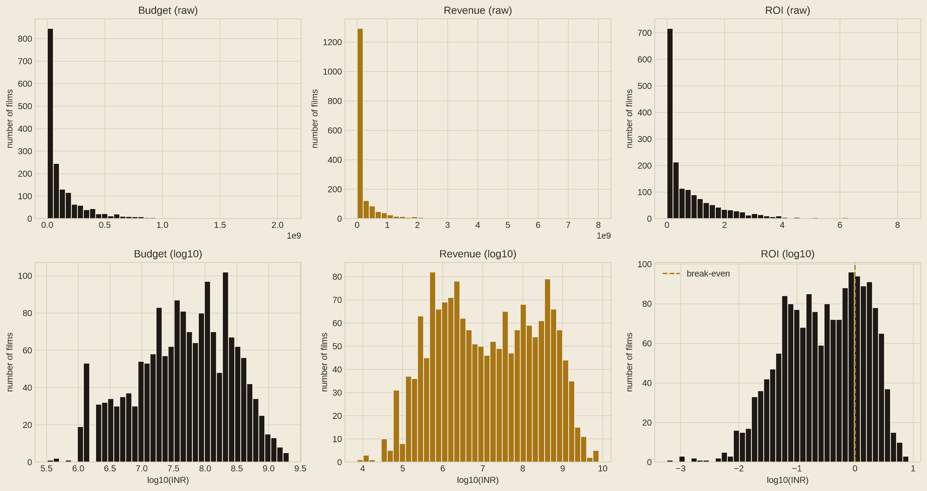
SC.05 / 13
SCENE 05 · THE FACT
The typical film loses money
What the raw revenue distribution actually looks like.
Fig. — 1,698 films, ranked by ROI · each bar ≈ 14 films
ROI < 1 — 72.1% never recover budget
Fig. — raw vs log₁₀ (notebook 2)
ROI ≥ 1
0.335
A few blockbusters carry the averages: mean revenue is 19× the median, and on the log scale the bell is almost perfect — every rupee variable is modelled on log scale.
median ROI — the typical film returns a third of its budget
Skew 5.82 → 0.006 (raw vs log₁₀)
The Budget Illusion · Team 05 · Scene 05 of 13 · Source: Bollywood Movies Data (Premkumar 2020) · Mendeley V1 · n = 1,698
Notes:
First fact: 72 percent of films lose money. The raw histograms are one spike with an invisible tail; the log row shows near-perfect bells. That visual is what sent us to log scale for everything that follows.

Slide 6
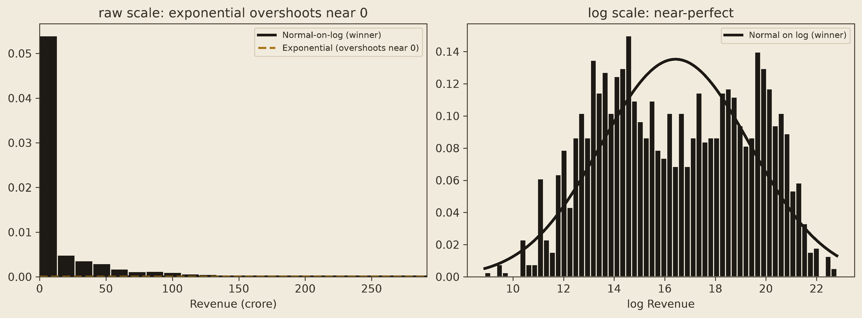
SC.06 / 13
SCENE 06 · THE AUDITION
Let the families compete
Six distribution families fit the revenue; the winner gets audited.
Lognormal
135.5
Winner
Fig. — χ² contest on revenue: winner (dark) vs exponential (dashed); log scale near-perfect (notebook 3)
χ² family
567
t
1,896
Exponential
4,071
Normal
6,218
Uniform
12,493
Honesty check
Six families fitted by maximum likelihood, scored on their own deciles.
Simulation-calibrated χ² rejects even the lognormal (p = 0.0025) — we use it to rank families, not to crown a truth. Shape s = 2.95, 95% CI [2.85, 3.05].
The Budget Illusion · Team 05 · Scene 06 of 13 · Source: Bollywood Movies Data (Premkumar 2020) · Mendeley V1 · n = 1,698
Notes:
We fitted six distribution families by maximum likelihood and scored them with chi-square tests on their own deciles. Lognormal wins for revenue and ROI. But because we estimated the parameters from the same data, we recalibrated the p-value by simulation — and it formally rejects. Best available approximation, not truth.

Slide 7
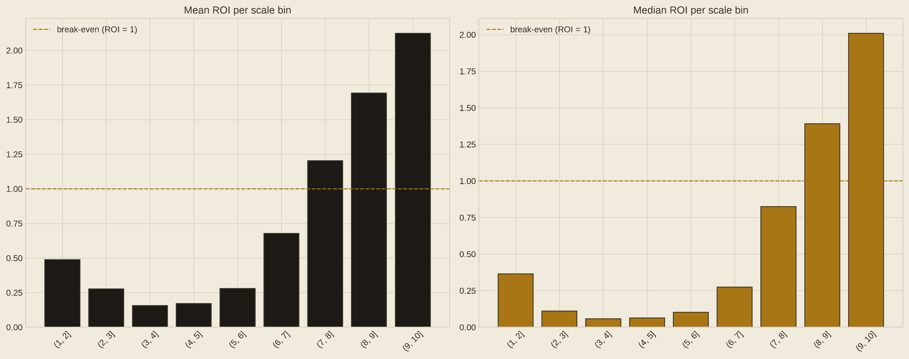
SC.07 / 13
SCENE 07 · THE LADDER
Compare like with like
The four-stage ladder that separates scale from strategy.
04 · Full model (HC3)
train = test · 0.554 / 0.522
03 · + scale bands
R² 0.549
02 · + content
—
01 · Unadjusted
R² 0.302
Response: log(ROI), validated near-normal · scale control: nine Movie_Scale band dummies, films compared within bands · HC3 errors.
Mean / median ROI per Movie_Scale band — each β reads as exp(β) − 1 on ROI (notebook 2, §9).
The Budget Illusion · Team 05 · Scene 07 of 13 · Source: Bollywood Movies Data (Premkumar 2020) · Mendeley V1 · n = 1,698
Notes:
The method in one slide: model log ROI with HC3 robust errors, and add nine scale-band dummies so every film is compared within its own budget-and-screens band. Explained variance jumps from 30 to 55 percent, and the model generalises to held-out data.

Slide 8
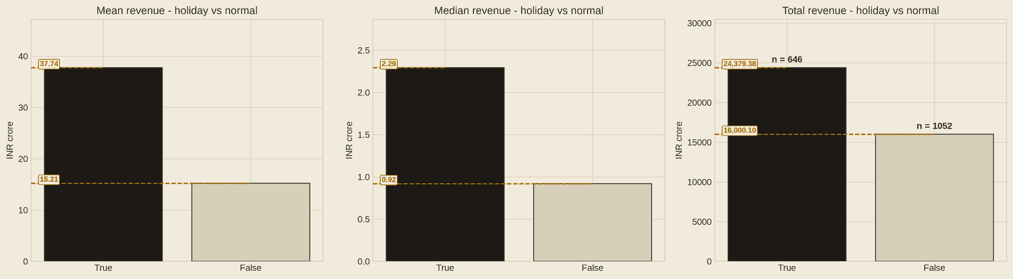
SC.08 / 13
SCENE 08 · VERDICT I — REJECTED
Timing buys reach, not returns
The +28% holiday premium, tested to destruction.
+0.28
→
−0.02
Holiday effect on log(ROI): unadjusted → full · p = 0.79
Holiday vs normal releases — mean, median, total revenue (notebook 2).
Where the premium went
Content ~62% · scale the rest
Permutation, top scale bins
(8,9] +0.21 · (9,10] +0.56 — revenue only
Conclusion · H1 — revenue at top scale, not ROI.
The Budget Illusion · Team 05 · Scene 08 of 13 · Source: Bollywood Movies Data (Premkumar 2020) · Mendeley V1 · n = 1,698
Notes:
H1 is our cleanest negative result. The unadjusted +28 percent holiday premium dissolves to minus two percent once scale is controlled. Permutation tests: the revenue gap survives only at top scale — (8,9] +0.21 (p = 0.025); (9,10] +0.56 (p = 0.001) — about +76% revenue, a revenue effect, not a returns effect.

Slide 9
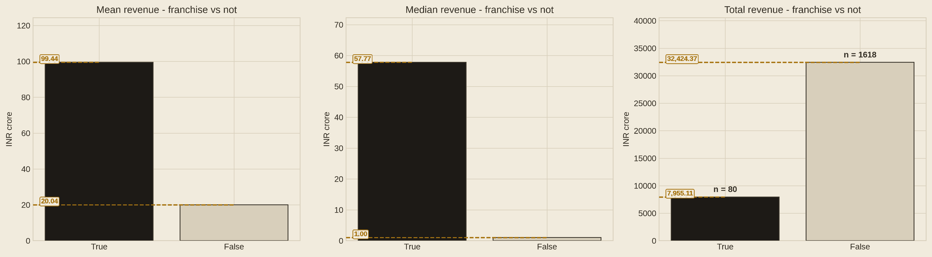
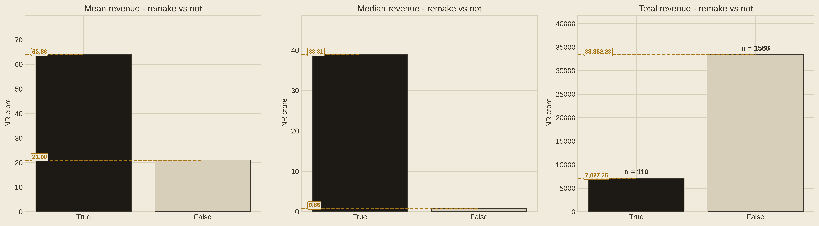
SC.09 / 13
SCENE 09 · VERDICT II — FRANCHISE & REMAKE
Two safe bets survive
Verdict II — franchise & remake, tested like-for-like.
Effect
Verdict
Evidence
Franchise
+40% ROI
raw +1.70 → full +0.34 · p = 0.0006 · ~78% from scale
Remake
+42% ROI
raw +1.60 → full +0.35 · p = 0.0001 · shuffle-confirmed
Conclusion · H2 — a real safe bet exists: ≈ +40% ROI at equal scale, confirmed for both.
The Budget Illusion · Team 05 · Scene 09 of 13 · Source: Bollywood Movies Data (Premkumar 2020) · Mendeley V1 · n = 1,698
Notes:
Verdict two: franchise and remake. Their premiums shrink from absurd to real once we compare like-for-like — raw +1.70 and +1.60 land at +0.34 and +0.35 in the full model, about plus 40 percent ROI for both. Roughly 78 percent of the raw franchise premium was scale. Both survive the label-shuffle test.

Slide 10
SC.10 / 13
SCENE 10 · VERDICT III — GENRE
Genre: real, but scoped
Verdict III — adult, fantasy, and the raw-only trio.
Effect
Verdict
Evidence
Adult genre
+407% ROI
p < 0.0001 · 76 films
Conclusion · H3 — genre effects are real but scoped: adult +407% (76 films); fantasy −66%; the trio raw-only.
Fantasy
−66% ROI
confirmed, like-for-like
Drama · rom-com · docu
raw only
dissolves on log scale
Raw premiums of +450% were mostly scale. What earns above its size: an adult film — and what to avoid: fantasy.
The Budget Illusion · Team 05 · Scene 10 of 13 · Source: Bollywood Movies Data (Premkumar 2020) · Mendeley V1 · n = 1,698
Notes:
Verdict three: genre. We have enough data to say this cleanly. Adult is the strongest effect in the study — plus 407 percent ROI, but scoped to 76 films in the small scale bands. Fantasy is the confirmed negative: minus 66 percent ROI. And drama, rom-com and documentary premiums exist only on raw ROI — they dissolve once we model on the validated log scale.

Slide 11
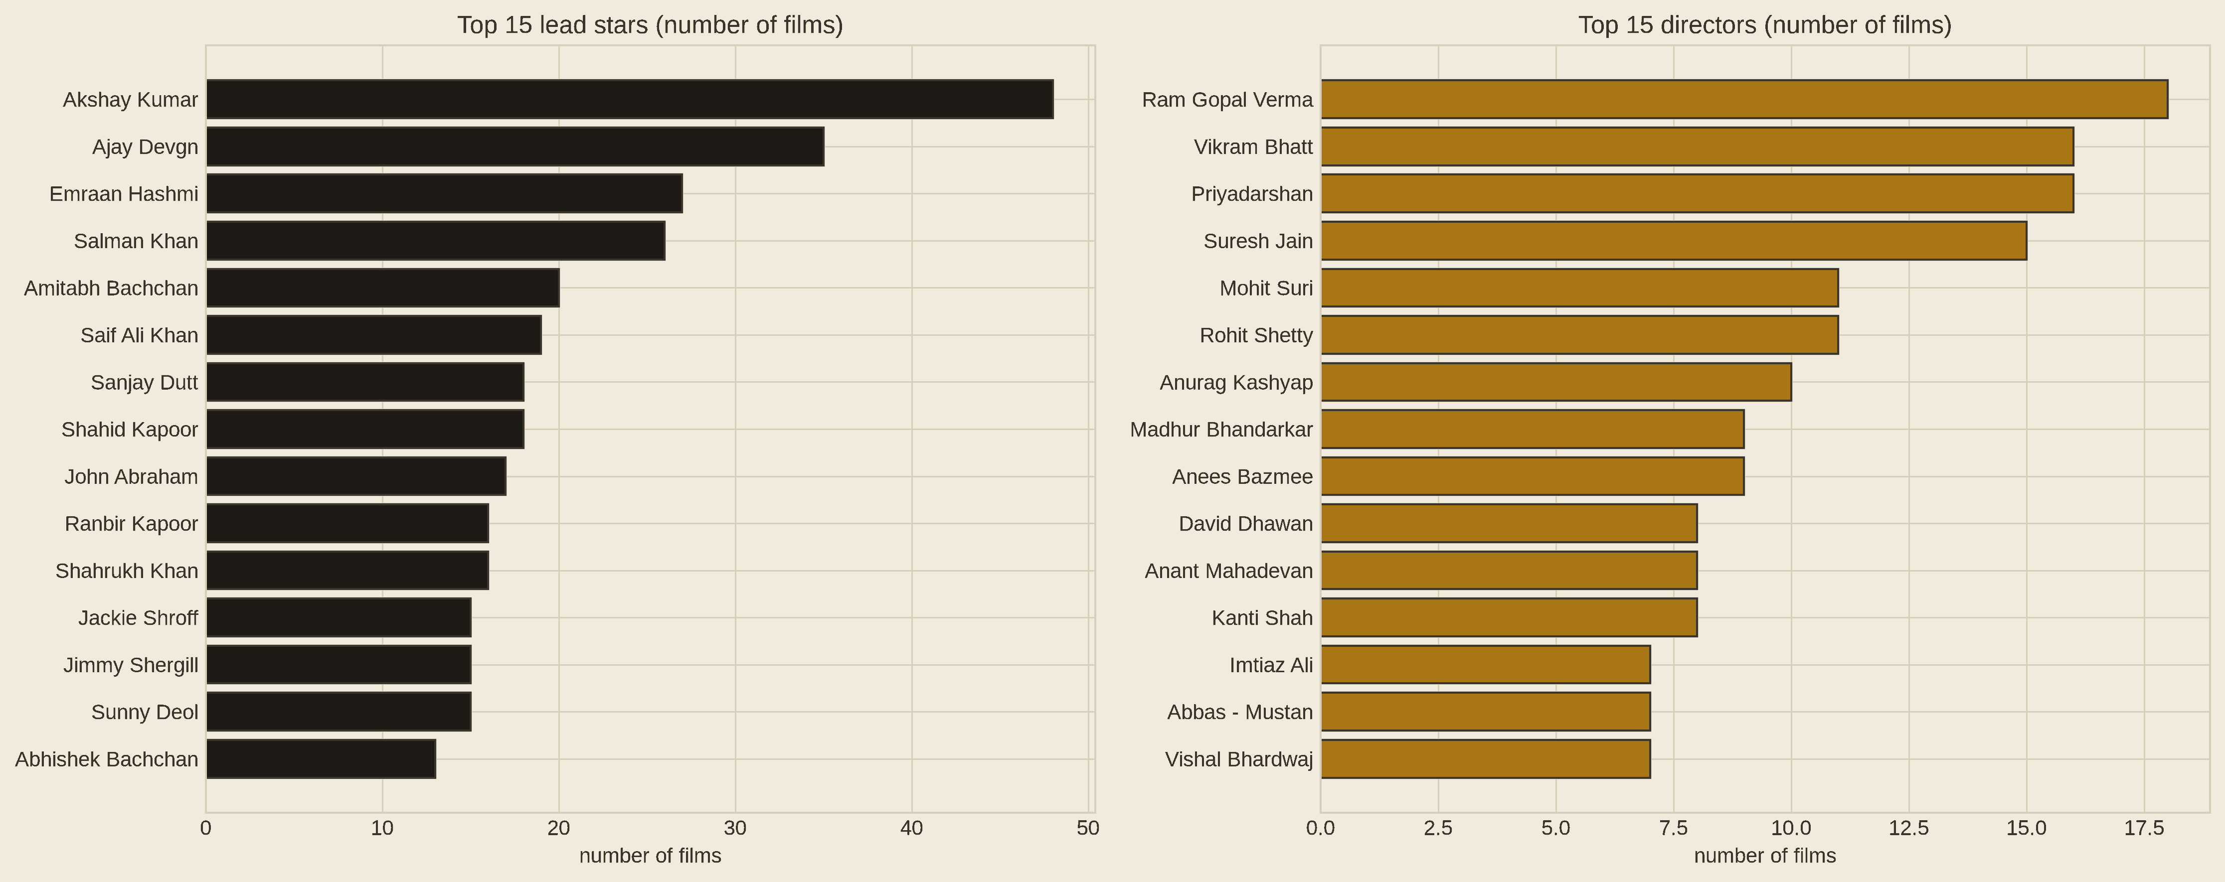
SC.11 / 13
SCENE 11 · VERDICT IV — SUPPORTED
Star power: extreme and real
Concentration, and what stars add beyond film size.
0.954
59.3%
Gini of star-level revenue — near-monopoly
of all revenue held by the top-10 stars (1.3% under equality)
R² 0.488 — scale bands alone
R² 0.804 — + 761 star dummies (+0.32)
Directors are concentrated too, but less: Gini 0.897 · top-10 share 25.6%.
Conclusion · H4 — the market is a star monopoly: extreme and real — association, not causation.
The Budget Illusion · Team 05 · Scene 11 of 13 · Source: Bollywood Movies Data (Premkumar 2020) · Mendeley V1 · n = 1,698
Notes:
Star revenue is close to a monopoly: Gini 0.954, and ten names hold 59 percent of all revenue (1.3% under equality). But the deeper test is that star identity still explains returns after film scale — R squared jumps from 0.49 to 0.80. We state clearly: this is association, not causation.

Slide 12
SC.12 / 13
SCENE 12 · THE MECHANISM
Spending buys reach, not returns
Mediation: where the budget's effect on revenue actually goes.
log(Screens)
a = 1.18
b = 0.63
log(Budget)
log(Revenue)
direct effect c′ = 0.76 (of total c = 1.50)
49.6%
p = 0.888
Money → reach
of budget's effect on revenue flows through screens (bootstrap 99% CI [0.59, 0.88])
stratified permutation: spending more does not improve returns within a scale band
→ revenue — not better returns per rupee; this is the mechanism behind the illusion.
Money buys reach; reach buys revenue — not better returns per rupee.
The Budget Illusion · Team 05 · Scene 12 of 13
Notes:
Why does spending not improve returns? Because half of budget's effect on revenue simply travels through screens — a path we quantified with mediation analysis and a bootstrap confidence interval. Within a scale band, a stratified permutation test shows high spenders do no better. Money buys reach; reach buys revenue.

Slide 13
SC.13 / 13
SCENE 13 · THE TAKEAWAY
What we would tell the industry
Four conclusions, stated plainly — with the limits attached.
01 Distrust raw comparisons
holiday +32%, franchise +448% — headline premiums were scale in disguise
02 A real “safe bet” exists
franchise & remake keep ≈ +40% ROI at equal scale · adult +407%
03 Festivals are marketing
they buy opening reach at top scale — revenue, not ROI
04 The market is a monopoly
top-10 stars hold 59.3% of revenue; stars add +0.32 R² beyond scale
Limitations — no release years · self-reported flags · association, not causation · Hindi cinema only.
github.com/cs215-cse-iitb/dai-aug-2026-openproject-group-5
The Budget Illusion · Team 05 · November 2026
Notes:
To sum up: be suspicious of raw comparisons; a real safe bet exists and it is franchise, remake, and adult cinema; festivals are marketing; and the market is a star monopoly. Our limitations are stated honestly — no release years, self-reported flags, and association rather than causation. Thank you!

