Slide 1
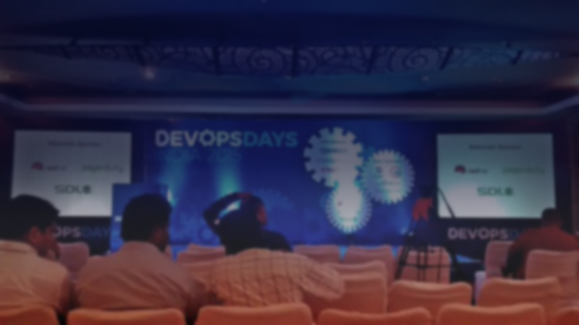

DEVOPSDAYS
INDIA 2016
SPONSORSHIP PROSPECTUS
DevOpsDays
INDIA 2016

Slide 2
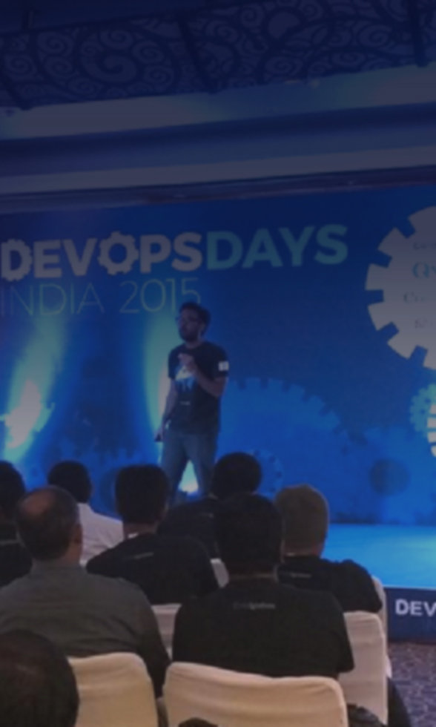

WHY SPONSOR
DEVOPSDAYS INDIA
DevOpsDays India is the premier Indian conference for all things DevOps & brings together the best and brightest from technology & business.
On the 5th & 6th of November 2016, the Third edition of DevOpsDays India will be held at (venue being finalized) in the garden technopolis of Bengaluru.
Organized by volunteers on a non-profit basis, DevOpsDays India is the ideal place for Sponsors to:
Reach 400+ community of talented programmers & architects
Meet international & Indian top programmers & experts
Learn emerging business technology trends & developments
Build your technology & employer brand
ORGANIZED BY:
DevOpsDays India 2016 Sponsorship Prospectus

Slide 3








A GLOBAL
COMMUNITY
DevOpsDays India has attracted participants from 15 countries in the last 2 editions & features expert speakers from India & abroad who are in constant demand all over the world.
Over the 2 day conference participants learn by attending talks & workshops, and networking opportunities are aplenty before and at the conference venue & post conference party.
Some of our early supporters who have sponsored DevOpsDays India in the past:
DevOpsDays India 2016 Sponsorship Prospectus

Slide 4
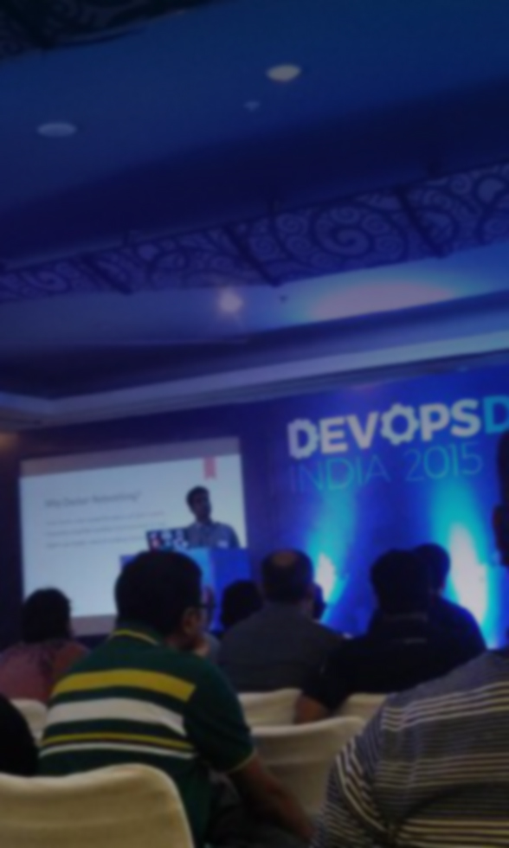
GOLD
SPONSOR
INR 350,000 / USD 5000 *
5 Slots
Company logo at Venue (registration area, stage, backdrop)
Company logo on Delegate kits
Company logo on T-shirts
1 delegate give-away
Booth Space 10 feet wide x 6 feet deep, along with table, two chairs and a power point. This will be available from 12 midnight of 4th Nov. 2016. Booths are not selectable. Our team will assign your booth. See ahead a photo of the Booth space.
Company logo in all videos.
4 Roll-up standees (to be designed by Sponsor)
Mention in all newsletters.
Company Name and Logo on webpage (350x200px)
Twitter Promotion and credits
8 conference passes
DevOpsDays India 2016 Sponsorship Prospectus
*Taxes applicable as per Govt. of India guidelines

Slide 5
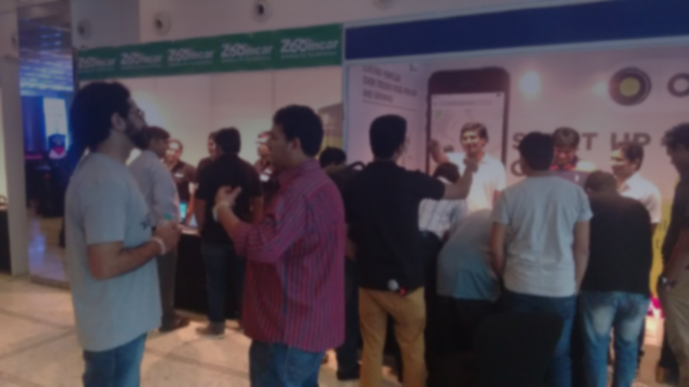
GOLD SPONSOR BOOTH SPACE

Slide 6
SILVER
SPONSOR
INR 225,000 / USD 3500 *
5 Slots
Company logo at Venue (registration area, stage, backdrop)
1 delegate give-away
2 Roll-up standees (to be designed by Sponsor)
Mention in all newsletters.
Company Name and Logo on webpage (200x150px)
Twitter Promotion and credits
6 conference passes
DevOpsDays India 2016 Sponsorship Prospectus
*Taxes applicable as per Govt. of India guidelines

Slide 7
ASSOCIATE
SPONSOR
INR 80,000 / USD 1200 *
5 Slots
Company Name and Logo on webpage (150x100px)
Logo on 4 Roll-up standees (prepared by conference organizers)
Display of logo during intervals and lunch
Twitter Promotion and credits
2 conference passes
DevOpsDays India 2016 Sponsorship Prospectus
*Taxes applicable as per Govt. of India guidelines

Slide 8
AD HOC
SPONSOR
TALK TO US!
Sponsor Full, Partial or Actual
Dinner Sponsor
Student Sponsor
Conference Party
Lanyard / Sticker sponsor
Speaker Sponsor
… more ideas are welcome.
DevOpsDays India 2016 Sponsorship Prospectus

Slide 9

GET IN TOUCH
To sign up to become a sponsor, send us an email at:
team@emergingtechs.in
DevOpsDays India will be held at (venue being finalized) on 5th & 6th November 2016.
@devopsdaysindia
www.devopsdaysindia.org
DevOpsDays India 2016 Sponsorship Prospectus

