Slide 1
Harry Potter Sorting Hat Chatbot
Taught by: Sejal K. Parmar
SAIL 2019

Slide 2




Agenda
 | Introductions | 3
 | Chatbots 101 | 4
 | The Sorting Hat + Github | 8
 | Your Turn! | 10

Slide 3





Sejal K. Parmar
Major: Computer Science
Minor: Applied Statistics
Badminton, Reading, Baking, Traveling
Software Engineer Intern:
Jump Trading (current), Facebook (summer)
Data Science, AI, NLP, Computer Vision
Ravenclaw or Slytherin

Slide 4
Chatbots 101

Slide 5








What is a chatbot?
A software program for simulating intelligent conversations with humans using rules or artificial intelligence
Written Text
Chatbot Interaction:
Conversational Interface
Response
Spoken Text
Example Uses
Ordering Products
Managing Finances
Weather Forecasting
Chatbots are more present than ever all across the internet and perform a variety of functions

Slide 6
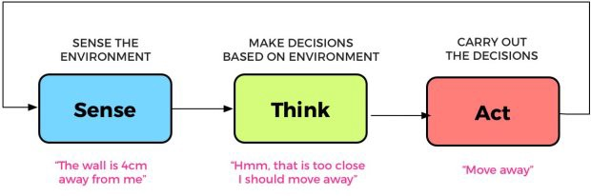

How do we determine if a chatbot is “intelligent”?
Identify a goal
Work autonomously
Achieve the goal
Convert information received from a user into an understandable format
Store it in a knowledge base
Make a decision: leverage existing knowledge and continuous feedback
Take action to achieve pre-defined goals based on the decision.
Use neural networks + machine learning to make the chatbot think and take actions depending on the request placed by the user

Slide 7
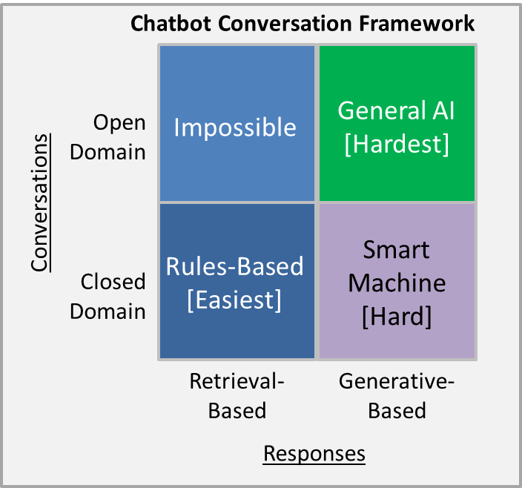

What types of bot models exist?
Retrieval Based Model
Concept of predefined responses
Picks appropriate responses from the repository stacked which is based on the context and query raised by the user
Conversation is bounded by what is programmed
Generative Model
Built using machine translation techniques
Come with the ability to generate new responses immediately
Enable longer conversations where the chatbot deals with several user queries
Retrieval-based close domain chatbots are the easiest to create, which is what our sorting hats are

Slide 8
The Sorting Hat + Github

Slide 9
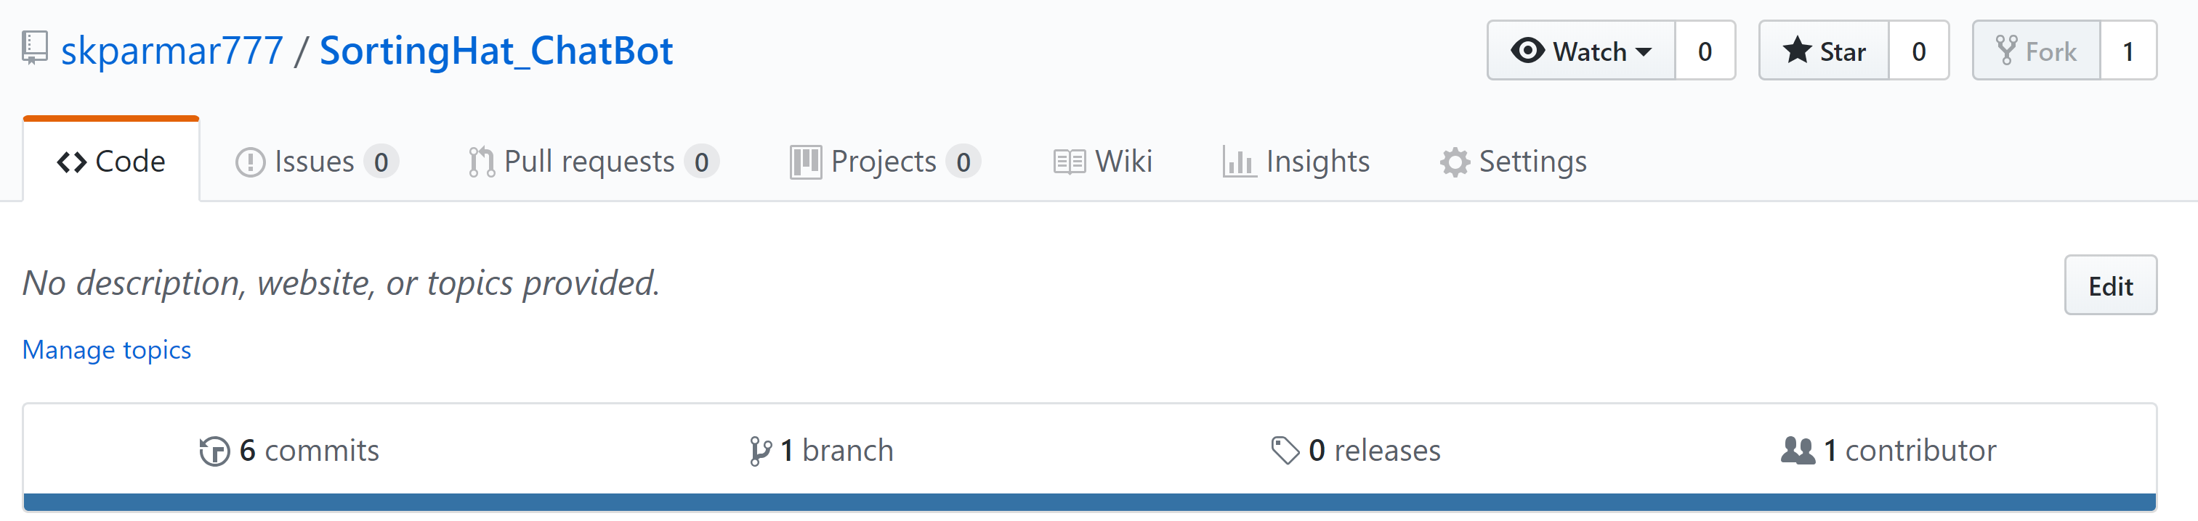
The Pottermore Sorting Hat Knockoff
Go to http://tinyurl.com/sailSortingHat
Create a GitHub account (if you don’t already have one) and log in
Fork the repo and clone it
This is an example of a retrieval-based chatbot: we’ll go over the code and what’s going on

Slide 10
Your Turn!

Slide 11
Your options!
1
Bug Fixes
2
Make your own hat!
3
Advanced students:
My code was written quickly…
There are probably some bugs.
Test out different questions/answers and play around with the sorting hat.
When you find issues (formatting, etc), fix them!
Pretend you’re the founder of a new wizarding school…
You get to create the houses, determine what traits each should have, and create your own hat!
Machine learning and Natural Language Processing are such big buzzwords…
If you want to try your hand at some NLP, check out fuzzywuzzy and see if you can make our current sorting hat more generative with understanding inputs
Have fun!

