Slide 1
Glove for Deaf
Group: D26 Online
Team members:
Seif Nasr
Ahmed Ragab
Omnia Osama

Slide 2
What we will take about ?
Introduction
Flow chart
Component
Simulation circuit
Code

Slide 3

Introduction
Sign language is used by deaf people.
Smart glove will be used to translate sign language into text.

Slide 4
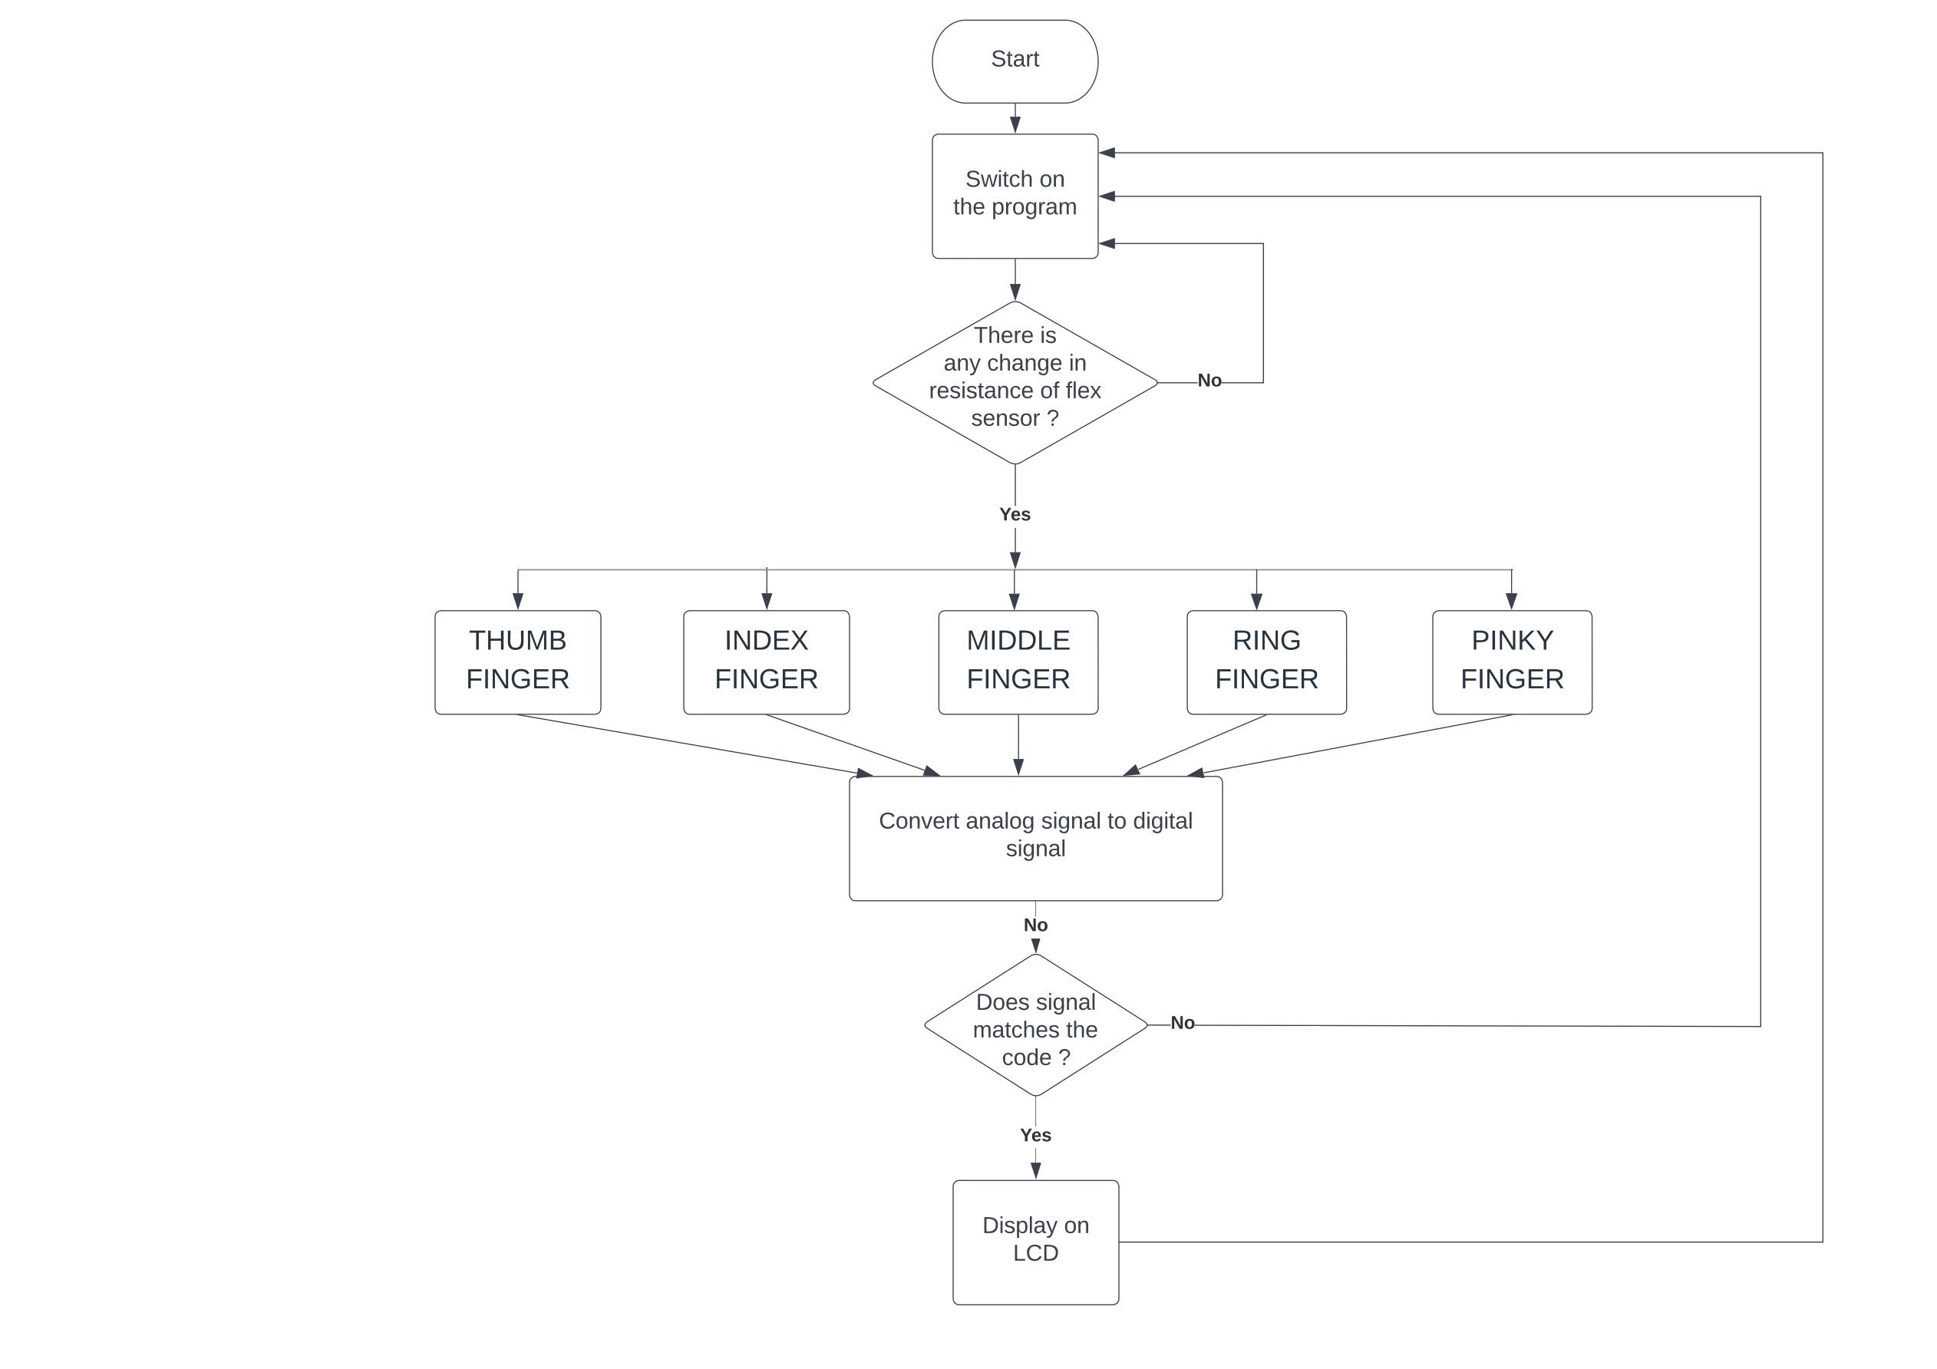
Flow Chart

Slide 5
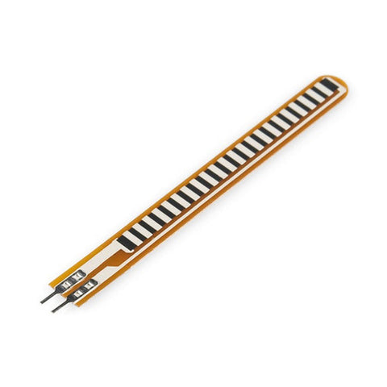
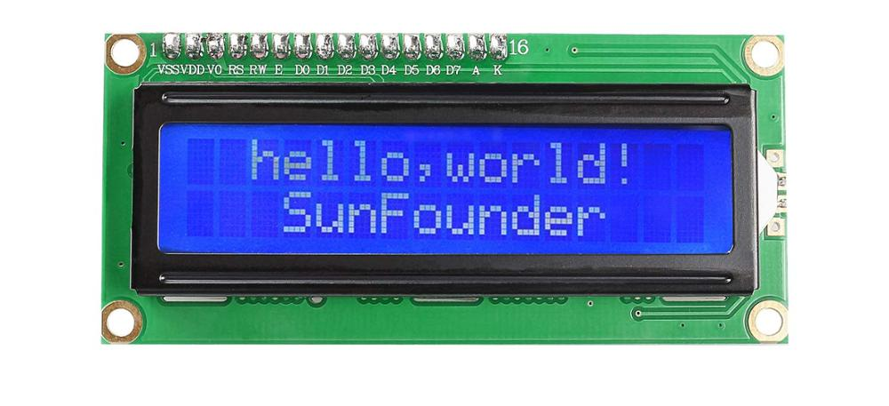
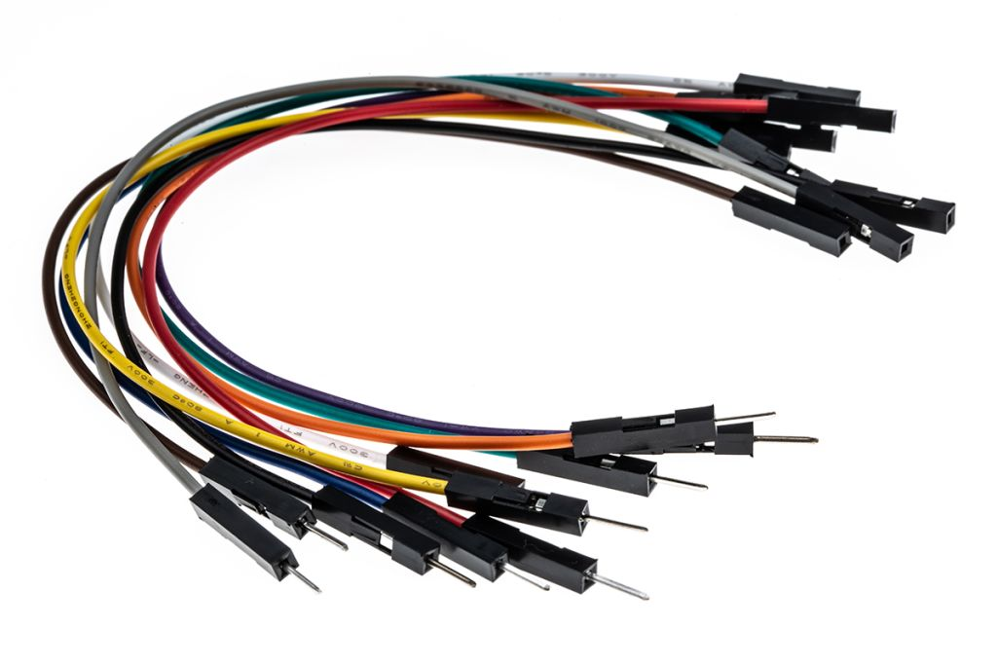
Component
5x flexible sensor
Gloves
Wires
LCD

Slide 6
flex sensor
The flex sensor changes its resistance when flexed so we can measure that change using ADC

Slide 7
Total cost
flexible sensor (430 × 5) = 2150 L.E
Gloves
Wires = 40 L.E
LCD -> Amit kit
Total cost = 2190 L.E

Slide 8
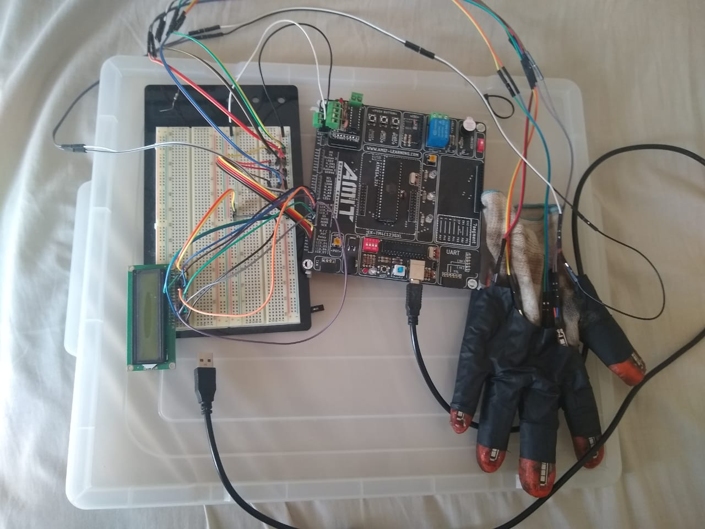
Hardware components

Slide 9
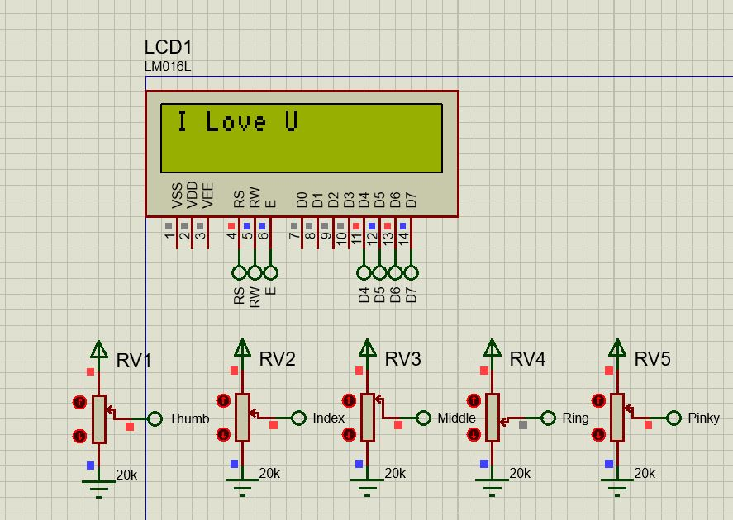
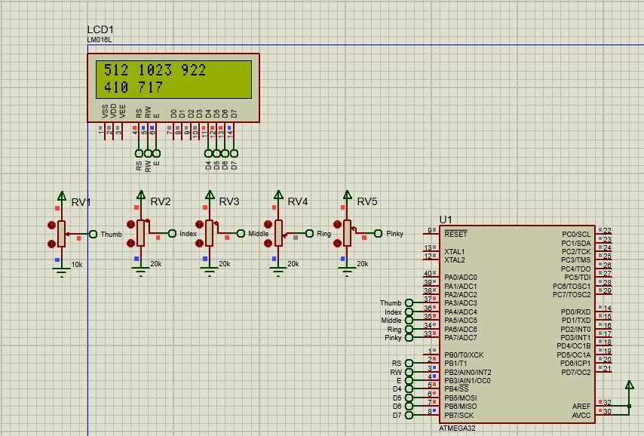
Simulation circuit

Slide 10
Code
Main File
LCD Files
ADC Files
https://github.com/ChaosGoldenDragon/D26-project-glove-for-deaf.git

Slide 11


