Slide 1


Simple log in page
Username
Password
Log In

Slide 2



Welcome, *Name
HOME
Simple home screen, to easily access different areas of the app
Training
Events Calendar
Rowers
Rowing Machine (ERG) DATA

Slide 3
TRAINING
Availability Calendar
Training Sets
Will show what training sets will be done on each day?
+ availability of rowers for each training session???
Training | Description
Sat (02/09/2023) 08:00 Available? | Training set: 1 Overview: 10 rowers, 1 coach
Mon (04/09/2023) 08:00 Available? | Training set: 3 Overview: 8 rowers, 2 coachs
Fri (08/09/2023) 08:00 Available? | Rest Day
… | …
Edit Training Sessions
View Availability

Slide 4
TRAINING
Availability Calendar
Training Sets
Where coach can make new training sets. Can scroll through existing training sets, edit them, delete them and add more
Training Set 1:
…
Training Set 2:
…
Training Set 3:
…
Edit Training Set

Slide 5



TRAINING
Availability Calendar
Training Sets
Where coach can make new training sets. Can scroll through existing training sets, edit them, delete them and add more
EDITING
Training Set 1:
…
Training Set 2:
…
Training Set 3:
…
Add set
Close Edit Mode

Slide 6
EVENTS CALENDAR
Display calendar as a list, with scroll bar. Coach has option to edit calendar.
Event | Description
Chester LDSc Sign up? | Date: Sunday 24th September Distances: - 5000m (Boat Class: 16/17/18. 1x, 2x, 4x) Extra Notes: N/A
Nottingham Autumn Head Sign up? | Date: Sunday 15th October Distances: - 6000m (Boat Class:16/17/18. 1x) - 3700m (Boat Class: 16/17/18. 4+, 4-, 2-, 4x-, 2x) Extra Notes: N/A
Training Camp, Nottingham Sign up? | Date: 25th - 28th October Distances: N/A Extra Notes: N/A
… | …
Edit Calendar

Slide 7
EVENTS CALENDAR
EDITING
Display calendar as a list, with scroll bar. When in editing mode coach can edit existing events, delete events or add ned events.
 | Event | Description
 | Chester LDSc Sign up? | Date: Sunday 24th September Distances: - 5000m (Boat Class: 16/17/18. 1x, 2x, 4x) Extra Notes: N/A
 | Nottingham Autumn Head Sign up? | Date: Sunday 15th October Distances: - 6000m (Boat Class:16/17/18. 1x) - 3700m (Boat Class: 16/17/18. 4+, 4-, 2-, 4x-, 2x) Extra Notes: N/A
 | Training Camp, Nottingham Sign up? | Date: 25th - 28th October Distances: N/A Extra Notes: N/A
 | … | …
Add event
Close Edit Mode

Slide 8
ROWERS
Search…
Coach is able to search for specific rowers to see their profiles and specific times + other info
Name | …
Rower 1
Rower 2
Rower 3
Rower 4
Rower 5
Rower 6
Rower 7
Rower 8
…
…
…
…
…
…

Slide 9
ROWER 1 PROFILE
Coach is able to search for specific rowers to wee their profiles and specific times + other info
Name: Rower 1
Age: 17
Group: …
Contact: #
Boat Allocation: …
Side: Left
Blades: J31A
Other info/stats here?
2K PB: 7.18
5K PB: 19.33
30mins: 7256
…

Slide 10
ACCOUNT
Basic account page, to view personal details
Username
>
Change Password
>
Email
>
Phone Number
>
…
>
…
>
Log Out

Slide 11
ROWING MACHINE (ERG)
Search…
Date of session | Link to ergs (database)
12/12/23 | …
13/12/23
14/12/23
…
…
…
…
…
…
…
…
…
…
…

Slide 12
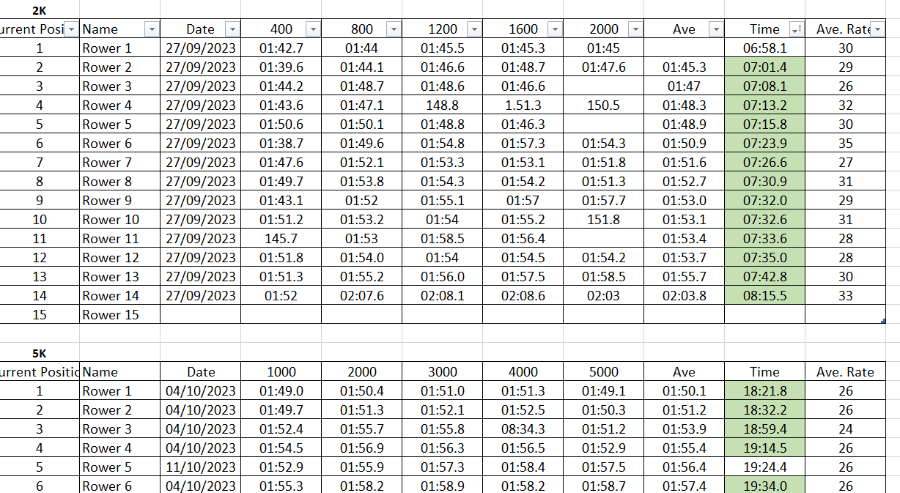
Rowing Machine (ERG) : *Session Date
Shows specific times from training sessions, with option to export data as a excel file?
Export

