Slide 1
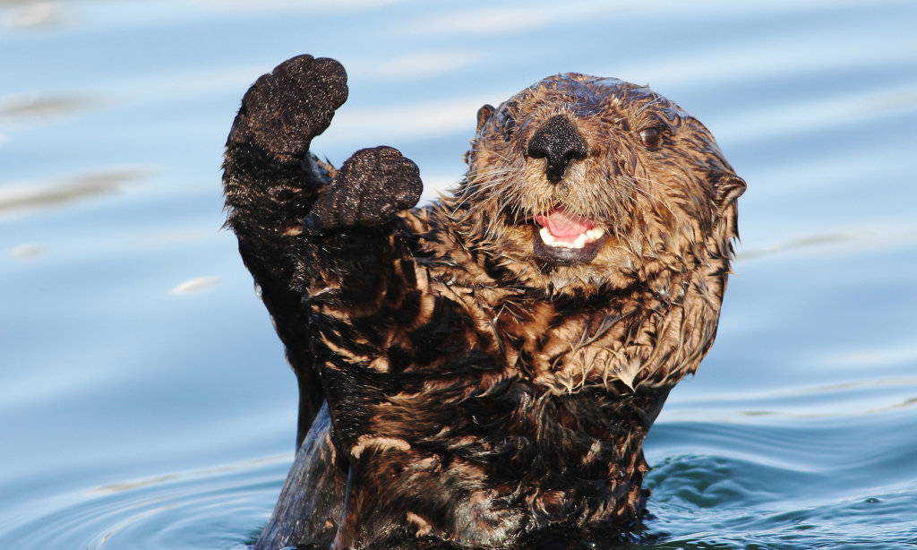

CSUMBy Filter
This filter will take any image and change it into CSUMB’s school colors with the logo and motivational text.
The three things applied to this filter are:
-Shifts color palette to Bay Blue ,Valley Green , and Golden Sand
-Adds school logo into the lower right of the image
-Draws “Go Otters!” text into upper left of the image

