Slide 1
Introduction to unit tests
and mocking

Slide 2
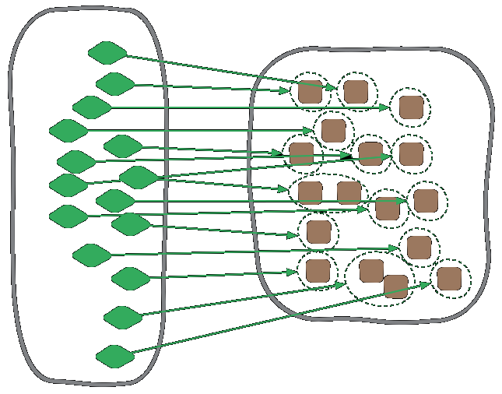
What's a unit test

Slide 3
What's a unit test
It's output is pass or fail (no in between)
Passes if the unit it tests works as expected
Fails if it doesn't
Deterministic
Does not depend other units
Does not depend on external sources such as DB or files on disk
The result does not depend on other tests
Runs fast

Slide 4
Unit test structure
Arrange
Act
Assert

Slide 5
My personal thoughts
Unit tests are efficient when they test code with logic
Sometimes it makes sense to test more than one unit
Good tests do not "mirror" the code
Units working with external elements like DB are better to be tested by functional tests
Do not write tests after the fact

