Slide 1

Bayesian Inference using Sequential Monte-Carlo Algorithms for Dynamical Systems Models
Chaolin Han
Supervised by Mark Bull and Linus Schumacher

Slide 2
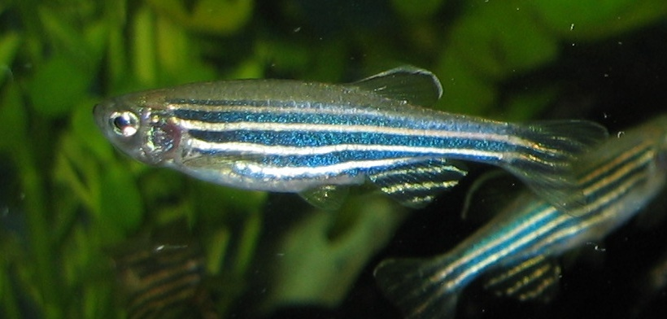
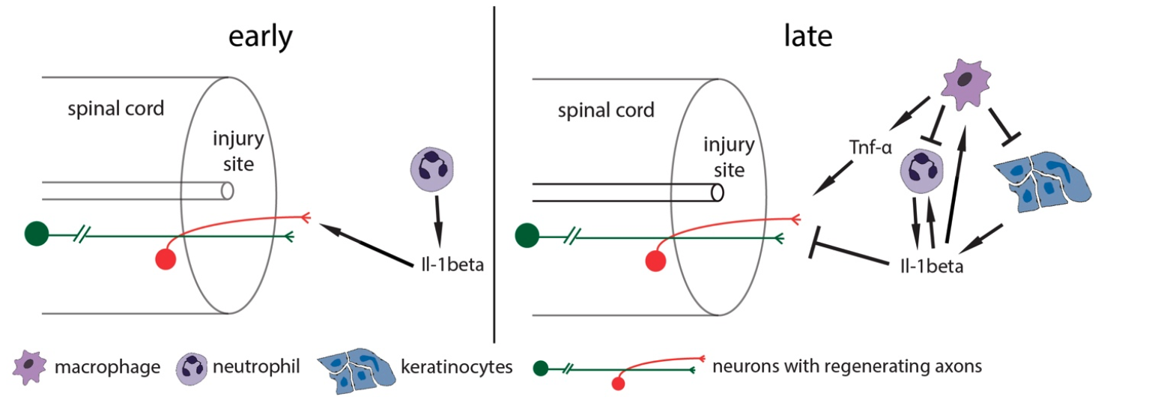
Background
Zebrafish spinal cord repair
Hypothesis: dynamically control by immune cells and molecules

Slide 3
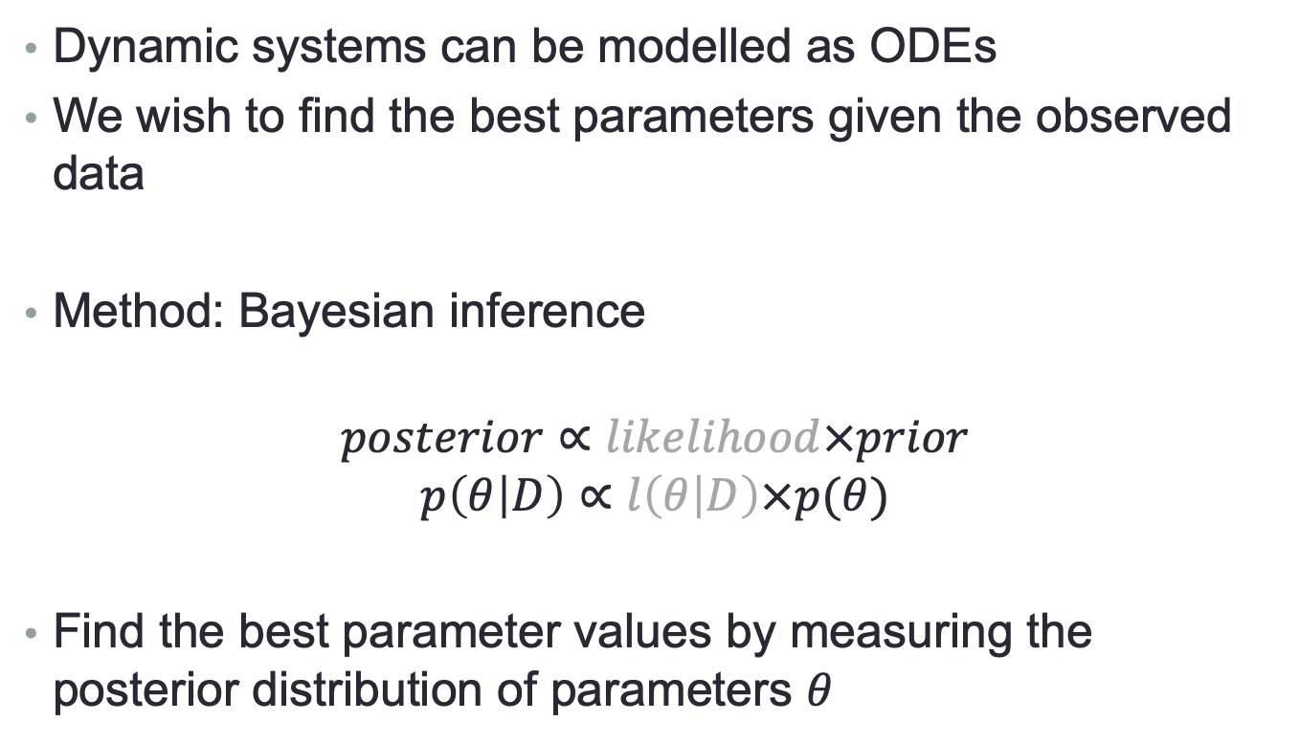
Background
Dynamic systems can be modelled as ODEs
We wish to find the best parameters given the observed data
Method: Bayesian inference
$$posterior∝likelihood×prior$$
$$p\left(θ | D\right)∝l\left(θ | D\right)×p(θ)$$
Find the best parameter values by measuring the posterior distribution of parameters $θ$

Slide 4
Background
Hard to write down an expression for likelihood
→ likelihood-free numerical approximation
Approximate Bayesian Computation (ABC)

Slide 5







Background
ABC-SMC (Sequential Monte-Carlo)
prior
population 1
population 2
population T
sample
perturb
...
Accept $θ^{∗}$ if $d\left(D^{∗},D\right)<ε_{1}$
Accept $θ^{∗}$ if $d\left(D^{∗},D\right)<ε_{2}$
$$θ$$
$$θ^{∗}$$
$$ε_{1}$$
$$ε_{2}$$
$$ε_{T}$$

Slide 6
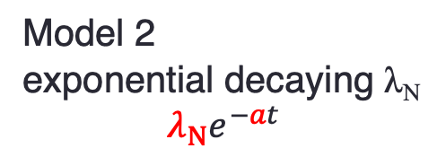
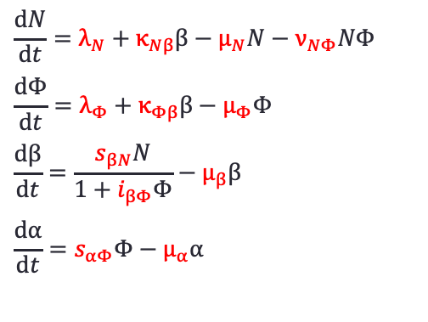
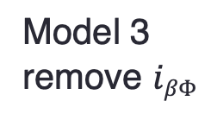
Models
$$\frac{\text{d}N}{\text{d}t}=λ_{N}+κ_{Nβ}β−μ_{N}N−ν_{NΦ}NΦ$$
$$\frac{\text{d}Φ}{\text{d}t}=λ_{Φ}+κ_{Φβ}β−μ_{Φ}Φ$$
$$\frac{\text{d}β}{\text{d}t}=\frac{s_{βN}N}{1+i_{βΦ}Φ}−μ_{β}β$$
$$\frac{\text{d}α}{\text{d}t}=s_{αΦ}Φ−μ_{α}α$$
Model 2
exponential decaying λ_{N}
$$λ_{Ν}e^{−at}$$
Model 1
Model 3
remove $iβΦ$

Slide 7
Implementations
pyABC (modified) in Python
Experiments
implementation options, algorithm hyperparameters
parameter inference
model comparison

Slide 8
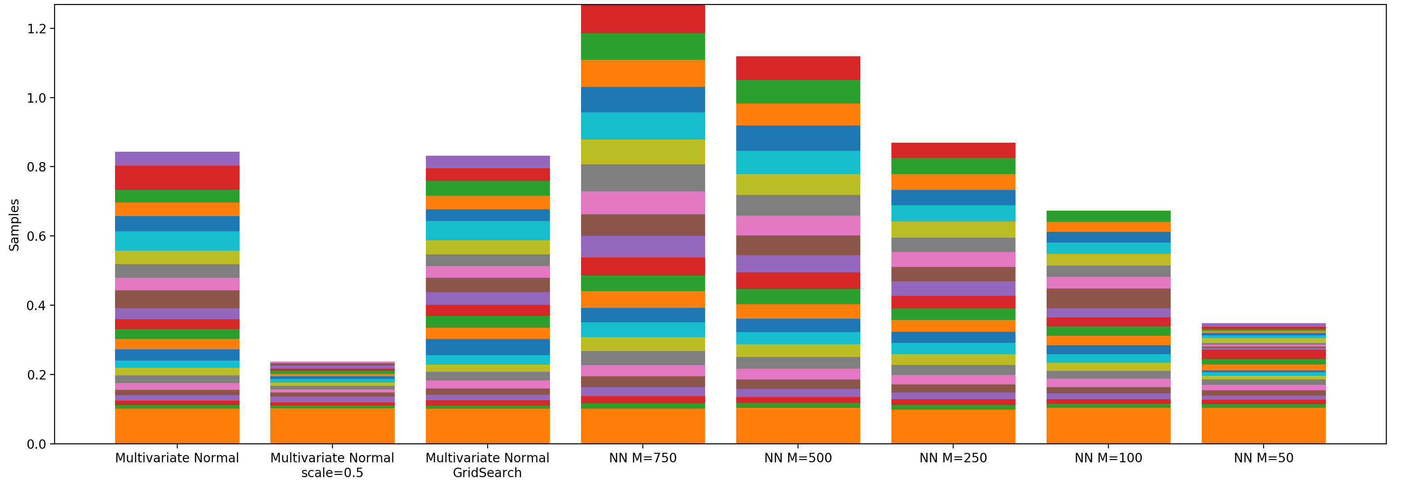
Implementations
Implementation options, algorithm hyperparameters
use synthetic data with know parameter values
compare efficiency and their influence on the goodness of fit
suggest proper setting for later parameter inference

Slide 9
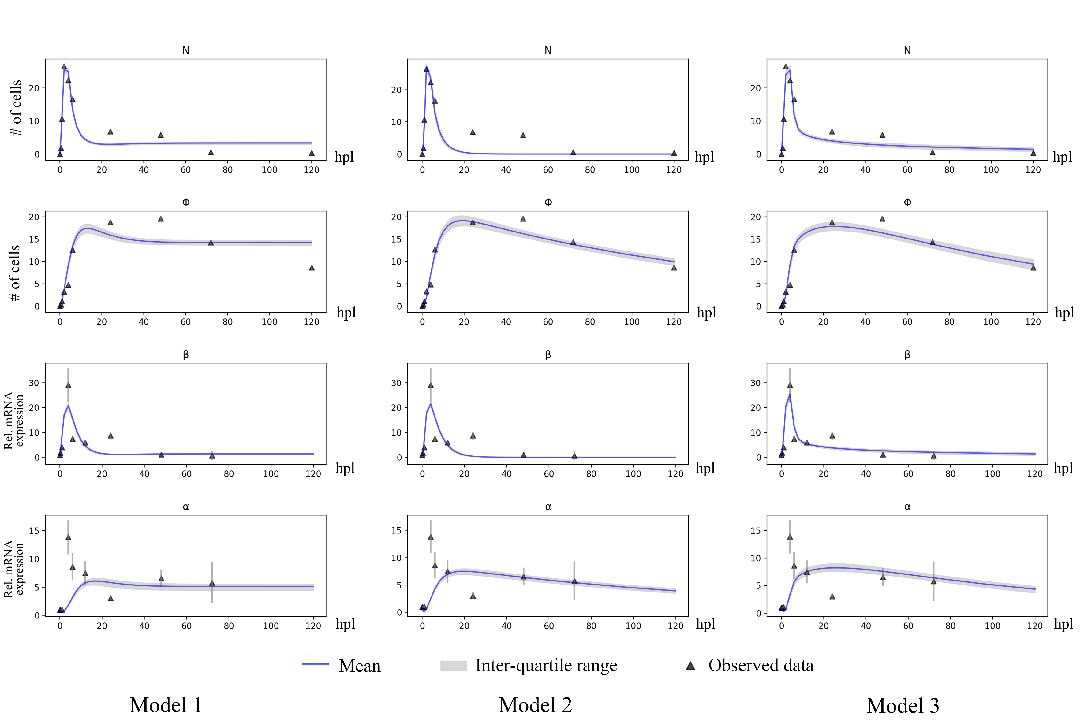
Implementations – Parameter inference

Slide 10
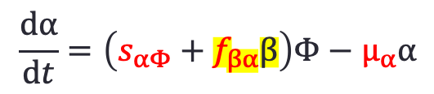
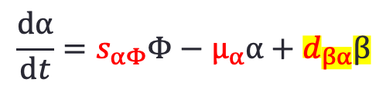
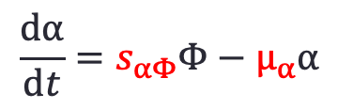
Implementations – Parameter inference
Model 3
$$\frac{\text{d}α}{\text{d}t}=s_{αΦ}Φ−μ_{α}α$$
Model 4
Model 5
$$\frac{\text{d}α}{\text{d}t}=s_{αΦ}Φ−μ_{α}α+d_{βα}β$$
$$\frac{\text{d}α}{\text{d}t}=\left(s_{αΦ}+f_{βα}β\right)Φ−μ_{α}α$$

Slide 11
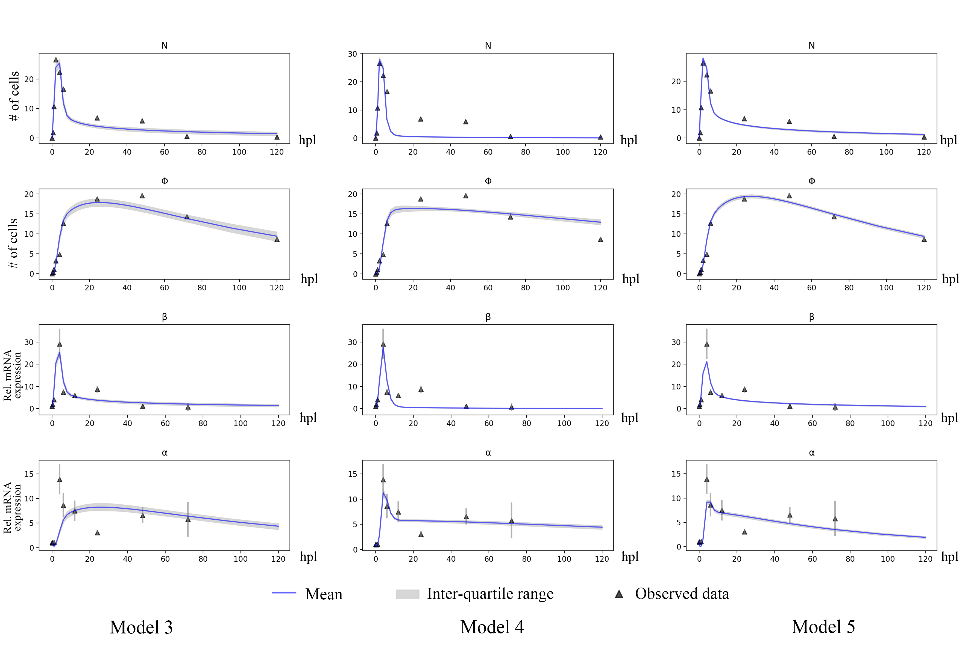
Implementations – Parameter inference

Slide 12
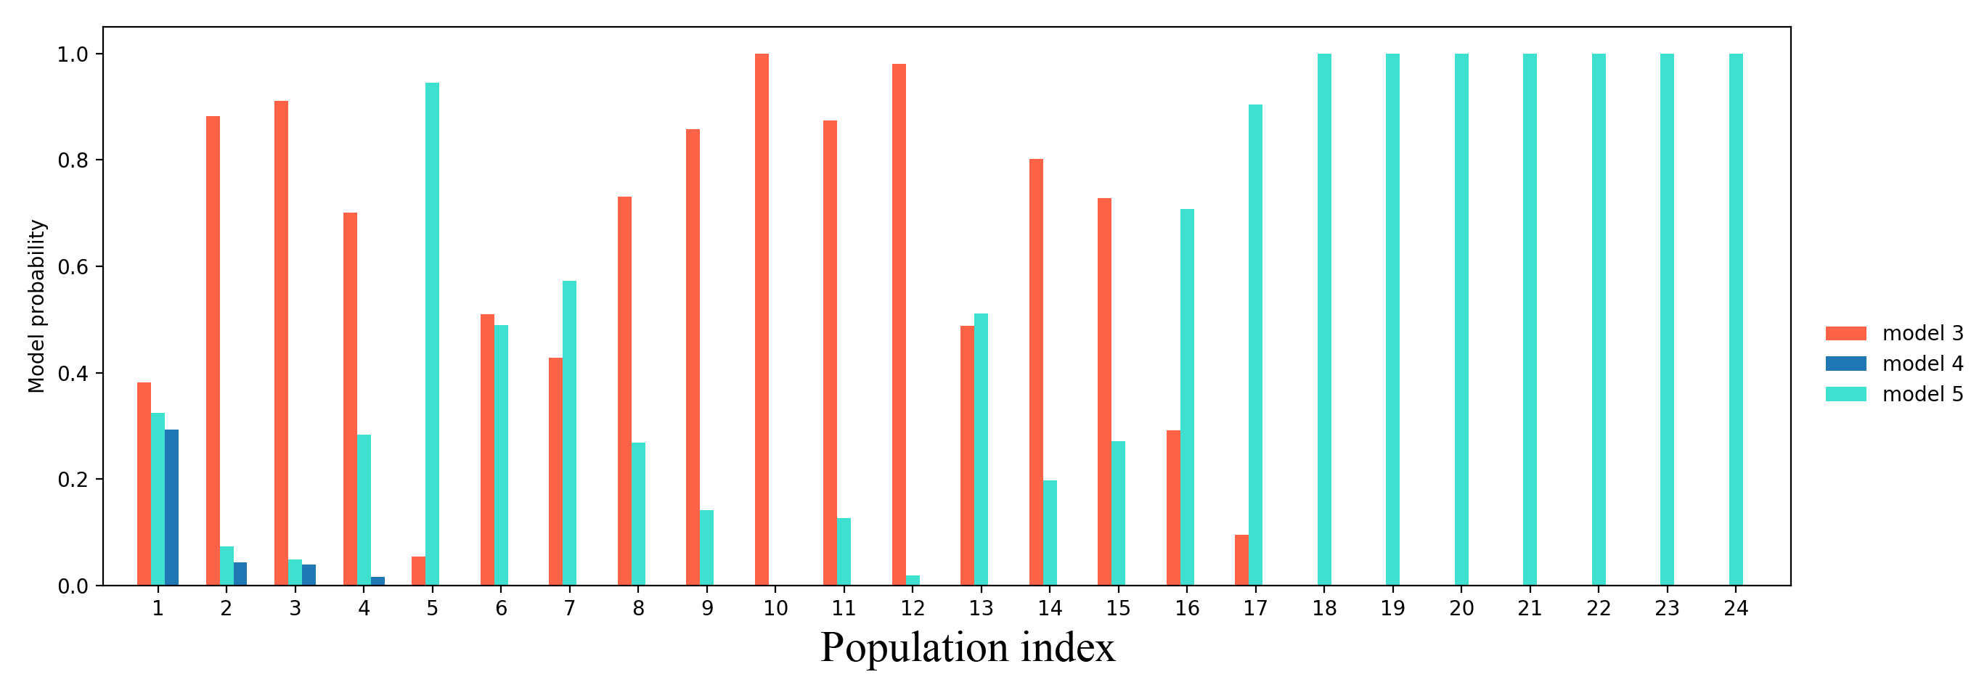
Implementations – Parameter inference

Slide 13
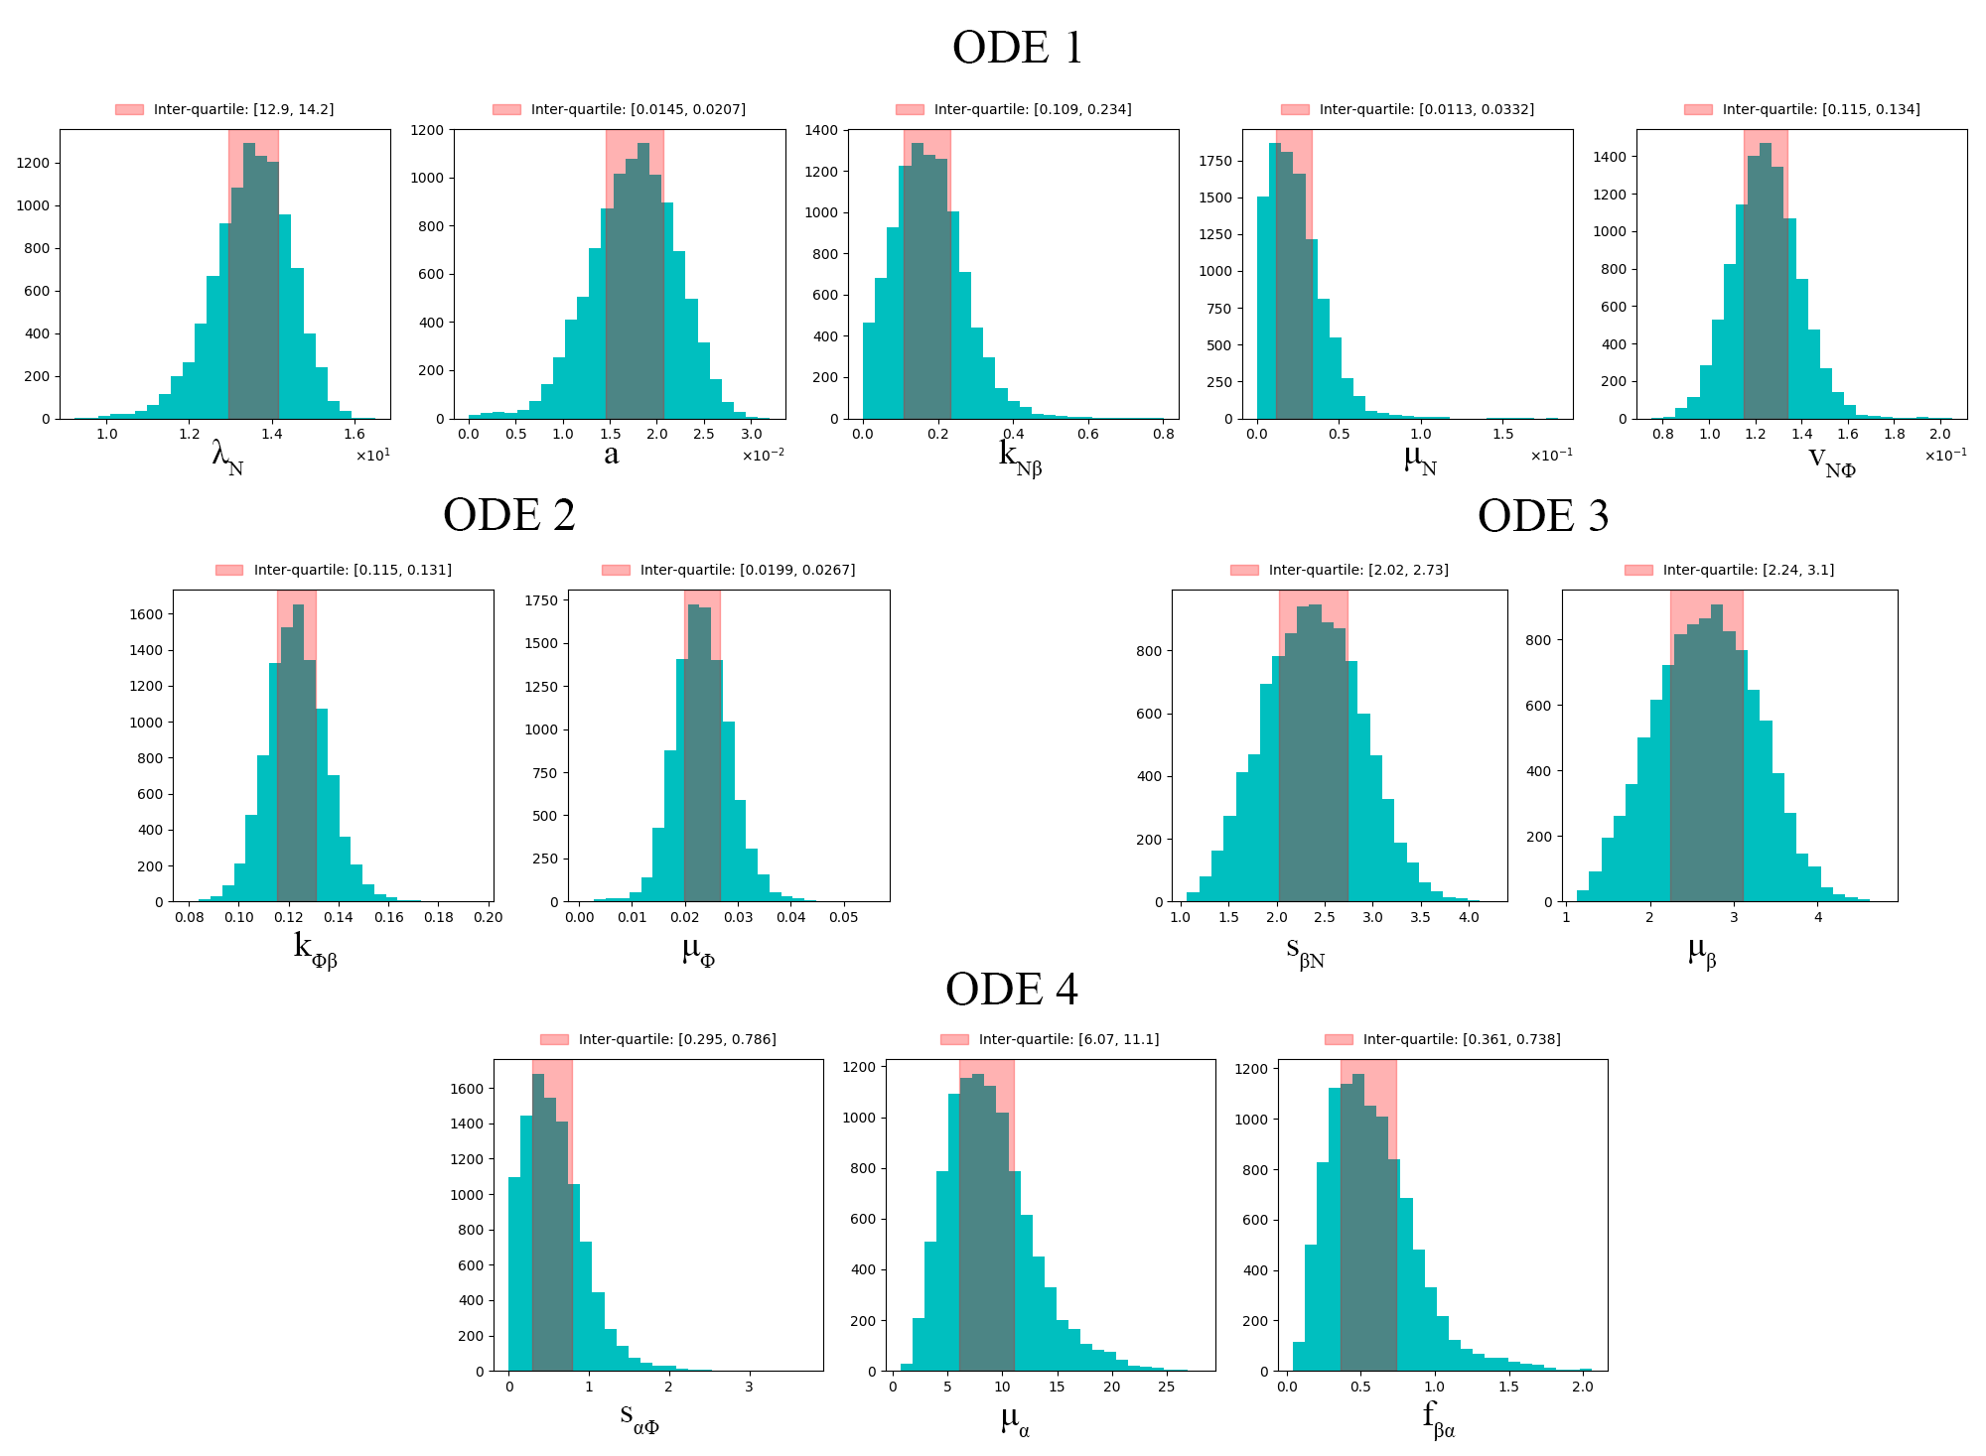
Implementations – Parameter inference
Model 5

Slide 14
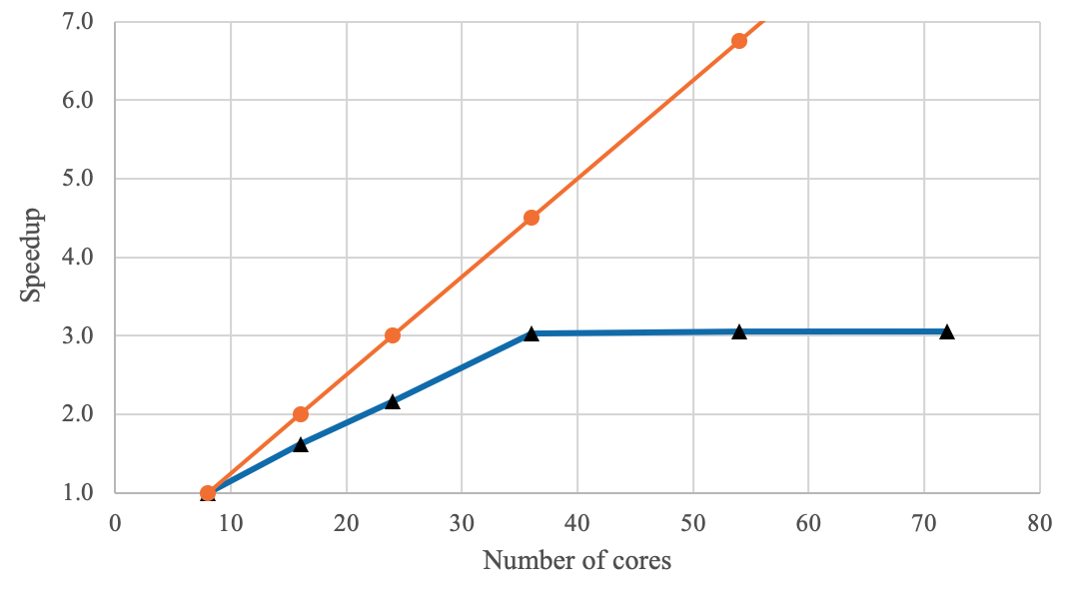
Performance

Slide 15
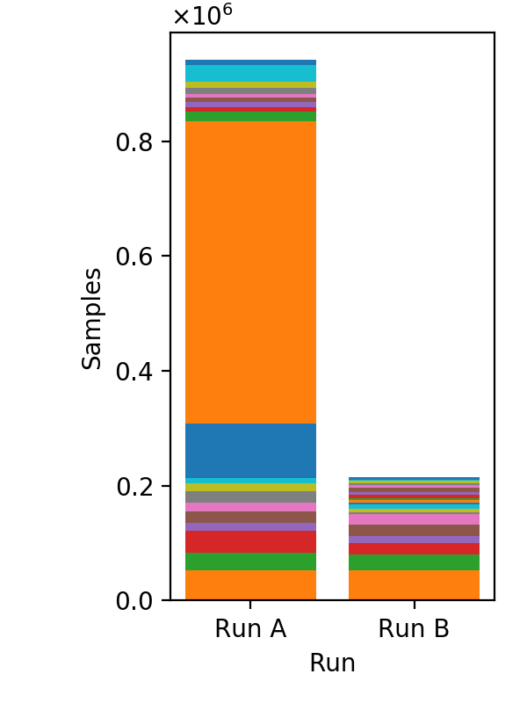
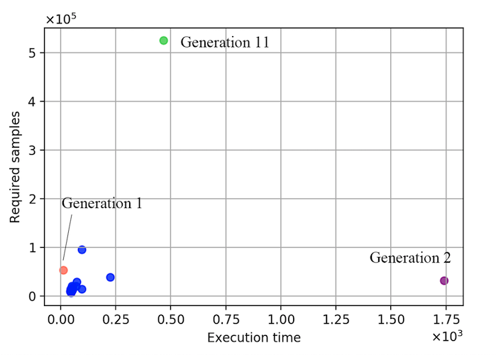
Performance
High variance observed in required number of samples of different runs
related to local optima
Execution time for each sample is not fixed

Slide 16
Conclusions
ABC SMC performed well in our parameter inference and model comparison task
with model 5 being the best model and its parameters being well-inferred
Scaling-up performance is reasonable
However, further analysis was affected by the uncertainties

Slide 17
Thanks!
Questions?

