Slide 1
Predicting House Prices in Zagreb, Croatia
A Coursera Capstone Project

Slide 2
INTRODUCTION
01
THE DATA
02
RESULTS
METHODOLOGY
TABLE OF CONTENTS
04
03
DISCUSSION
05
CONCLUSION
06
Discussion of the business problem and who would be interested in this project
Description of the data that will be used to solve the problem and the source of the data
Discussion of the results
Exploratory data analysis, inferential statistical testing and machine learning
Recommendations based on the results
Presentation conclusion

Slide 3
01
INTRODUCTION
Discussion of the business problem and who would be interested in this project

Slide 4
INTRODUCTION
The problem to be investigated is to what extent do nearby venues determine house prices.
The location chosen for this project is the city of Zagreb, Croatia
The people interested in solving this sort of problem would be as follows: people looking to buy houses in Zagreb, real-estate agents, city planners, investors etc.

Slide 5
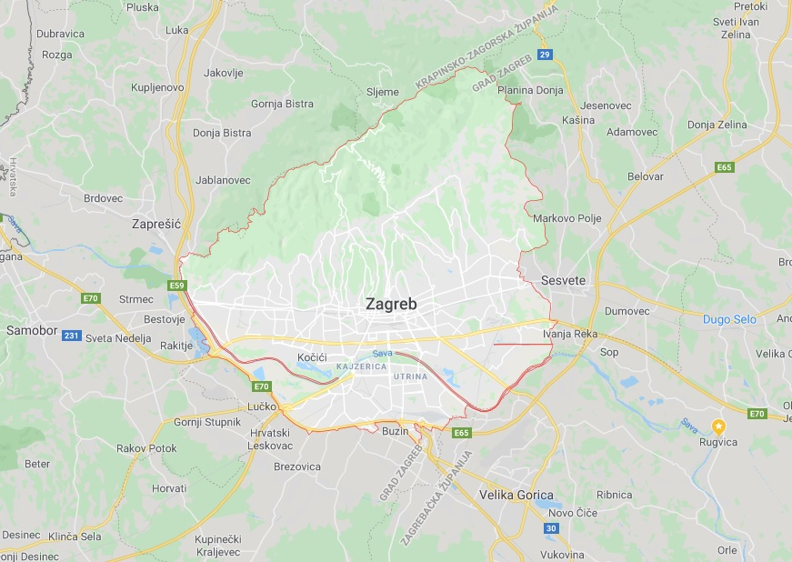
INTRODUCTION
Figure 1. Zagreb, Croatia

Slide 6
02
THE DATA
Description of the data that will be used to solve the problem and the source of the data

Slide 7
THE DATA
The Foursquare location data is leveraged to explore and compare neighborhoods, and the house prices (as well their size in meters squared) is parsed from www.gohome.hr
By manually creating and filling the corresponding .csv file with neighborhoods’ latitudes and longitudes, and assigning those latitudes and longitudes to all the houses in the same neighborhood, the first part of the dataset is obtained

Slide 8
THE DATA
As already mentioned, using the Foursquare location data to each house a vector of the number of nearby venues is joined (the second part of the dataset)
The data will be used to find correlations between the selected features (venue categories and size of the house) and the house prices in EUR

Slide 9
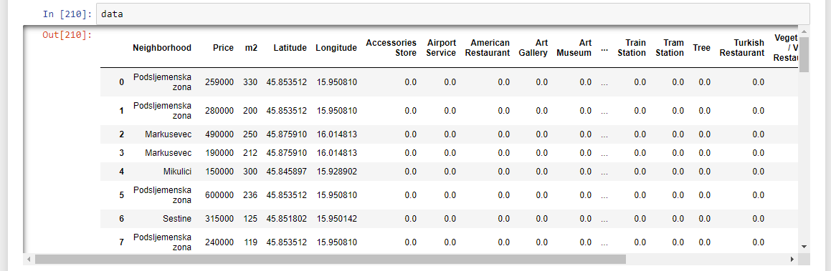
THE DATA
Figure 2. The dataset

Slide 10
03
METHODOLOGY
Exploratory data analysis, inferential statistical testing and machine learning

Slide 11
METHODOLOGY
Using Nominatim module from geopy python library, Zagreb’s geograpical coordinates were extracted
Then, by utilizing folium python library’s mapping capabilities, a visualization was created to better portray the various neighborhood distribution within the city of Zagreb, Croatia

Slide 12
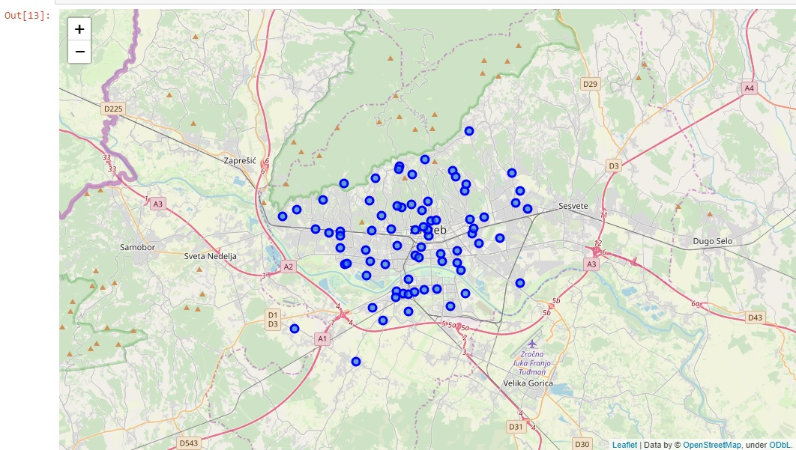
METHODOLOGY
Figure 3. Neighborhood distribution in Zagreb, Croatia

Slide 13
METHODOLOGY
Nearby venues (1 kilometer) for neighborhood are pulled from their servers, subsequently aggregated by type so that they could be assigned to all the houses in the same neighborhood
Preliminary exploratory data analysis was performed where the top correlation values between venues categories and house price were compared and plotted in a bar chart

Slide 14
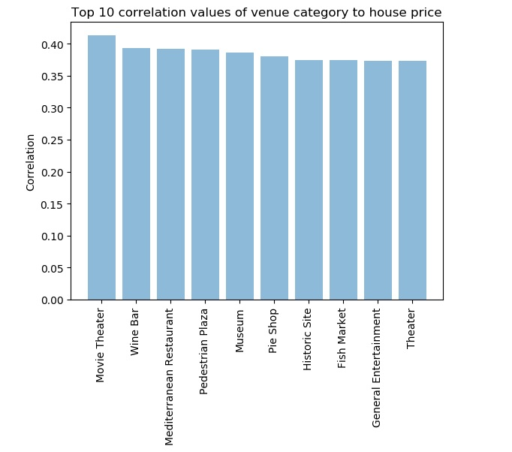
METHODOLOGY
Figure 4. Top 10 correlation values of venue category to house price

Slide 15
METHODOLOGY
Another analysis that was done was to identify which neighborhoods in Zagreb have the highest mean house price to m^2 ratio and how far are these neighborhoods geographically distanced to the center of the city which is empirically determined the priciest of them all

Slide 16
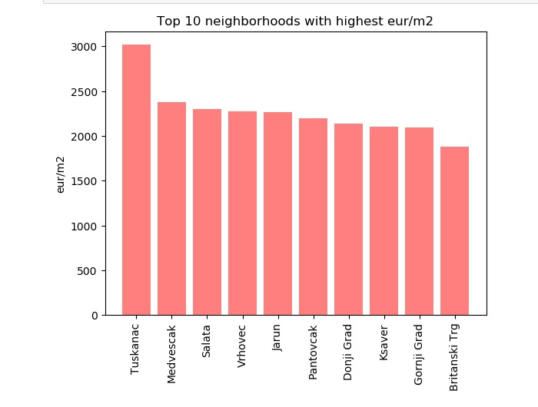
METHODOLOGY
Figure 4. Top 10 correlation values of venue category to house price

Slide 17
METHODOLOGY
Of the machine learning algorithms, polynomial linear regression of degree 2 was used where the features included only the top 40 venue categories with the highest correlation to house price
Of other features, meters squared was also used
StandardScaler transformed the features into data with zero mean and variance of one
All the data was split into 80/20 training and test sets

Slide 18
04
RESULTS
Discussion of the results

Slide 19
RESULTS
The lowest residual sum of squares that was achieved was 47278303818.68 and the highest variance score (fit) of 0.65
The best result was achieved by trying to combine the most optimal values of hyperparameters (number of venue categories, degree of polynomial features, type of scaling etc.)

Slide 20
05
DISCUSSION
Recommendations based on the results

Slide 21
DISCUSSION
It is assumed that better results could be achieved by the following means: more house samples in the dataset, more venues in the Foursquare database for the city of Zagreb, Croatia, more computer memory for higher degree polynomial features, using a neural network to fit the data, and others

Slide 22
06
CONCLUSION
Presentation conclusion

Slide 23
CONCLUSION
This Coursera capstone project allowed for practicing with the skills and the tools to use location data to explore a geographical location, as well as applying all the knowledge acquired during previous courses in the IBM Data Science Professional Certificate specialization
This course also enabled the student to deal with real-world data that is often times messy and incomplete. In conclusion, a big part of the data science profession is to also be able to deal with these kind of problems

Slide 24
Thank you for your attention

