Slide 1
Android GitHub Client
Features
* View your own GitHub Repository
* Search for a repository at GitHub
* Find user living in the same country as you
* Remember your last login information for future connections
* View your own gists and read it out loud!
And when you watch a repository you can
* View it's files and read the files out loud
* View it's issues
…. and more!

Slide 2
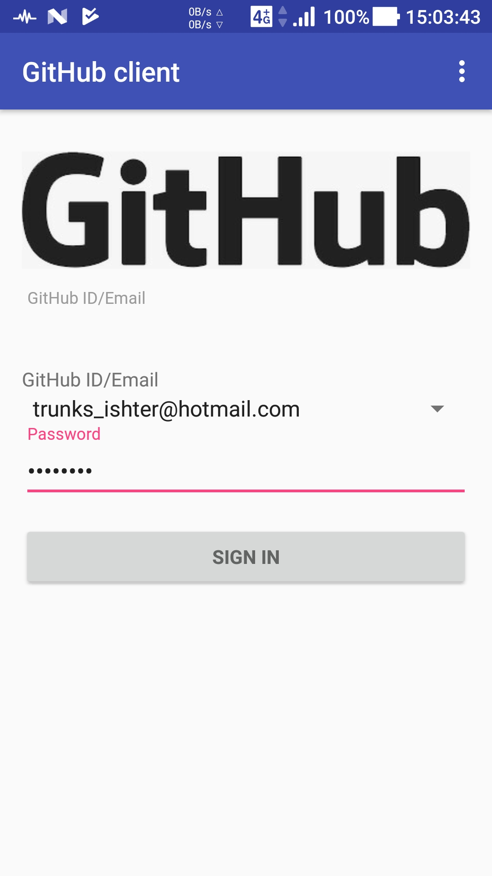
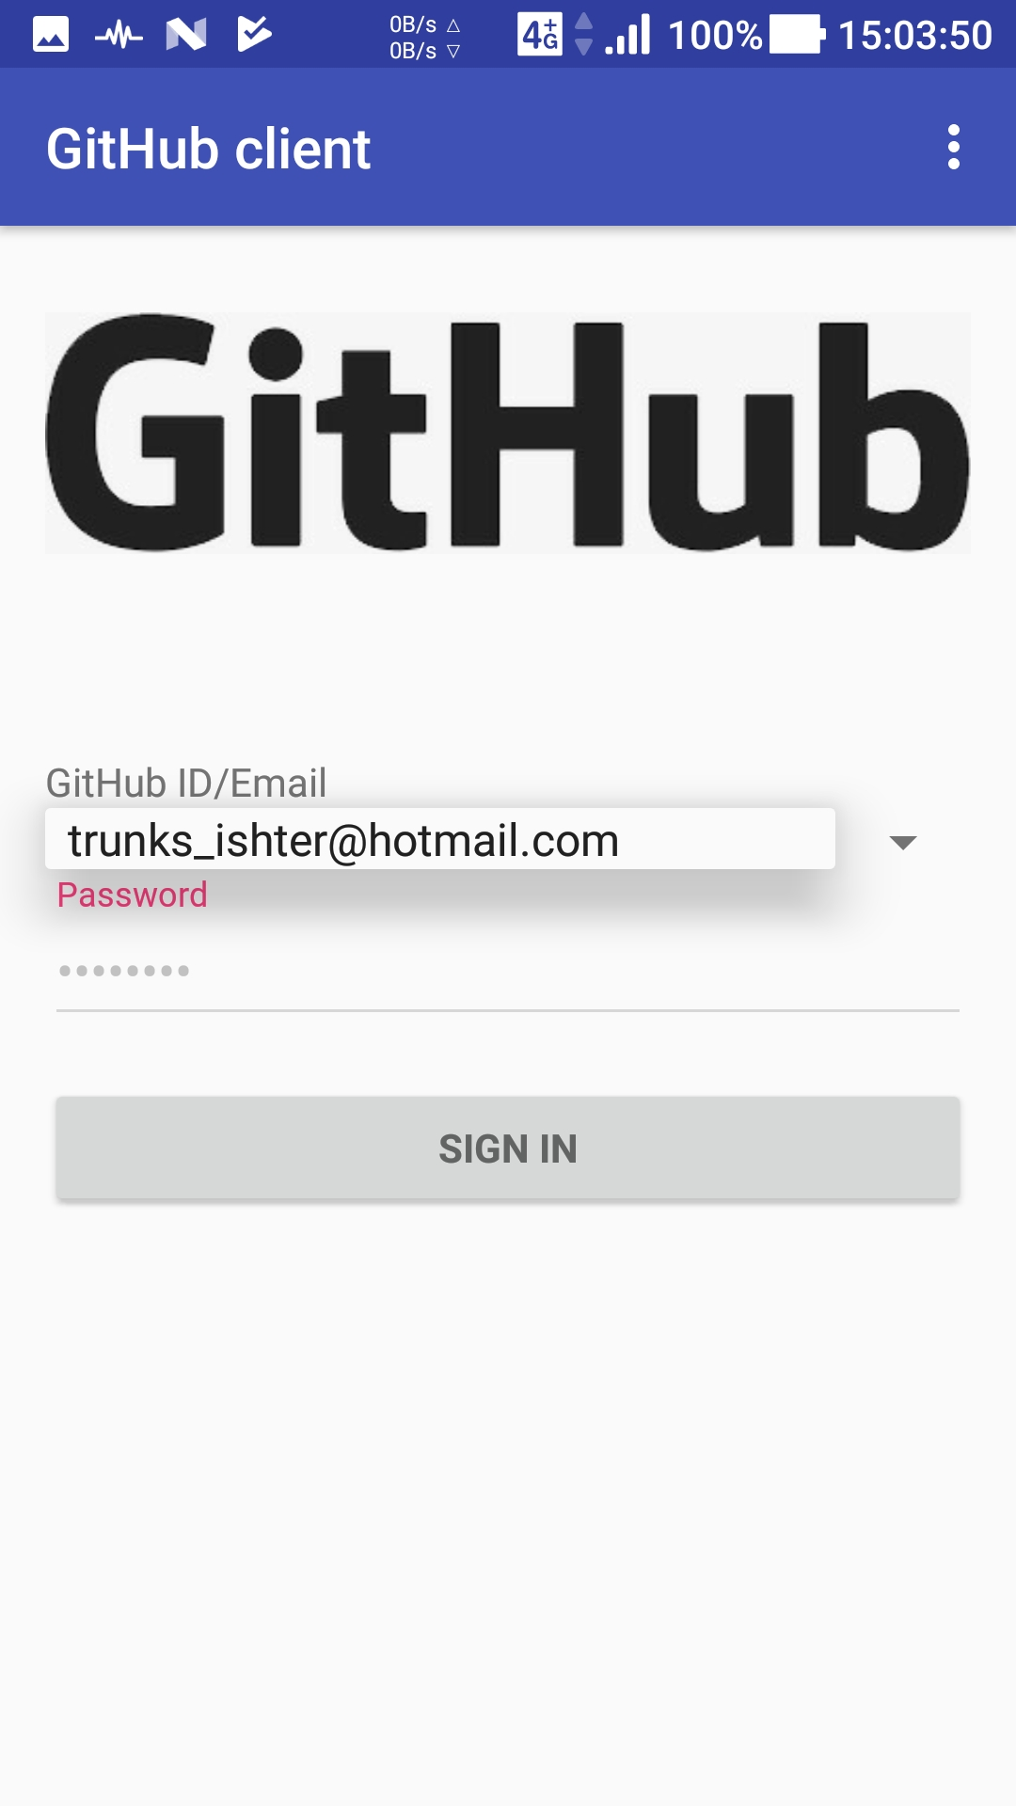
Login Screen

Slide 3
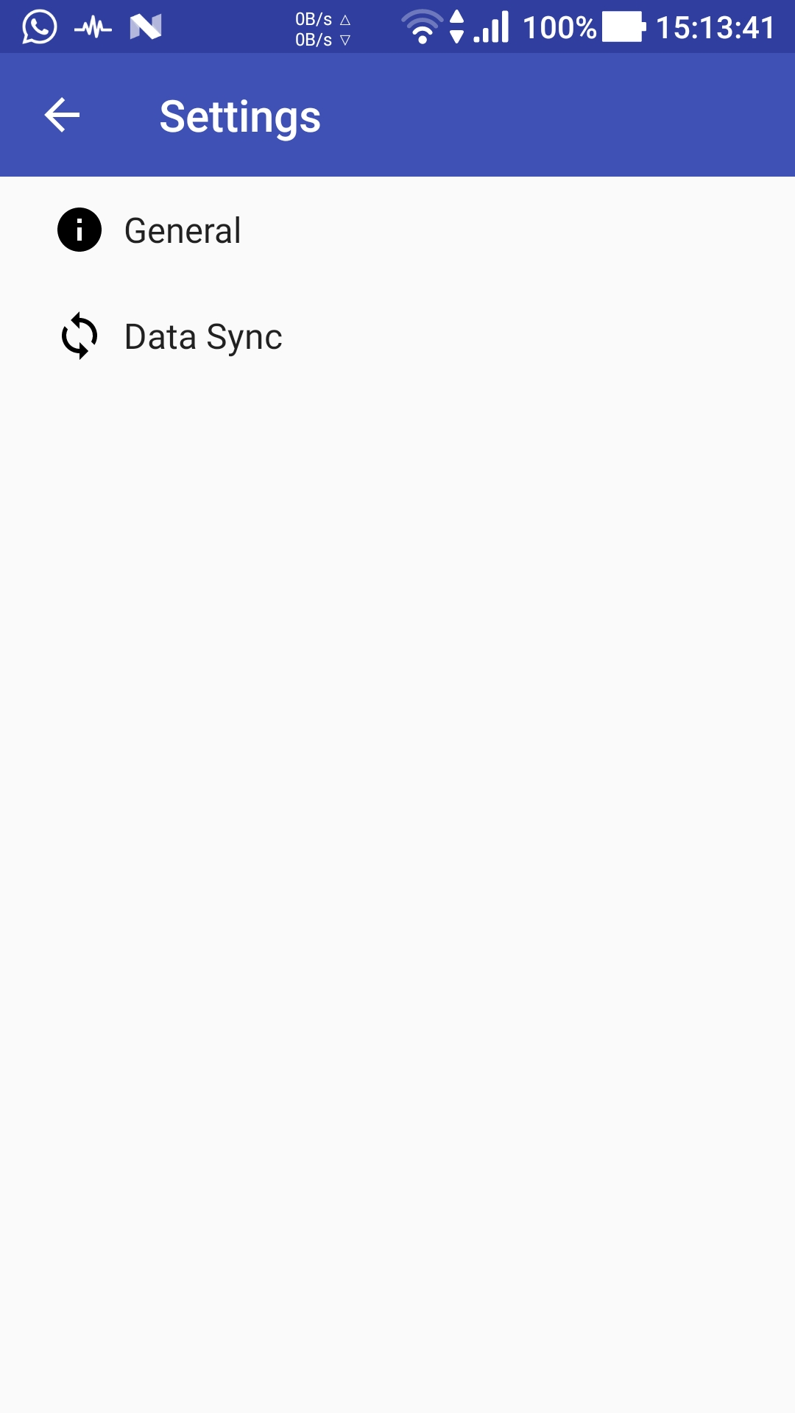
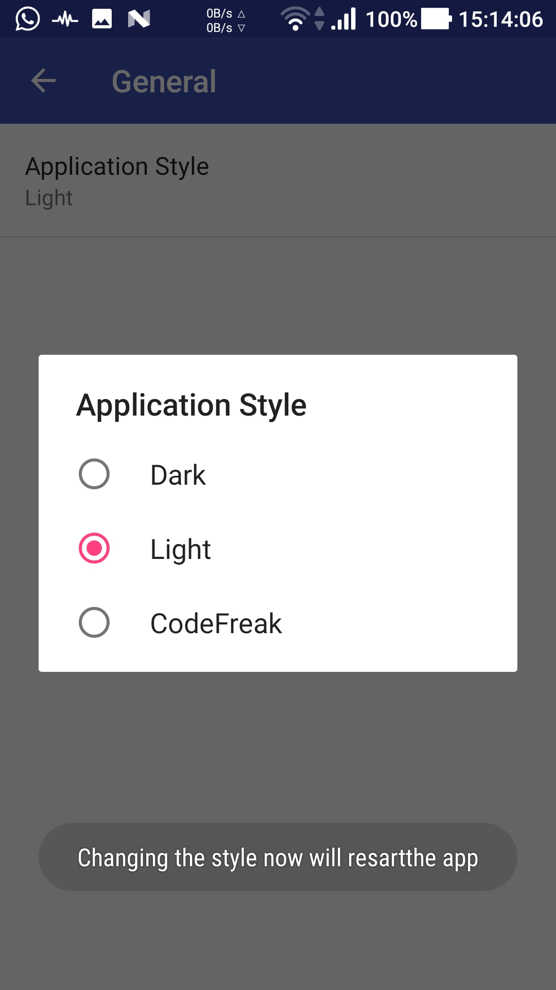
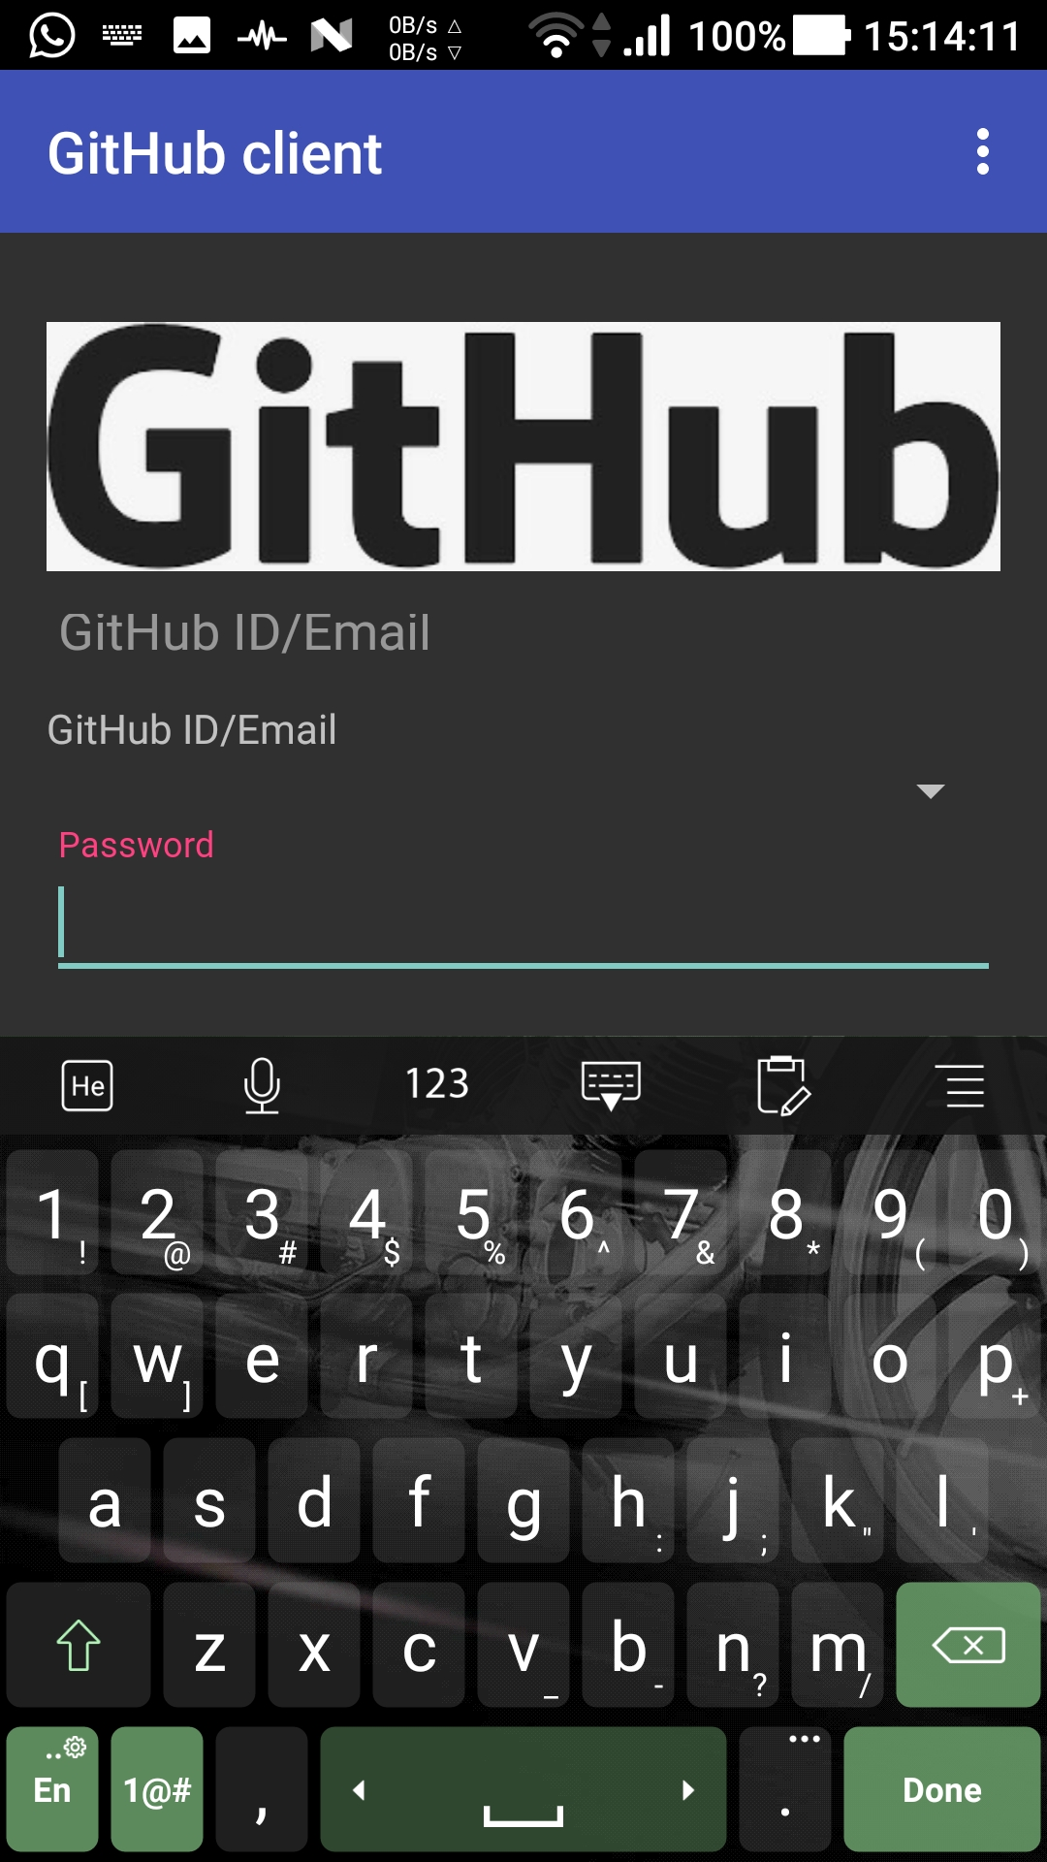
Style your screen with various skins

Slide 4
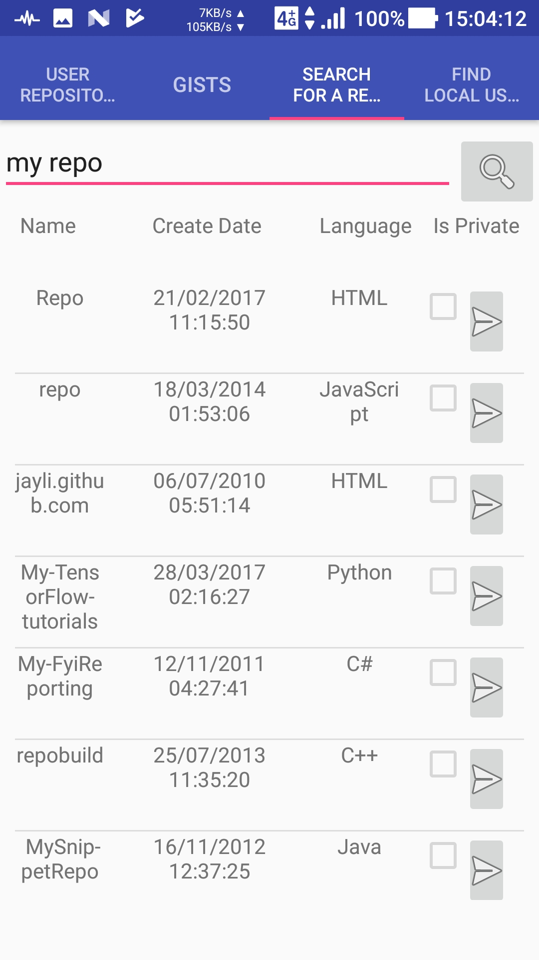
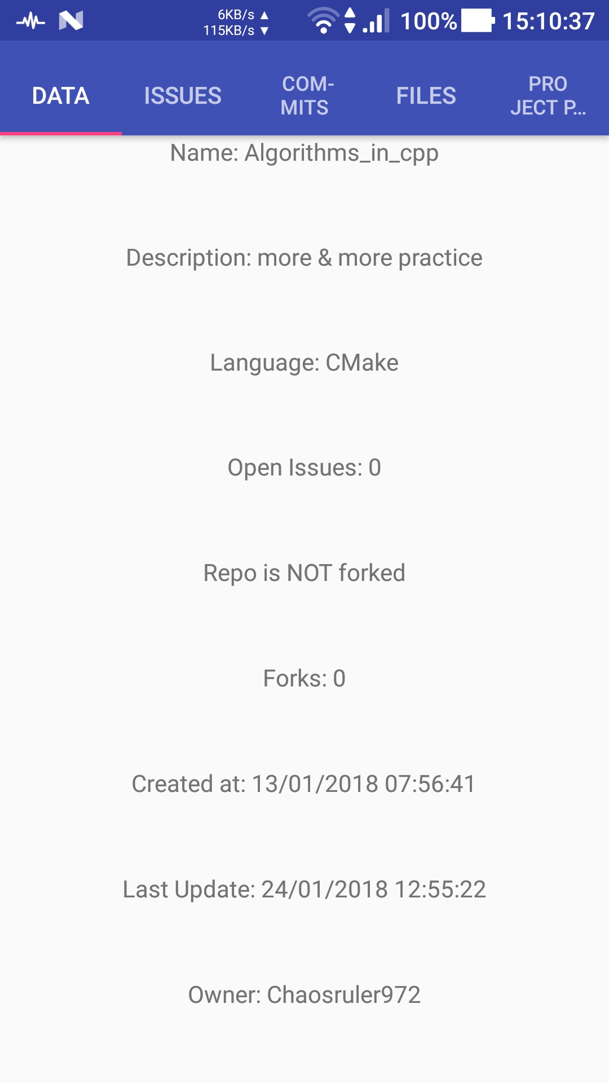
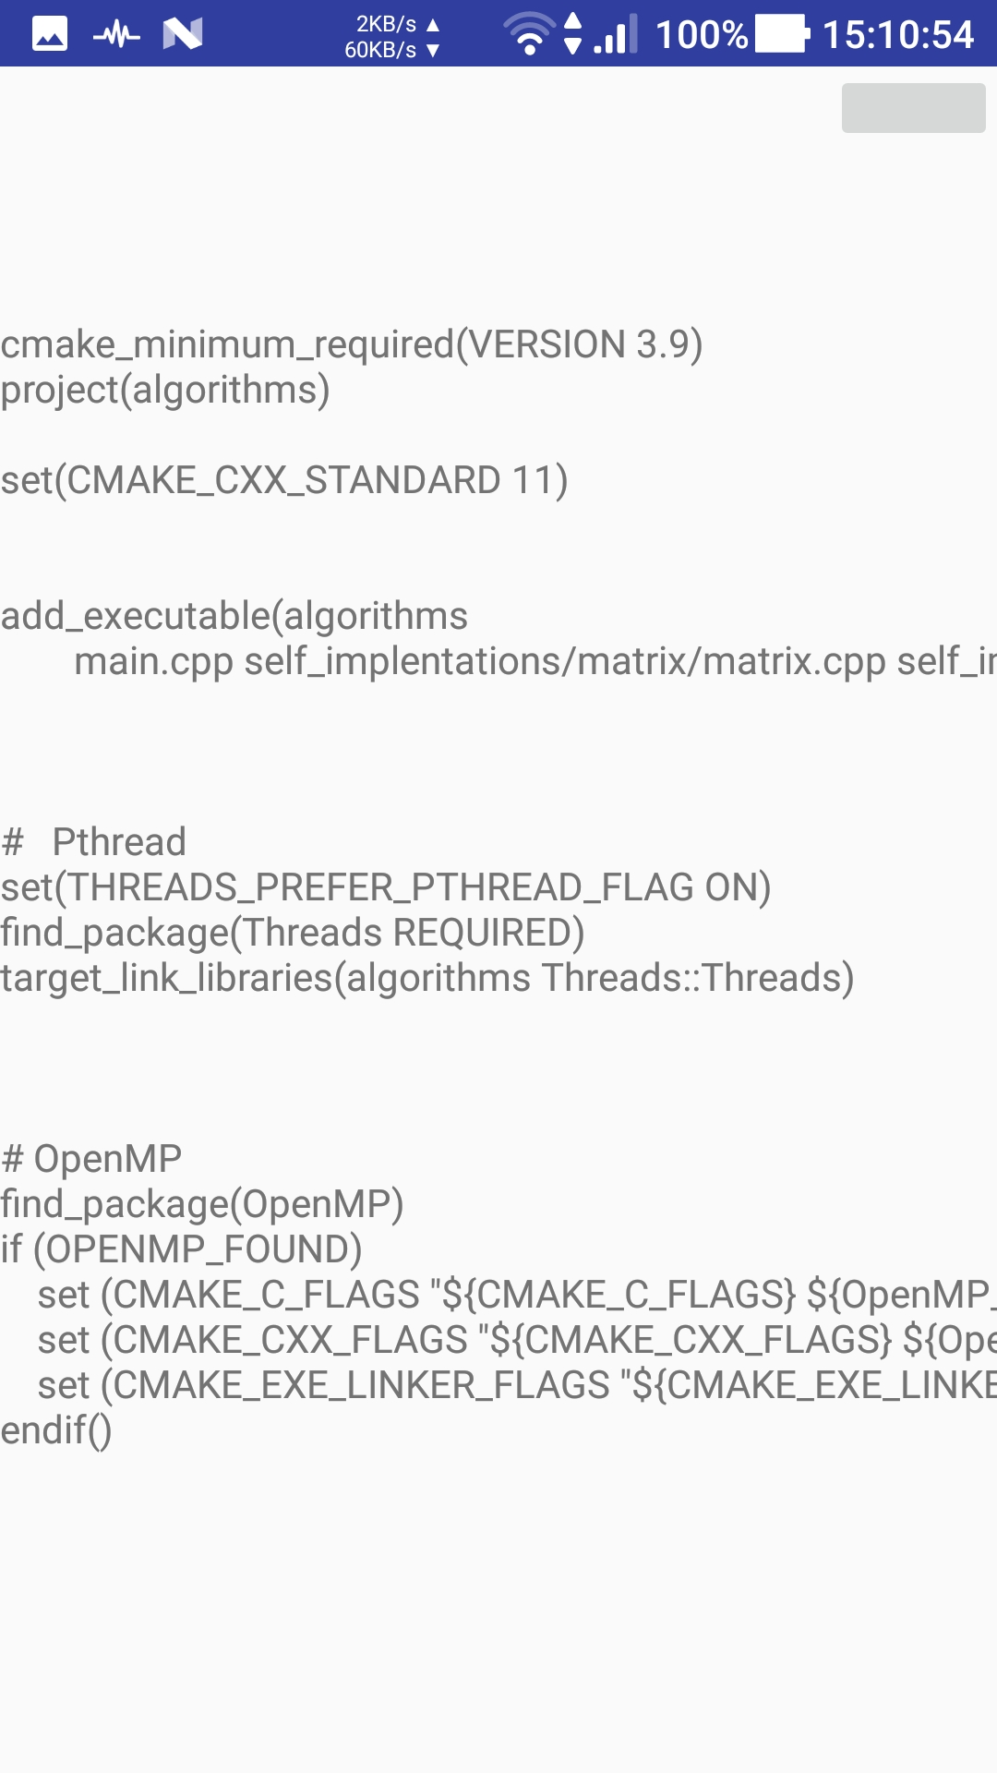
Of course you can view a repository

Slide 5
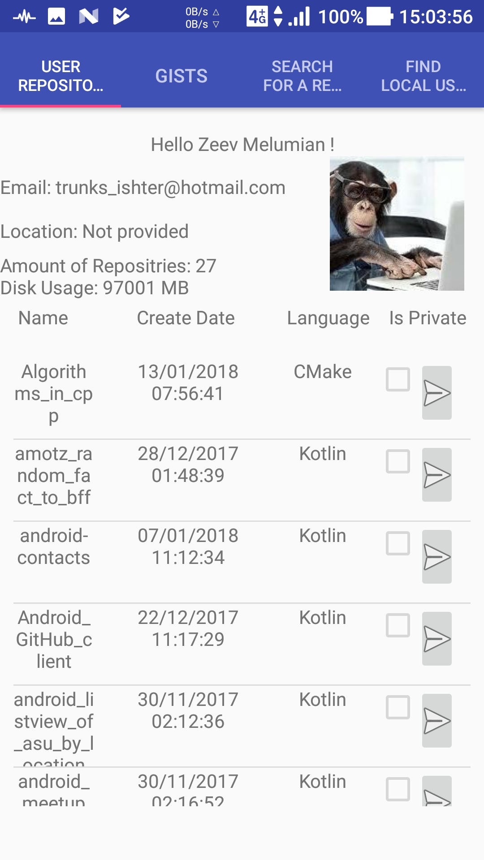
View your profile

Slide 6
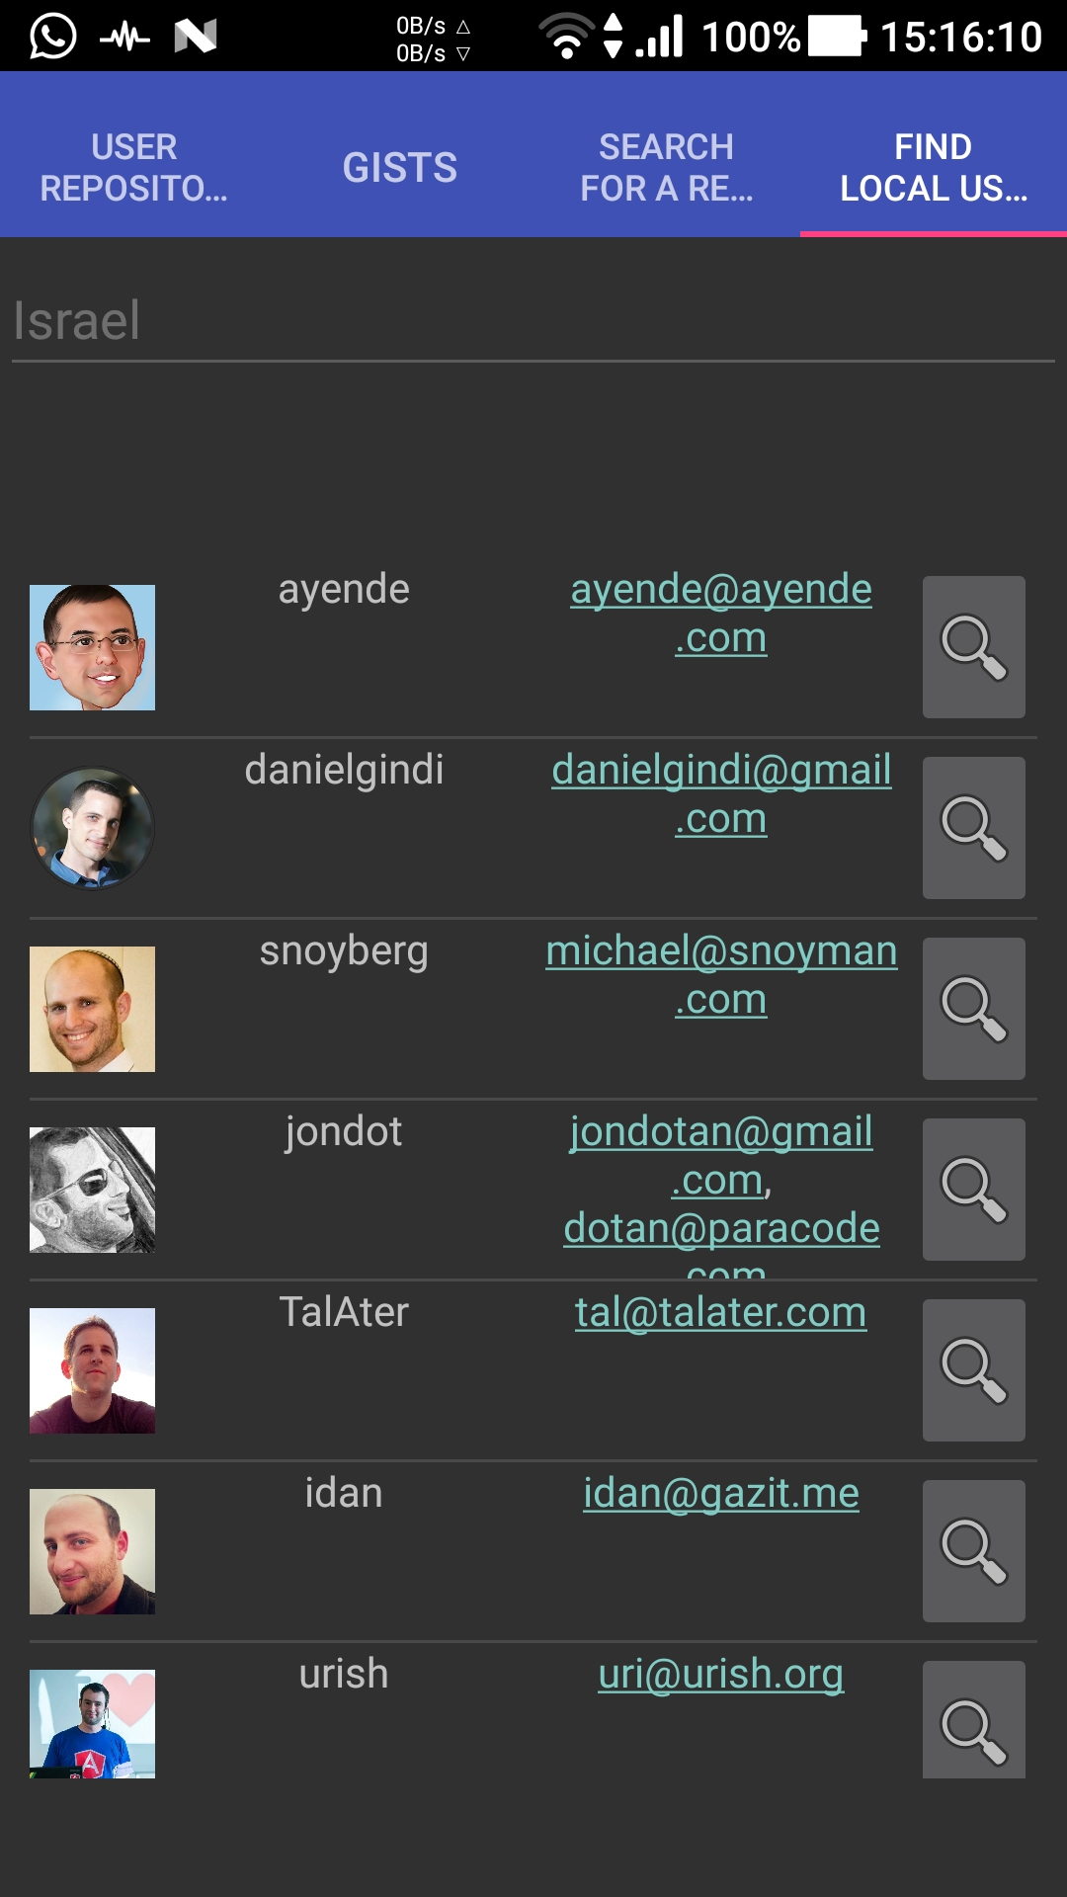
Look for nearby users

Slide 7
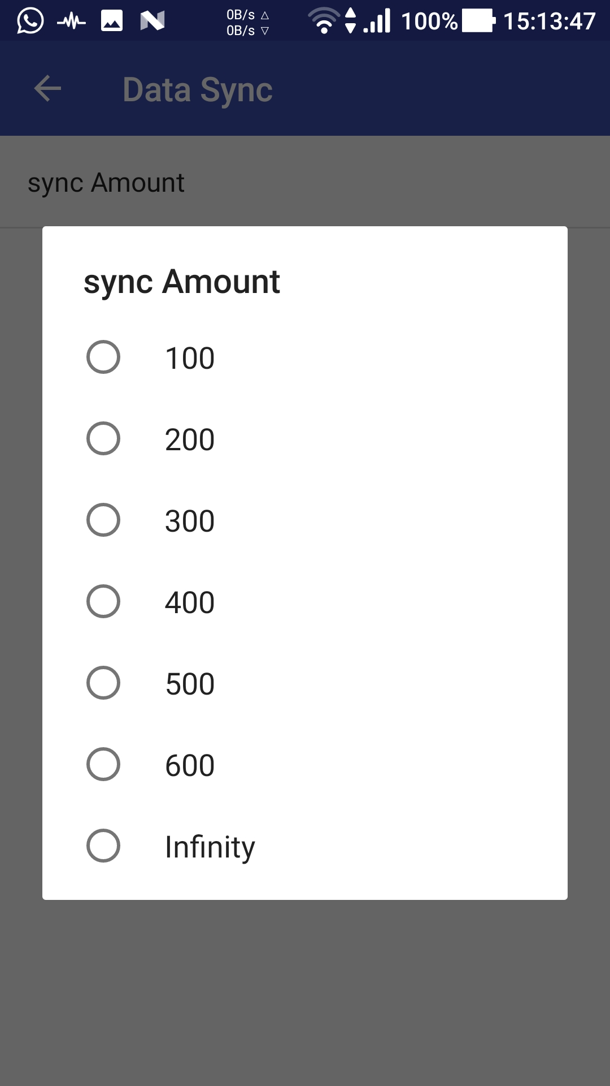
Save your data plan and decide how much data you want to sync

