Slide 1
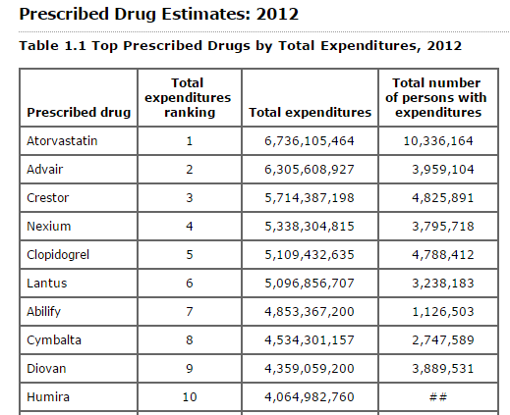
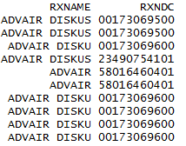
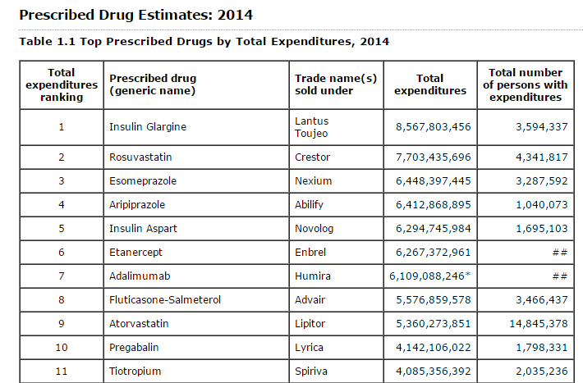
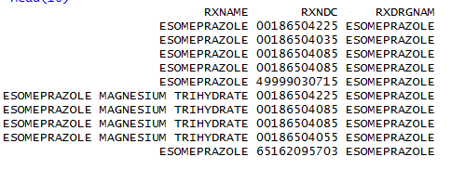
2000-2004 (Top 10), 2005-2012 (Top 25)
2000-2008: SSS
2009-2014: Westat
SAS program
2012-2014

Slide 2
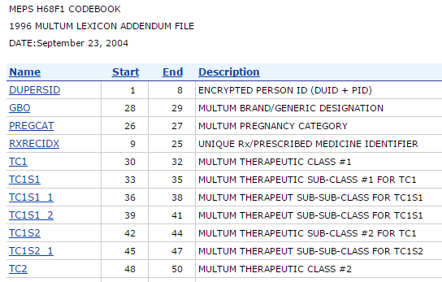
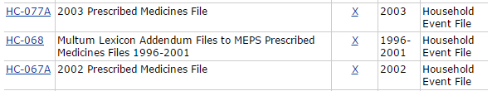
Option | Advantages | Disadvantages
Only have tables for therapeutic classes, not Prescribed Drugs | Consistent across years Easy to program from PUFs (TC1) | Omit valuable info on RX names
Use existing tables as is, do not provide code | Less work for everyone | Inconsistent across years Users can’t re-create tables using only PUFs (even though it looks like they can)
Update tables to be consistent across all years, do not provide code | Consistent across years | More work for SSS / Westat Users can’t re-create tables using only PUFs (even though it looks like they can)
Add RXDRGNAM to all files, via Appendix files | Consistent across years Users can easily recreate tables using PUFs Potentially fix error in classifying Therapeutic Classes from 1996-2002. | More work for SSS / Westat Need to update yearly
RXDRGNAM?

