Slide 1

Introduction to Open Source
A hands-on session session with git and GitHub.
Aditya Bakare
VIIT, Pune
@aditya_bakare

Slide 2
What is Open Source?
And why is it awesome?
People are free to use, modify, distribute and contribute to the code as they see fit.
Bugs are more likely to get fixed faster in an Open Source Software(OSS).
New features keep getting added(as contributors keep getting new ideas).

Slide 3
Why should OSS be preferred?
More control over the application.
Training for newbie programmers.
Stability
Huge Community

Slide 4






Some examples of OSS
Linux kernel
Flutter
git
TensorFlow
Python
VLC Media Player

Slide 5
“The power of Open-source is the power of the people. The people rule.”
Philippe Kahn

Slide 6



Version Control

Slide 7

Benefits of Version Control
a=1
b=2
c=3
a=1
b=2
c=3
d=4
a=1
b=2
d=4
Keep track of changes to the code

Slide 8



Benefits of Version Control
Helps to remotely collaborate with teammates

Slide 9
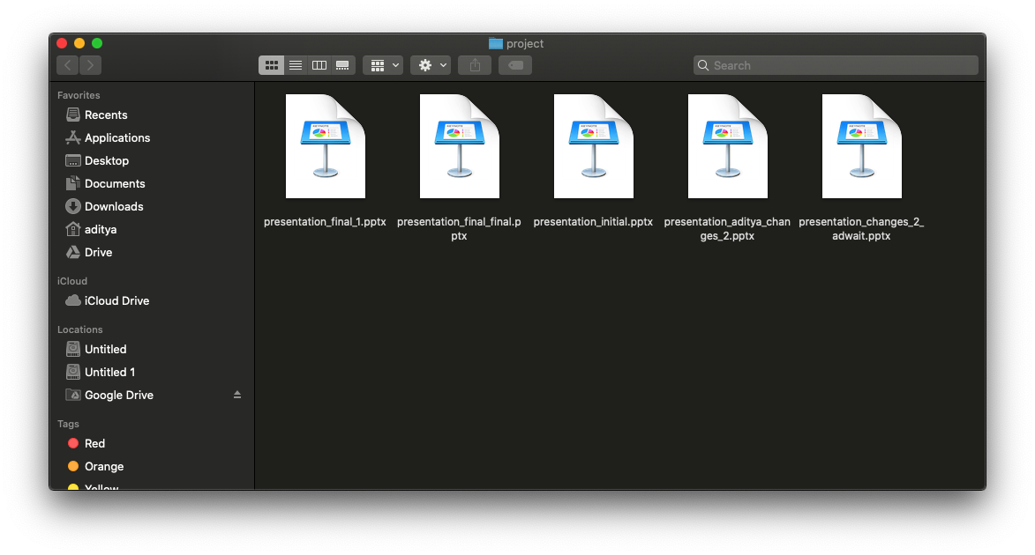
Benefits of Version Control
You don’t need to do this anymore

Slide 10
Hands-on with git and GitHub

Slide 11
Thank You!
Aditya Bakare
VIIT, Pune
@aditya_bakare

