Slide 1
Book1
File created on: 4/7/2019 6:42:14 PM

Slide 2
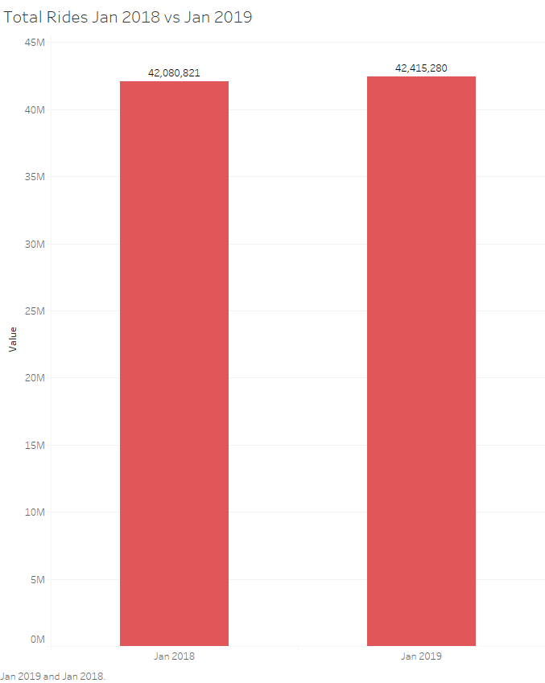
This indicates a 400,000 ride increase when comparing January last year to January this year

Slide 3
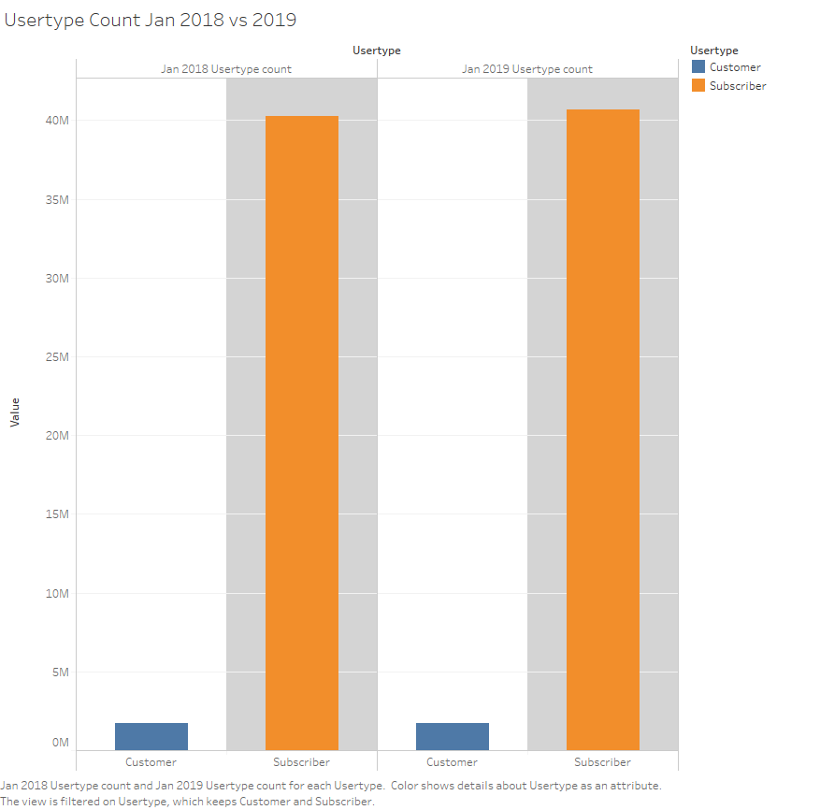
Along with an increase in usage came an increase in subscriptions as well as Temporary Customers the ratio however largely stayed the same indicating growth and a consistent conversion rate

Slide 4
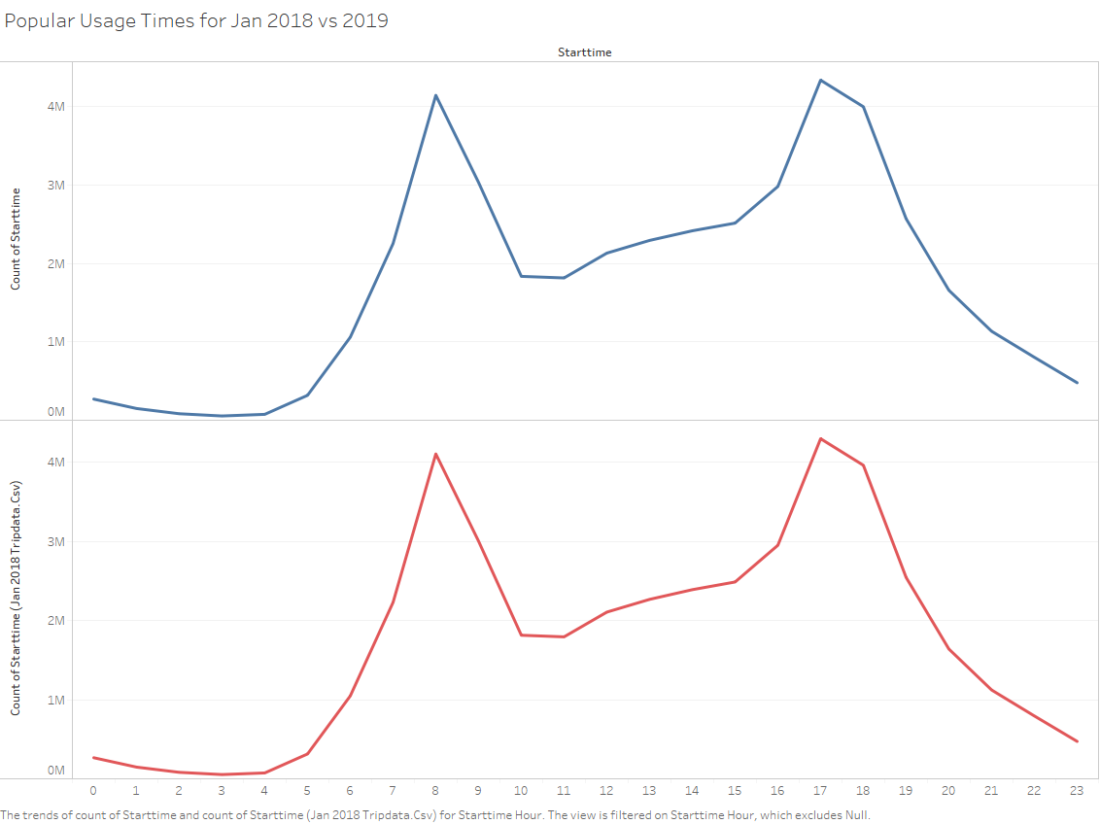
Popular starting times indicates a consistent customer base where members and customers habitually use our services throught the days aside from slight overall increase no real difference can be observed

Slide 5
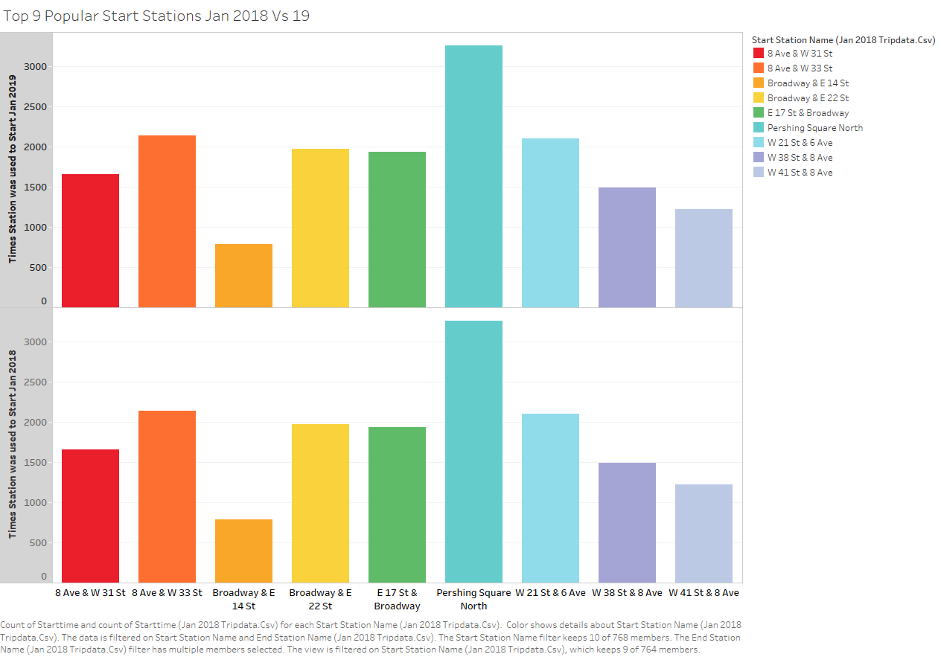
The top 9 most popular stations and their usage from last year to this year have not changed either enforcing the idea of a consistent customer base habitualy using our services

Slide 6
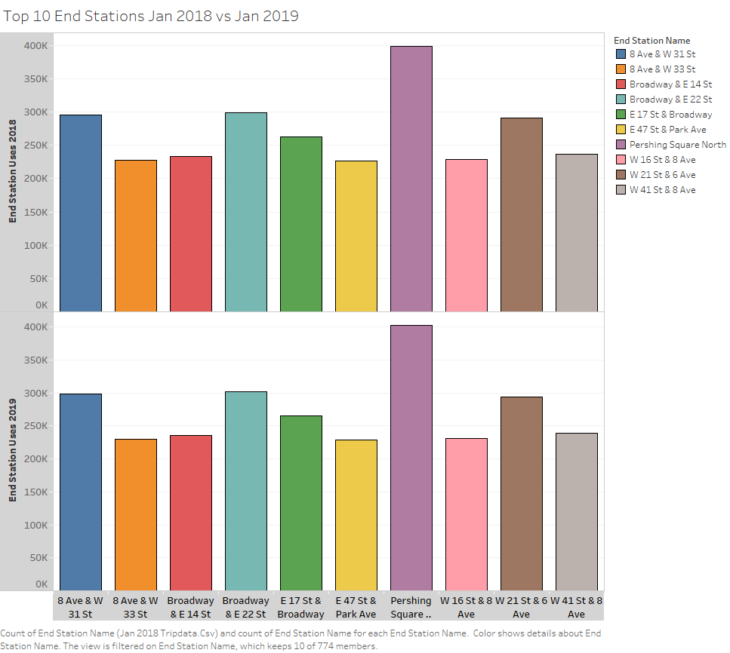
Just like the previous slide the top ending stations have not changed as well

Slide 7
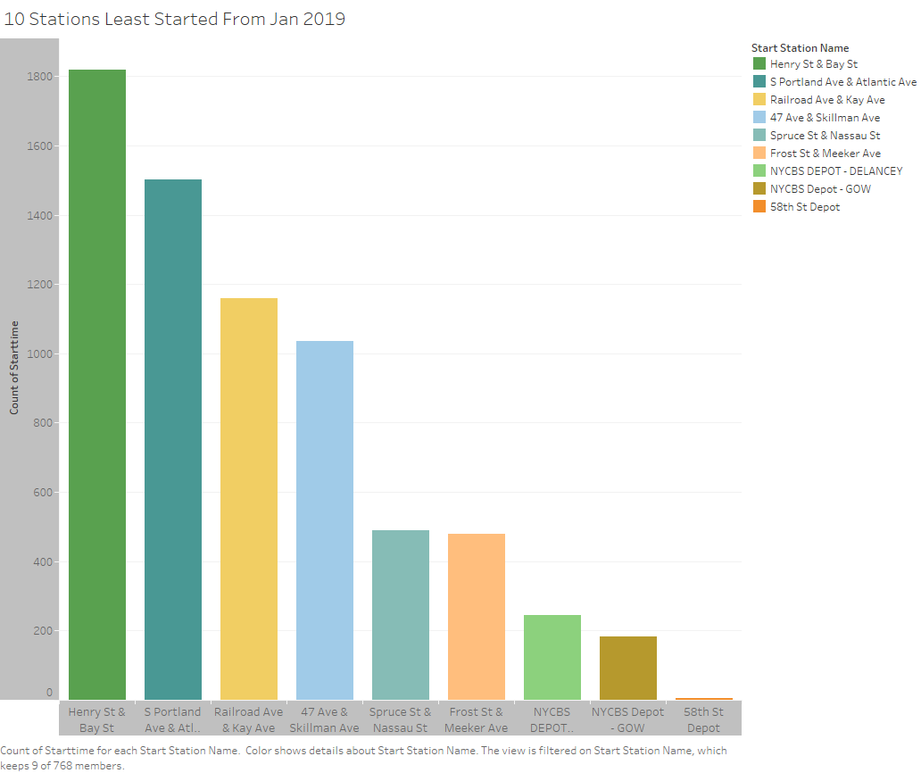
The least popular stations of this year have drastically fewer numbers than those of our top stations Perhaps a call for increased marketing in these areas can provide a solution.

Slide 8
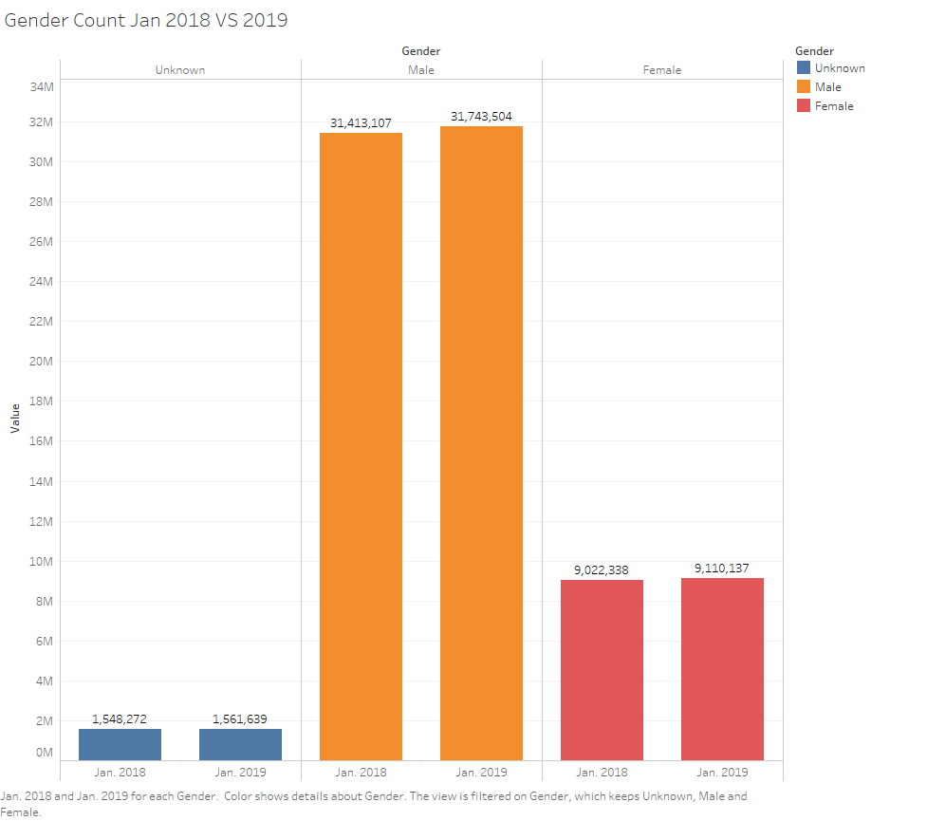
Gender demographics are fairly similar as well. The ratio of female to male also stayed virtualy the same despite both numbers growing over the year

Slide 9
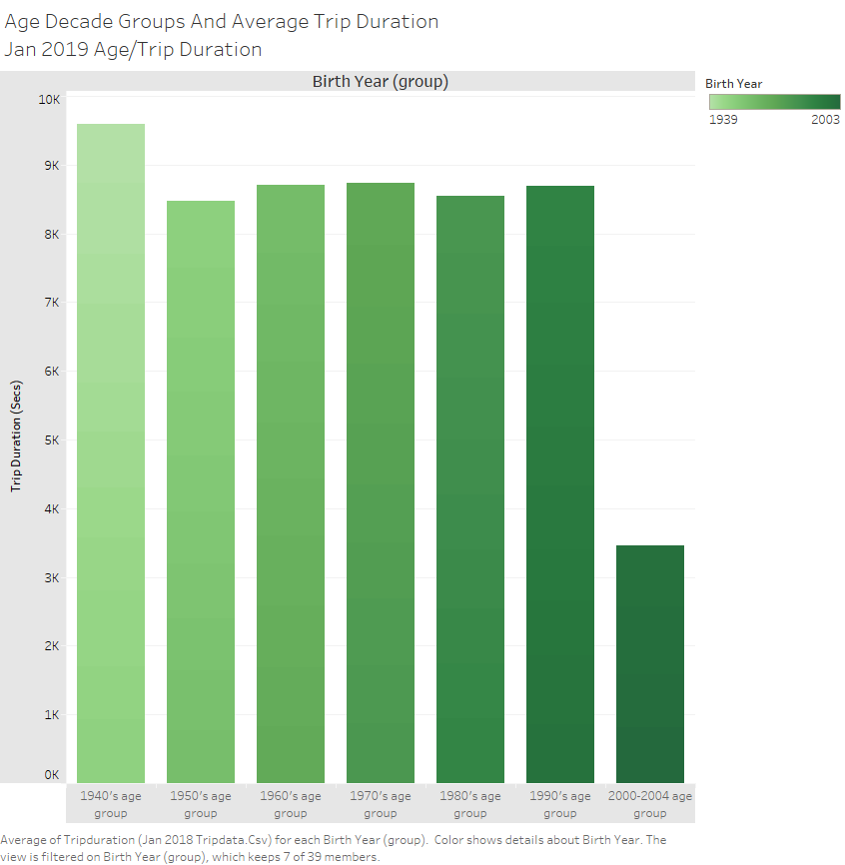
Unlike the gender ration within our customer demographics an even ratio can be found in our age groups(by decades).

Slide 10
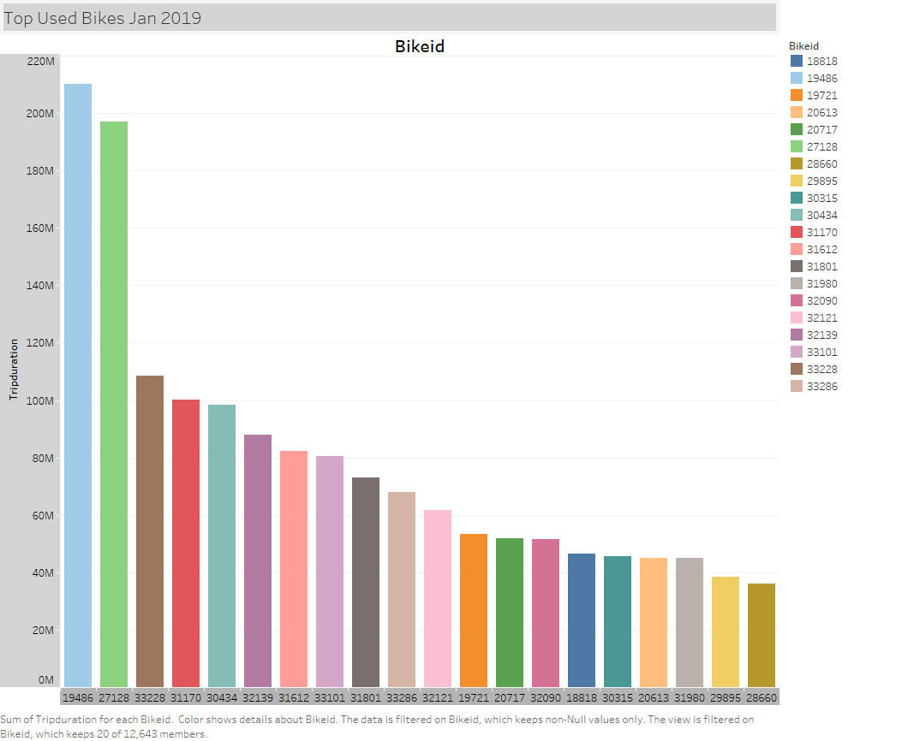
The top 10 most used bikes can be seen here with two specifically being tremendously used. Attention to these heavily used bikes would be recommended to ensure safety in regards to potential repairs

