Slide 1


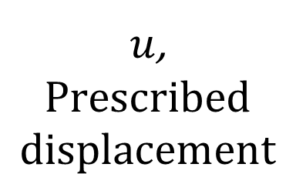
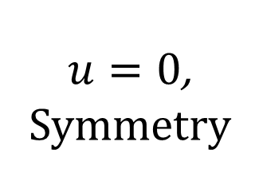
Stiff thin film
$u=0$,
Symmetry
Compliant substrate
$u$,
$$Prescribed$$
$$displacement$$
$v=0$, Simply supported

Slide 2
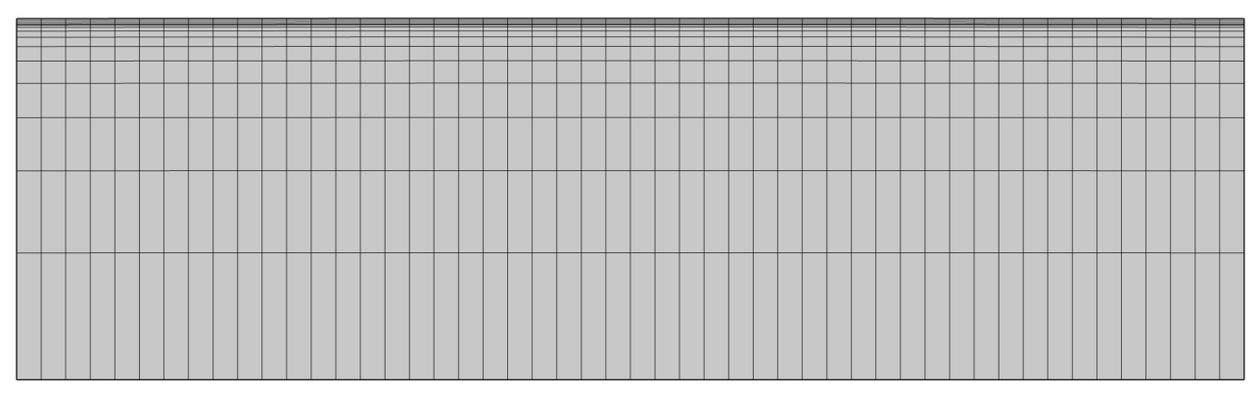
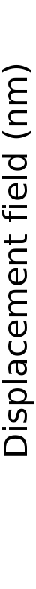
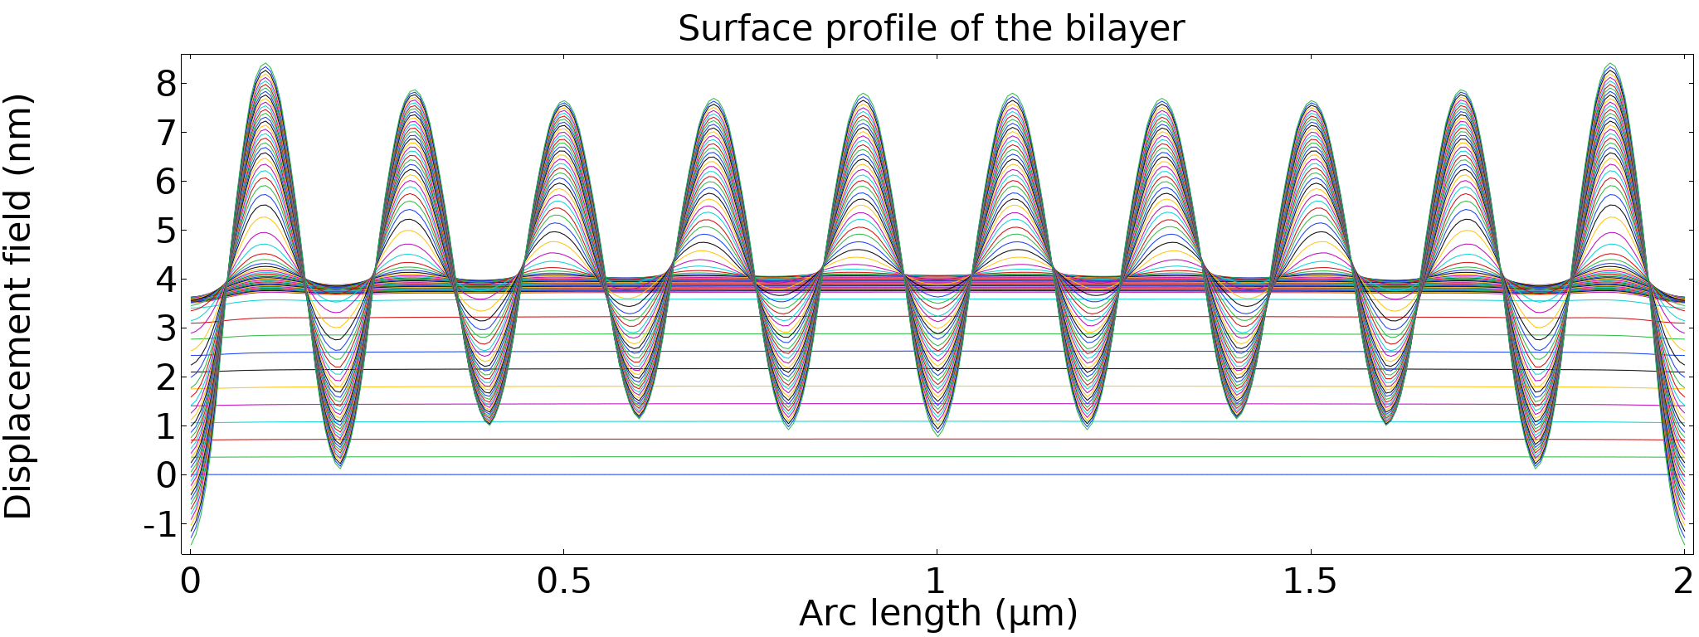
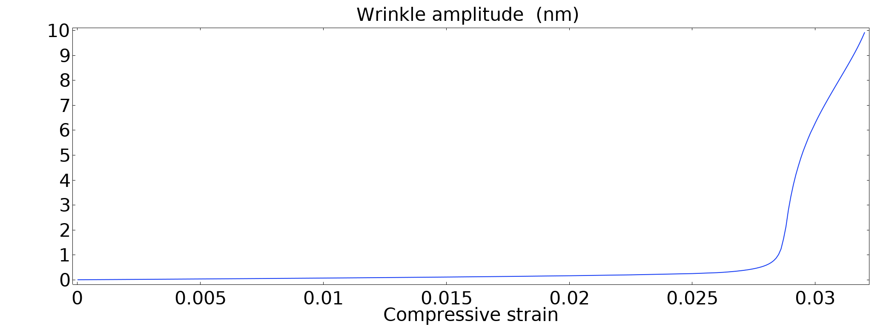
Instability, growing wrinkle
Increasing compressive strain
Stable
Wrinkle onset

