Slide 1
Training Sim.
Project Members:
Aaron Hannon(G00347352)
Matthew Sloyan(G00348036)
Project Supervisor:
Damien Costello
Industrial Partner:
ICSE security

Slide 2
Overview
Table of Contents:
1. Project Overview
2. System Design
3. System Evaluation
4. Conclusions

Slide 3
Project Overview
Context
The project is a training simulation to train ticket inspectors with conflict resolution. We use Unity, Azure Speech to Text and Text to Speech along with AIML bots and all of this is built to the Oculus Quest(VR) to give the user a realistic experience. The reason this application is important for ICSE Security is to reduce the cost of their current training program. Currently, when training Luas ticket inspectors, they must close a Luas track in Dublin and hire actors to be passengers. This costs a lot of money and is not repeatable on a daily basis. So that is the problem that this project attempts to fix.
Goals / Objectives
To make sure that we, as developers, understood the requirements of the client to help us develop a system that the client was content with.
To research the latest technology to aid in creating an application that would not be out-dated and that it was as efficient as possible for the time.
To Implement a robust system architecture what we have learnt from our research of the latest technologies.
To create an application that we, as developers, were happy with but more importantly, creating a product that met the requirements of our client.

Slide 4
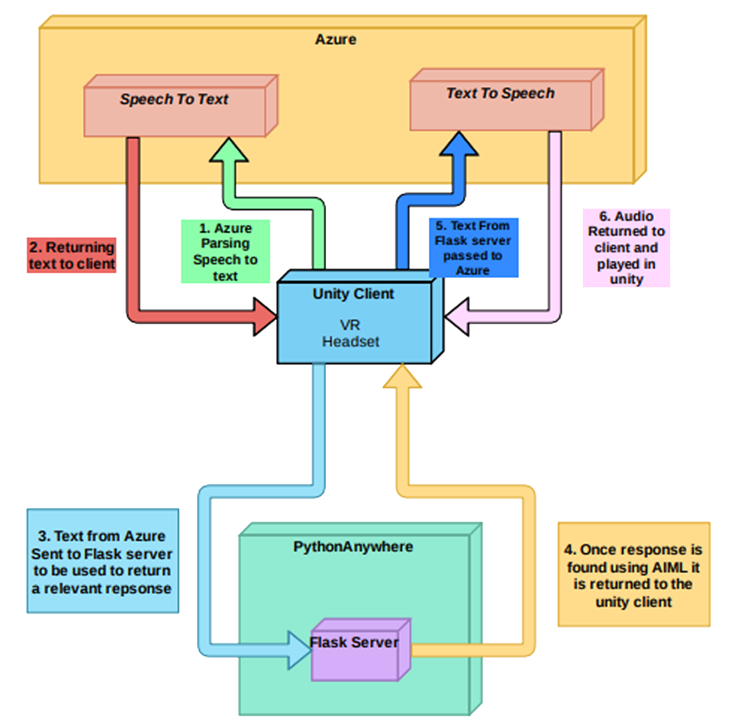
System Design
Here you can see a UML diagram of the system’s architecture and the flow of data. I will go through all 6 steps that happens each time you speak to a bot in the training simulation.
The user speaks and the data is sent to Azure to be converted to text.
That text is returned to the Unity client.
The Unity client sends the users converted speech to a python flask server, hosted on PythonAnywhere, and fed into an AIML bot to generate a text response.
Once the text response is generated it is sent back to the Unity client.
The Unity client sends the bot’s response to the Azure Text to Speech service.
Audio is generated based on the bot’s response and sent back to Unity and played for the user.

Slide 5
System Design
Technologies In Final Build:
Unity: Creating a 3D environment
Oculus Quest: Platform we were developing for
Azure Services: Convert Speech to Text and vice versa
AIML: Create a diction for the bot
Flask: Handle requests and host the AIML bot
HTTP web protocol : Pass data the Flask server
PythonAnywhere: Host our flask server publicly
MongoDB: Store training session data.

Slide 6
System Evaluation / Testing
Tests:
Unit Testing: Was used to check if smaller components worked correctly by themselves.
Integration Testing: Was used to test that all the individual components of the project worked correctly together.
Network / System Performance Testing: We were worried that the Oculus Quest would not be able to handle the Unity Engine however through multiple builds we found out that it could handle the project with no problem. The way we tested the network speed is by running the application and seeing how long it would take to get a response from the flask server. We discovered that the experience is a lot better on higher network speeds .
Limitations:
The only main limitation that we encountered was latency. As there is a lot of data moving around, on weaker internet connections it can take a few seconds to for the whole process to finish. On good internet connections it works perfectly.

Slide 7
Conclusions
Insights:
Learnt a lot about:
Speech APIs
Chat Bots
Back-end servers
VR support / implementation
Goals Met:
We believe that we met all out goals throughout the project:
We developed a project based on requirements that the client was happy with.
We researched all the latest technologies so that the application would not be out-dated.
We implemented a robust system based on our research.
We created a project that we were happy with as well as the client.
Scope, Limitations:
Scope: We believe the scope of our project was perfect for the time-frame we were given.
Limitations: The only limitation we faced during development was network connection

