Slide 1
Life cycle modeling
Heyiming

Slide 2
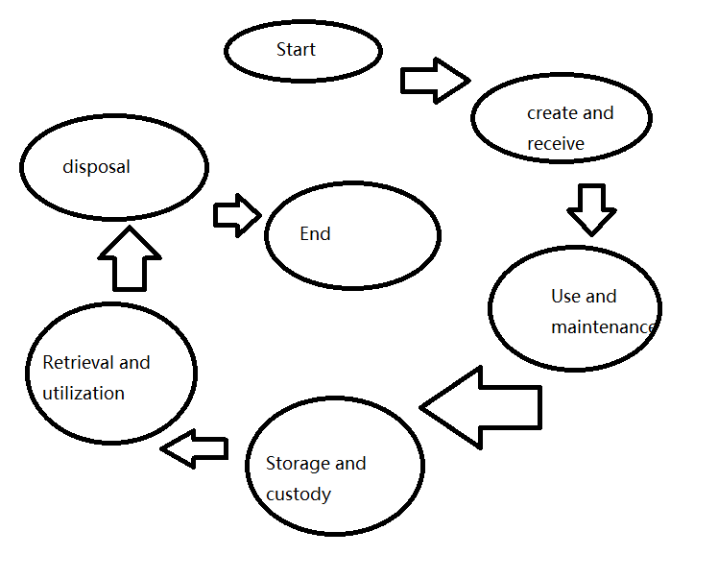
structure

Slide 3
Details
1.start
The start of a record's life cycle, marking the generation of a new record or the receipt of an existing record.
2.Creation and Receipt
In this stage, records are created (such as documents, emails, database entries, etc.) or received (such as external communications, copies of contracts, etc.). The creation and receipt process shall comply with the organization's records management policies and procedures.
3.Use and maintenance
Records may be used several times during their life cycle, such as for reference, review, update, etc. This stage also involves maintaining the integrity and accuracy of the record, ensuring that the contents of the record are not tampered with or lost.

Slide 4
Details
4.Storage and custody
Once records are no longer used frequently, they are stored for future reference. Storage should ensure that records are safe, easy to retrieve and long-term readability. Custodial measures include physical security (e.g., fire, water, anti-theft) and digital security (e.g., backup, encryption, access control).
5.Retrieval and utilization
Relevant records should be quickly accessible for use when required. This may require efficient indexing and retrieval systems, as well as proper rights management to ensure that only authorized personnel have access to sensitive information.

Slide 5
Details
6.Disposal
When records are no longer of business value or required by law, they should be disposed of properly. Disposal methods may include destruction (physical destruction or digital erasure), migration (such as transferring old records to an archiving system), or retention (such as long-term preservation of important historical records). The disposal process shall comply with laws and regulations and the organization's records management policy.
7.End
The end of a record's life cycle, when the record no longer needs to be managed or retained

