Slide 1
RNS FIPS tests
He yiming

Slide 2
catalogue
1.FIPS 140-3
2.FIPS 800-56A

Slide 3
FIPS 140-3
FIPS (Federal Information Processing Standard) 140-3 is a standard for verifying the validity of encryption modules. Although FIPS 140-3 is a federal standard in the United States and Canada, FIPS 140-3 compliance has been widely adopted worldwide. FIPS 140-3 is based on the international standard ISO/IEC 19790. The FIPS 140-3 standard is used to ensure that the hardware, software or firmware selected meets specific security feature requirements and approved algorithms.
FIPS 140-3 does not contain module requirements directly, but rather references the International Organization for Standardization/International Electrotechnical Commission (ISO/IEC) 19790:2012(E). These requirements will be tested in accordance with ISO/IEC 24759:2017(E).

Slide 4
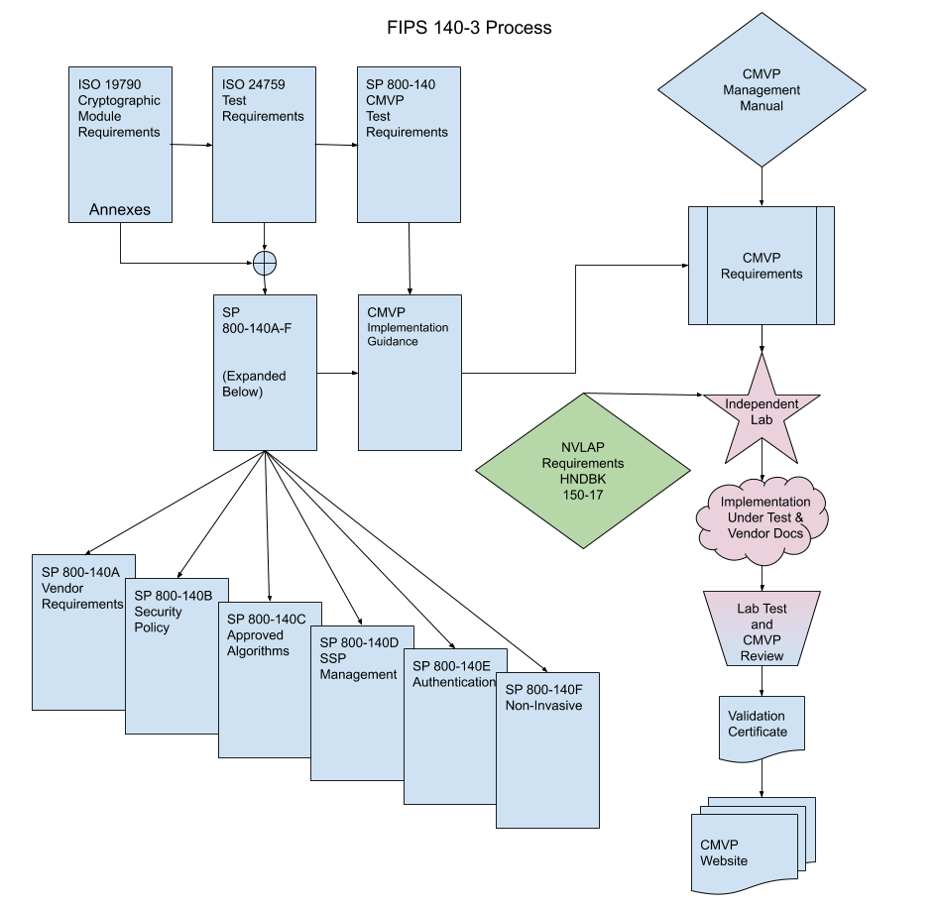
FIPS 140-3
The diagram on the right shows the required flow of the FIPS 140-3 process.

Slide 5
FIPS 140-3
The ISO/IEC 19790 specifies the cryptographic module requirements, along with the associated guidance issued through the Annexes. ISO/IEC 24759 extracts the requirements of ISO/IEC 19790 and associates vendor information and lab procedures to assure the requirements are met.
The CMVP manages the variances allowed in the ISO/IEC 19790 and ISO/IEC 24759 through the SP 800-140x documents. Specifically, the SP 800-140 provides additional evidence and testing that is necessary to meet CMVP cryptographic module requirement evidence, while also providing to ISO/IEC recommended adjustments to the existing standard when next reviewed. The remaining SP 800-140A through SP 800-140F provide additional requirements for vendor evidence, security policy, approved encryption and key management, authentication and non-invasive physical security requirements.

Slide 6
FIPS 140-3
Clarification or interpretation of the requirements and assurance measures are included in the Implementation Guidance, which are often technology specific. A standalone document, the FIPS 140-3 CMVP management manual, addresses the programmatic procedures and requirements of the process. In addition, NVLAP Handbook 150-17 identifies CMVP specific NVLAP requirements which includes requirements in quality systems, personnel, environmental conditions, test and calibration methods, equipment, test quality assurance, and reporting results control.
Independent test labs holding appropriate NVLAP accreditation, manage and perform the testing process. The labs create a submission package with the results of the assessment which CMVP reviews and coordinates any resulting comments with the lab. Upon satisfactory agreement, a validation is issued and added to the database of validated modules hosted on the CMVP website.

Slide 7
FIPS 800-56A
NIST SP 800-56A provides recommendations for asymmetric-key-based key-agreement schemes based on the Diffie-Hellman (DH) and Menezes-Qu-Vanstone (MQV) algorithms and is intended to provide sufficient information for a vendor to implement secure key establishment using asymmetric algorithms in a FIPS validated module.
First is “Domain Parameter Generation”. The public and private key pairs used in the 56A key-establishment process need to be generated with respect to a set of domain parameters based on either Finite Field Cryptography (FFC) or Elliptic Curve Cryptography (ECC), depending on the key-agreement scheme used.

Slide 8
FIPS 800-56A
The next area to look at is “Domain Parameter Validation”. Secure key establishment depends on the arithmetic validity of the domain parameters used by the parties. Therefore,the 56A standard requires that each party shall have assurance of the validity of the domain parameters before they are used.
The next step in the “Key Generation” stage which includes requirements for the generation of key pairs to be used in the key agreement process, along with methods for obtaining assurances that valid key pairs are used. [56Ar3] explicitly states that the generated key pairs shall be used only for key-agreement purposes.[56Ar3] also differs in the length of the allowed range of sizes for the generated key pair. Specifically, the range for the private key has been changed from [1, q–1] to [1, min (2N − 1, q− 1)] and from [1, p–1] to [2, p – 2] for the public key.

Slide 9
FIPS 800-56A
With respect to assurances required by the key pair owner, [56Ar1] only required assurances for possession of the private key and validity of the public key, whereas [56Ar3] mandates the owner to obtain assurances for correct generation of the key pair, possession of the key pair, assurance of the private as well as the public key validity, and assurance of pair-wise consistency using different methods listed in subsection of 5.6.2.1 of [56Ar3].
With respect to the recipient of the public key, the required types of assurances i.e. public key validation and private key possession are more or less the same in revision 1 and 3 of 56A, but the methods allowed for obtaining these assurances differ. For assurance of private key possession, [56Ar3] introduced an optional method for obtaining this assurance for ephemeral keys. The [56Ar3] retains those routines and also introduces an FFC partial public-key validation routine to be used for ephemeral keys generated using safe-prime groups only.

Slide 10
FIPS 800-56A
The next step in the key agreement process is to compute the shared secret, which is a secret value computed using a key-establishment scheme and is known by both participants. [56Ar3] includes the same type of DLC primitive allowed to be used as that of [56Ar1] namely FFC DH, ECC CDH, FFC MQV and ECC MQV.
The next step in the Key Derivation process that includes deriving key material using a shared secret. [56Ar1] included the Concatenation based KDF and its variant calledthe ASN.1 key derivation function. [56Ar3] references a stand-alone document [SP800-56C]
for all the approved key derivation functions, which includes one-step and two-step KDFs as well as the application-specific KDFs listed in [SP800-135].

Slide 11
thanks

